Slide 1
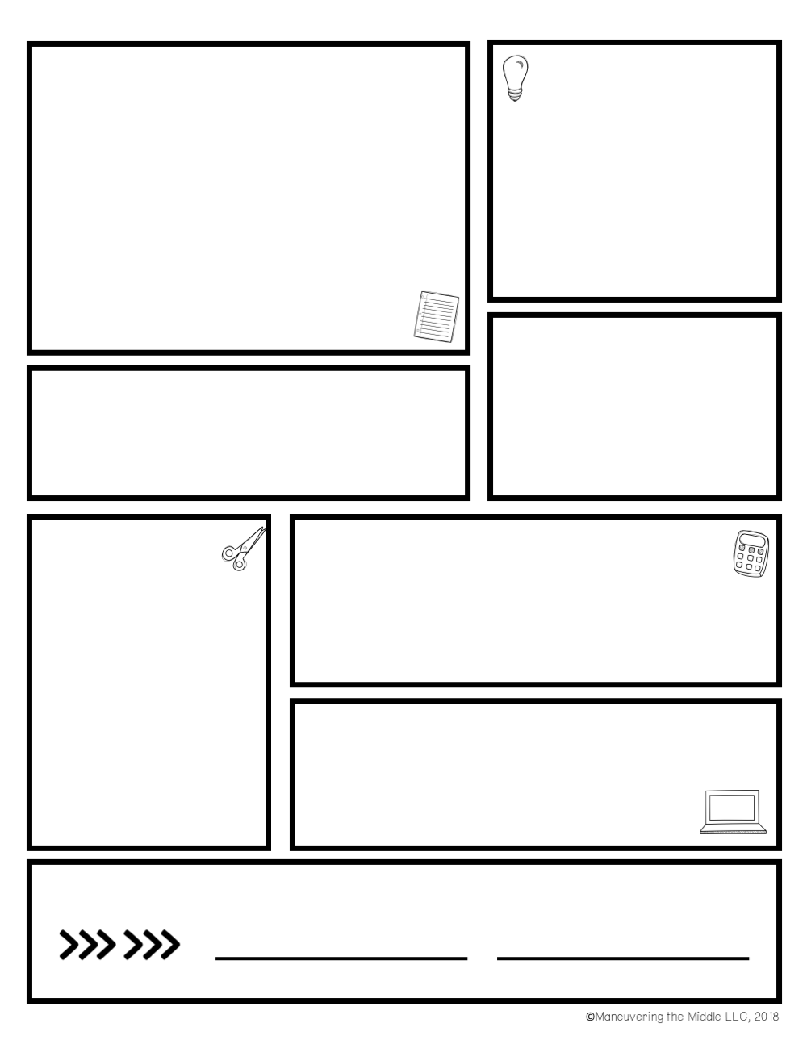





Houston County School District Mobile App: Thrillshare
Supply Wish List
Tissue
Hand sanitizer
Disinfecting wipes
Lysol Spray
🔔 Receive important alerts & notifications
📂 View important documents for the school and classrooms
💬 Communication between teachers and parents
Classroom Expectations
Always come prepared to class.
Be respectful.
Put forth your best effort.
No plagiarism under any circumstances
A personal planner is encouraged
The app is available for download on the iOS App Store and Android Play Store.
Supply List
One 2” binder
Pencils
Notebook paper
Erasers
Color pencils
Highlighters
Glue sticks
Scissors
Composition Notebook
Students and parents are encouraged to check Infinite Campus weekly. However, please do not expect grades to be updated daily.
Grading
Notes, PowerPoints and activities done in class will be posted in Canvas. This is a great tool to utilize if you are absent.
Sign here
Parent signature
Student signature

Slide 2
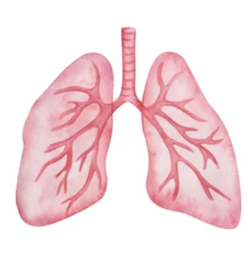
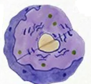
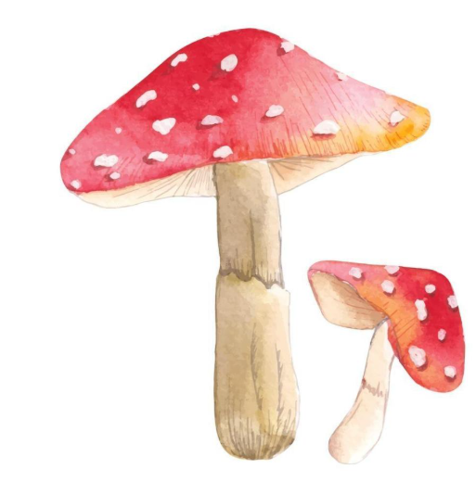


Grading Procedures
Major
Projects
Category | 7th Grade
Major | 40%
Minor | 30%
Daily | 20%
Final | 10%
Final Notes | Semester 1 & 2: Final from 18 weeks of content
Any project assigned will be completed in class unless stated otherwise.
7th Grade
Life Science
Mrs. Rodgers
cally.rodgers@hcbe.net
Retesting
Science Safety Contract
I agree to follow all instructions carefully, wear safety gear when needed, and use equipment responsibly. I will not eat, drink, or play during experiments, and I will report any accidents to the teacher immediately. By signing this contract, I promise to help keep our lab a safe and respectful place for learning.
Students who are not satisfied with their test grade may retest, but only after completing in-class test corrections. Retesting is only available on the assigned date given in class, and all corrections must be finished beforehand.
Student Attendance
If a student is absent, it is their responsibility to obtain and complete any assignments or work missed during their absence.
SIGN HERE
PARENT SIGNATURE
STUDENT SIGNATURE
©Maneuvering the Middle LLC, 2020

Slide 3
Houston County School District Mobile App: Thrillshare
Supply Wish List
Tissue
Hand sanitizer
Disinfecting wipes
Lysol Spray
Individually wrapped candy
🔔 Receive important alerts & notifications
📂 View important documents for the school and classrooms
💬 Communication between teachers and parents
Classroom Expectations
Always come prepared to class.
Be respectful.
Put forth your best effort.
No plagiarism under any circumstances
A personal planner is encouraged
The app is available for download on the iOS App Store and Android Play Store.
Supply List
One 2” binder
Pencils
Notebook paper
Erasers
Color pencils
Highlighters
Dry erase markers
Composition Notebook
Students and parents are encouraged to check Infinite Campus weekly. However, please do not expect grades to be updated daily.
Grading
All notes we cover in class will be posted here. This is a great tool to utilize if you are absent.
Sign here
Parent signature
Student signature

Slide 4
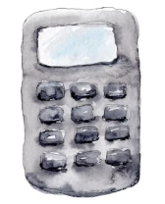
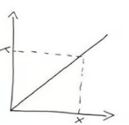


Grading Procedures
Homework
Students will complete weekly homework consisting of 2–3 instructional videos, depending on the week’s content. Each video includes accompanying questions graded daily for accuracy.
Category | 7th Grade
Major | 40%
Minor | 30%
Daily | 20%
Final | 10%
Final Notes | Semester 1 & 2: Final from 18 weeks of content
"You don’t have to be great to start, but you have to start to be great." – Zig Ziglar
Mrs. Rodgers
cally.rodgers@hcbe.net
Student
Attendance
7th Grade
Math
If a student is absent, it is their responsibility to obtain and complete any assignments or work missed during their absence.
Students who are not satisfied with their test grade may retest, but only after completing in-class test corrections. Retesting is only available on the assigned date given in class, and all corrections must be finished beforehand.
Retesting
SIGN HERE
PARENT SIGNATURE
STUDENT SIGNATURE
©Maneuvering the Middle LLC, 2020

