Slide 1
BLAST
Brilliant

Slide 2

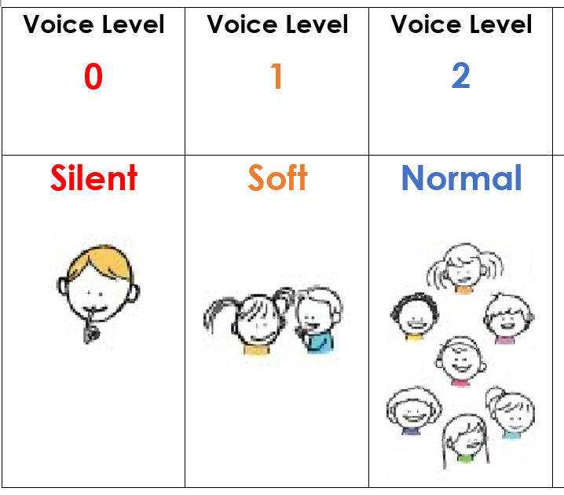
Brilliant in the Classroom
Try your BEST!
Set goals
Meet or exceed goals

Slide 3
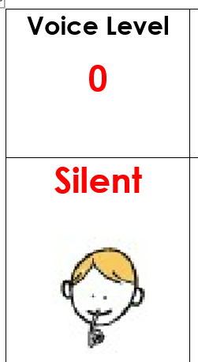
Brilliant in the Hallway
Walking feet
Listen and follow directions

Slide 4


Brilliant in the Restroom
Wait patiently for your turn to use the restroom

Slide 5
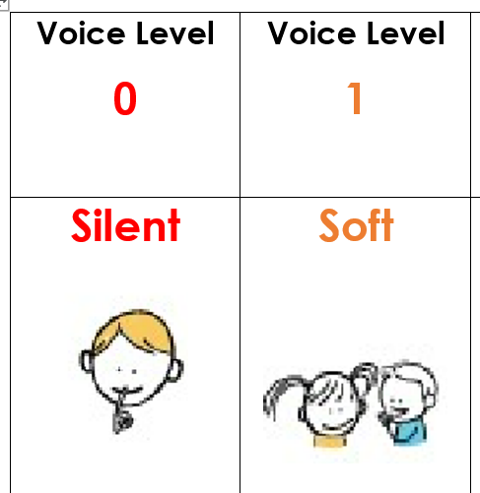
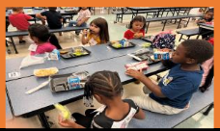
Brilliant in the Cafeteria
Make healthy food choices
Keep your area clean

Slide 6
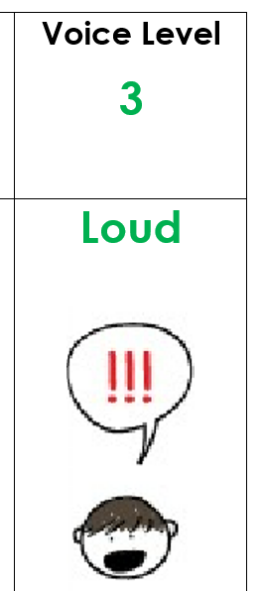
Brilliant on the Playground
Play in assigned area

Slide 7
Brilliant on the Bus
Listen and follow directions
Keep your area clean

Slide 8
BLAST
Leader

Slide 9
Leader in the Classroom
Be respectful to others in words and actions
Stay focused
Ask questions

Slide 10
Leader in the Restroom
Be Respectful to others in words and actions
Voice level 0

Slide 11
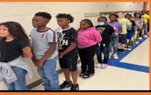
Leader in the Hallway
Be respectful to others in words and actions
Voice level 0

Slide 12
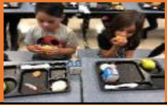
Leader in the Cafeteria
Be respectful to others in words and actions
Voice level 0 when music is on
Voice level 1 when music is off

Slide 13
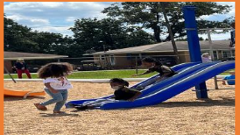
Leader on the Playground
Problem solve with kind words
Throw away snack trash
Help keep the playground beautiful

Slide 14
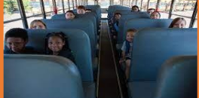
Leader on the Bus
Be respectful to others in words and actions
Use quiet voices

Slide 15
BLAST
Accountable

Slide 16
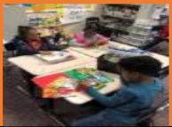
Accountable in the Classroom
Be responsible for your words, actions, behavior, and work

Slide 17
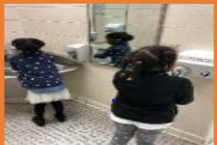
Accountable in the Restroom
Be responsible for your words, actions, and behavior

Slide 18
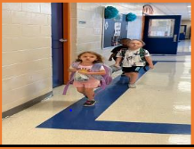
Accountable in the Hallway
Be responsible for your words, actions, and behavior

Slide 19
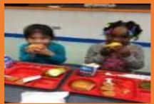
Accountable in the Cafeteria
Be responsible for your words, actions, and behavior

Slide 20
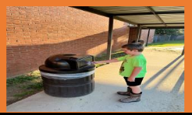
Accountable on the Playground
Be responsible for your words, actions, behavior, and snack trash

Slide 21
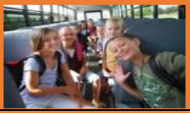
Accountable on the Bus
Be responsible for your words, actions and behavior

Slide 22
BLAST
Safe

Slide 23
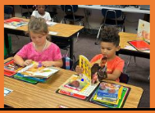
Safe in the Classroom
Hands, feet, and objects to oneself

Slide 24
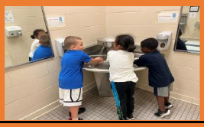
Safe in the Restroom
Hands, feet, and objects to oneself
Wash your hands appropriately

Slide 25
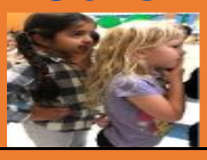
Safe in the Hallway
Hands, feet, and objects to oneself

Slide 26
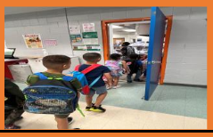
Safe in the Cafeteria
Hands, feet, and objects to oneself

Slide 27
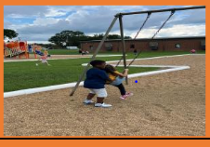
Safe on the Playground
Hands, feet, and objects to oneself
Play responsibility

Slide 28
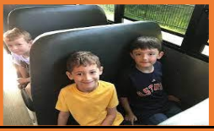
Safe on the Bus
Walking feet to the bus
Hands, feet, and objects to oneself
Back to seat, feet on floor

Slide 29
BLAST
Timely

Slide 30
Timely in the Classroom
Arrive to school and class on time
Start assignment and continue working
Complete and turn in work on time

Slide 31
Timely in the Restroom
Use the restroom and exit swiftly
Wash hands and quickly get in line

Slide 32
Timely in the Hallway
Two on blue
Face forward
Continue walking

Slide 33
Timely in the Cafeteria
Line: Ready to enter and exit cafeteria

Slide 34
Timely on the Playground
Line up as soon as called and ready to enter the school

Slide 35
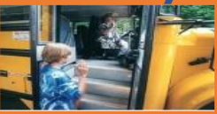
Timely on the Bus
Quickly sit in your assigned seat

