Slide 1
Welcome to Fourth Grade 2024/2025
Mrs. Thompson and Mrs. Junco

Slide 2
Our Day at Daniel Pratt!
Doors open at 7:15.
Class schedules are posted on our website and in the classroom.
Students will enter the classrooms at 7:45.
Tardy Bell is at 8:00.
PE 10:10-10:50
Lunch 11:59-12:22
Snack 2:40-2:50
2:50- Begins dismissal

Slide 3
Carpool Tags are required.
Parents are allowed to walk their students to class on the first day only.
Please do not bring fidget poppers, spinners, etc. to school.
Students need to come prepared with pencils, paper, binders, art supplies and snack.

Slide 4
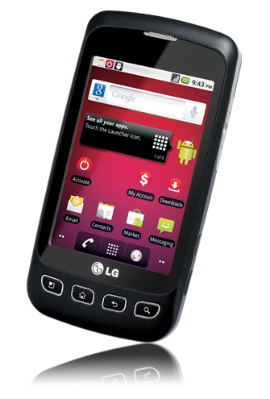
Contact
. We will use Parent Square to send out group information as well as individual messages. If your phone number changes, don’t forget to adjust it with the front office so you won’t miss important information!
Keeping your contact information updated is vital.
Watch Parent Square as well as our dpeseagles web site to stay on top of things.

Slide 5
Classroom Behavior
We will use a chart with colored tags to help students monitor their classroom behavior.
Consequences 1 and 2 = Green Tag
Consequences 3 and 4 = Yellow Tag
Consequence 5 = Orange Tag
Consequence 6 = Red Tag
Once students reach consequence 3, we will have a student conference. At consequence 4, we will contact the parent. Consequence 5 and 6 will begin an office referral. The 4th documentation on the referral will go to administration.
A copy of this plan will be kept in the front of the student’s binder.

Slide 6
Grades
Grades will be updated weekly in PowerSchool. This allows parents to progressively watch their child’s grades throughout each 9 weeks.

Slide 7
Folders
We will send folders home every other week. When your child brings the folder home, it will have graded papers and any school related information inside. Please keep these papers at home. If any papers have a score below 60%, you will sign these and return them. Folders will be labeled with a “Return” and “Keep” side to help keep things organized. Please make sure you sign and return the folder the next school day.

Slide 8
Lunch
Our lunch time is 11:59-12:22.
Lunch will be free this year.
Students are allowed to purchase extras (milk,
juice/water, chips) in the lunchroom (even if they bring
their lunch from home.) Lunch money can be sent to
the classroom teacher or online through the PayPams.
Please let us know if your child has any food allergies.

Slide 9
Check out the Daniel Pratt Web Page!
Our school website will have the following items:
Lunch menu
School calendar
Student Handbook
Fundraisers
School Information
Contact Information
…It’s updated regularly so you’re in the know!

Slide 10
Important:
To receive call-out messages, the telephone number in PowerSchool must be correct.
Please make sure your child’s teachers have correct contact information, including phone numbers and emails for parents.
Please make sure to send in a written excuse even if you contact us through Parent Square.
Transportation changes must be made in writing or through the front office. You cannot message these.

Slide 11
Mrs. Junco
We will use Social Studies Weekly, along with our AL History textbook. Some of the graded material will be online. Students will participate in hands-on activities as well.
Math will be in our new consumable textbooks, workbooks and online Reflex math program. We will maintain math journals and participate in hands-on math activities.
Our science books are consumable. We will complete journal activities and hands-on science experiments.
Students will have homework, study guides, and projects to complete. When we do have homework or a study guide for a test, we go over it as a class and pack it in our book bags, together as a class.
Study guides are to be signed and brought back the next day for bonus points.
All assignments will be added to the student planner as a class to keep up with assignments.

Slide 12
Mrs. Thompson
Students must bring their Literacy binder to class each day. The binder is divided into 5 sections: Homework, Reading Skills, Grammar Skills, Figurative Language, & Spelling. All work will be put into designated sections each day.
Students must keep a pencil pouch with pencils, erasers, highlighters, and coloring utensils in the binder at all times.
Our Reading curriculum will be from Open Court, and Grammar & Spelling will come from Scott Foresman. We will also do approved novel studies and book tastings.
Students will have homework each night, but not always written. There will always be vocabulary to study, spelling words to study, and reading a minimum of 30 minutes per night.
All students are required to have a book to read at their desk in case work is finished early or during SSR (Sustained Silent Reading).

Slide 13
Teacher Contact
michelle.thompson@acboe.net
tracy.junco@acboe.net
dpeseagles.com
Remember you can message us directly through Parent Square. Check you students binder and planner every day and make sure they have their supplies every day.

Slide 14
Teacher Wish list
Individually wrapped snacks/no peanutbutter
Lysol/Clorox wipes
Kleenex
Batteries (Double A and Triple A)
Masking/packing tape
Bottles of water (Small Size)

Slide 15
2024-2025 Will Be The Best Year Yet!

