Slide 1
Back to School
5th Grade
2024-2025
Mrs.Daniel & Mrs.Jamison

Slide 3
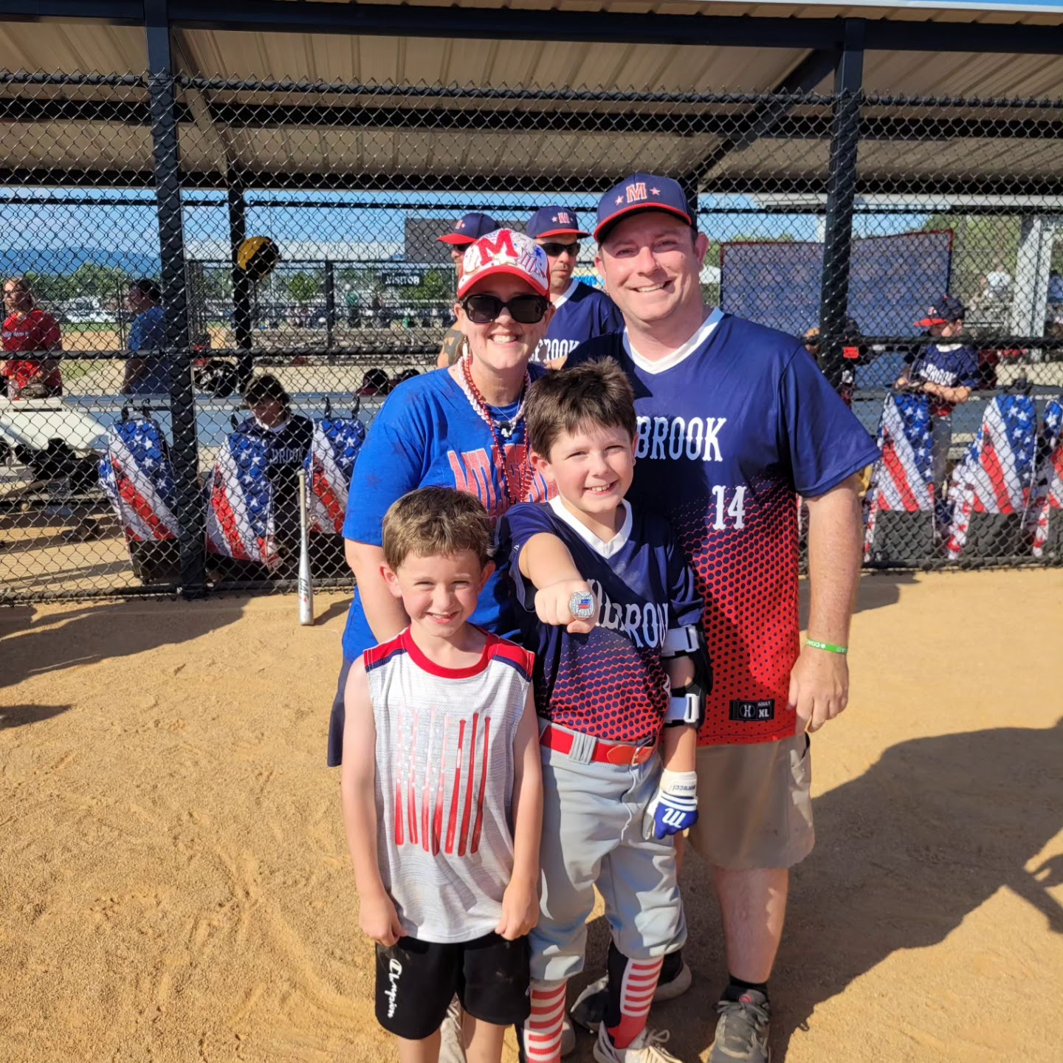
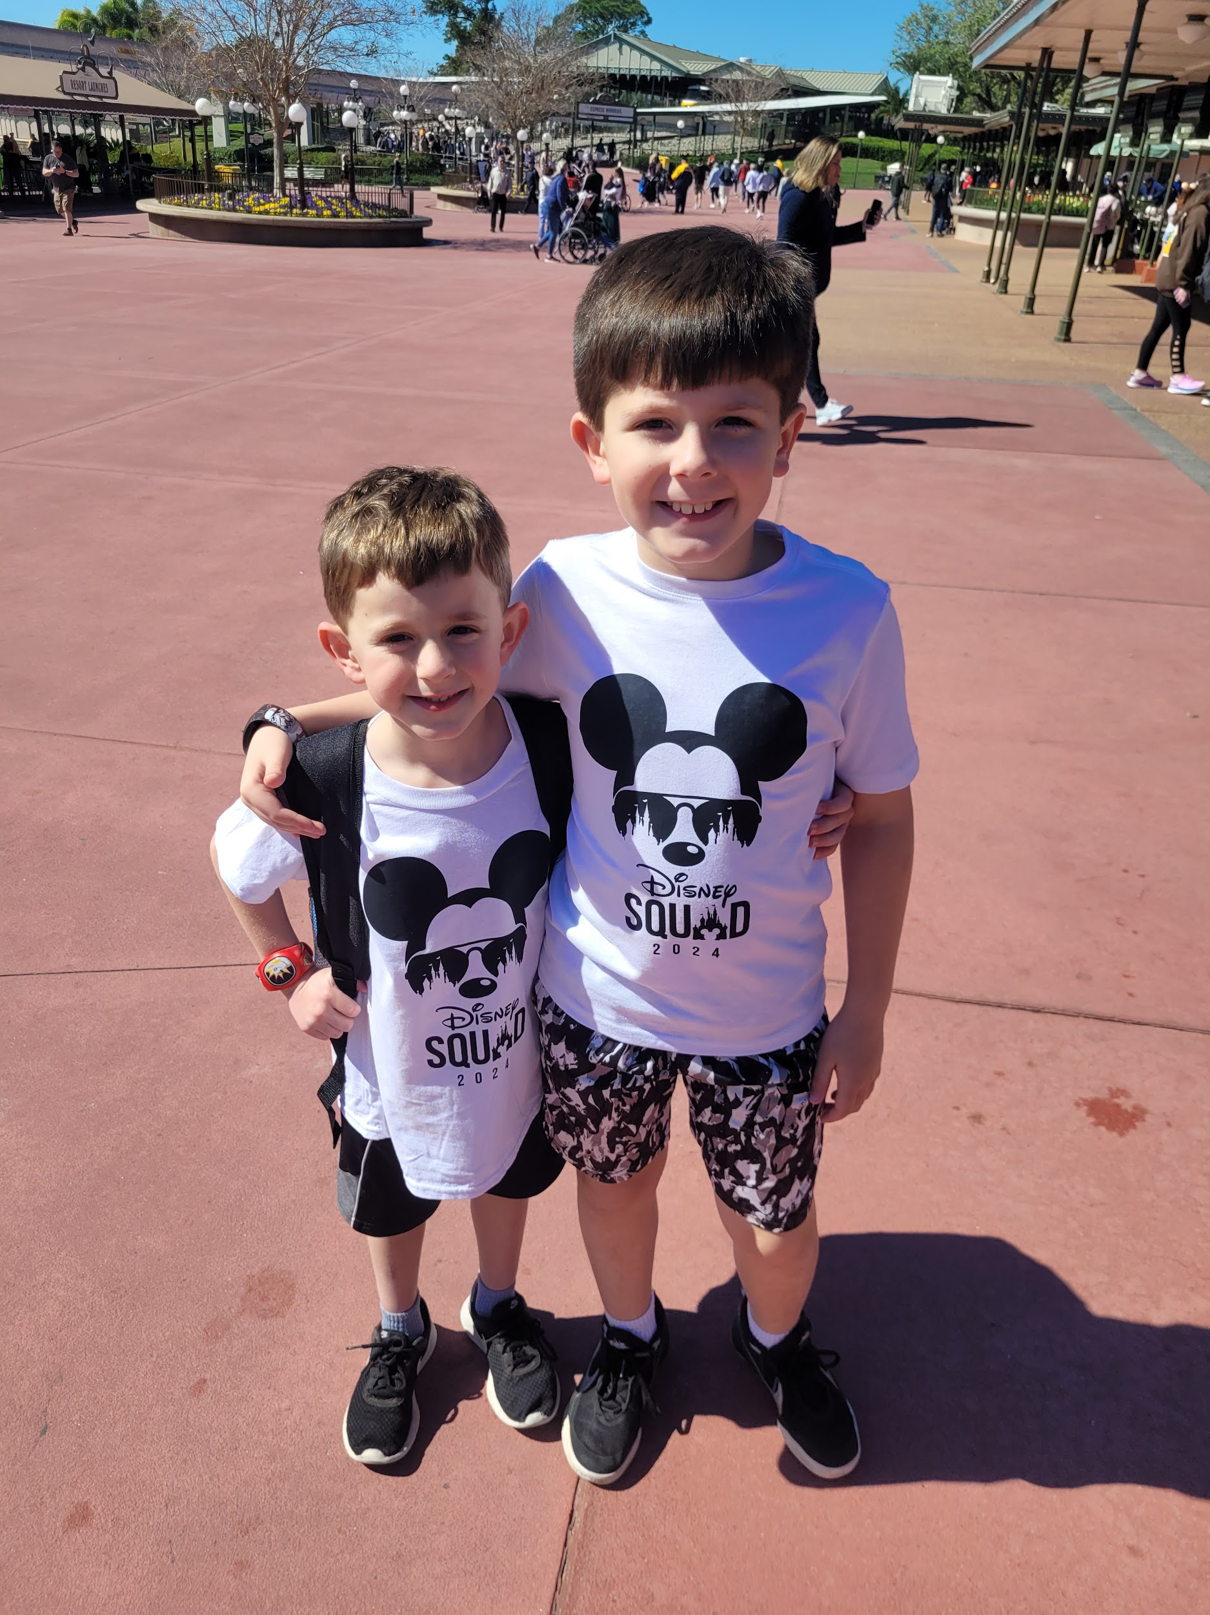
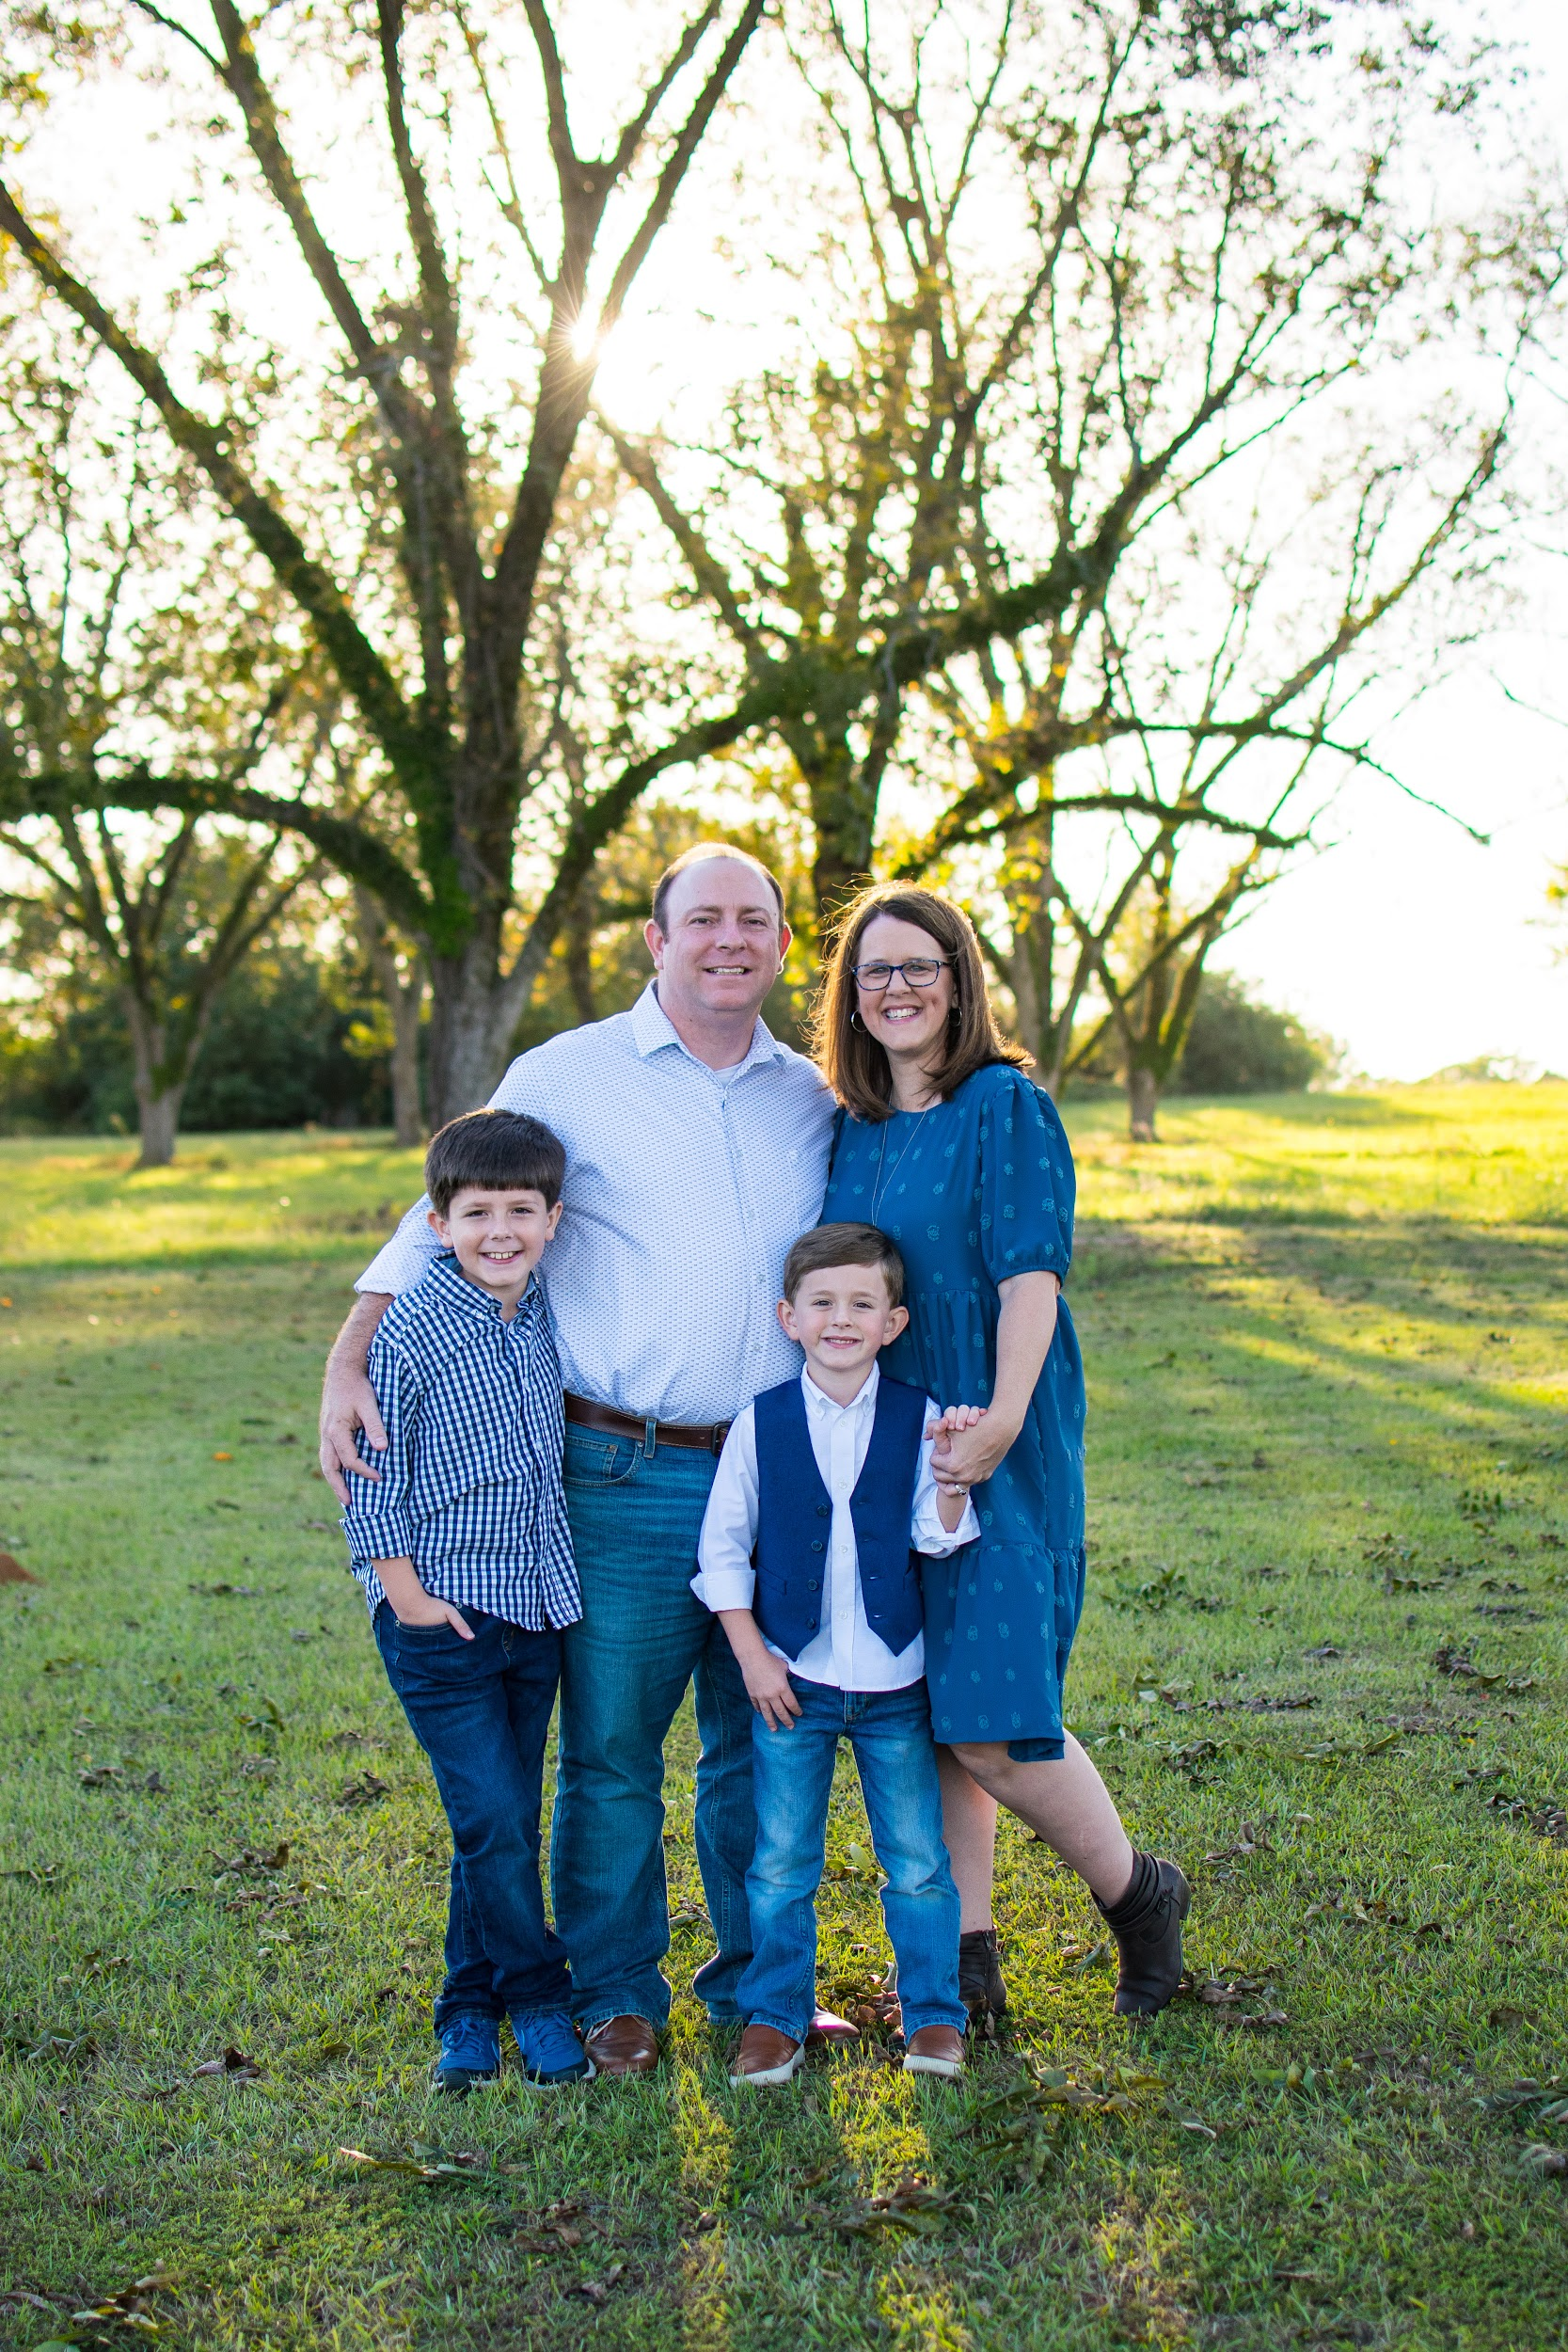
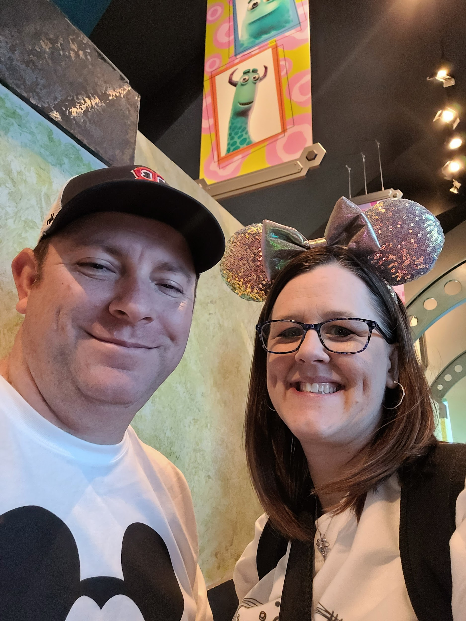
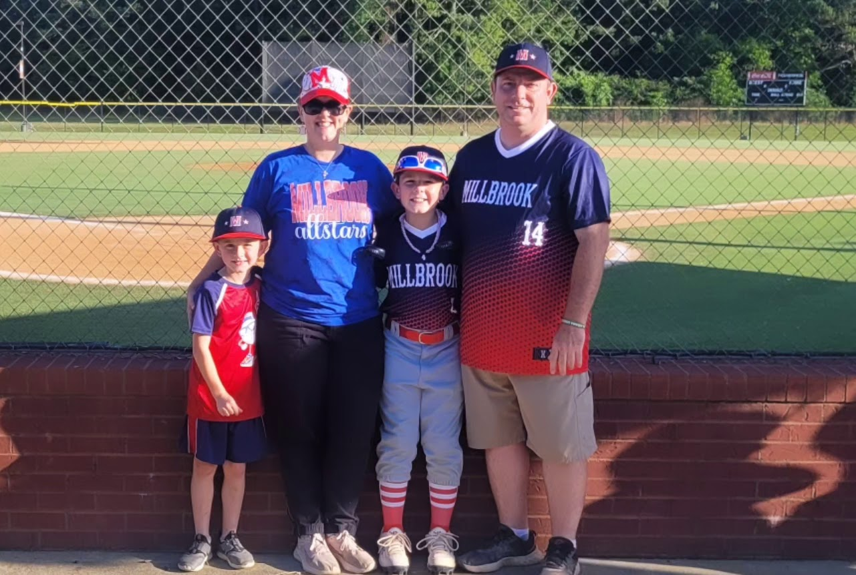

Slide 4
Autauga County Student Handbooks are digital this year. Please make sure you read the handbook carefully and become familiar with school-wide policies.
ParentSquare is the county’s preferred method of contact. All important information will be sent via ParentSquare. Please make sure you have an account and that you monitor it regularly.
Teacher and DPES websites will provide important information, reminders, forms, links and so much more! When in doubt, check these out!

Slide 5
First Day of School
Parents may walk their children to class on the first day of school.
Doors will not open until 8:00 due to student breakfast and bus riders. Parent drop off times will be from 8:00-8:30.
Please park in the front of the school and adhere to “no parking” signs in designated areas.
Enter and exit through the doors at the end of our hallway.
Please make sure you provide your student’s dismissal plan for the first day to us before leaving Open House.

Slide 6
Starbase Field Trip will take place 8/30-9/6 this year. There will be more information coming soon. Please be on the lookout for this information. Chaperones are not permitted on this trip per Maxwell AFB.
We would love to have parent volunteers help in various ways throughout the year. If you are interested, please grab a volunteer form.
Please visit the lunchroom to purchase school shirts, water bottles, get snack shack info, meet with transportation representatives, and learn about the YMCA afterschool program!

Slide 7
3 Rs
Respectful
Be prepared with a good attitude towards others.
Be respectful of the learning process.
Responsible:
Complete class assignments/projects.
Be honest about your work and your actions.
Resourceful:
Be prepared with class supplies.
Always give your best effort.
Be Respectful
Be Responsible
Be Resourceful

Slide 8
Updated discipline policies will be published soon. ACBOE has developed a more unified plan and a copy will be provided shortly.
Please make sure your child is not bringing prohibited items or devices to school.
We will have numerous positive behavior incentives that students can earn this year including movie days, special snacks, game days, etc.
Please send all money to school with your child in a clearly marked envelope or bag. The front office will not accept any money for students.

Slide 9
Please review the Parent-Student Handbook for the absence policy and truant/tardy policies.
Arrivals
Car riders may begin being dropped off at 7:15.
Any student not in the classroom at 8:00 is considered tardy. If your child is tardy, you will need to go to the school’s office to sign him/her in.
Dismissals
Parents are urged to leave their children in school all day. Students will NOT be allowed to check out after 2:30 p.m. Car riders, walkers, and 1st Bus Bell will all leave at 3:00.

Slide 10
Grades & Homework
Students will receive graded papers every other Thursday for review. Please sign and return these pages.
Grades for all classes can be monitored through PowerSchool. If you are returning, you will use your same information from previous years. If you are new, log in information will be sent out soon.

Slide 11
Grades & Homework Contd.
Mrs. Daniel’s classes will receive homework each Thursday. This homework will be due the following Thursday.
Mrs. Jamison’s classes will receive math review sheets each Monday that are due on Friday.
Binders will go home with your child each day. Please make sure to check these daily.

Slide 12
We’re here to help!
We are open to any questions, comments, or concerns you may have as the year progresses. Please feel free to reach out to us at any time via the info below. Please allow up to 24 hours for us to respond.
Mrs. Daniel: magan.daniel@acboe.net
Mrs. Jamison: mandy.jamison@acboe.net

Slide 13
Thank-You!
We are looking forward to a great year!

