Slide 2
Reagan’s Cold War Strategy
“Peace through Strength” – started a $1.5 Trillion military build up meant to bankrupt USSR if it tried to keep up
Reagan Doctrine – support guerilla forces that were fighting communist or Pro Soviet governments (Examples: Nicaragua and Afghanistan)
Reagan also pushed the USSR to make reforms and tear down the Berlin Wall

Slide 3
Strategic Defense Initiative (SDI)
Sometimes called “Star Wars” program
Reagan wanted military to produce a missile defense system to shoot down Soviet nukes

Slide 4
1983
Communists overthrew the government in Grenada
Reagan sent in U.S. troops which quickly defeated the Grenadian and Cuban forces
U.S. set up a new anti-communist government

Slide 5
Mikhail Gorbachev
Became leader of Soviet Union in 1985
Created “Perestroika”
Created “Glasnost”
wanted better relations with U.S., so USSR could spend less on defense to save economy

Slide 6
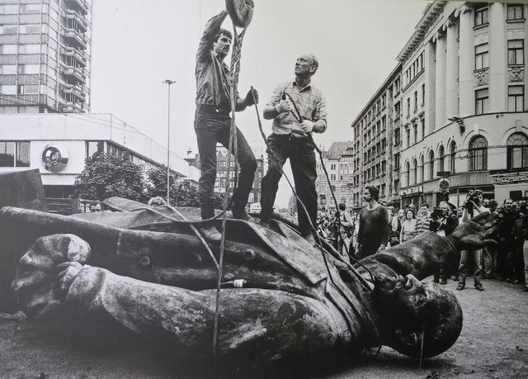
End of the Cold War
Soviet Union’s economy continued to get worse
1989, Berlin Wall fell
1991, Soviet Union collapsed and became 14 different countries

Slide 7
Iran Contra Affair
1979 communists took control Nicaragua
U.S. secretly armed a guerilla force called the Contras, until Congress stopped it
Reagan administration secretly sold arms to Iran for hostage releases
Gave the money from the arms deal to the Contras
Public found out in 1986
Oliver North took the fall in Congressional hearings

Slide 8
George H.W. Bush
Elected President in 1988
Reagan’s Vice President
Former Director of CIA
Often called “Bush 41”

Slide 9
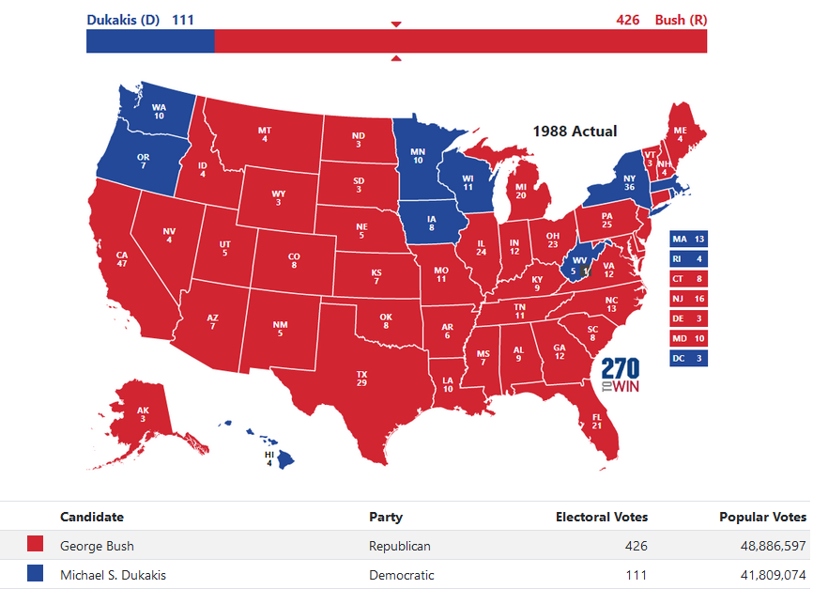

Slide 10
Invasion of Panama
Manuel Noriega was Panama’s dictator
Noriega aided drug traffickers and harassed U.S. military defending Panama Canal
1989, Bush ordered invasion of Panama
Noriega was arrested on drug charges
U.S. helped Panama hold elections

Slide 11
Persian Gulf War
Iraq invaded Kuwait for its Oil
U.S formed a coalition of countries with United Nations approval to remove Saddam Hussein from Kuwait
Operation Desert Storm was launched in January of 1991
Kuwait liberated in 6 weeks, coalition deaths 292, Iraqi deaths 20,000 – 50,000

Slide 12
