Slide 1
3rd Grade!
I’m excited you’re here!

Slide 2
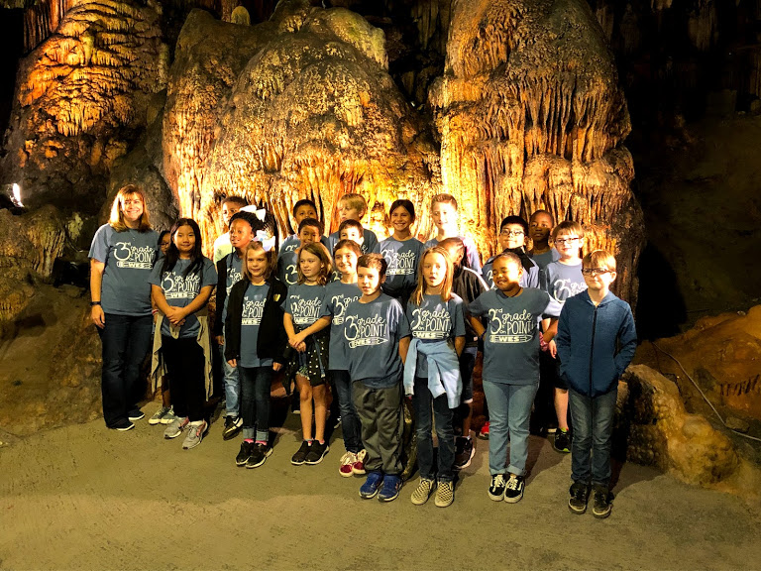
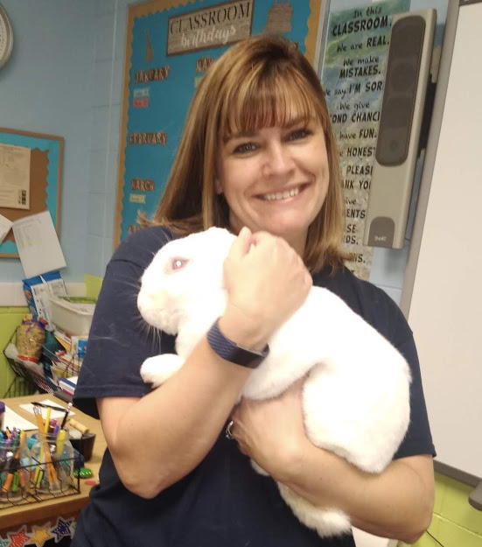
Mrs. Hoover

Slide 3
Learning is a treasure that will follow its owner everywhere.
Bachelor’s of Arts
University of Louisiana at Monroe
Teaching Certificate- Elementary Education- K-6th grades
Masters of Education
Southeastern Louisiana University
Educational Administrator
Experience
26th year of teaching
Have taught K, 2nd, 3rd, and 4th grades

Slide 4
Don’t’ watch the clock; do what it does. Keep going.
I will send you a copy through Remind.

Slide 5
A genius is a talented person who does his homework.
I will assign homework Monday-Thursday of each week.
Reading- Read AR for at least 15 minutes
Math- Practice skill(s) for that week
Occasionally, students will be assigned projects that will need to be completed at home.
Homework should not take more than 30 minutes.

Slide 6
I love the smell of new school supplies because it means my students are back in school.
MOST SCHOOL SUPPLIES HAVE BEEN PURCHASED.
Additional supplies that you may want to purchase:
Crayons
Pencils
Earbuds/Headphones
*Supplies may need to be refurbished as the year continues.

Slide 7
Breakfast
The most important meal of the day!
Students will eat in the classroom between 7:15-7:45 AM.

Slide 8
Keep your friends close and your snacks closer.
We will have a snack time each day.
Students can purchase snack and juice or bring it from home.
Snacks and juices are $0.75 each.

Slide 9
My favorite exercise is a cross between a lunge and a crunch… I call it lunch.
Students can bring their lunch or order from the cafeteria.
Lunch will no longer be free. The cost for a student lunch is $2.75 for full pay and $0.40 for reduced pay. (Please go online to the Elmore County Child Nutrition page to fill out your application.)

Slide 10
If your child will be a car rider, please make sure that you have your Car Rider Pro tag handy! If you do not still have one and/or need one, please send me a note as soon as possible and I will get you the necessary form.
Students will no longer be allowed to walk home from school.

Slide 11
SCHOOL SAFETY
Make sure you have your I.D. with you when coming to check your child out of school.
Make sure that the school has been provided with a list of people who may or may not check your child out. PLEASE keep this list updated.
Notify the school of any phone number or address changes ASAP.

Slide 12
Every school day counts!
Attendance is very important!
Please make sure to send in a written excuse within three days of your child returning to school.
Please read the information provided in the handbook regarding attendance.

Slide 13
Stay hydrated!
Students will be allowed to keep a water bottle at their desk.
Please fill water bottles at home each morning.
Students will also be allowed to fill their water bottle during the day at school.

Slide 14
Students will have scheduled bathroom breaks, but are also allowed to go to the restroom upon request outside of those times. Please make sure that I am aware of any circumstances that may require frequent bathroom visits (i.e. medical necessity).

Slide 15
As of right now, we may schedule field trips. Please be aware that this may change.
We will be ordering a 3rd grade t-shirt. We do plan to wear them as a grade level on the first Friday of each month and on other days throughout the year as well. More information on field trips and shirts will be coming home soon!

Slide 16
Communication must be HOT. That’s Honest, Open, and Two-way.
Remind is the easiest way to contact me. When you message me on Remind, I am the only one who receives your message. I will be sharing information with you through Remind.
Text @wes-hoover to 81010 to join our class Remind.
You can contact me by email- hilary.hoover@elmoreco.com.
Also, you can call the office and leave a message for me.
(334)567-4323

Slide 17
A good relationship begins with good communication.
A class newsletter will be sent home each Monday in your child’s Homework Folder. This newsletter will include an upcoming events schedule, skills we are working on for the week, and any other important information.

Slide 18
First Quarter Skills/Standards
ELA | MATH | SOCIAL SCIENCE
Story Elements | Multiplication | Animal Habitats
Comparing Texts | Division | Map Skills
Main Idea
Sentences, Nouns, and Pronouns
The Writing Process
*Ongoing Reading Strategies Used Each Quarter: Predicting, Summarizing, Inferring, Drawing Conclusions, Visualizing, and Sequencing.

Slide 19
If you put in the Time +Effort, you will see the Results.
ELA (weighted) | MATH | SOCIAL SCIENCE
Comprehension (60%) 3 Site-based grades 1 County grade | 5-7 Site-based grades | 6-8 Site-based grades (combination of science and social studies)
Grammar (25%) 3 Site-based grades 1 Writing grade | 1 County grade
Phonics (15%) 3 Site-based grades | 1 Fact Practice
Grading Scale:
A 100-90
B 89-80
C 79-70
D 69-60
F 59 & below

Slide 20
Log-in information will be coming home for PowerSchool. Please use this program to keep track of your child’s progress.

Slide 21
Children are apt to live up to what you believe of them.
Students will take Star Math and Star Reading Tests 3 times this year.
In preparation for ACAP testing some classroom tests will be given on the computer.
ACAP (Alabama Comprehensive Assessment Program) will be administered in the spring. Third graders will be tested in ELA and Math. (March/April)

Slide 22
Attitude is key to all success.
To maintain a classroom that allows all children to learn, our class follows a plan that includes rules, consequences, and rewards. I will use the “strike” system this year. I will go over expectations with students on Monday.
A discipline calendar will be sent home in your child’s homework folder to be signed daily.

Slide 23
Attitudes are contagious, is yours worth catching?
Number of Offense | Offense | Number of Offense | Offense
1 | No Homework | 11 | Hands/Feet are being used to bother others
2 | Not prepared | 12 | Playing-lunchroom
3 | Inattentive | 13 | Playing-Bathroom
4 | Not following directions | 14 | Playing-Classroom
5 | Talking during instruction | 15 | Playing-Hallway
6 | Talking - Hallway | 16 | Sleeping in Class
7 | Talking during silent lunch period at lunch | 17 | Making inappropriate noises
8 | Wasting Time | 18 | Disrespectful
9 | Out of Seat | 19 | Other
10 | Defiant behavior toward adults | 20 | Feet placed inappropriately on desk

Slide 24
Treat others the way you want to be treated.
Rules:
Respect yourself, others, and their property.
Come to class prepared.
Follow directions the first time given.
Always use an appropriate voice level.
Raise your hand to speak or to leave your area.

Slide 25
There’s always consequences to your actions.
Before you act, make sure you’re prepared for them.
Consequences:
Silent Lunch
Student/Teacher Conference
Behavior Management Form
Parent/Teacher Conference
Office Visit

Slide 26
It is the things we work hardest for that will reward us the most.
Rewards:
Special Snack
Games/Free Time
Extra Recess
Movie Time
Special Projects

Slide 27
Let today be the start of something new.
Please make sure that you send in your child’s transportation information (how they will be getting home).
Please send in all completed forms from Open House.

Slide 28
Teamwork makes the dream work!
Checklist for success:
read with your child
practice multiplication facts
check and sign your child’s homework folder and/or conduct log
*Please complete this checklist each night!

Slide 29
Education is a shared commitment between dedicated teachers, motivated students, and enthusiastic parents with high expectations.
Remind is the best way to communicate with me during the school day.
Remind: Text @wes-hoover to 81010
Email- hilary.hoover@elmoreco.com
School Phone #- (334)567-4323

