Slide 1
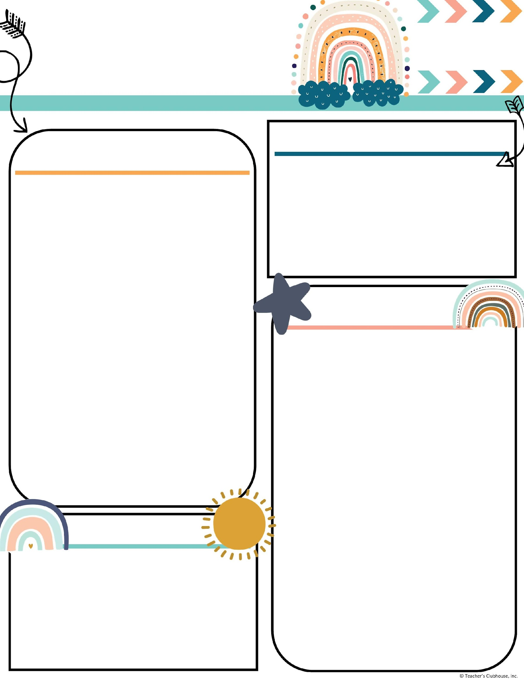
Every Student Empowered. Every student succeeds.
Second Grade, E122
334.285.0273
Remind App @6bc96eg
joan.johnston@elmoreco.com
Ms. Johnston’s
Newsletter
Week of March 3-7, 2025
Upcoming Events
A Peek at Our Week
Reading:
Benchmark
  Compound Words
    lighthouse
  Silent Letters kn, gn, wr
    Example: knot, gnat, wrap
Great link to decodable books! I encourage you to utilize this free resource:
https://portal.flyleafpublishing.com/learners-resources/
Word Study: bathroom, toothbrush, birthday, starfish, cowboy, snowball, doorknob, seashell, moonlight, railroad
Grammar:
Review Quarter 3 Skills
Comprehension:
Ask and Answer Questions to Demonstrate Understanding of Key Details
Determine Central Message
Acknowledge Differences in the Points of View of Characters
Use Illustrations and Words to Demonstrate Understanding of Characters, Setting, or Plot
Math:
Money → Solve problems with money
a. Identify coins by name and value.
b. Find the value of a collection of quarters, dimes, nickels, and pennies.
c. Solve word problems by adding and subtracting within one dollar, using the $ and ¢ symbols appropriately
Writing/Language:
Writing complete sentences
Narrative Fiction
Science/Social Studies:
Read Across America
March 3-7 ~ Book Fair & Read Across America Week
March 4 ~ PTO Meeting & Reading Night
March 9th ~ Time Change Spring Forward and Happy Birthday Jayden!!
March 12 ~ Spring Pictures
March 14 ~ ½ Day for students and Happy Birthday Taylor!!
March 18 ~ Happy Birthday Ms. Johnston!
March 24-28 ~ Spring Break
April 17 ~ Spring Carnival
Weekly Homework
Please check your child's folder for their homework that will be due on Friday
Tests this week
*Dates subject to change
Phonics (short oo/u; al, aw, au) ~ Tuesday
Topic 8 Money Test ~ Thursday
Math County Test (Wednesday, March 11)
Quarter 3 Sight Words:
Week 1: answer, there, brown, wash, country, went, start, who, then, your
Week 2: above, grow, began, they, different, were, enough, which, few, why
Week 3: follow, leave, girl, might, head, next, idea, often, kind, paper
Week 4: river, until, second, watch, song, white, think, three, young, point
Week 5: add, group, between, hear, close, home, example, left, food, mountain
Week 6: music, spell, night, thought, old, together, picture, while, sentence, world
Reminders
Every Wednesday is Wonderful Wednesday Snack. All items are $2.
Donations appreciated: Candy for Spring Carnival

