Slide 1


Slide 2

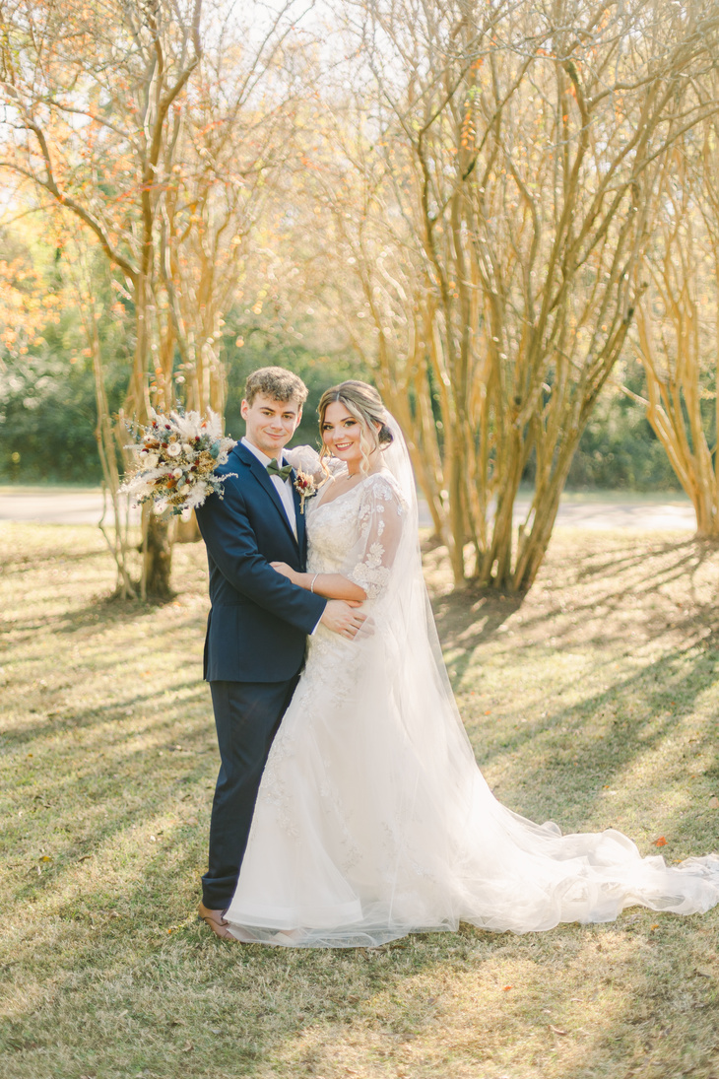


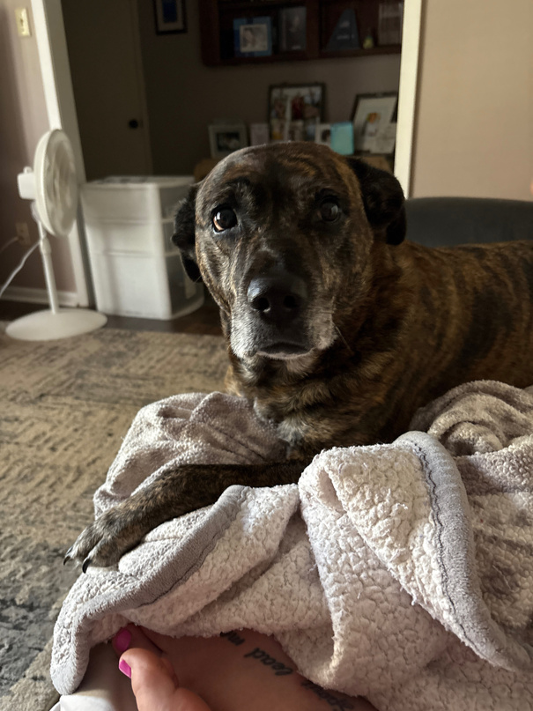
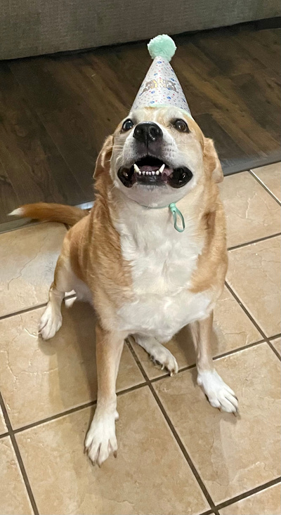
  This will be my 5th year in the classroom, 2nd year teaching 1st Grade. Previously I taught 3rd Grade for 3 years. I am married to my high school sweetheart, Carson. We will be celebrating our three year wedding anniversary this November!!
  I have two SWEET puppies, Mayzee and Luna!

Slide 3

  Students will be given letter grades in ELA and Math. Major grades count 60% and Minor grades 40% for these subjects.
  Students will be given an S, N, or U in Handwriting, Science, and Social Studies.
  Students will have to pass Language Arts, and Math with a yearly average of 60 or higher to be promoted to second grade.

Slide 4

  Weekly reading homework will be sent on Mondays, and it will be due Fridays. This is optional, but great at home review of what we are learning in class!
  Math homework will be sent throughout the year, usually before a test. You will not have weekly Math homework.
  Addition and subtraction facts to 20 are a great thing to practice and help your child become fluent in.
  Reading 10 minutes per night.
  All homework will be placed in binders.

Slide 5

It is very important that you check your child’s binder nightly and return it to school the following day. If you need to make a transportation change, it must be in writing! I am available during my planning time 12:55-1:45 for conferences.
  Zipper pouch for money and notes (Label all money sent in! Name & what it is for)
  Behavior chart by color
  Helpful First grade resources for you to use at home
  Graded papers may stay at home, unless they are below a 60 and have a Sigh and Return stamp.

Slide 6

  Students will start the day with their clothespins on green. They will move up or down, according to behavior. As they move up the chart for positive behaviors, they’ll have the opportunity to visit the treat box once they have earned 3 pinks.
  Behavior will be marked daily on conduct sheet.
  Please initial Behavior calendar square daily.
  Demerit System for common areas (see the DPES handbook!)

Slide 7

  The best way to contact me is through email.
  caitlin.mcdonald@acboe.net or Parent Square.
  Weekly newsletters will be sent home on every Friday or Monday.
  Check school and class website regularly..
  Parent Square is the county’s form of communication. Be sure to download the app. This is how I will communicate with you, as we well as the school and county. Keep phone numbers updated, it uses what is in Powerschool.

Slide 8

I will add important dates on the weekly newsletter as they approach!
We will go on a few Field Trips this year, and I will send info several weeks prior to the trip to allow you to plan.

Slide 9

Anyone interested in Volunteering will need to stop by the Lunchroom and fill out a Volunteer form.
We will have a parent liaison that will help coordinate parents where volunteers are needed.

Slide 10

  We will eat birthday treats during snack time so it is not necessary to send plates, napkins, or drinks.
  Store bought cupcakes/Pre-packaged Snack cakes work well!
  Send items with your child in the morning.

Slide 11

Please read the Attendance policy in the handbook, as some information has changed.
  Please send an excuse within 3 days if your child is absent. Only 7 days may be excused with a written parent note, after that a Doctor’s excuse is required.

Slide 12

  I posted our school supply list on Parent Square. Extra crayons/pencils may need to be replenished throughout the year.
  Please be sure to send in a sturdy pair of “over the ear” headphones to stay in class.
  Please send a water bottle with your student daily! We have refill stations.

Slide 13

We have a snack DAILY in the afternoon!
  Snacks may be purchased at the Power Pantry in the morning upon arrival, or you may pack one. No carbonated beverages please!
  The school will have “Special Snack” days throughout the year, I will be sure to include those on newsletters and send reminders on Parent Square!
  If you wish to send extra snacks for a classroom share basket, they are always welcome!

Slide 14

Breakfast is FREE for all students this year! YAY!!
  Students that wish to eat breakfast at school will go directly to the Lunchroom when they arrive.
  After they finish their breakfast they will walk to our hallway.
  Be mindful of getting to school in a timely manner to allow your child plenty of time to have breakfast in the lunchroom.
  Breakfast will cut off when the tardy bells rings.

Slide 15

Lunch is also FREE for all students this year!
  You are still welcome to pack your child’s lunch if you wish!
  I will take a lunch count each morning, so please make sure your child knows if they will be eating a Lunchroom lunch or one from home.

Slide 16

If your child will be taking medications at school, please go by and visit the Nurse’s office. You will need to fill out a form.
Make sure you document on their Information Sheet if there are any allergies/health issues I should be aware of.

Slide 17

  Morning drop off- Students will be dropped off in the front of the school. Enter at the front of the school for morning drop off.
  Drop off begins at 7:10 and ends at 7:55.
  If you arrive after this time, please sign in at the front office.
  We have DEAR Time in the hallways each morning, so be sure your child has a book or something they can read.

Slide 18
Car Rider Pro- We have adopted a new system for car pickup in the afternoons. If your child will be a car rider, you MUST go to the lunchroom and get them a special tag. This tag will hang on your rearview mirror and the number should be facing the front window. There is a video on the next slide for your reference. Extra tags may be purchased for $5.00.
Dismissal:
Car riders- 2:50 1ˢᵗ Load Bus- 3:05
Walkers- 2:55 YMCA- 3:10 to DPES Gym

Slide 19
  Yellow Bus tags need to be attached to your child’s backpack for the entire first 2 weeks.
  Be sure to take these and pin them to your child’s backpack before the first day!
  Label ALL money and put in an envelope/baggy.
  Remember to return forms ASAP, and make SURE I know how your child will be getting home on the First Day, and Rest of the year. (If different!)

Slide 20

  First day ONLY, Parents may walk their child in at a designated time. Our classroom time is from 8:15-8:30. You will enter from the front doors of red hall.
  Regular schedule will resume Friday, August 8ᵗʰ. Drop off will begin at 7:10.

Slide 21


Slide 22

You are always welcome to reach out to me with ANY questions or concerns!
caitlin.mcdonald@acboe.net
or Parent Square

