Slide 1


End of Grade and
End of Course
Spring 2023
Administration
April 24 – May 5

Slide 2
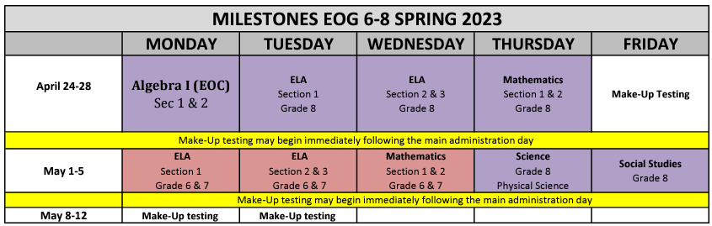
Milestones Schedule

Slide 3
Georgia Milestones Overview
Notes:
Taiesha

Slide 4
Summative Purpose for Assessment
The Georgia Milestones is a summative assessment and is considered an assessment of learning.
Takes place at the end of the year
Is used to assess instructional practices, to review curriculum mapping, and to evaluate academic programing in support of learning student needs
Measures student mastery of the
Georgia Standards of Excellence (GSE)
There are no changes in the Georgia Milestones test design for 2022-2023.

Slide 5
Georgia Milestones
Changes for 2023
Students will enter a monitoring code after signing in to testing platform.
  Moving to ticketless testing
No ELA field test essay question
Notes:
Testing times have been reduced this year to reflect the shortened test design. In order to accomplish the reduction in testing time, certain item types have been replaced, overall number of points have been reduced, and some items have been eliminated. This slide itemizes those changes.

Slide 6
Georgia Milestones
Testing Times – EOG and EOC
Content Area | Section | Typical Testing Time | Maximum Testing Time
ELA | 1 | 45-65 | 90
 | 2 | 40-60 | 80
 | 3 | 40-60 | 80
Math | 1 | 30-50 | 65
 | 2 | 30-50 | 65
Science | 1 | 20-30 | 40
 | 2 | 20-30 | 40
Social Studies | 1 | 15-25 | 35
 | 2 | 15-25 | 35
There is no minimum time for testing. If all students have submitted the test, the examiner should complete the test section.
The Examiner must keep time during testing in accordance with the script. When time has been called, the Examiner must instruct the student to stop the test.
Notes:
The Examiner must keep time during testing in accordance with the script.
Based on analyses of prior years’ testing, we have determined the typical amount of time in which most student should complete testing. If needed, however, students are allowed up to the maximum time shown here.
There is no minimum time for testing. If all students have submitted the test, the examiner should complete the test section.

Slide 7
Item Types
English Language Arts
Item Types
Selected Response Constructed Response items Constructed Response Extended Constructed Response (Narrative Writing) | Extended Writing Response Evidence-Based Selected Response Drag and Drop/Paste Drop-down List
Unique Feature(s)
Reading and Evidence-Based Writing Section requires students to construct meaning, make inferences, draw conclusions, compare and contrast ideas as well as synthesize ideas and concepts across multiple texts Selected Response Constructed Response Extended Writing Response
Extended Writing Response requires students to develop an informative/explanatory or opinion/argumentative essay – citing evidence from text(s) and using standard language conventions, etc.
Notes:
Item types found on the English language arts assessments and presented to students include selected response (or multiple choice), constructed response, extended constructed response, extended writing response, evidence-based selected response, drag and drop/paste and drop-down list.

Slide 8
Item Types
Mathematics
Item Types
Selected Response Multi-Part Multi-Select Drag and Drop/Paste | Graphing (Bar graph, line graph, pictograph) Keypad Input Drop-down list
Unique Feature(s)
No-Calculator Section Desmos Calculator ONLY
Notes:
These item types and features are included for mathematics.

Slide 9
Item Types
Science and Social Studies
Item Types
Selected Response Multi-Part Multi-Select Drag and Drop/Paste Drop-down list
Unique Feature(s)
Science requires understanding of the core concepts, ideas, and practices of science to explain scientific phenomena Social Studies requires understanding of the past and its influence on the present and future – including the interconnectedness of history, culture, geography, economics, and government/civics
Notes:
These item types are included for science and social studies.

Slide 10

Are Students Ready?
Orient students to testing via an online platform:
  Experience Online Testing Georgia: http://www.gaexperienceonline.com
  Available anywhere, anytime.
  Can be used by students and parents and a script is available for use in the classroom.
Notes:
Students should be comfortable with the format of the Georgia Milestones assessment as well as the INSIGHT program and all available tools. Districts should set up practice sessions with students using the Secure Practice Tests. Teachers, students and parents can experience the format of the test and the INSIGHT program anywhere anytime through Experience Online Testing Georgia.

Slide 11
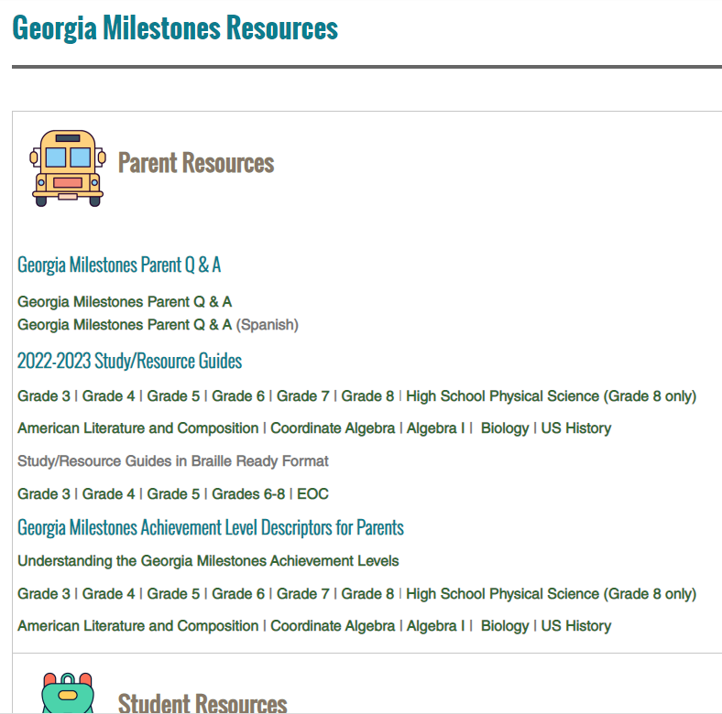
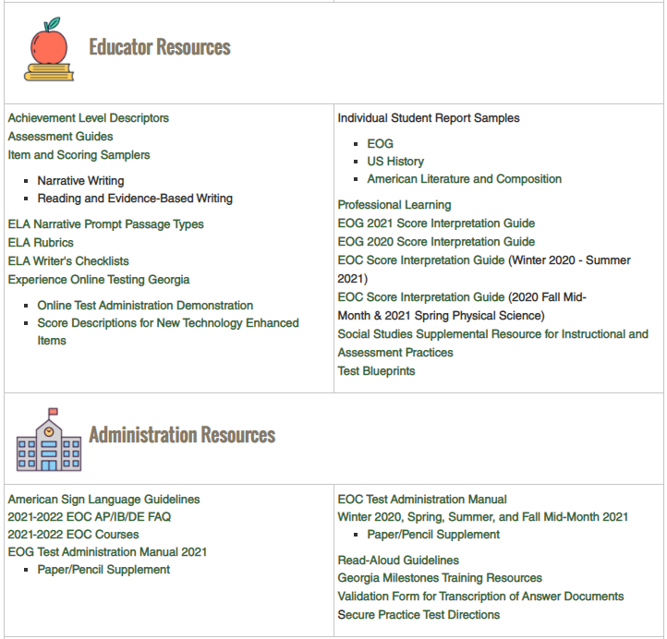
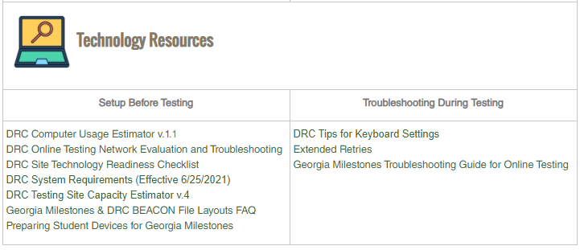
Georgia Milestones Resources
Notes:
Georgia Milestones has a wide variety of resources for Parents, Students, and Educators as well as for administration and technology implementation. There are numerous resources for gaining a better understanding of Georgia Milestones included Study/Resource Guides, sample formula sheets, Achievement Level Descriptors, Assessment Guides, Sample Rubrics and many more.

Slide 12
Student Preparation
Train Students on Strategies, Item Formats and Universal Tools
Device Familiarity – Ensure students are familiar with the operation of the device they will use during testing.
  Mouse
  Keyboard
  Touchpad
Online Administration Familiarity – Ensure students are familiar with the tools and accommodations they will use during the online testing assessment.
Ensure that students have practiced with testing devices before testing.
www.gaexperienceonline.com
Notes:
Online practice sessions provide the opportunity to verify students can manipulate the keyboard and mouse or touchpad and be familiar with online tools.

Slide 13
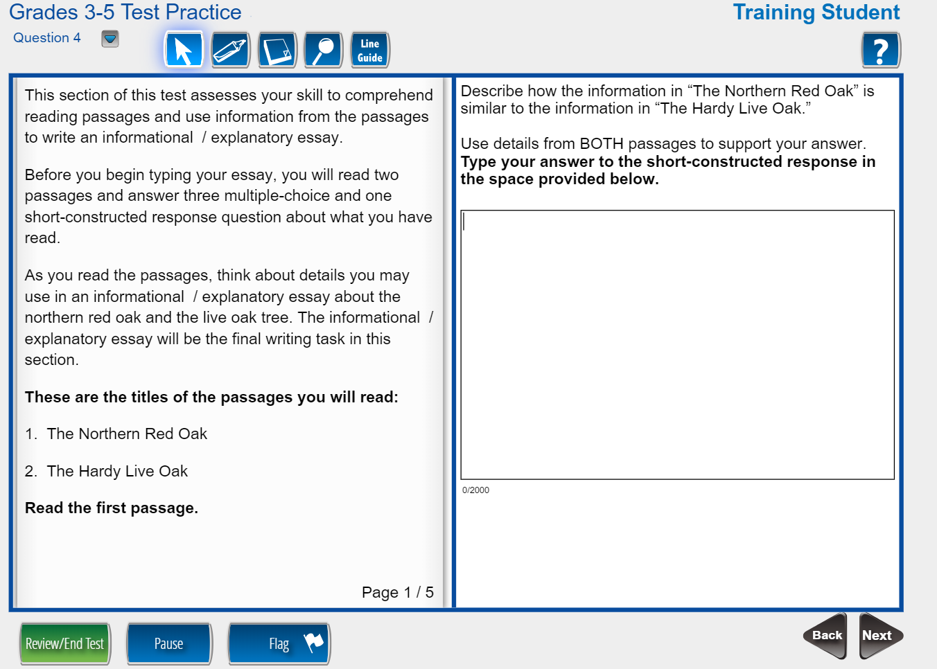
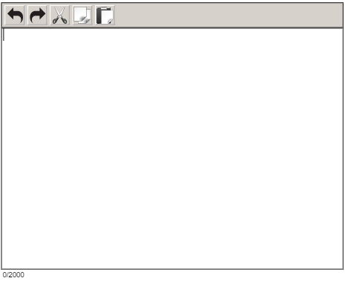
Are Students Ready?
Format of the test
Testing tools
Time and date of test
Different item types
Online calculators
Cut, copy, paste, undo, redo
Online reference Documents
Accommodations
Familiarity with device for testing
Closing out the test
Notes:
The format of the test includes different test item types, how they will be displayed, and how students interact with the items. Experience Online Testing Georgia allows students to use the Universal Testing Tools. Students should know how to use cut, copy, paste, undo and redo when responding to constructed response items.

Slide 14
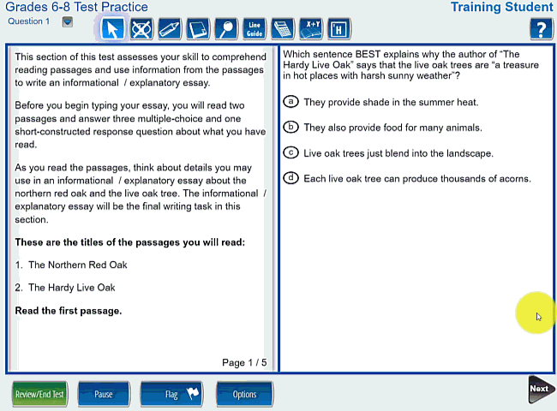
Item Types – Reading & Evidence Based Writing

Slide 15
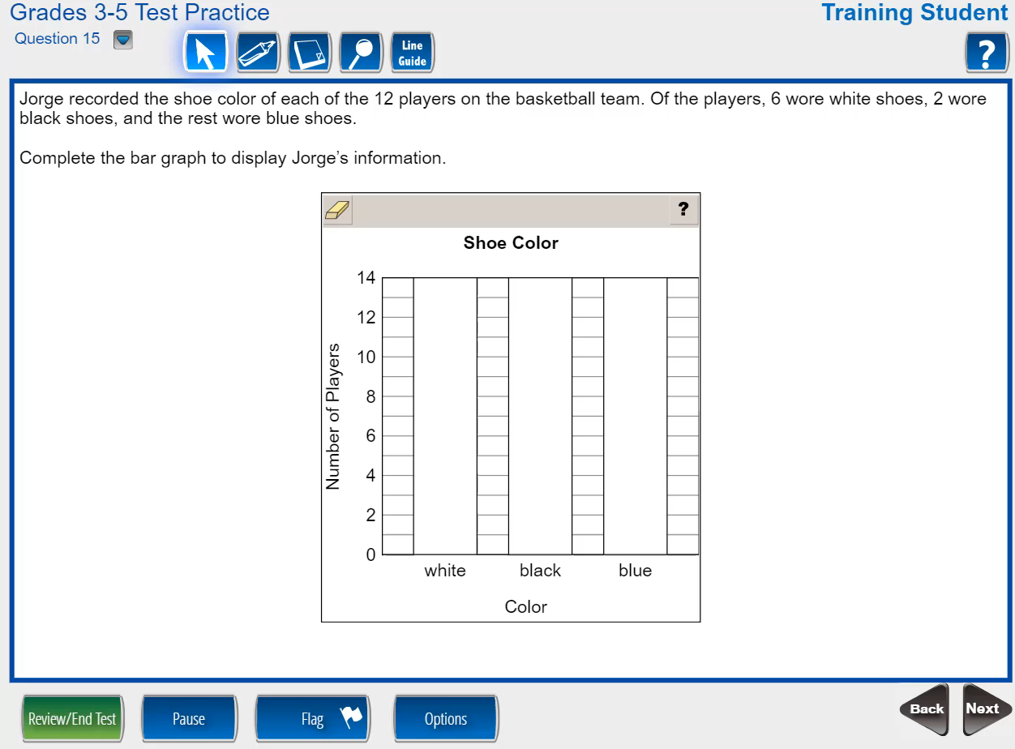
Item Types – Bar Graph

Slide 16
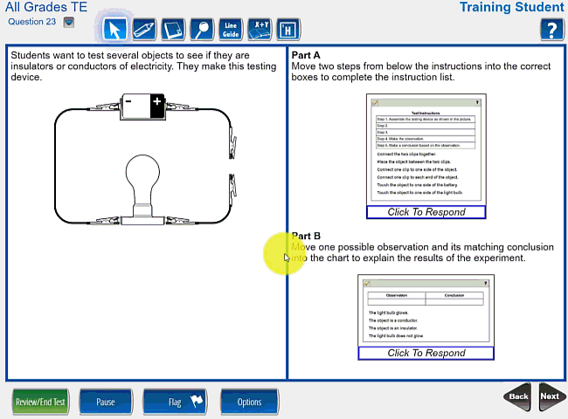
Item Types – Drag and Drop

Slide 17
Thank you again for joining us.
If you have any questions…
Dr. Moore’s email:
  Jami.moore@hcbe.net
Practice test:
www.gaexperienceonline.com

