Slide 1

Dealing with Crossover Claims: When Regular and Special Education Meet
Phil Hartley
Pereira, Kirby, Kinsinger & Nguyen
phartley@pkknlaw.com
cell – 770-654-3616
2026 Spring Conference March 2, 2026

Slide 2
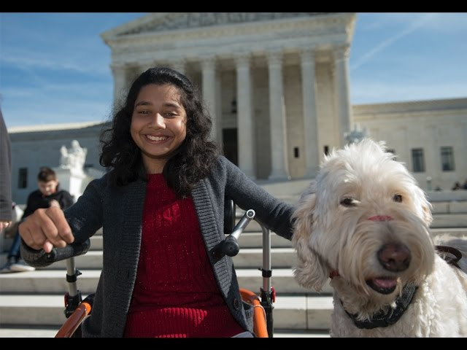

Remember…
Fry v. Napoleon Community Schools
Perez v. Sturgis Public Schools

Slide 3
Powell v. School Board of Volusia County (11th Cir. 2023)
“Appellants unambiguously sought compensatory monetary damages under the ADA and not compensatory education under the IDEA. Consequently, in light of Perez, the Appellants should have been allowed to proceed with their claims regardless of the IDEA’s exhaustion requirements.”

Slide 4
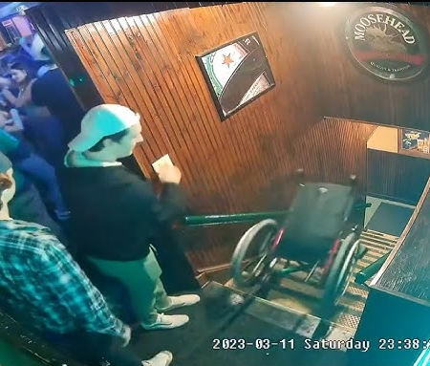
A.J.T. v. Osseo Area Schools, (USSC 2025)
Schoolchildren bringing claims related to their education under either the Americans with Disabilities Act or Section 504 of the Rehabilitation Act are not required to make a heightened showing of “bad faith or gross misjudgment” but instead are subject to the same standards that apply in other disability discrimination contexts.
Unanimous decision by Court
Same standard as applied to all section 504 or Title VI or IX claims

Slide 5

So Why Does It Matter?
Two bites at the Apple
Special education claims turn more to administrative complaints and lawsuits, especially more difficult claims
Lawsuits are more likely to add other claims, Title VI, Title IX, section 1983, claims against individual educators

Slide 6

School Choice and Special Education
Not just SB 10 anymore
Tax Credits will be the growing vehicle
Easier for a more affluent population to understand
Federal Tax Credits, Georgia has opted in, but procedures not yet clear
Funding consequences

Slide 7
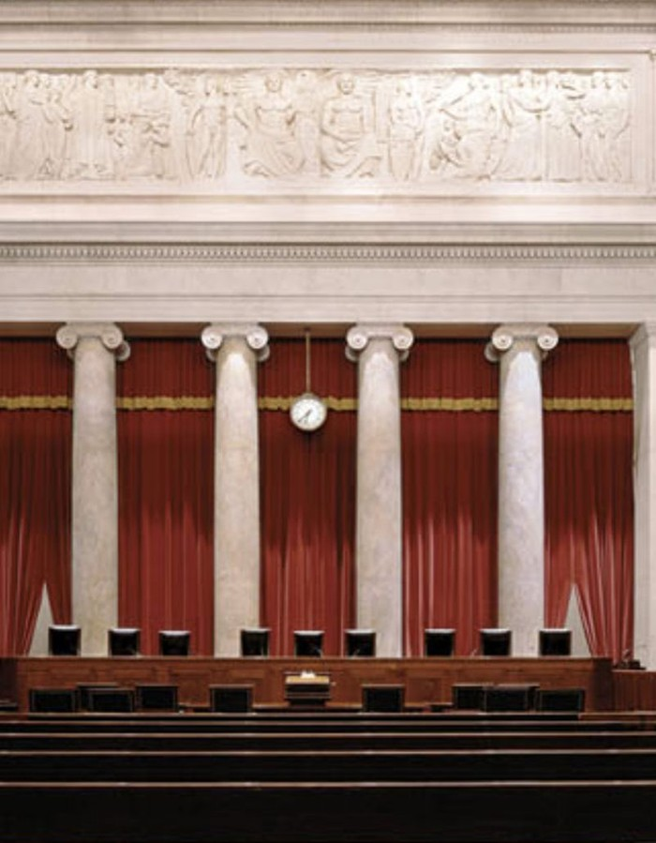
Mahmoud v. Taylor
“[W]e hold that the Board's introduction of the “LGBTQ+-inclusive” storybooks—combined with its decision to withhold notice to parents and to forbid opt outs—substantially interferes with the religious development of their children and imposes the kind of burden on religious exercise that Yoder found unacceptable.”
3 school districts being investigated for violating religious rights of parents, without a parental complaint

Slide 8

Mahmoud v. Taylor
The government’s operation of public schools is not a matter of “internal affairs” akin to the administration of Social Security or the selection of “filing cabinets.” It implicates direct, coercive interactions between the State and its young residents.

Slide 9
Littlejohn v. School Board of Leon County
2-1 decision in favor of the School District with four different opinions
Parents allege a substantive due process violation when school allowed 13-year- old student to express a gender identity and then develop a support plan without parent’s knowledge.
Under current law the question is whether the action of school officials “shocked the conscience” and the answer was no, by the majority
One member of the majority objected to the concept of substantive due process but admitted that existing precedent led to affirming of decision below, so-called concurring opinion actually dissents to this due process analysis
Dissent - The “right of parents to direct the upbringing of their children is among the ‘unalienable Rights’ with which the Declaration of Independence proclaims ‘all men . . . are endowed by their Creator.’”

Slide 10

O.C.G.A. 20-2-786 Georgia’s Parent Bill of Rights
(1) All parental rights are reserved to the parent of a minor child in this state without obstruction or interference from a state or local government entity, governing body, or any officer, employee, or agent thereof, including, but not limited to:
(A) The right to direct the upbringing and the moral or religious training of his or her minor child;
(B) The right to review all instructional materials intended for use in the classroom of his or her minor child;
(D) The right to access and review all records relating to his or her minor child, including, but not limited to, current grade reports and attendance records, unless otherwise prohibited by law;
This Photo by Unknown Author is licensed under CC BY-ND

Slide 11
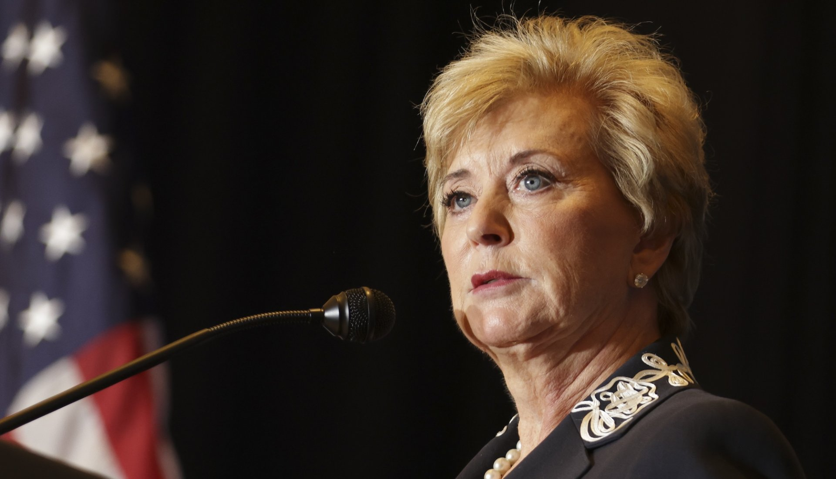

Slide 12
Recent Actions by USDOE/OCR
Drops appeal from Md. DC that DCL on DEI and certification requirement violated APA
Multiple Title IX investigations involving transgender issues including reimbursement rules and threats to funding in Va.
Any investigation is truly expedited
Beginning of move of certain staff to DOL

Slide 13
CB v. Henry County School District, (11th Cir. 2026)
Down Syndrome student in 4th grade moved by IEP team from resource class for academics to MI class
Parents object and bring due process action, instituting stay put
District court agrees with ALJ that move from one special ed class to another did not invoke LRE; appeal to 11th Circuit
11th Circuit agreed finding the challenge was more of methodology
“… the text of the IDEA makes clear that the least-restrictive-environment requirement applies only to the placement choice between a regular education class and a special education class—not to placement choices among different types of special education classes.”

Slide 14
Consequences of litigation, CB v. Henry County School District
“…since the parents obtained the stay put order when C.B. was entering the fifth grade, he has remained subject to the Georgia Milestones Assessment. By the time of this appeal, C.B. was seventeen years old and in the eleventh grade.”

Slide 15

Spencer v. Cherokee County School District, Ga. COA 2025
Parent sought to copy an entire book that was part of the sex ed curriculum under the ORA
Trial court’s summary judgment for the District reversed by the COA in 2-1 vote
“Specifically, the rights provided by the ORA are for personal inspection and copying of public records, without mention of copyright status. The federal
copyright law, on the other hand, protects the exclusive right of the copyright owner to reproduce, perform, distribute or display the copyrighted work.”
Think testing protocols
This Photo by Unknown Author is licensed under CC BY

Slide 16

BELIEVE IN PUBLIC EDUCATION

