Slide 1
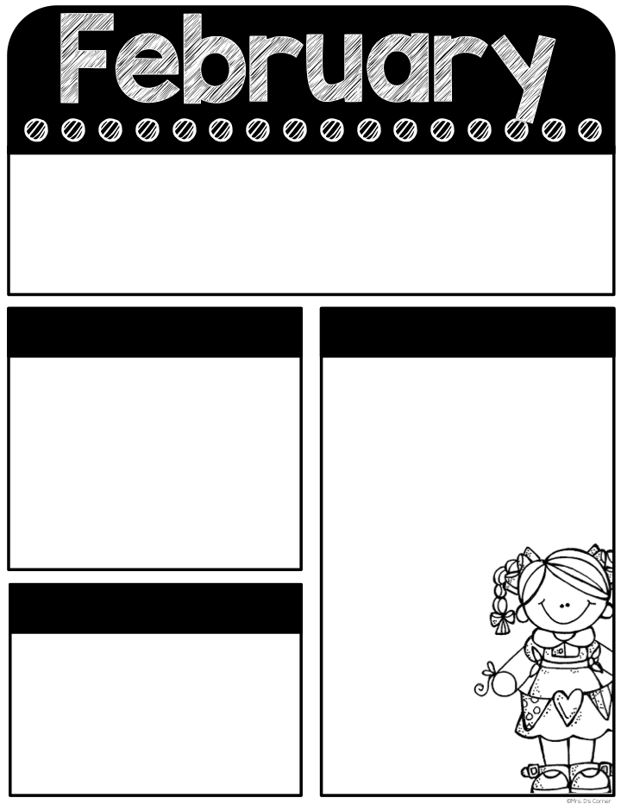
24-28
Classroom Reminders
Transportation changes must be in written form. No texts/emails/phone calls.
Don’t forget PE shoes every day.
Graded work will be sent home every Thursday and needs to be returned every Friday.
Don’t forget your car rider pro tag! The car rider line closes at 7:35 in the morning and 2:55 in the afternoon.
Tardy bell rings at 7:40. Students must be on time to receive breakfast in the classroom.
Please send a snack every day. If your child is purchasing snack, send in exact change ($1.50) daily.
If you have any questions, please don’t hesitate to contact me on remind. Have a great week!
Remind code: @holena2024
Mark your Calendar
What we’re learning
3/3- Wear Pajamas
3/4- Read Across America Shirt
3/5-wear blue
3/6- wear sunglasses
3/7-Dress as a book character/field trip money due
3/12- Spring pictures
3/13- Safari Field trip
3/14- ½ day
3/24 - 3/28- Spring Break
Math-
Place value (tens and ones), comparing quantities up to 100
Reading-
Phonics-
Review: vowel teams, suffixes, syllables, prefixes, abc order
New: long i spelling/gh and jobs of y
Tests this week:
Comprehension test
Math assessment
Sight Words
Again, round, they, country
Comprehension-
Fact/opinion
Grammar-
Possessive nouns,
Sentence types/compound sentences
Social Science-
Black History Month
Lives past/present/future
Helpful Hints
-When gh comes at the beginning of a word, it has the sound /g/ (ghost).
-When gh comes at the end of a word, it sometimes has the sound /f/ (laugh).
3-When the vowel i comes before gh, the i is long, and the gh is silent (high; night). This is the case for most gh words.
-When y is followed by one or two consonants, the vowel sound is short i. (gym)
-When y is alone at the end of a single-syllable word, the sound is long i. (fly)
Every Student Empowered. Every Student Succeeds.

