Slide 1
Welcome to Fifth Grade!
Pine Level Elementary School
2024-2025

Slide 2
Welcome Fifth Graders!
Fifth Grade is a year when students are able to build upon the foundation of reading and math skills and concepts they learned in fourth grade. They will also be encouraged to become more independent and responsible.
The information in this presentation will make you aware of various skills for language arts and math as well as personal and social responsibilities that students should have as they enter fifth grade.
Thank you for taking the time to review this presentation. We hope the information will be useful to you and your child.

Slide 3
Language Arts
Summarize the key details of stories, dramas, poems, and nonfiction materials, including themes or main idea.
Identify and judge evidence that supports particular ideas in an author’s argument to change a reader’s point of view.
Integrate information from several print & digital sources to answer questions & solve problems.
Write opinions that offer reasoned arguments and provide facts and examples that are logically grouped to support the writer’s point of view.
Write stories, real or imaginary, that unfold naturally and develop the plot with dialogue, description, and effective pacing of the action.
Engage fully and thoughtfully with others in classroom discussions (contributing accurate, relevant information; elaborating on the remarks of others; synthesizing ideas).
Report on a topic or present an opinion with his or her own words, a logical sequence of ideas, sufficient facts and details, and formal English
when appropriate.

Slide 4
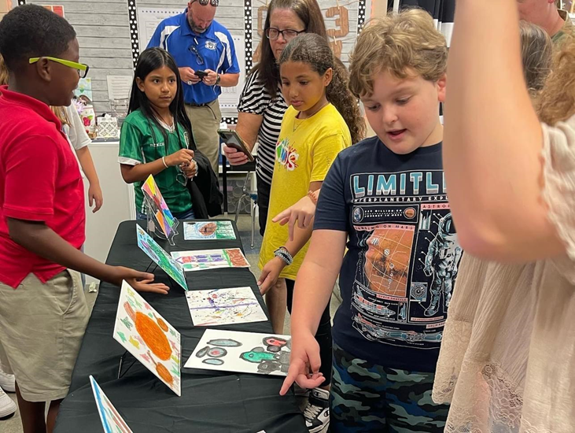
Language Arts (continued)
Expand, combine, and reduce sentences to improve meaning, interest, and style of writing.
Build knowledge of academic words with an emphasis on those that signal a contrast in ideas or logical relationships, such as on the other hand, similarly, and therefore.
Produce writing on the computer.
Read fiction and non-fiction daily.
Write complete and compound sentences with correct capitalization, spelling, and punctuation.
Write legibly in cursive.
Read for 45 minutes in one sitting without pause to build endurance.

Slide 5
Math
Add and subtract fractions with unlike denominators (e.g., 21⁄4 – 11⁄3), and solve word problems of this kind.
Multiply fractions; divide fractions in simple cases; and solve related word problems (e.g., finding the area of a rectangle with fractional side lengths; determining how many 1⁄3-cup servings are in 2 cups of raisins; determining the size of a share if 9 people share a 50-pound sack of rice equally or if 3 people share 1⁄2 pound of chocolate equally).
Generalize the place-value system to include decimals, and calculate with decimals to the hundredths place (two places after the decimal).

Slide 6
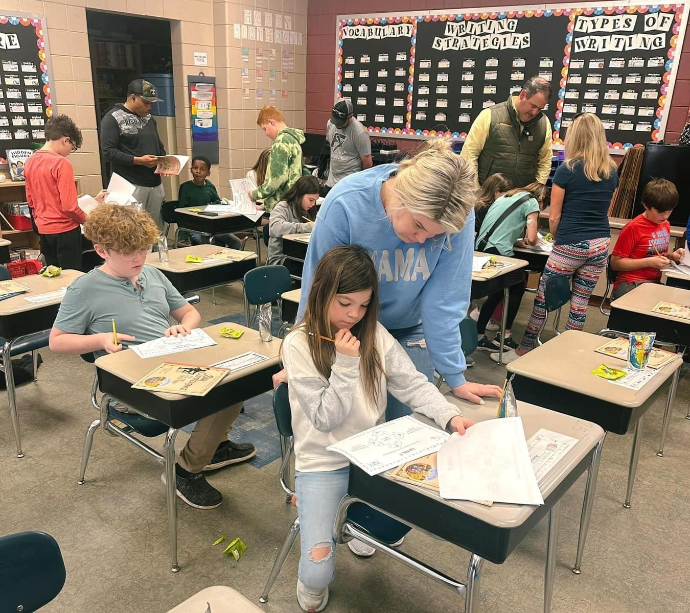
Math (continued)
Multiply whole numbers quickly and accurately, for example 1,638 × 753, and divide whole numbers in simple cases, such as dividing 6,971 by 63.
Understand the concept of volume, and solve word problems that involve volume.
Graph points in the coordinate plane (two dimensions) to solve problems.
Analyze mathematical patterns and relationships.

Slide 7
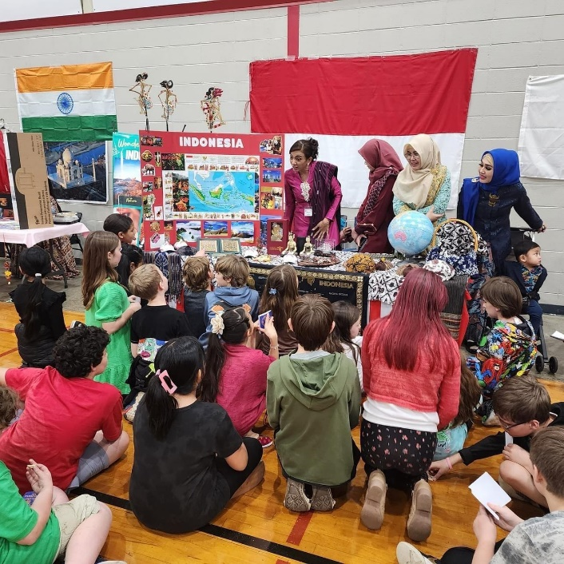
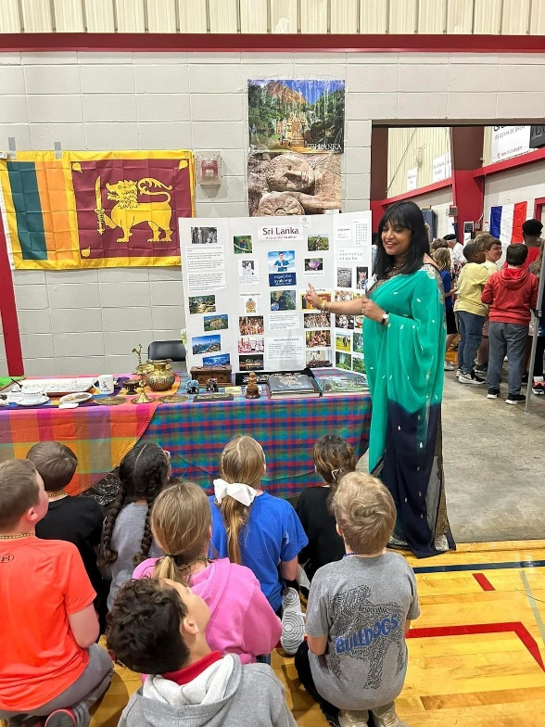
Personal and Social Responsibilities
Treat others kindly and with respect
Has a good attitude and is responsible for their learning
Listens and follows directions
Completes assignments in class and at home
Converses with others using the rules of listening, asking questions and waiting their turn to respond
Remains on task during independent work

Slide 8
Parent Expectations and Suggestions
Speak positively about school and staff. If you are excited about learning, your child will be too.
Communicates with teachers and signs weekly folder.
Take time to talk about the school day.
Help with homework.
Make sure student is prepared for school with needed items and supplies.
Make sure the student gets plenty of rest each night.
Makes attendance at school a priority.
Take time each day to talk to your child about anything and everything.
Have your child read independently every day. Ask them to tell you about the reading.

Slide 9
Expectations and Suggestions (continued)
Watch the news together and discuss it.
Urge your child to use logical arguments to defend his or her opinion.
Involve your child in activities and games that require listening and following directions.
Support your child’s independence and encourage responsibility by having them pack for a trip or weekend outing, care for belongings, help prepare meals, complete chores around the house, and assist with other everyday activities.
Provide opportunities to interact with other children.
Encourage work values such as effort, persistence, and initiative.

Slide 10
Back to School Event
Tentative Back to School Event: August 5th - 2:00-6:00 pm
First Day of School: August 7th
Open House: TBD

