Slide 1
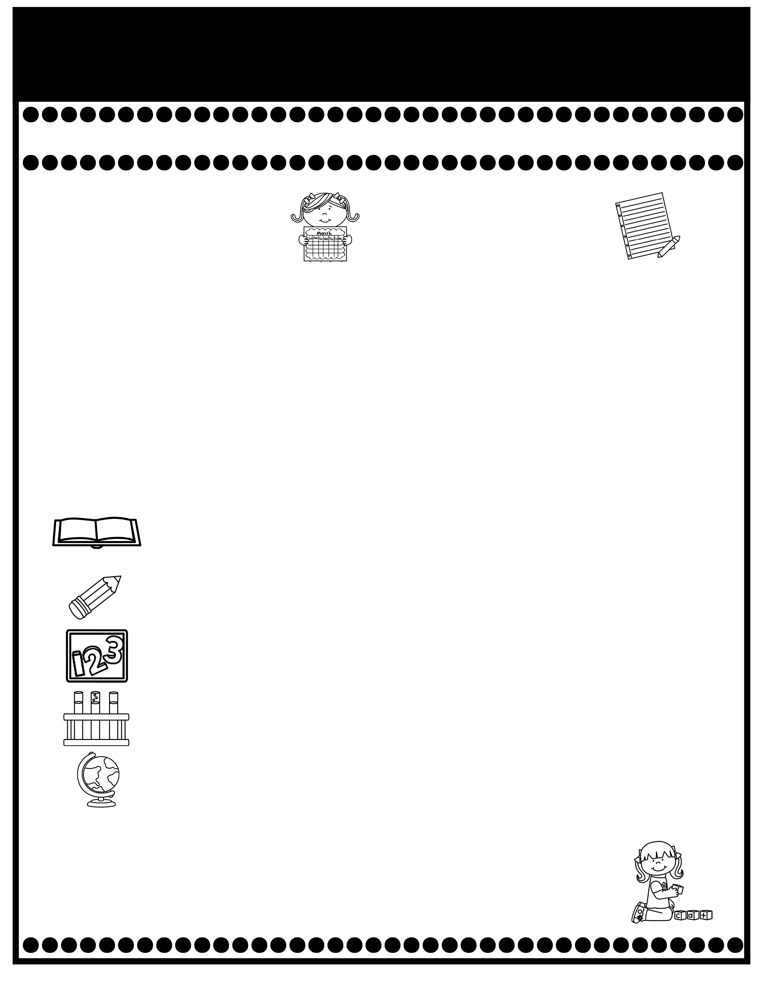
Branning’s Buzz
Week of: September 2-5, 2025
What’s Happening
This Week
Upcoming Events
Car riders will now dismiss at 2:50.
Pease check your child’s Take Home Binder for daily work and important information. Empty nightly.
Decodable Reader stories will be sent home in your child’s Take Home Binder after reading them in class. Please practice reading them with your child.
The cost for snack is $1.00 each. Please send the exact amount.
Sept. 2: Labor Day Holiday
Parents are now allowed to attend lunch for our classroom on Thursday from 11:54-12:19. The cost is $5.00.
September is our Attendance Challenge month. More information to come.
Sept. 8: Progress Reports
Sept. 8-12: Grits with Grandparents (Grandparents may come to eat breakfast with their grandchild. The cost is $4.00).
Sept. 19: Fall Pictures
If you have questions or concerns, you may email me at Wendy.branning@acboe.net.
A Peek At What We Are Learning
Reading | Phonics: a, i Review Sequence, Predicting, Cause & Effect This is a review week in reading. Please don’t complete 1.3 homework.
Writing/ Grammar | Singular & Plural Nouns
Math | Complete Topic 1: Understand Addition and Subtraction & begin Topic 2: Fluently Add & Subtract within 10 9/02 Topic 1 Test (Review pages were sent home Friday)
Science | We rotate Science and Social Studies.
Social Studies | Week 2: Rules and Laws
Spelling Words
No Spelling Test will be given until Unit 7.
.

