Slide 1
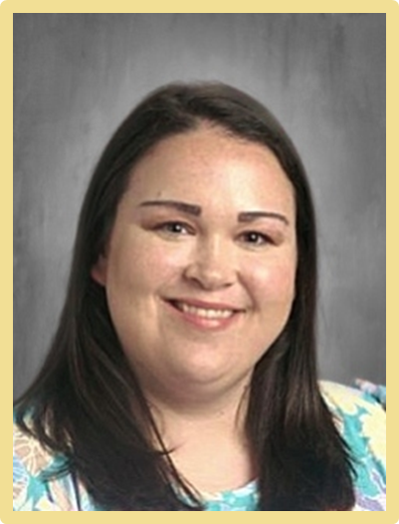
Mrs. Jessica Boler
Remind: text @bolermoore to 81010
Jessica.boler@elmoreco.com
My name is Jessica Boler. This is my 3rd year at WES and 5th year teaching PreK. I have a Bachelors degree from Mississippi State University in Human Development and Family Studies., and a Masters degree from The University of West Alabama in Early Childhood Education. My husband and I have been married for 5 years and have a daughter, Mary Kymbal, who is two years old. We have two dogs, Remi and Chipper. We are originally from Mississippi and are huge Mississippi State fans and attend many of their sporting events. We are members of FBC Prattville where we teach the 3 year old class on Wednesday nights. I cannot wait to meet you all and get this school year started! It is going to be a great year!
Favorites
Food: Chick-Fila
Drink: Loaded Tea or Fizz Co
Snack: Peanut butter crackers
Sweet: Reeses
Store: Target
Color: Teal

