Slide 1
erry High School 8th Grade Transition Night

Slide 2
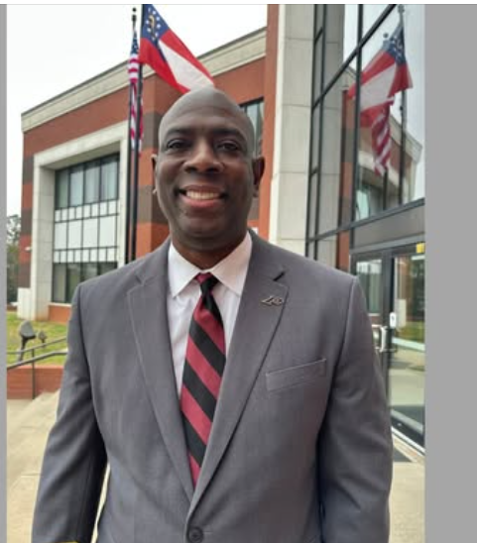
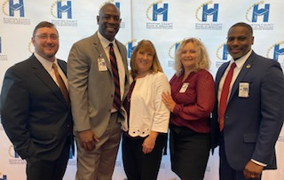
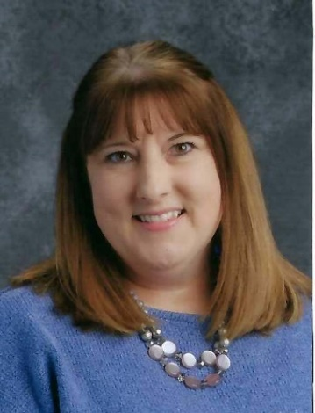
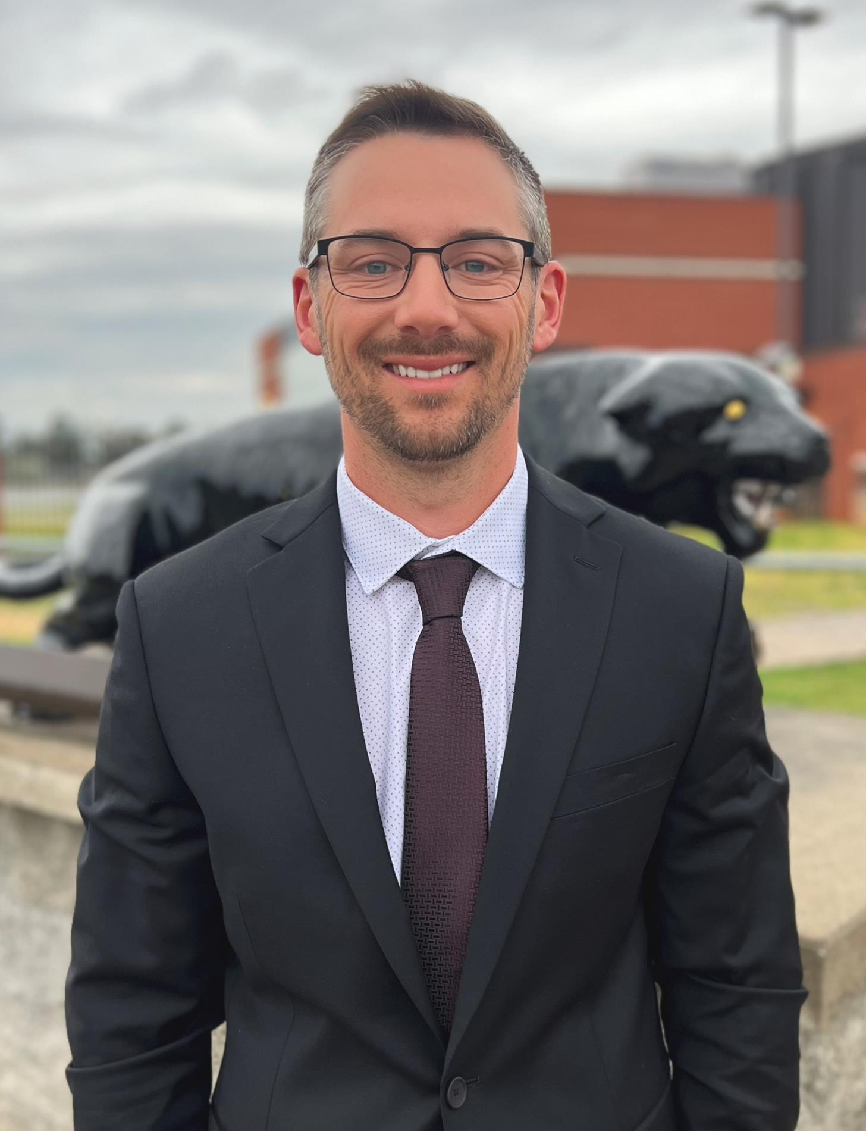
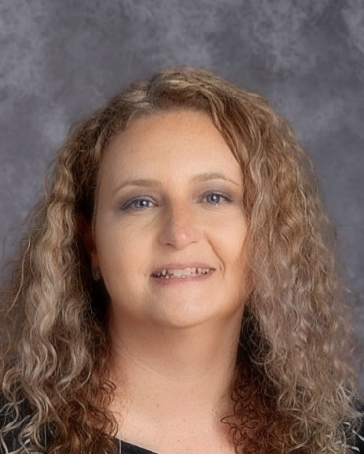
ADMINISTRATION
Dr. Arthur Billings
Principal
Mr. Jay Wood
Assistant Principal
CTAE Supervisor
(A-G)
Melisa Hunt
Assistant Principal
PBIS
(H-O)
Dr. Tyler Rodgers
Assistant Principal
Athletic Director
(P-Z)
Nicole Stone
Assistant Principal
of Instruction

Slide 3
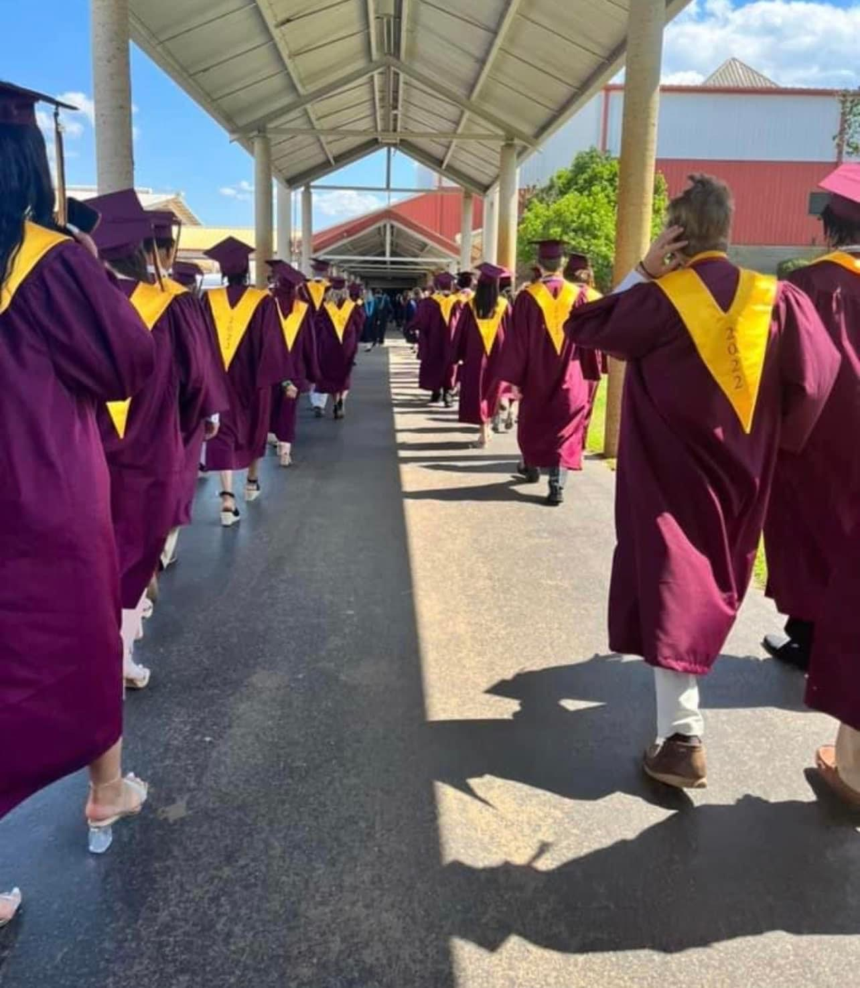
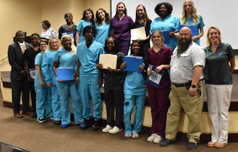

Slide 4
PBIS at PHS
Panther Cart
Student of the Month
Character
Celebrations
PANTHERS SHOW PRIDE BY BEING | Prepared | Respectful | Involved | Dedicated | The Standard of Excellence
COMMONS | ⇒ Maintain dress code ⇒ Be on time to class ⇒ No gathering | ⇒ Use respectful language ⇒ Use your inside voice and talk quietly ⇒ Be respectful of other people and their property | ⇒ Assist others if needed ⇒ Be attentive to posted information ⇒ Refrain from cell phone usage | ⇒ Keep it clean ⇒ Keep traffic moving ⇒ Use your time wisely | ⇒ Show appreciation and gratitude for faculty and staff ⇒ Attend tutoring sessions
HALLWAYS | ⇒ Maintain dress code ⇒ Keep it moving ⇒ Use locker responsibly ⇒ Have hall pass during class | ⇒ Use respectful language ⇒ Use your inside voice and talk quietly ⇒ Be respectful of other people and their property | ⇒ Assist others if needed ⇒ Be attentive to posted information ⇒ Refrain from cell phone usage | ⇒ Keep it clean ⇒ Keep traffic moving in correct direction ⇒ Walk at all times | ⇒ Be early to class ⇒ Greet others
CAFETERIA | ⇒ Maintain dress code ⇒ Know your lunch number ⇒ Have your account in order ⇒ Be prepared to leave on time | ⇒ Use respectful language ⇒ Use your inside voice and talk quietly ⇒ Wait your turn in line ⇒ Stay in assigned area | ⇒ Assist others if needed ⇒ Be inclusive and invite others to lunch ⇒ Report any misuse ⇒ Refrain from cell phone use until | ⇒ Keep it clean ⇒ Respect your environment ⇒ Clean up your space | ⇒ Show appreciation and gratitude for custodial and cafeteria staff ⇒ Say “Please” and “Thank You”
RESTROOMS | ⇒ Wash your hands ⇒ Sign out and have a hall pass if during class time | ⇒ Use restroom during transition time ⇒ Only go into bathroom when needed | ⇒Report any misuse ⇒Refrain from cell phone | ⇒ Keep it clean ⇒ Use nearest facility | ⇒ Show appreciation and gratitude for custodial staff
BUS | ⇒ Be prepared and prompt ⇒ Enter and exit the bus calmly ⇒ Remain in your seat | ⇒ Use respectful language ⇒ Use your inside voice and talk quietly ⇒ Listen to the bus driver / monitor | ⇒ Be attentive ⇒ Assist bus driver and others if needed ⇒ Adhere to the safety policies | ⇒ Keep aisle clean and clear ⇒ Dispose of trash ⇒ Maintain pride for bus property | ⇒ Show appreciation and gratitude for bus driver / monitors
Drawings and prizes
Get involved!

Slide 5
GRADUATION REQUIREMENTS
Class of 2029
- Each student will take 7 classes per
semester
In high school, each semester course is worth 0.5 units of credit
Students may earn up to 3.5 units a semester (7 x .5) or 7 units per year or 28 units in 4 years

Slide 6
Grade Point Average
A student’s GPA (Grade Point Average), used for college admissions and scholarships, begins when he or she enters the 9th grade.

Slide 7
Two main types of GPAs
Perry High School GPA
Includes an average of all classes taken in High School
Used for College Admission
HOPE GPA
Includes only Math, English, Science, Social Studies and Foreign Language
Used to determine eligibility for HOPE (3.0) and Zell Miller Scholarship (3.7) plus qualifying ACT or SAT
Calculated by the Georgia Finance Commission and can only be found at gafutures.org

Slide 8
Rigor to be Eligible for HOPE
Students must take 4 “rigorous” courses in order to be eligible for the HOPE scholarship. A list of rigor courses can be found on gafutures.org.

Slide 9
High School Grading Periods
Students will take 18-week semester courses
Progress reports for grades and attendance will be sent out at 6 weeks and 12 weeks.
Semester Final Grades will be posted on the transcript at the end of each semester (December and May).
Classes failed each semester must be made up or retaken. They are not averaged into previous semesters.

Slide 10
Grading Example
For example:
Biology A (first semester) 80
Biology B (second semester) 65
The student would have to retake only second semester of the course.

Slide 11
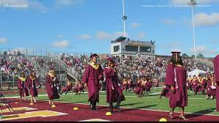
Graduation Requirements
4 units of English
4 units of Math
3 units of Social Studies
4 units of Science
3 units of Career Tech, Fine arts, and/or Foreign Language
1 unit of Personal Fitness/Health
5 additional elective credits
24 total credits

Slide 12
Sample 9th Grade Schedule
Foundations of Algebra, Algebra 1, Geometry
9th Grade Literature
Physical Science/Biology
Civics/World Geography
Health/Personal Fitness
One Elective Choice
Second Elective Choice
(AP Human Geography)

Slide 13
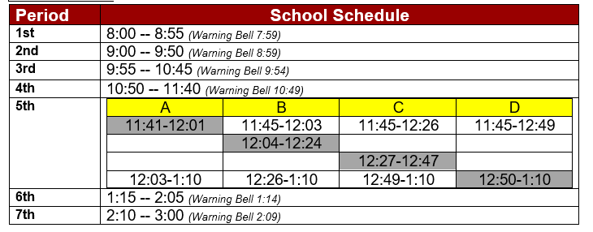
Sample 9th Grade Schedule

Slide 14
Panther Period/PAWS

Slide 15
Honors Program
Students in the honors program must take at least 1 honors class each year to remain in the program.

Slide 16
Testing
Select courses in each academic area will have End of Course Tests (EOC) that will count for 20% of their final course grade. Students must pass all courses containing an EOC.
Most freshmen will take 1 EOC
Algebra
MAP Testing is done
two times a year.
MAP Testing is important

Slide 17
Opportunities for Success
Tutoring-Based on the teacher’s scheduled days.
APT-After school and before school on Wednesdays.
PAWS
Saturday School 8:00-11:30 on specific Saturdays

Slide 18
Topics of importance
Infinite Campus –
Please check your student’s grades and attendance weekly!
Students have access to IC to monitor their own grades.
Accountability is an
important character
trait for Perry to start
teaching our students.

Slide 19
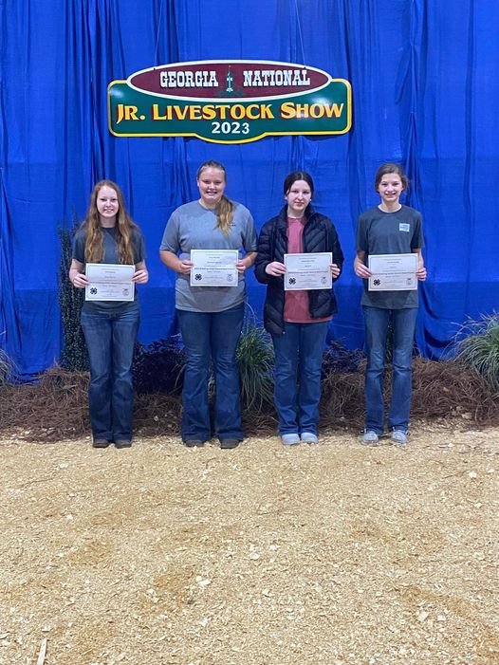
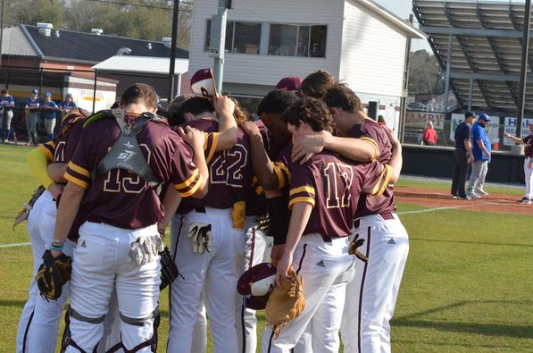
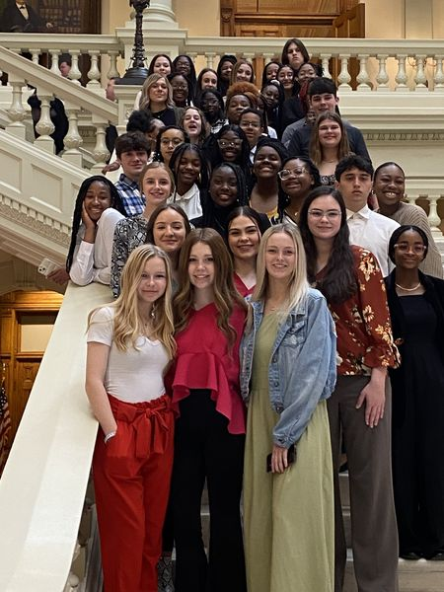
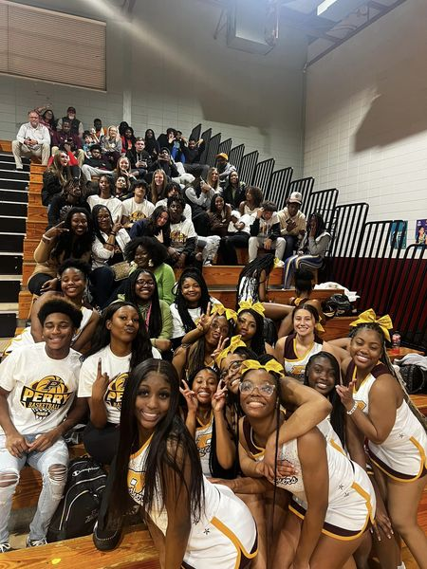
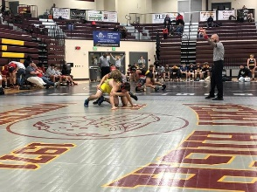
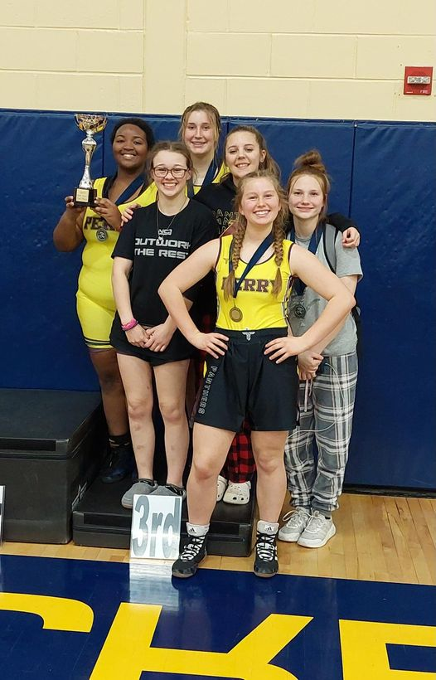
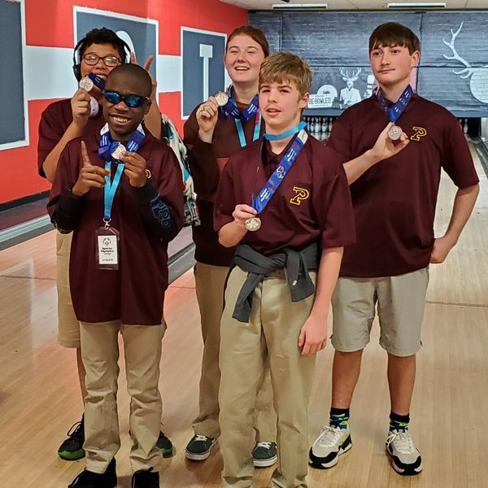
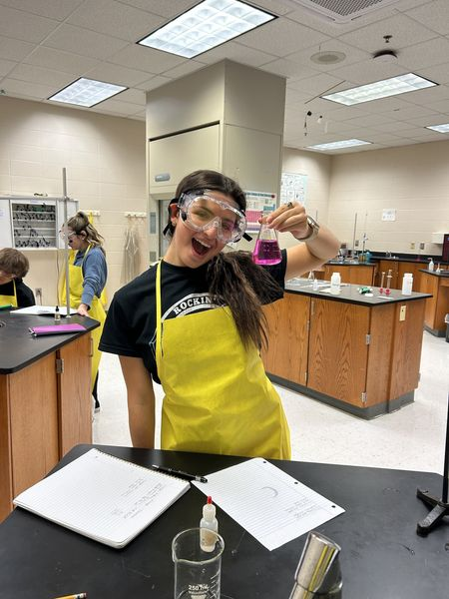
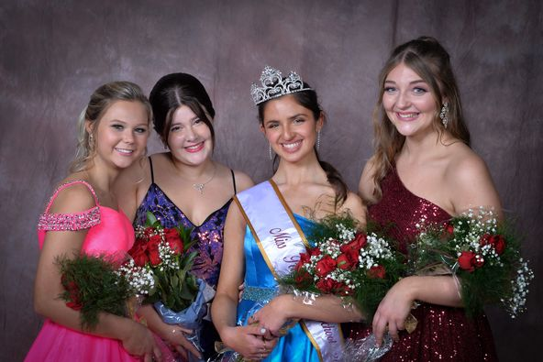
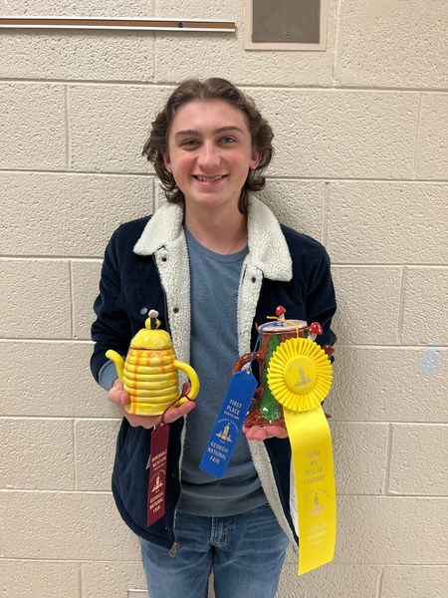
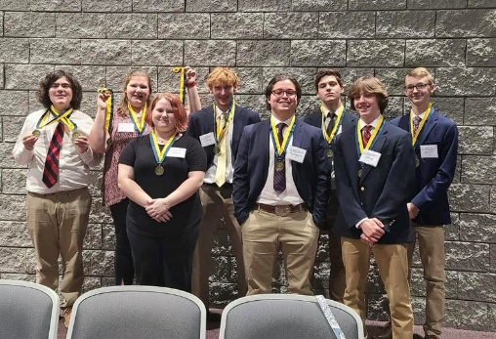
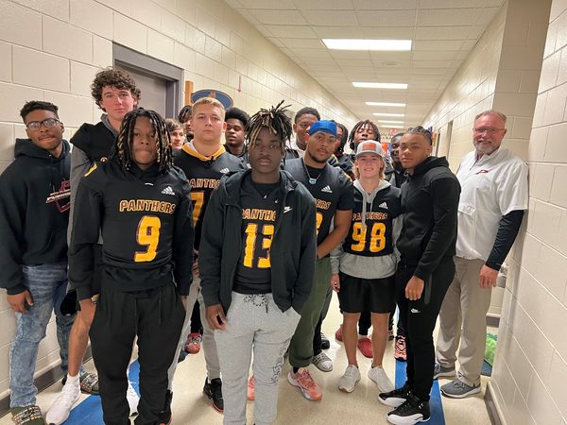
Get Involved

Slide 20
We are Perry! We are Proud! Just a few highlights of our year so far
FFA has won a plethora of state and local competitions
Our art program has won several state and local competitions
Theatre program has won state, region, and national awards
Our FCCLA has one several region and state awards
State and region awards in many of our athletic programs.
Our FBLA program has won several state and national awards.
Our football team has won several region championships and a state for 4A championship.
Our Airforce Raider team has been #1 in the nation
Our literary team won region this year.

Slide 21
High School Registration
Your student should have received a registration form from the middle school. This form asked your student to choose their academic and elective courses.

Slide 22
Deadline
Please return the registration form to your middle school or scan the QR code by March 21. We will also accept the forms tonight.

Slide 23
Registration Details

Slide 24
Electives at PHS

Slide 25
When Do I Get My Schedule?
All 2025-2026 freshmen and new students will be invited to receive their schedules before school starts and tour the school to find their classes. Ninth Grade New Student Orientation is on July 29th from 3:30-5:30.

Slide 26
Welcome Panthers
We are looking forward to having your student at PHS as a member of the Class of 2029!

