Slide 1
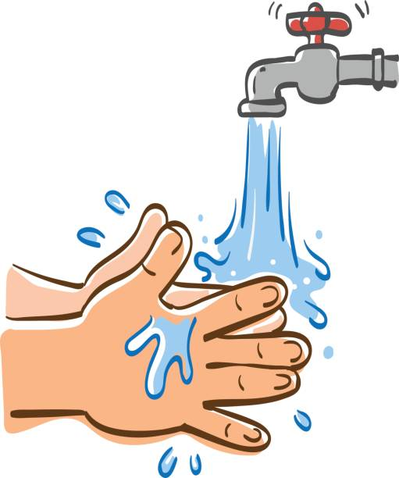
CONNECTING WITH THE
SCHOOL COUNSELOR
We are Learning!
Compassion -is when you show concern for others by caring for them with your words and actions.
(1st & 2nd grade)
Tattling –is when you are choosing to try to get someone else in trouble. (1st grade)
Reporting –is when you are choosing to try to get protect someone else or yourself from trouble.
(1st grade)
I-Messages –are positive ways to communicate how you are feeling and what you would like to happen. (2nd grade)
Children thrive on consistency, structure, and predictability. Develop a morning routine that looks the same each day to help get you and your kids out the door with a smile!
National Handwashing Awareness Week
December 5-11, 2024
Wash your hands with soap and clean water for at least 20 seconds. Be sure to get a good lather going and clean the back of the hands, between the fingers and under the nails. Dry them using a clean towel.
Happy, Healthy Kids TIP:
.
Let’s CONNECT!
Email: veronica.hardy@acboe.net
Phone: 334-365-6277 ext. 1216

