Slide 1

Annual Title 1 Meeting
August 19, 2026

Slide 2
What is a Title I School?
The purpose of Title I is to “ensure that ALL children have a fair, equal, and significant opportunity to obtain a high-quality education and reach, at a minimum, proficiency on challenging state academic achievement standards and state academic assessments.”
We are a School-Wide Title I program. We use a comprehensive reform model to assist ALL students and particularly the lowest achieving children to meet state academic standards.

Slide 3
How Title I Funds are spent?
Behavior Paraprofessional
Two Intervention Paraprofessionals
Family Engagement Liaison
Materials for Family and Parent Events
Reading Programs
Computers/Software
Books for Students

Slide 4

Northside Elementary is a schoolwide Title 1 School, therefore ALL students benefit from Title 1 resources.
What are our Title 1 schoolwide requirements?

Slide 5
Northside Elementary Schoolwide Goals
Increase the number of students reading and writing at or above grade level.
Increase the number of students performing math at or above grade level.
Build and sustain a positive, strong culture to support the whole child, create an effective learning environment, and increase the number of students attending positive behavior celebrations and practicing social-emotional skills.
Provide workshops and events that increase family involvement.

Slide 6
Programs to support our students:
Parent Resource Center
Accelerated Reader
Reflex Math
Positive Behavioral Intervention and Supports (PBIS)
Staff Professional Development

Slide 7
Our Educators and My
Right to Know
100% of teachers and paraprofessionals are highly qualified. Our teachers have met federal requirements for core academic subjects to provide the highest level of instruction.
Parents have the right to inquire about your child’s teacher training and credentials through our Director of Federal Programs.

Slide 8


What is the Purpose of Testing?
The Georgia student assessment program is designed to measure student achievement relative to the state-mandated content standards.
The purpose of testing is to:
  Identify students failing to achieve mastery of content.
  Provide teachers with diagnostic information.
  Help us identify strengths and weaknesses in order to establish priorities in planning educational programs.

Slide 9
What Tests Will My Child Take?
MAP Growth
Amira (reading fluency)
GMAS
Access for English Language Learners
Georgia Kindergarten Inventory of Developing Skills (GKIDS)

Slide 10
Law Requirements for Parent and Family Engagement:
The law requires a 1% set-aside of Title I Funds to be allocated for a District Parent and Family Engagement Coordinator.
Family Engagement Liaison
Technology to support Student Learning
Workshop materials
Conferences
Programs that will improve student achievement and include ways to help parents help their children succeed
Parent input in the development of a written Parent and Family Engagement Plan
Shared Decision-Making opportunities
Family Engagement Guidebook*
Parent and Family Engagement
School-Parent Compact

Slide 11
Family Engagement
Guidebooks and Compacts
Each grade level has a Title I Compact that lists our District goals, school goals, and areas of focus for each grade level. The compact describes the roles of NES, the family, and student, in order to achieve academic success.
Our FE Guidebook is available for your viewing on our school website. Once you reach the home page, hover under the Parents and Students tab and select ‘Family Engagement.’ You will find the FE Guidebook on this webpage.
You will be receiving the FE Guidebook Acknowledgement Form this week, which you’ll sign to acknowledge that you have accessed that document and read through it.

Slide 12
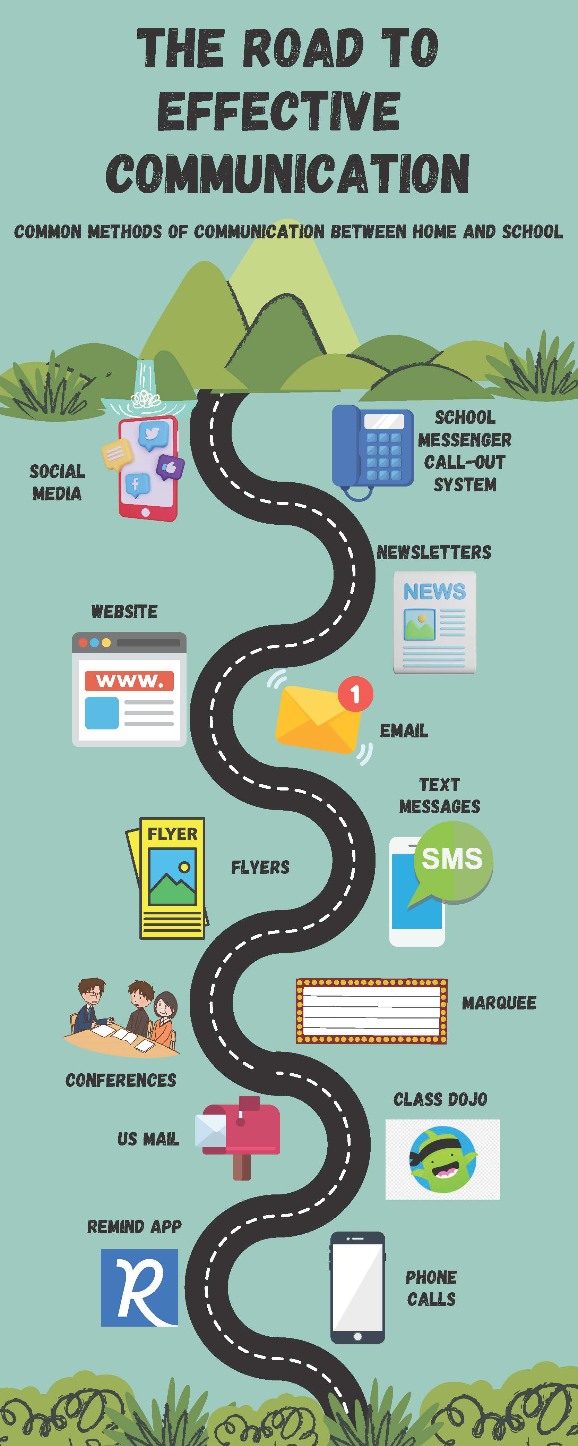
Staff Capacity for Parent and Family Engagement
Our staff participates each year in four professional development trainings designed to encourage Parent and Family Engagement.

Slide 13
Family Engagement Opportunities
Parent Teacher conferences
Shared Decision Meeting
Pastries with the Principal
Volunteering
School Council
Taco 'Bout Night
Grits and Grandparents
Math and Munchies
Fall Festival and Breakfast with Santa
Hispanic Heritage Night
Black History Night
Exceptional Children's Week
End of Year Student Showcase

Slide 14
Upcoming Events
Grits, Grandparents, and Books: is broken into two dates:
-Sept. 14 Kinder, 2nd & 4th grades
-Sept. 15 PreK, 1st, 3rd, and 5th grades
Hispanic Heritage & ESOL Night,
Sept. 24th
Fall Into Reading Oct. 29
Math & Munchies Nov. 5
A Night with Santa Dec. 3

Slide 15
Other Federal Programs
ESOL-Rosalin Rodrigues and Dalymarie Torres-Gonzalez
McKinney-Vento Homeless-Patricia Lane
Migrant Education-Araceli Ulmer

Slide 16


Bullying Information:
Bullying defined:
  An action that is clear, persistent, and pervasive.
  Always report! Don't wait!
  Anonymous Reporting
  Bullying can also be online, through notes, actions, on the bus... not just in the classroom.
  Safety and student/staff wellbeing is always number ONE.

Slide 17



Slide 18
Sexual Harassment
The program emphasizes: ​
-Protecting your body ​
-Keeping hands, feet, objects to yourself ​
-That harassment can be words, notes, motions, touches. ​
-Report! (If it happens to you or you see it!)

Slide 19
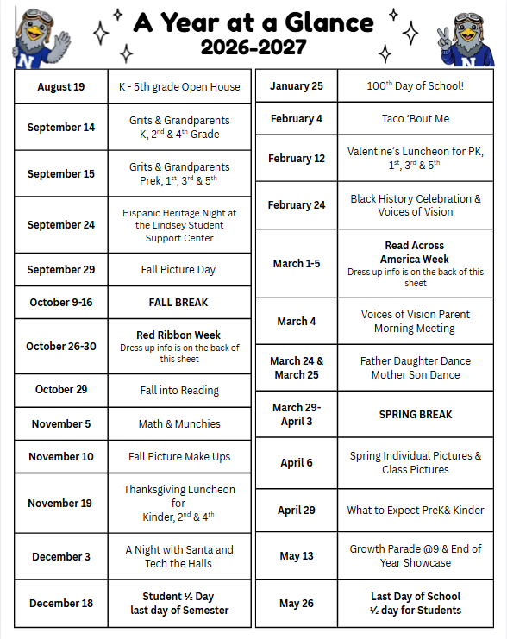
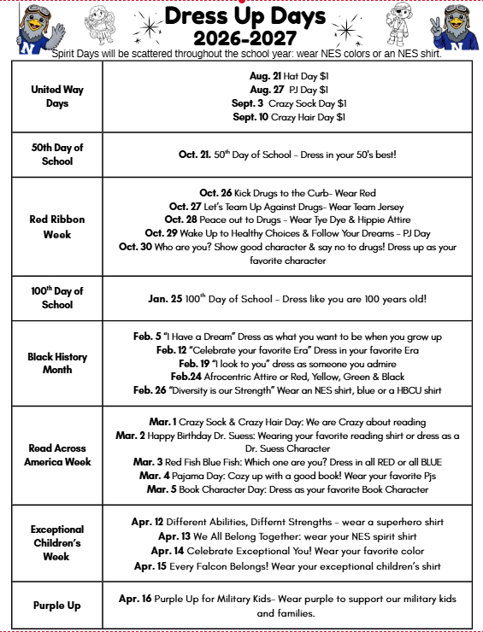

Slide 20

Contact Information
478-929-7816
Dr. Kristina Cummings, Principal
Ms. Cristina Betancourt, Assistant Principal for Instruction
Ms. Rachada Page, Assistant Principal for Discipline
Alex Randall, Family Engagement Liaison,
alex.randall@hcbe.net , 478-929-7816 ext.2563

Slide 21
Introductions
Current School Needs
  Playground shade initiative
Fundraising Opportunities
  Sponsorships
  Donations
  Additional fundraising ideas
Student Support
  Santa Shop
  School Spirit Store
PTO Meeting
Staff Support
  Jolly Trolley
  Teacher and Staff Appreciation
  Classroom needs and volunteer opportunities (Frosty Fridays, Dances)
Communication
  PTO announcements and member updates
PTO Committees
  Fundraising
  Event Volunteers
  Classroom Helpers
  Other volunteer opportunities

