Slide 1
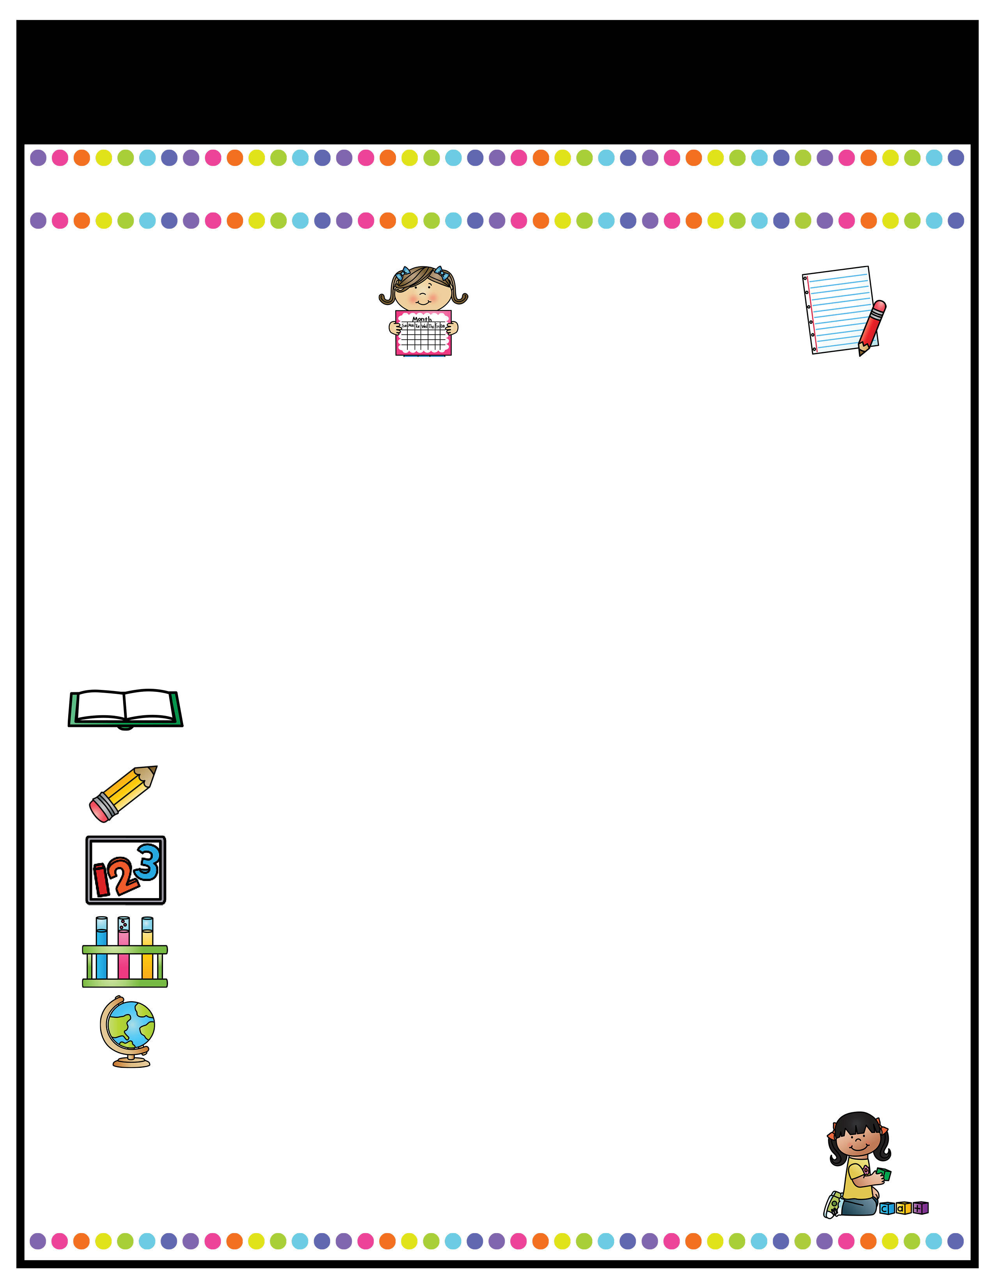
Our Classroom News
Week of: August 15 - 19th
What’s Happening
This Week
A Note From
Mrs. Cook
Math- Topic 1: Understanding Addition & subtraction
1-1: Add to
1-2: Put Together
1-3: Both Addends Unknown
1-4: Take From
1-5: Compare Situations
Science/Social Studies:
All about me, Leader In Me: Habits 1-5
Aug. 19- Sink-a-palooza money due​
Aug. 20- Sink-a-palooza 11-2:00 ​
Aug. 30- Curriculum Night​
A Peek At What We Are Learning
Language Arts: Kindergarten Review -Review of letter shape and sounds letters A-M -Developing new vocabulary- sport, sway, stew, doodle, glide, sails, cherish, lovely, drools, whines, annoys -Distinguish between Author/Illustrator -Make a class alphabet book -Introduce rules & expectations during “workshop time”
Check RED binders DAILY for notes, behavior problems, and classwork. Please sign up for my Remind if you have not done so already! This will be the main form of communication. Our "Classroom News" will come home every Monday with homework and should be completed and returned by Friday.

Slide 2

Our Classroom News
Week of:
What’s Happening
This Week
A Note From
Mrs. Jones
Type event here.
Type event here.
Type event here.
Type event here.
Type your teacher note here.
A Peek At What We Are Learning
Reading | Type your information here.
Writing | Type your information here.
Math | Type your information here.
Science | Type your information here.
Social Studies | Type your information here.
Spelling Words
Type your weekly spelling words here.

Slide 3

Our Classroom News
What’s Happening
This Week September 5th – 8th
A Note From
Mrs. Cook
*September 7th – Mrs. Cook's Birthday
*We are learning How to lead in and out of School
and to have a Growth Mindset as part of our
Leader in Me curriculum.
*Homework Attached: Math sheet on Doubles, Reading sheet on rhyming and Decodable stories that your child should read to you each night with fluency and ease for practice with skills and words we have previously learned.
Progress Reports come home Wednesday, Sept. 6th
*I have completed beginning of the year testing with all of the students. I will send home a letter this week letting you know where your child placed depending on STAR Early Literacy test, Kindergarten sight words, Letters/Sounds, and classroom observations.
ATTENDANCE CHALLENGE: No tardy’s, no check-ins, no check-outs = A POP IT BRACELET this week!
A Peek At What We Are Learning
Reading | Review sounds /s/ /h/ /t/ /a/ /i/ /t/ /p/ /n/ /l/ /o/ /b/ /d/ Sight Words: and to for him said can the has
Writing | Handwriting Practice
Math | Topic 2 (Facts with 5 on a ten frame, add in any order, count back to subtract on a number line, think addition to subtract
Language Arts | Singular and Plural Nouns (hat – hats, pig – pigs)
Social Studies | Leader in Me & Science (My 5 Senses continued)
Mark your calendar:
Friday, September 8th – SPECIAL SNACK $1.00 SLUSHIES
Thursday, September 14th will be our classes Parent Lunch Day from 10:50 – 11:25. You are invited to come eat lunch with your child. No outside food from restaurants is allowed.

Slide 4
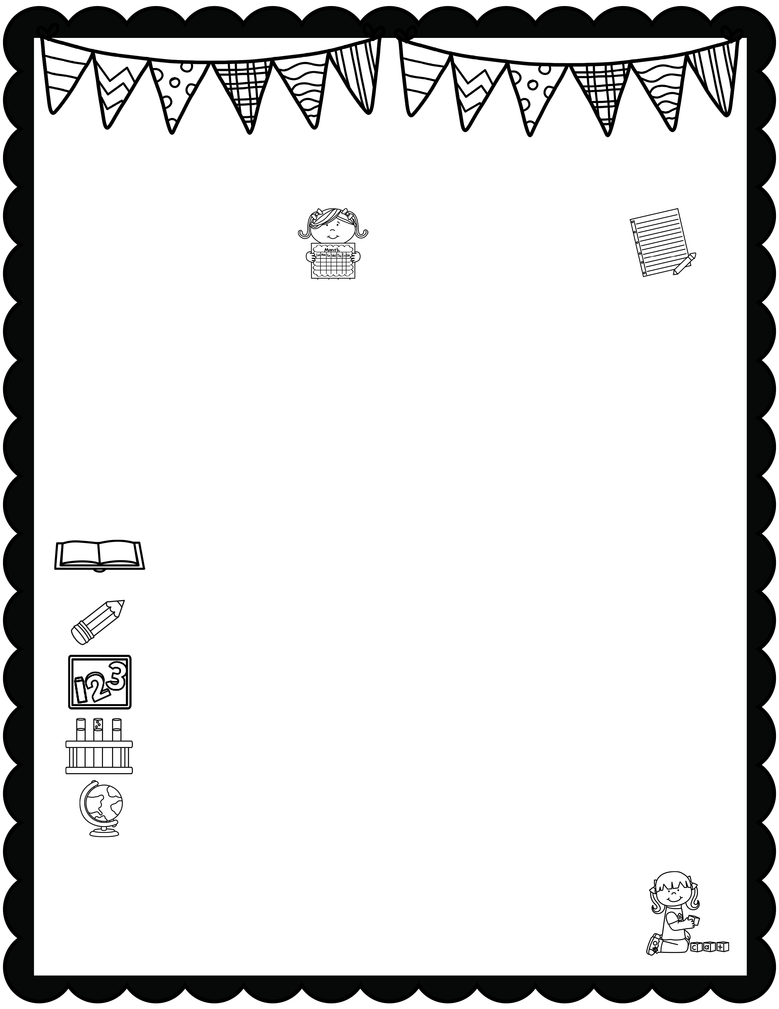
January News
What’s Happening
This Month
A Note From
Mrs. Jones
Type event here.
Type event here.
Type event here.
Type event here.
Type your teacher note here.
A Peek At What We Are Learning
Reading | Type your information here.
Writing | Type your information here.
Math | Type your information here.
Science | Type your information here.
Social Studies | Type your information here.
Spelling Words
Type your weekly spelling words here.

Slide 5

Our Classroom News
Week of:
What’s Happening
This Week
A Note From
Mrs. Jones
Type event here.
Type event here.
Type event here.
Type event here.
Type your teacher note here.
A Peek At What We Are Learning
Reading | Type your information here.
Writing | Type your information here.
Math | Type your information here.
Science | Type your information here.
Social Studies | Type your information here.
Spelling Words
Type your weekly spelling words here.

Slide 6

Our Classroom News
Week of:
What’s Happening
This Week
A Note From
Mrs. Jones
Type event here.
Type event here.
Type event here.
Type event here.
Type your teacher note here.
A Peek At What We Are Learning
Reading | Type your information here.
Writing | Type your information here.
Math | Type your information here.
Science | Type your information here.
Social Studies | Type your information here.
Spelling Words
Type your weekly spelling words here.

Slide 7

January News
What’s Happening
This Month
A Note From
Mrs. Jones
Type event here.
Type event here.
Type event here.
Type event here.
Type your teacher note here.
A Peek At What We Are Learning
Reading | Type your information here.
Writing | Type your information here.
Math | Type your information here.
Science | Type your information here.
Social Studies | Type your information here.
Spelling Words
Type your weekly spelling words here.

Slide 8

January News
What’s Happening
This Month
A Note From
Mrs. Jones
Type event here.
Type event here.
Type event here.
Type event here.
Type your teacher note here.
A Peek At What We Are Learning
Reading | Type your information here.
Writing | Type your information here.
Math | Type your information here.
Science | Type your information here.
Social Studies | Type your information here.
Spelling Words
Type your weekly spelling words here.

