Slide 1


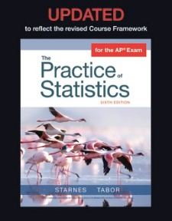
SUPPLY LIST
Charged Chromebook
TI-84+ Calculator
Paper
3 Ring Binder
Colored pencils
Google Classroom Code:
xosguwn
b3rw5bu
Textbook:
The Practice of Statistics,
Starnes, Tabor, Yates, & Moore
AP STATISTICS
Mrs. Jennifer Arnold
Room 801
Jenniferm.arnold@carrollcounty schools.com
GRADING POLICY
60% Tests and Quizzes
40% Daily Grade (Topic quizzes, Textbook problems)
Any work that is not turned in by the due date/time will incur a 30 point penalty per day (NO EXCUSES take a picture and email it)
CLASSROOM EXPECTATIONS
Self-motivated
Work independently and cooperatively
Read and write technical mathematics
Persistent practice of concepts
Keep up with the pace of each chapter schedule
Near perfect attendance
Adherence to CHS and classroom policies
RETAKES
Students may retake a chapter test given the following conditions have been met:
All textbook problems completed and turned in ON TIME
All AP Daily videos have been completed for the Unit
AP Exam:
MAY 8th 2025
Notes:
http://www.teacherspayteachers.com/Store/The-Enlightened-Elephant

