Slide 1
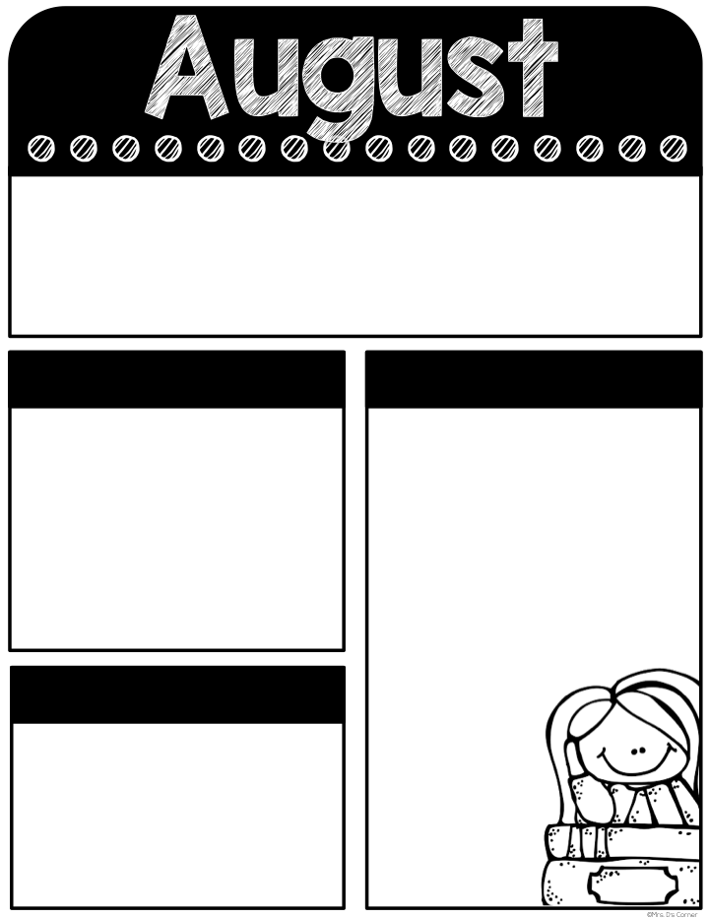
Every Student Empowered. Every Student Succeeds.
August
21-25
Classroom Reminders
Transportation changes must be in written form. No texts/emails/phone calls.
Don’t forget PE shoes every day.
Graded work will be sent home every Thursday and needs to be returned every Friday.
Don’t forget your car rider pro tag! Car rider line closes at 7:35 in the morning and 2:55 in the afternoon.
Tardy bell rings at 7:40. Students must be on time to receive breakfast in the classroom.
Please send a snack every day. If your child is purchasing snack, send in exact change ($1.50) daily.
Please return all paperwork and class fees ASAP!
If you have any questions, please don’t hesitate to contact me on remind. Have a great week!
Remind class code: @holena23
Mark your Calendar
What we’re learning
8/31-Picture Day
9/1- fundraiser shirt money due
9/4 - Labor Day (No school)
9/14 – Parent Report Day
10/2 - Picture retakes
10/6- End of First Quarter (1/2 day for students)
10/9 - 10/10- Fall Break
10/19 - Report Cards
Math-
Writing numbers to 20, number words, representing a number, patterns, and addition to 10
Reading-
Phonics- review of Kindergarten skills (focus letters- f, p, o, c, h),
Social Science-
All about my family
Tests this week:
Math- numbers to 20, adding to 10, patterns
ELA- Listening comprehension
Helpful Hints
Things to review at home:
Counting to 100 by 1’s and 10’s
recognizing shapes
naming all letters and sounds
High frequency words, color words, and number words
Writing first and last name
Most Common Words
Number words: one, two, three, four, five, six, seven, eight, nine, ten

