Slide 1
Segregation and Discrimination in the South

Slide 2
Reconstruction
After Civil War, the U.S. Army stayed in the South from 1865-1877.
Blacks had voting rights and a say so in political power.
Mississippi had the first black Congressman and mayor in the country.
Most blacks voted Republican at the time. (Abraham Lincoln’s Party)
Most black southerners were sharecroppers.
Sharecropping was an economic system designed to keep people in debt.
Many poor whites were sharecroppers as well.
Congress added the 13th, 14th, and 15th amendments to the Constitution.
There were several violent events that occurred in the South.

Slide 3
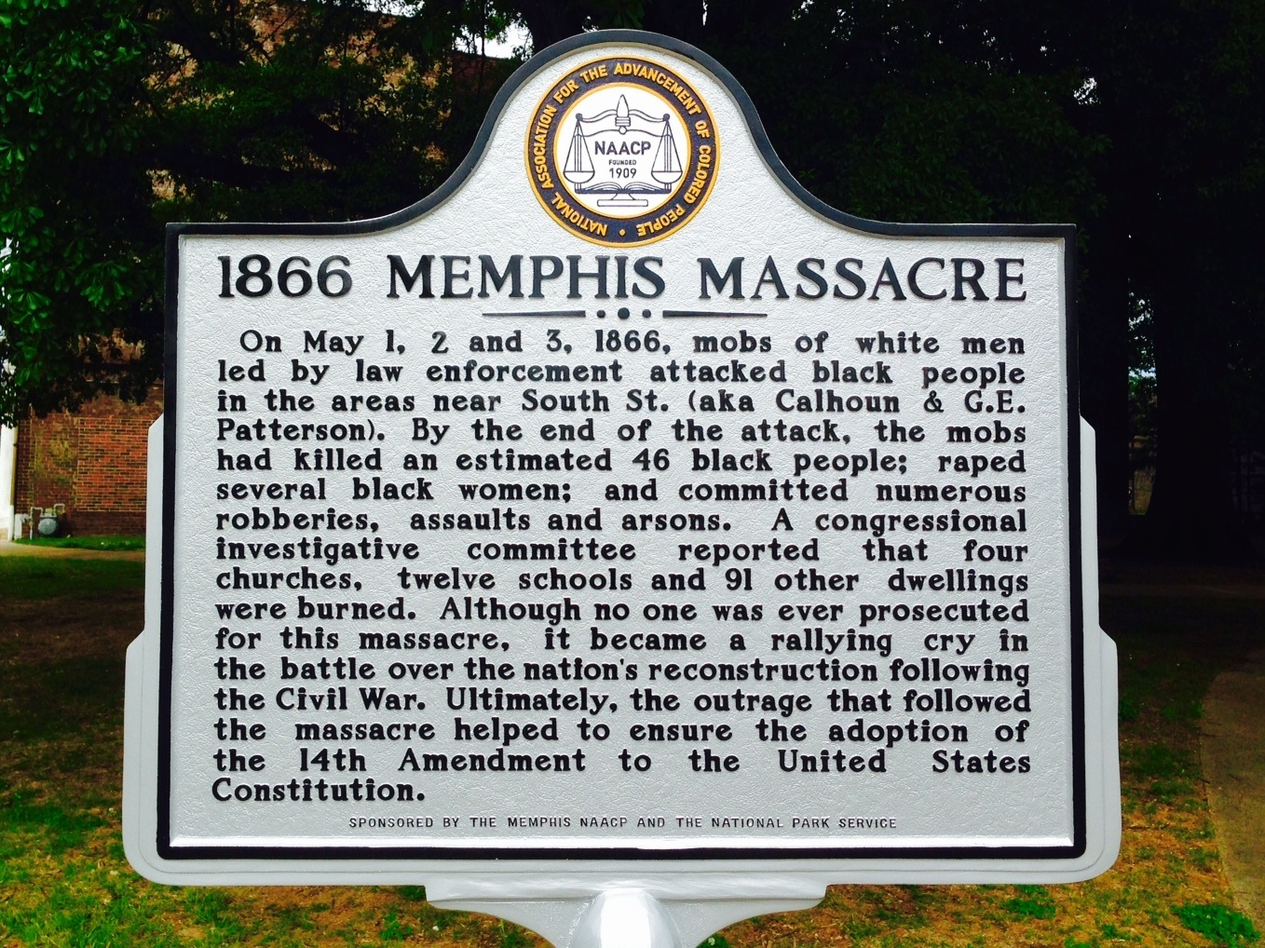
The Memphis Massacre

Slide 4
After Reconstruction
African Americans in the South begin to have their political power weakened.
Southern states imposed new voting restrictions and denied legal equality.
States did this by changing their state constitution. In Mississippi, it happened in 1890.

Slide 5
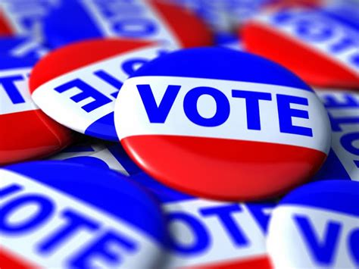
Black Voters Disenfranchised
Literacy test – limiting the vote to people that could read, the tests were often unfair
Poll tax – annual tax that had to be paid to vote, also affected poor whites.
Grandfather clause – stated that if a man could still vote if his father or grandfather was eligible to vote before Jan 1st, 1867.

Slide 6
Jim Crow Laws
Laws that segregated people in public places based on race.
de facto vs de jure
There were also a series of unwritten rules and customs that blacks were expected to follow.

Slide 7
Plessy v. Ferguson – 1896, Supreme Court case that ruled “separate but equal” facilities were legal. This decision basically legalized segregation for almost 60 years.

Slide 8
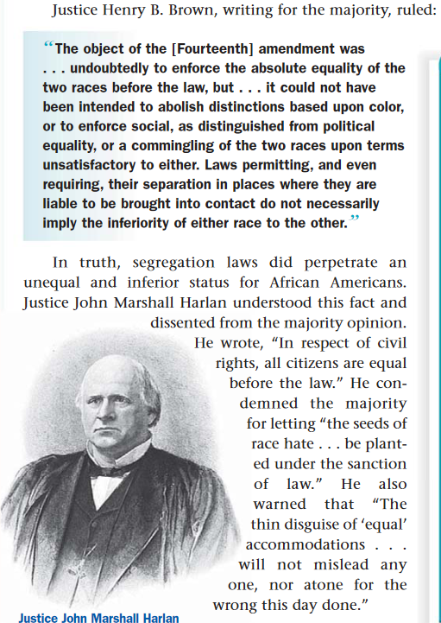
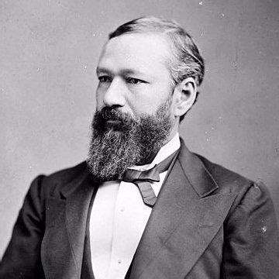
Plessy v. Ferguson
Homer Plessy

Slide 9
Lynching
Lynching – mob murder
1882-1892, about 1400 African Americans were lynched in the South

