Slide 1
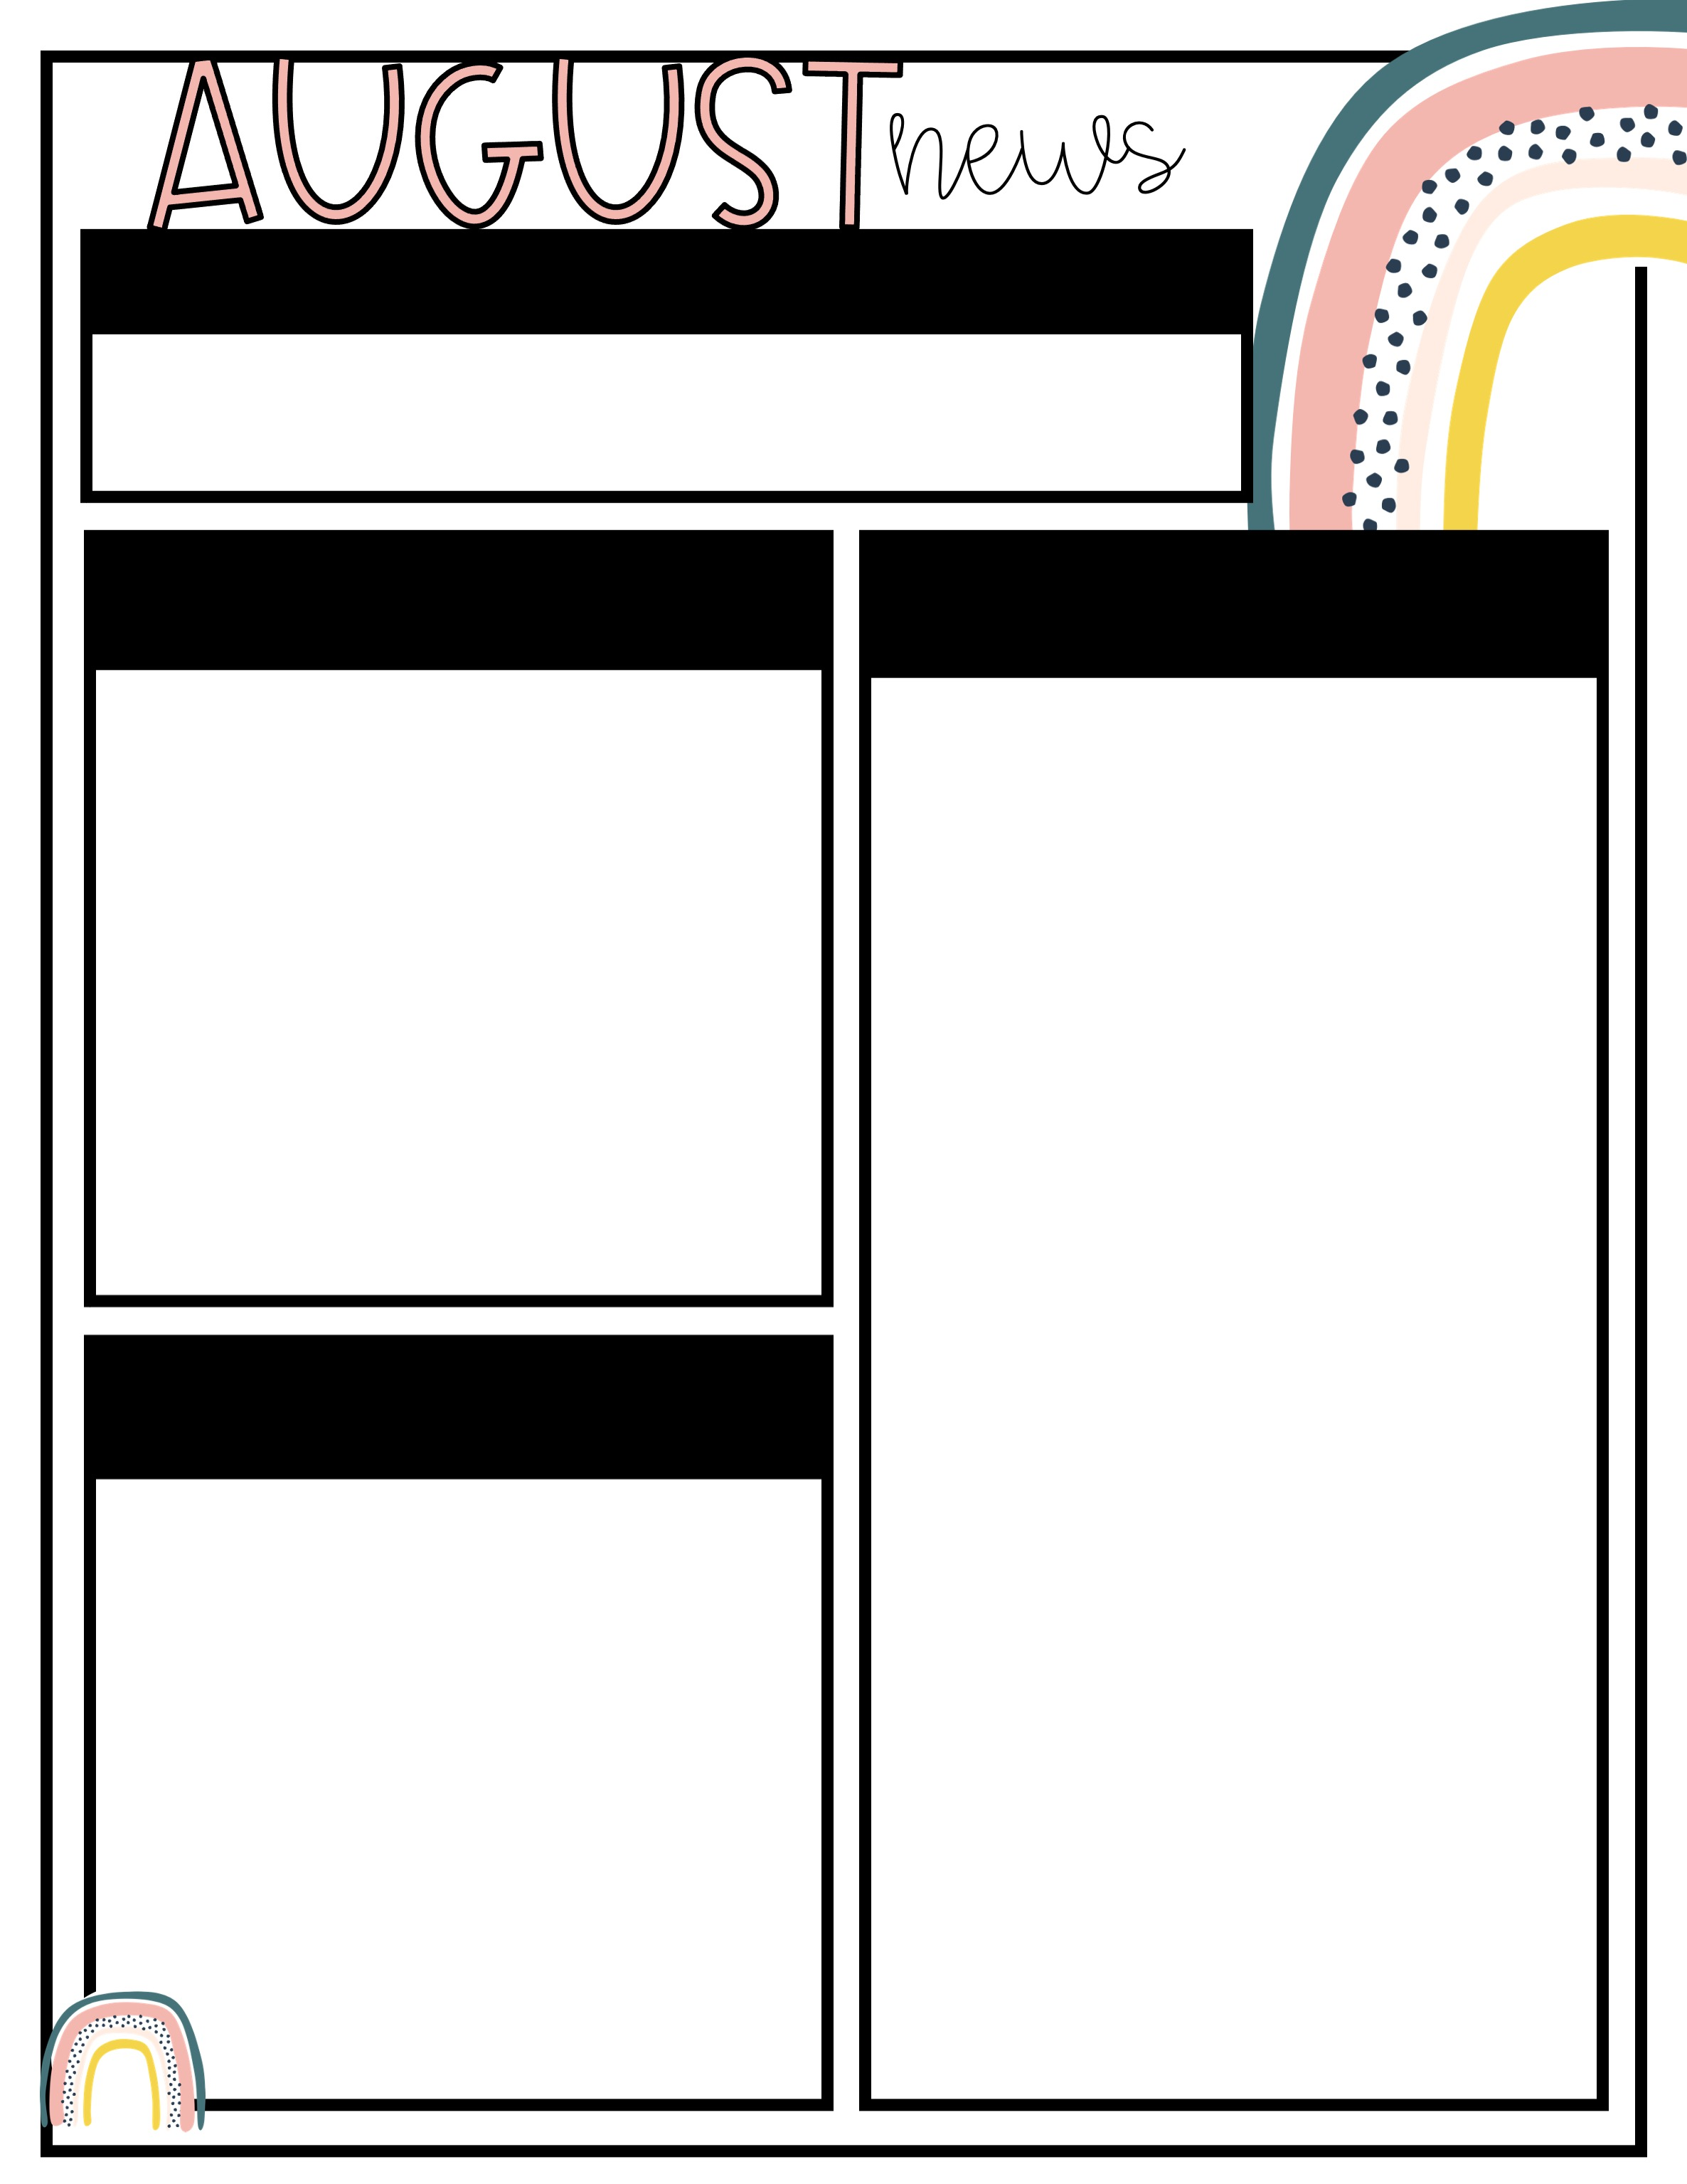
September 2 – September 6
Please contact me through Parent Square or email me at stephanie.rowell@acboe.net.
Assessments
What We’re
learning
NO ELA assessments this week
Friday, September 6th – Math Topic 2 Assessment
ELA
Writing: Opinion Writing
Math
Topic 2 Work with Equal Groups
- Lesson 4 Make Arrays to Find Totals
- Lesson 5 Problem Solving: Model with
Math
Science
* Land and Water
Important
dates
Friday, Sept. 6th – Grandparent Picnic 12:07 p.m.
Friday, Sept. 6th – Hat Day for students with perfect attendance
Monday, Sept. 8th – Open House
5 – 6:30

