Slide 1
DAILY MATH REVIEW
Math 8
BM# 1
Week 1

Slide 2
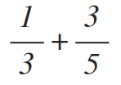
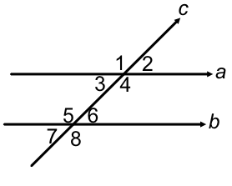
Week 1, Day 1
Simplify:
Simplify:
What is 23% of 80?
Using the image, name a pair of corresponding angles.
Simplify:

Slide 3
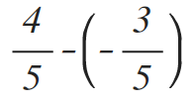
Week 1, Day 2
Simplify:
Simplify:
What is 60% of 120?
If ∠1=108°, what is ∠2? Explain your answer.

Slide 4
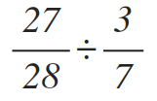
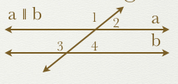
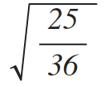
Week 1, Day 3
Simplify:
Simplify:
What is 9% of 110?
If ∠1=120°, what are angles 2, 3, and 4?

Slide 5
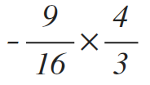
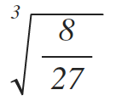
Week 1, Day 4
Simplify:
Simplify:
What percent is 20 of 150?
Using the image, name the alternate interior angle pairs.

Slide 6
Friday Five
Simplify:
Simplify:
What is 23% of 80?
If ∠1=108°, what is ∠2? Explain your answer.

Slide 7
DAILY MATH REVIEW
Math 8
BM# 1
Week 2

Slide 8
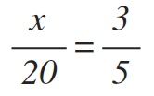
Week 2, Day 1
Simplify:
Solve the proportion:
If x = 12 and y = 15, evaluate the following:
Find the missing angles in the diagram:
Simplify:

Slide 9
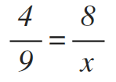
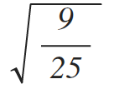
Week 2, Day 2
Simplify:
Solve the proportion:
Solve for x: x² = 225
Find the measure of ∠4. Justify your answer by stating the angle relationship.
Simplify:

Slide 10
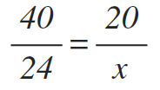
Week 2, Day 3
Simplify:
Solve the proportion:
If x=9 and y=10, what is x² - y?
Find the measure of ∠x. Justify your answer by stating the angle relationship.
Simplify:

Slide 11
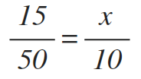
Week 2, Day 4
Simplify:
Solve the proportion:
If x=3 and y=5, what is -x² + y²?
Find the measure of ∠3, if ∠5 is 110°. Justify your answer by stating the angle relationship.
Simplify:

Slide 12
Friday Five
Simplify:
Solve the proportion:
Solve for x: x² = 225
Find the missing angles in the diagram.
Simplify:

Slide 13
DAILY MATH REVIEW
Math 8
BM# 1
Week 3

Slide 14
Week 3, Day 1
Simplify:
Identify the pairs of alternate exterior angles.
Jane has a square side table that has an area of 256 square inches. What is the length of each side of the table?
Between what two integers is ?
Estimate to the nearest tenth.

Slide 15
Week 3, Day 2
Simplify:
What are the measures of angles 1 and 2?
Tarzan finds a large box full of gadgets that has a volume of 27 cubic feet. What is one side of the box?
Between what two integers is ?
Estimate to the nearest tenth.

Slide 16
Week 3, Day 3
Find the value of 3x² - 24x, when x = 3
What are the measures of angles 1 and 7?
Terk found 25 tiles and is putting together a playhouse for her and her friends. Each tile has an area of 36 square inches. What are the dimensions of the square floor ?
Estimate the value of:
Estimate to the nearest tenth.

Slide 17
Week 3, Day 4
Find the value of x² + 3x, when x = -9
What are the measures of angles 4 and 6?
A cube has a volume of 729 cubic inches. What is the length of each side of the cube?
Estimate the value of:
Estimate to the nearest tenth.

Slide 18
Friday Five
Simplify:
What are the measures of angles 4 and 6?
Jane has a square side table that has an area of 256 square inches. What is the length of each side of the table?
Estimate the value of:
Estimate to the nearest tenth.

Slide 19
DAILY MATH REVIEW
Math 8
BM# 1
Week 4

Slide 20
Week 4, Day 1
Estimate the value of and identify its location on the number line shown.
The area of a square painting is 2500 cm². What is the side length of the painting?
Find the measure of the missing angle:
Solve for z: 3z = 24
Solve for n: n + 4 > 16

Slide 21
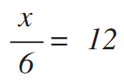
Week 4, Day 2
Estimate the value of and identify its location on the number line shown.
The volume of a cube is 512 cubic centimeters. What is the area, in square centimeters, of each side of the cube?
Find the measure of the missing angles:
Solve for x:
What are inverse operations? Give an example.

Slide 22
Week 4, Day 3
Estimate the value of and identify its location on the number line shown.
The area of a square is 144 cm². What is the length of one side?
Find the measure of the missing angle:
Solve for r: -6r - 7 = -19
What property would be used to simplify 3(x - 4)?
a
b
c
d

Slide 23
Week 4, Day 4
Estimate the value of and identify its location on the number line shown.
The volume of a cube is 343 cm³. What is the length of one side of the cube?
Find the measure of the missing angle:
Solve for y: 3y - 8 < 25
How would you simplify: 3x + 2x - 7 + 5?
a
b
c
d

Slide 24
Friday Five
Estimate the value of and identify its location on the number line shown.
The volume of a cube is 512 cubic centimeters. What is the area, in square centimeters, of each side of the cube?
Find the measure of the missing angles:
Solve for x:
What property would be used to simplify 3(x - 4)?
a
b
c
d

Slide 25
DAILY MATH REVIEW
Math 8
BM# 1
Week 5

Slide 26
Week 5, Day 1
Put the following numbers in order from least to greatest:
Chloe wants to build a storage container in the shape of a cube to hold 1728 cubic meters of hay for her horse. What length does she need to make each side?
Solve for y: -4y + 6 = 34
How many solutions does this equation have? If one, solve.
Estimate:

Slide 27
Week 5, Day 2
Put the following numbers in order from least to greatest:
A square wall has an area of 121 square feet. What are the length and width of the wall?
Solve for m: 5(m-3)=25
Solve the following inequality and graph its solution.
Estimate:

Slide 28
Week 5, Day 3
Put the following numbers in order from greatest to least:
A cube-shaped aquarium has a volume of 3,375 cubic inches. What is the length and width of the aquarium?
Solve for n: 5n+4(n-3)=24
How many solutions does this equation have? If one, solve.
Estimate:

Slide 29
Week 5, Day 4
Put the following numbers in order from greatest to least:
What is the side of a square whose area is 289 ft²?
Solve for y: 3y + 4y - 7 = 49
Solve the following inequality and graph its solution.
Estimate:

Slide 30
Friday Five
Put the following numbers in order from greatest to least:
A square wall has an area of 121 square feet. What are the length and width of the wall?
Solve for n: 5n+4(n-3)=24
Solve the following inequality and graph its solution.
Estimate:

Slide 31
DAILY MATH REVIEW
Math 8
BM# 1
Week 6

Slide 32
Week 6, Day 1
Solve for x: 4(x - 7) = 8
Which of the following graphs represent linear functions?
Write an example of an equation that is non-linear.
If ½ of the students in the class like cookies and ³/4 of those who like cookies, also like ice cream, what fraction of the class likes ice cream and cookies?
Between what two integers is ?

Slide 33
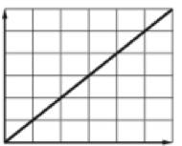
Week 6, Day 2
Solve for b: 9b + 4(b + 1) < 17
Which of the following equations represent linear functions?
Is the graph shown, linear or non-linear?
Explain why.
Kira uses 2/5 of a cup of vinegar in her salad dressing recipe. How much vinegar would Kira use to make 1/2 of a recipe?
Between what two integers is ?

Slide 34
Week 6, Day 3
Solve for n: 2n + 14 = 36
The height of a ball being dropped from a building can be represented by the function: h(t) = -16.1t² + 150. Is this function linear or nonlinear? Explain why.
Is the graph shown linear or non-linear?
Explain why.
Adam had a lump of silly putty that was 4 5⁄6 inches long. If he stretched it out to 2 2⁄3 times its current length how long would it be?
Between what two integers is ?

Slide 35
Week 6, Day 4
Solve for g: -18g - (-3g) > 105
The amount of money in a savings account can be modeled by the equation y=25x + 400. Is this function linear or nonlinear? Explain why.
Is the graph shown linear or non-linear?
Explain why.
A single box of thumb tacks weighed 3 ½ ounces. If a teacher had 4 ¹/7 boxes, how much would their combined weight be?
Between what two integers is ?

Slide 36
Friday Five
Solve for g: -18g - (-3g) > 105
Which of the following graphs are non-linear?
Is the graph shown, linear or non-linear?
Explain why.
A single box of thumb tacks weighed 3 ½ ounces. If a teacher had 4 ¹/7 boxes, how much would their combined weight be?
Between what two integers is ?

Slide 37
DAILY MATH REVIEW
Math 8
BM# 1
Week 7

Slide 38
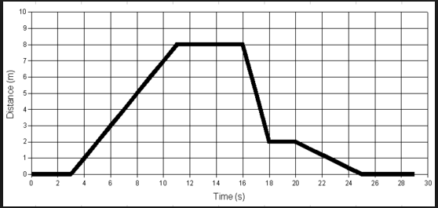
Week 7, Day 1
Using the graph, describe what is happening between 11 and 16 seconds.
Sketch a graph of a car accelerating to 75 mph and staying that speed on the freeway.
Solve for x: 9(x - 1) = 9x + 11
Solve for y: 3y + 2(y - 7) < 6
In the diagram, which angles are corresponding?

Slide 39
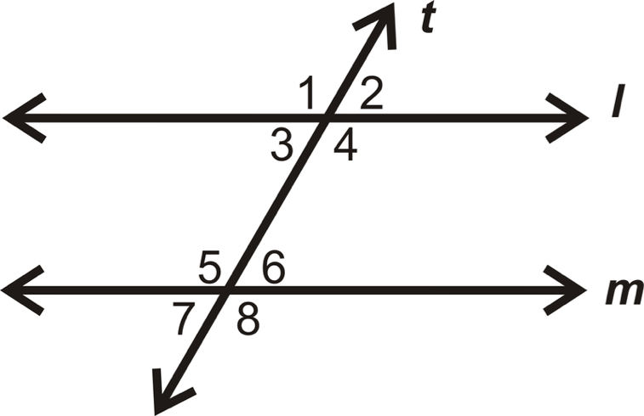
Week 7, Day 2
Using the graph, describe what is happening between 3 and 11 seconds.
Sketch a graph of a 6 ft deep swimming pool being emptied.
Solve for x: 5(6 + 3x) +7 > 127
Solve for m: 11m + 21 = 109
In the diagram, which angles are alternate interior?

Slide 40
Week 7, Day 3
Using the graph, describe what is happening between 20 and 25 seconds.
Sketch a graph of a runner who is running at a steady pace to the end of a track, turns around, and then runs at the same speed back.
Solve for x: 4x = 0
Solve for a: a³ = 729
In the diagram, which angles are alternate exterior?

Slide 41
Week 7, Day 4
Which graph best shows the path of a baseball thrown to the outfield? Explain your choice.
Sketch a graph of a person riding a bicycle to the store, shopping, then riding their bicycle home.
Solve for x: 2(x + 17) = 2x + 34
Solve the inequality and graph its solution.
In the diagram, which angles are consecutive exterior?
a)
b)
c)

Slide 42
Friday Five
Using the graph, describe what is happening between 3 and 11 seconds.
Sketch a graph of a car accelerating to 75 mph and staying that speed on the freeway.
Solve for x: 2(x + 17) = 2x + 34
Solve for y: 3y + 2(y - 7) = 6
In the diagram, which angles are alternate exterior?

