Slide 1
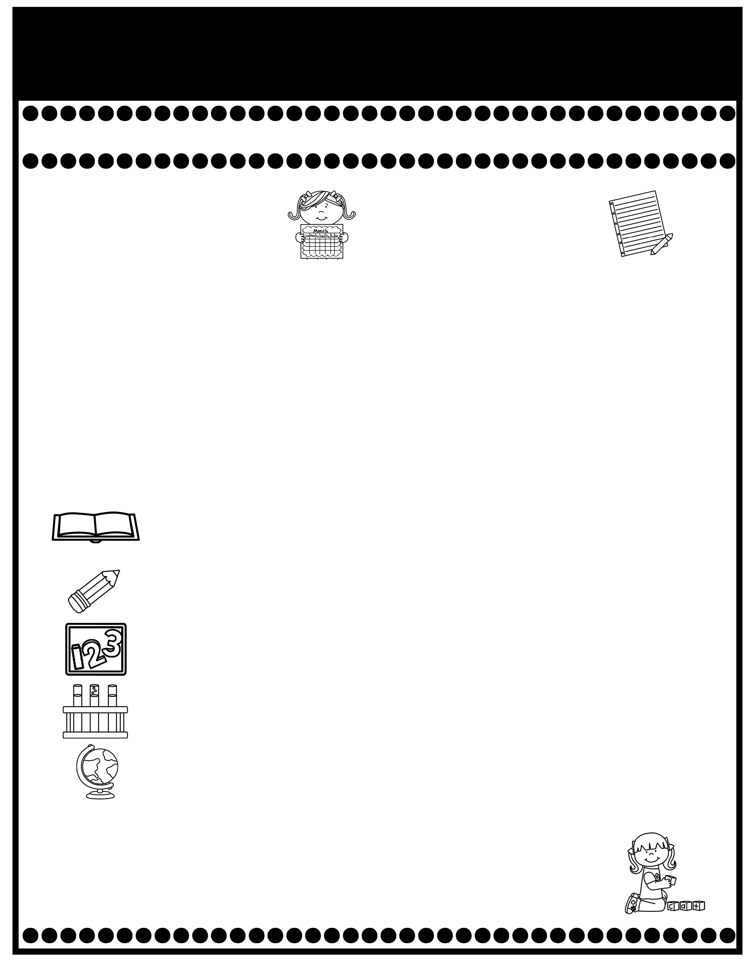
Branning’s Buzz
Week of: September 15-19, 2025
What’s Happening
This Week
Upcoming Events
  .
  The Attendance Challenge continues this month. The students who are present each day without check ins or check outs earn a pizza party with Mr. Cochran & Mrs. Baxley.
  Sept. 19: Fall pictures. All students will be photographed.
  Sept. 20: Special Snack Slushy $1.00
  The cost for snack is $1.00 each.
  A Weekly Reading Overview page wll be sent home each week to help you practice skills with your child. Also, nightly reading homework will be assigned in your child’s Take Home Binder. Please don’t remove pages.
  I will begin teaching your child to take A.R. tests this week. Library books aren’t allowed to go home at this time. A Reading Log was placed in your child’s Take Home Binder. .At this time, we are only recording the books read at school.
Tuesday Folders will be sent home Tuesday. Please review test papers & return them to school. Sign the sign in sheet. Please don’t keep the test papers at home. I keep them on file for the entire year. You don’t have to sign each test paper, unless I have stamped it.
If you have questions or concerns, you may email me at wendy.branning@acboe.net or message me on Parent Square.
A Peek At What We Are Learning
Reading | Phonics: Review al/all sound (walk, ball), c, ck, k, r, short a, I, o & comprehension: Predicting, Sequencing & Summarizing 9/19 Read the Words Individual Assessment, High Frequency Words & Syllables minor grade,
Writing | Adjectives, Penmanship (Handwriting), Describing an event. 9/19 Dictation grade
Math | Continue Topic 2: Fluently Add & Subtract within 10. 9/22 Topic 2 Test (Review pages will be sent home 9/19)
Science | N/A ( We will alternate weeks for SS/Science).
Social Studies | Johnny Appleseed Unit
Spelling Words
Spelling will begin in Unit 7.

