Slide 1
NATALIA ISD BOND Community Meeting
February 7, 2024, at 6:00 pm

Slide 2
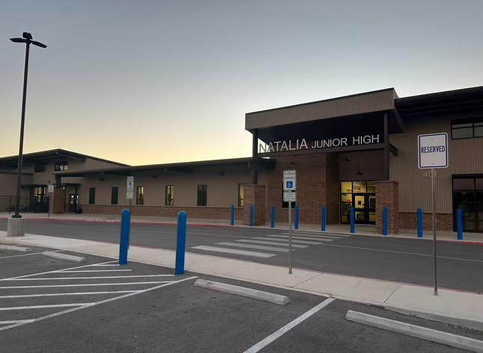

Slide 3
NATALIA BOND PLANNING
UPDATE CURRENT STATUS
NISD Selected AG|CM for bond planning
A district bond planning committee was formed
3 School Board Members, 4 Principals, 3 Assistant Principals, AD, Ag Teachers, Safety Coordinator
Campus meetings and committee meetings
NISD Selected Pfluger Architects
Understanding Priorities
Preliminary Cost Estimating Efforts

Slide 4
NATALIA BOND PLANNING
NATALIA IDENTIFIED PRIORITIES
ELEMENTARY SCHOOL – Addition/Renovation
ATHLETICS – New Fields & Concessions
CTE/AG BUILDING – Addition/Renovation
EARLY CHILDHOOD CENTER – Addition/Renovation
OTHER AREAS OF CONCERN:
Elementary Gym
Parking

Slide 5
PRELIMINARY/CONCEPTUAL DESIGN IDEAS
ELEMENTARY SCHOOL – Addition/Renovation
10 New Classrooms and 1 New ALE Classroom
New Library
New Nurses Room
New Life Skills Room with Restroom
New Enclosed Courtyard
New Administrative Offices (New Front Entrance)

Slide 6
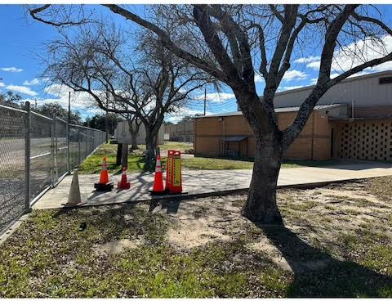

Slide 7
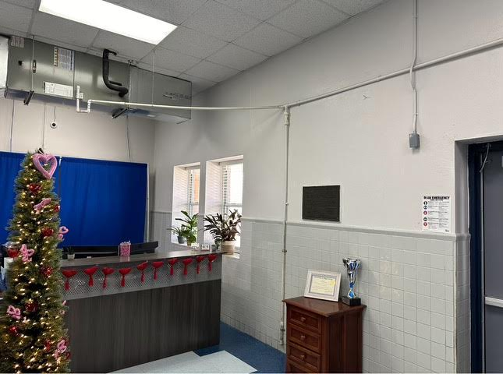

Slide 8
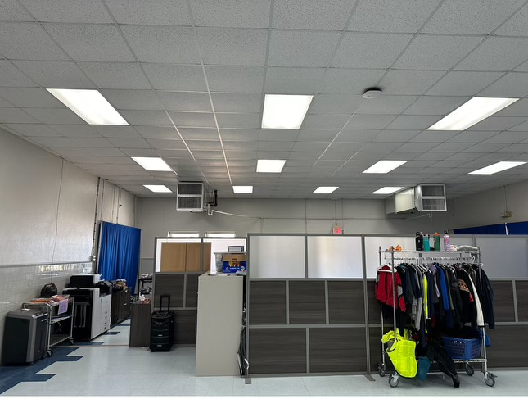

Slide 9
PRELIMINARY/CONCEPTUAL DESIGN IDEAS
ATHLETICS – New Fields & Concessions
New Turf – Baseball & Softball
New Lighting, New Fencing
New Dugouts
New Seating (approx. 250) at each field
New Scoreboards
New Drainage
Announcer Box at both fields

Slide 10
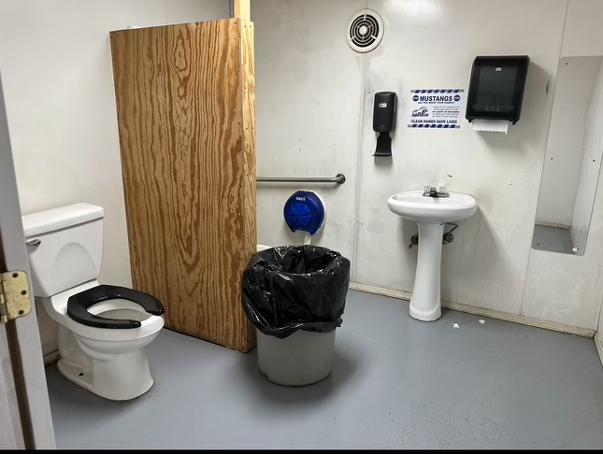

Slide 11
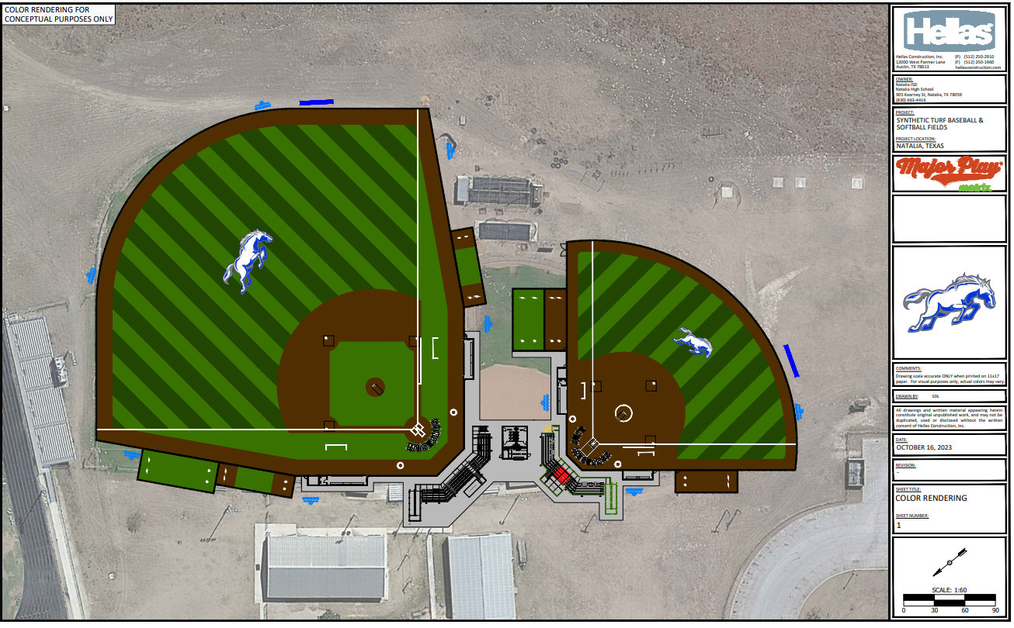
NATALIA BOND PLANNING
ATHLETIC CONCEPT

Slide 12
PRELIMINARY/CONCEPTUAL DESIGN IDEAS
CTE/AG BUILDING – Addition/Renovation
Renovations
Defined Space and User Layout
ADA Requirements
Code Implications/Upgrades
3 Classrooms

Slide 13
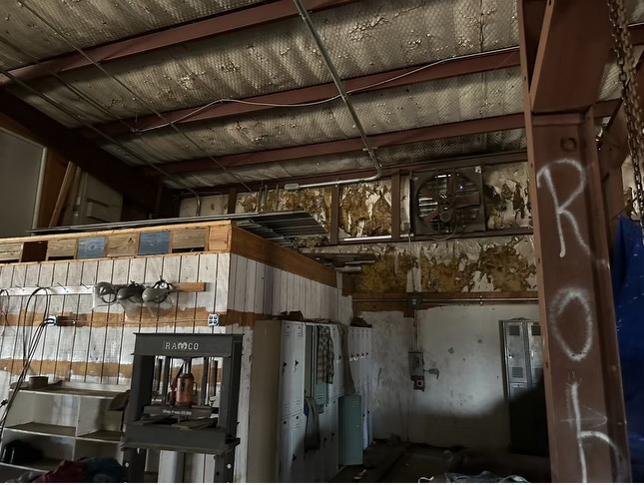

Slide 14
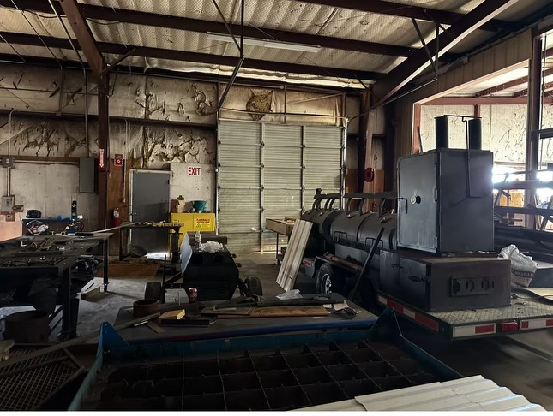

Slide 15
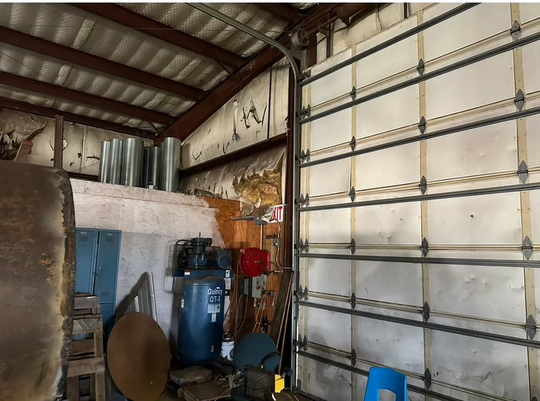

Slide 16
PRELIMINARY/CONCEPTUAL DESIGN IDEAS
EARLY CHILDHOOD CENTER – Addition/Renovation
Vacate 4 Classrooms – Move 1st Grade to Elementary School
New Multipurpose Room/Gym
1 Vacated Classroom = Library
1 Vacated could be Music & Art (If not New Space)
Parent & Teacher Workspace

Slide 17
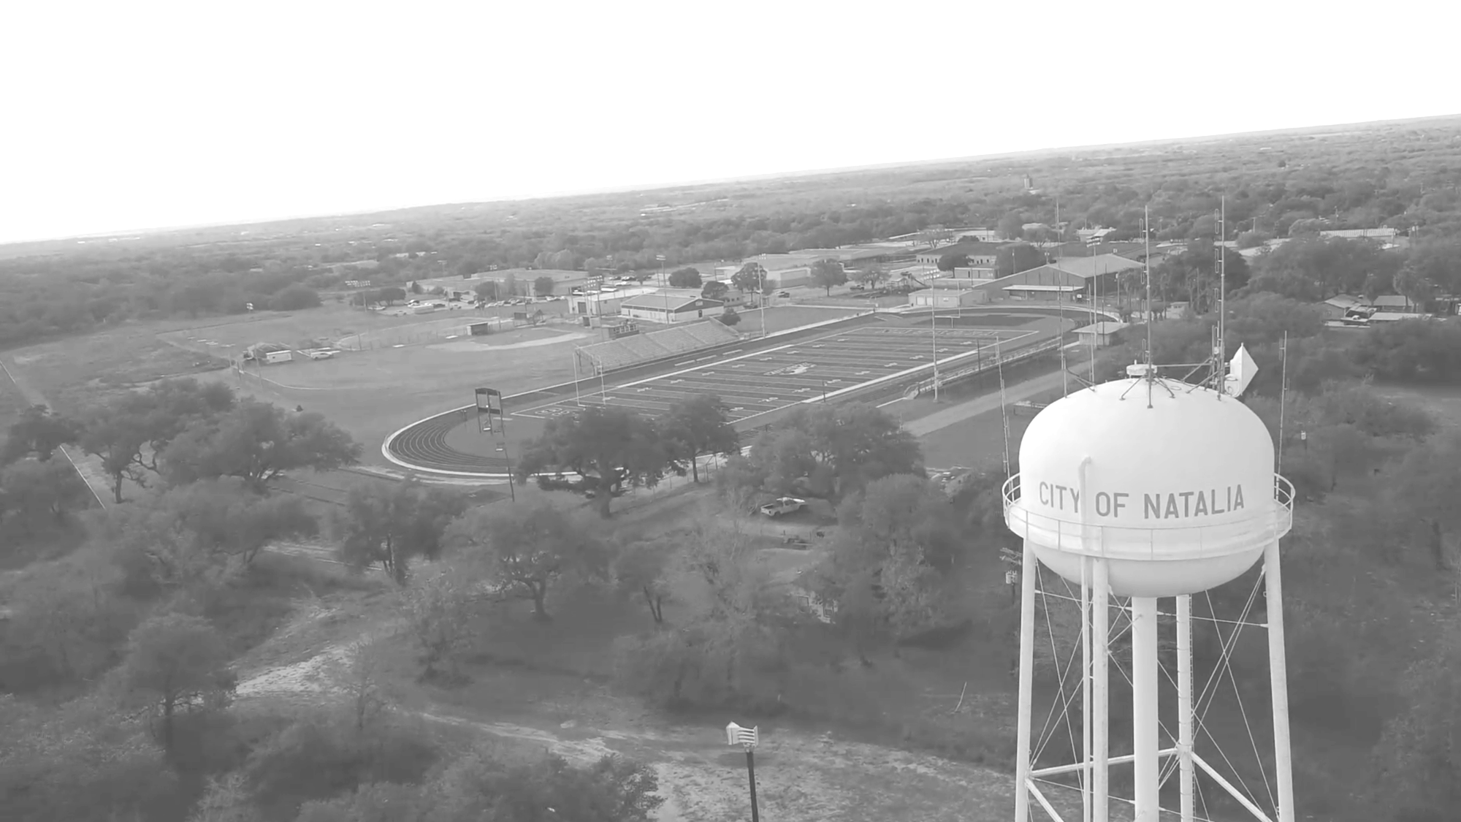
NATALIA ISD
DESIGN
INSPIRING
PLACES

Slide 18
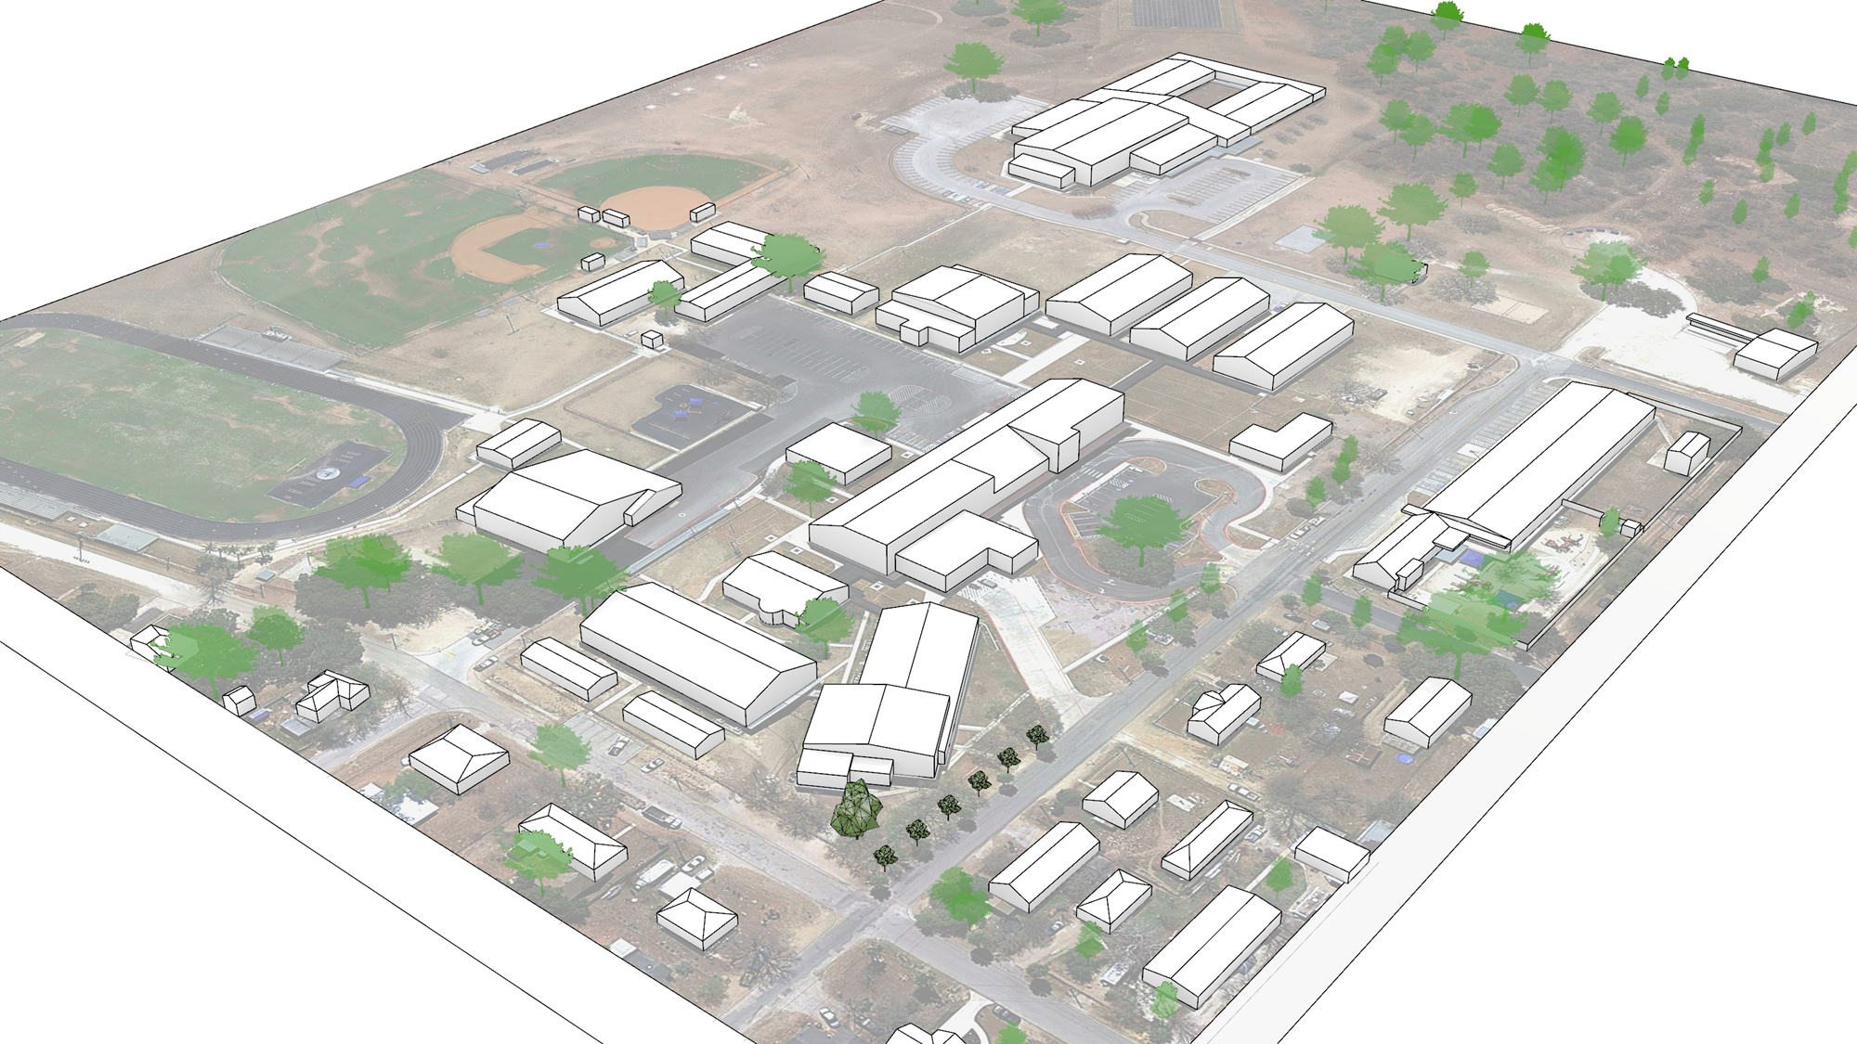
CTE Building Improvements
Early Childhood Center
Multi- Purpose
Elementary Additions & Renovations
Natalia ISD
District Improvements

Slide 19
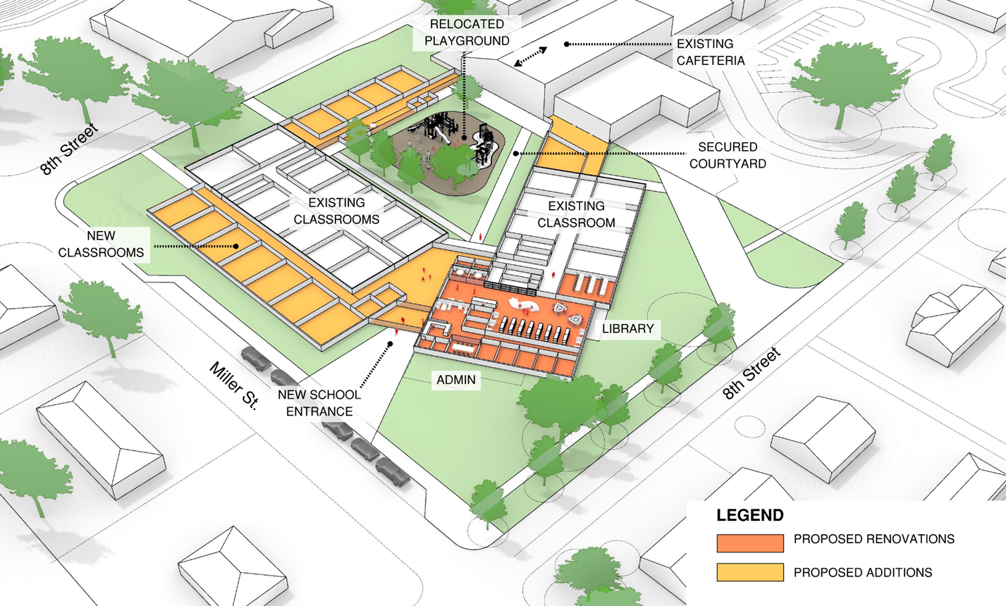
ELEMENTARY SCHOOL
ADDITIONS & RENOVATIONS
Add 10 general classrooms
Add 1 ALE classroom
Renovate to create Admin. Suite
Renovate to create Library
Renovate to create Clinic
Relocate Playground to new Secured Courtyard

Slide 20
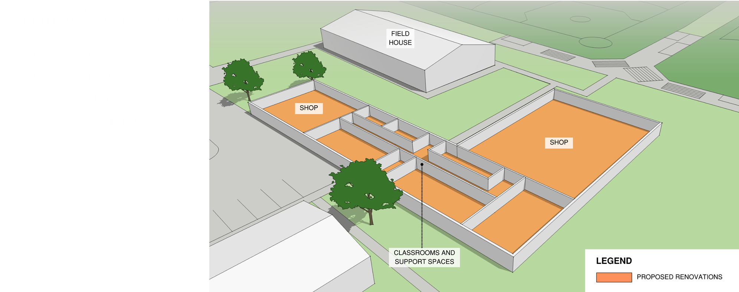
CTE/AG PROGRAM
ADDITIONS & RENOVATIONS
Renovate CTE Shops
Renovate CTE Classrooms
Address Code Issues
Address Accessibility Issues

Slide 21
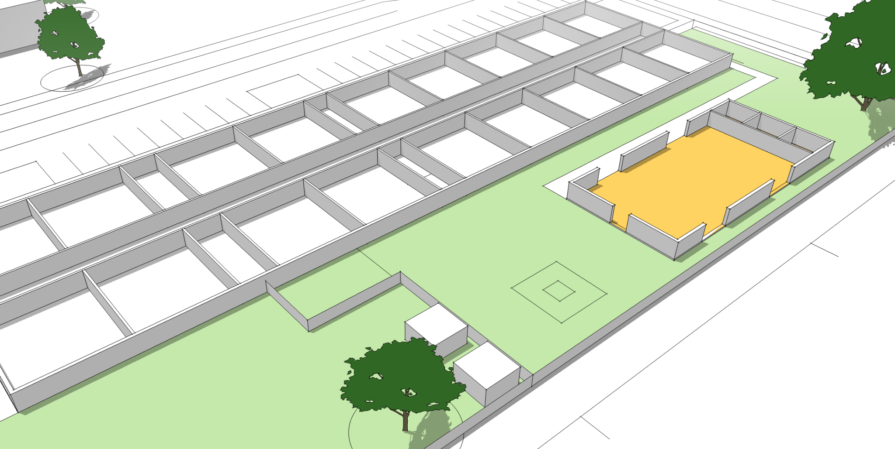
EARLY CHILDHOOD CENTER
ADDITIONS & RENOVATIONS
Restrooms
Add Multi-Purpose Room with Restrooms/Custodial/Storage
4 Classrooms Vacated (1st Grade move to ES)
Remove Maintenance Storage Building
Multi-Purpose Room

Slide 22
PRELIMINARY COST ESTIMATES
ITEM | COST EST. | NOTES/OTHER
EARLY CHILDHOOD CENTER | $3,110,000 | Vacate 4 classrooms (to Elementary) New Multi-purpose Room/Gym Remove Maintenance Bldg. Add classrooms for Music & Art
ELEMENTARY SCHOOL | $8,970,000 | Add 10 classrooms and 1 ALE classroom New Library (from Existing Cafeteria) New Front Office
CTE/AG BUILDING (Reno) | $4,680,000 | Renovate existing building, include 3 classrooms
CTE BUILDING (New) | $3,480,000 | New Bldg. with 4 classrooms with 1 Open Bay
CONSTRUCTION COST EST. | $20,240,000 | Construction Estimate (EC, Elem, CTE/AG)
TOTAL EST. w/SOFT COSTS (25%) | $25,300,000 | Total Project Cost Estimate (EC, Elem, CTE/AG)
BASEBALL & SOFTBALL FIELDS | $ 5,555,895 | New Fields, Concessions, Seating, Dugouts, Lighting
TOTAL ESTIMATE | $30,855,895 | Preliminary Total Estimated Costs
ESTIMATED BOND | $ 22,000,000 | Estimated Bond Funds at Current I&S Tax Rate
Cost estimates shown above can/will change as scope becomes more defined

Slide 23
PRELIMINARY COST ESTIMATES
Cost estimates shown above can/will change as scope becomes more defined
ITEM | COST EST. | NOTES/OTHER
EARLY CHILDHOOD CENTER | $3,110,000 | Vacate 4 classrooms (to Elementary) New Multi-purpose Room/Gym Remove Maintenance Bldg. Add classrooms for Music & Art
ELEMENTARY SCHOOL | $8,970,000 | Add 10 classrooms and 1 ALE classroom New Library (from Existing Cafeteria) New Front Office
CTE/AG BUILDING (Reno) | $4,680,000 | Renovate existing building, include 3 classrooms
CTE BUILDING (New) | $3,480,000 | New Bldg. with 4 classrooms with 1 Open Bay
CONSTRUCTION COST EST. | $13,650,000 | Construction Estimate (Elem, CTE/AG)
TOTAL EST. w/SOFT COSTS (25%) | $17,062,500 | Total Project Cost Estimate (Elem, CTE/AG)
BASEBALL & SOFTBALL FIELDS | $ 5,555,895 | New Fields, Concessions, Seating, Dugouts, Lighting $5,555,895+ $401,605 added from increased bond capacity to move fields for parking
TOTAL ESTIMATE | $22,618,395 | Preliminary Total Estimated Costs
 | $401,605 | Increase in bond capacity to move the Baseball/Softball - $5,555,895+ $401,605 added from increased bond capacity to move fields for parking
UPDATED BOND CAPACITY | $ 23,020,000 | Estimated Bond Funds at Current I&S Tax Rate

Slide 24
FUNDING THE BOND
Let’s have a discussion regarding available funding.
$23,020,000 - NATALIA BOND CAPACITY w/NO TAX INCREASE
$0.399 – CURRENT NISD I&S TAX RATE

Slide 25
SCHOOL FINANCE 101
Maintenance & Operations
(M&O) Tax Rate
Funds used to operate a school district such as teacher salaries, utilities, equipment, supplies, etc.
Funding for “running” the district.
CURRENT NISD M&O: $0.758
Interest & Sinking
(I&S) Tax Rate
May only be used for the repayment of bonds that were approved by the voters from a bond election.
Funding for “paying off district debt.”
CURRENT NISD I&S: $0.399

Slide 26
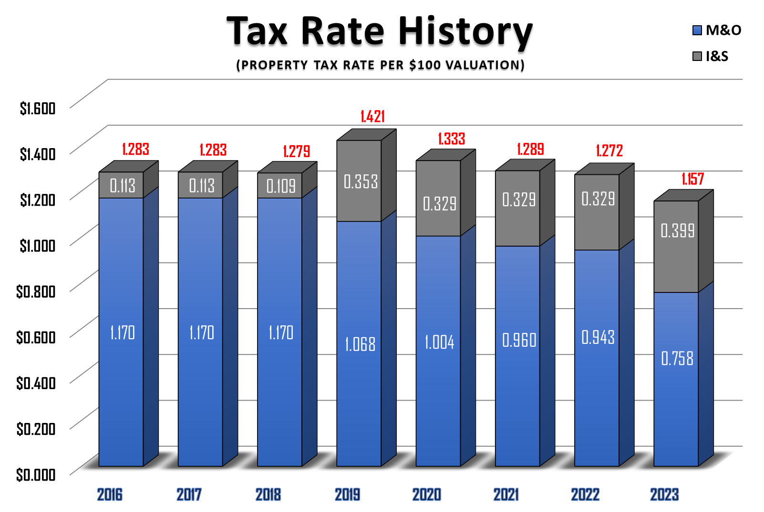

Slide 27
THE ELECTION - May 5, 2024
If the board calls for a bond election, there could be two bond propositions:
Proposition A - Elementary and AG - $17,465,000
Proposition B - Athletics - $5,555,000
No Interest and Sinking Tax Rate increase to fund the bond
State law requires this language on the ballot:
THIS IS A PROPERTY TAX INCREASE

Slide 28
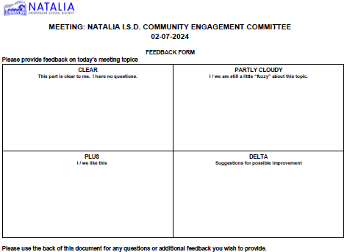
BEFORE YOU LEAVE
PLEASE REMEMBER TO LEAVE US YOUR FEEDBACK DOCUMENT
We will review all feedback comments
Your feedback is important to us through this process

Slide 31
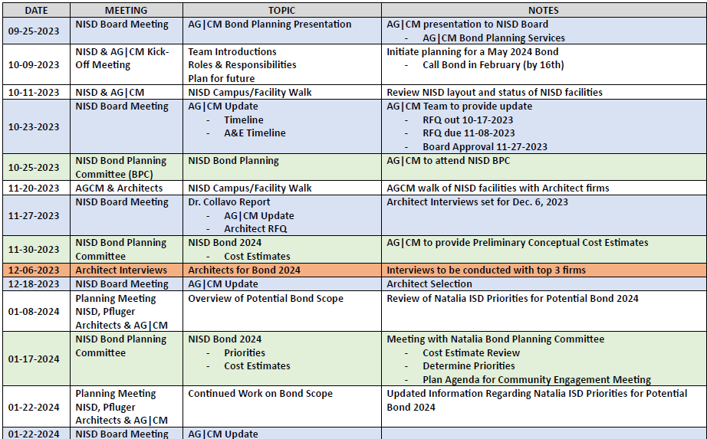
PROCESS TIMELINE

Slide 32
PROCESS TIMELINE

