Slide 1
Energy Flow in Ecosystems
Chapter 3 Lesson 1

Slide 2
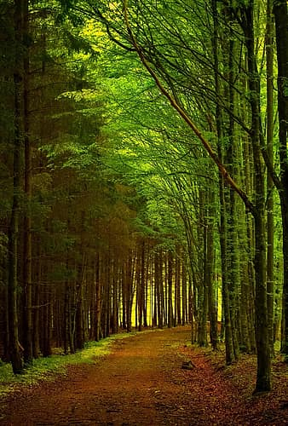
What is an ecosystem?
-An ecosystem includes all the living and non-living things in an environment.
Picture a forest for a minute:
-Plants and animals are biotic factors, or living things in the environment.
-Rocks, water, and air are some of the abiotic factors, or non-living things in the environment.
-All of these biotic and abiotic factors make up an ecosystem

Slide 3
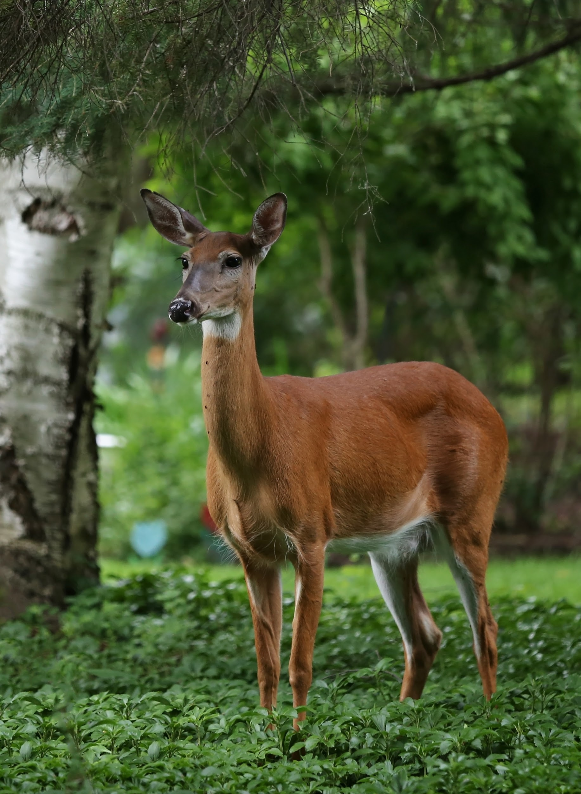
continued...
-Biotic and abiotic factors in an ecosystem interact and supply the needs of living things.
-For example, plants (biotic) need soil (abiotic) to grow and survive. Plants (biotic) also provide food for many animals (also biotic) in the forest.

Slide 4
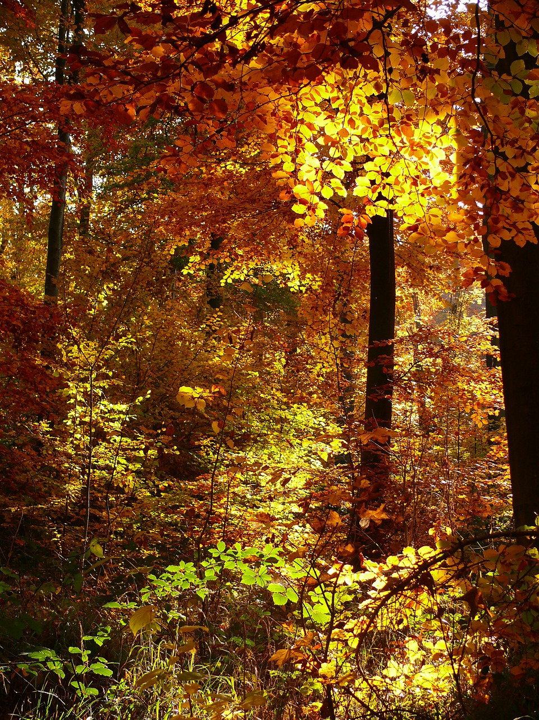
continued...
-The organisms in an ecosystem can sorted into different populations. A population includes all members of the same species. For example, all the blue spruce trees in a forest make a population.
-Together, many different populations make a community. A community includes all the living things in an ecosystem. A community can have thousands of populations.

Slide 5
Food Chains
-The path that energy and nutrients follow in an ecosystem is called a food chain. Food chains model the relationships between living things in an ecosystem. In a food chain, energy flows in one direction.
-The energy is a food chain starts with the Sun.
-Producers are organisms that use the Sun’s energy to make sugar and oxygen. What living things do you know of use the sun’s energy to make sugar and oxygen???

Slide 6
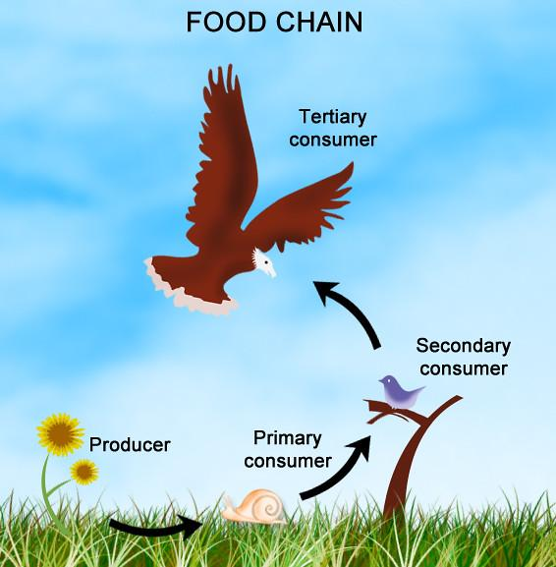
PLANTS!
-Plants are producers.
-Consumers are any animal that eats plants or other animals (view the picture on page 144 of your textbook)

Slide 7
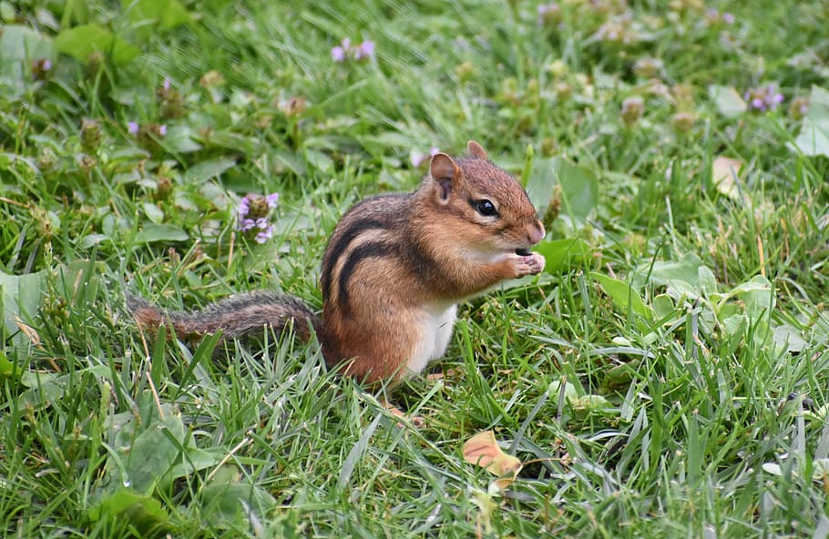
Herbivores
Animals that eat producers only are called herbivores.
This means they only eat plants.
Some examples of herbivores are squirrels, some birds, some insects, and grazing animals (like deer).

Slide 8
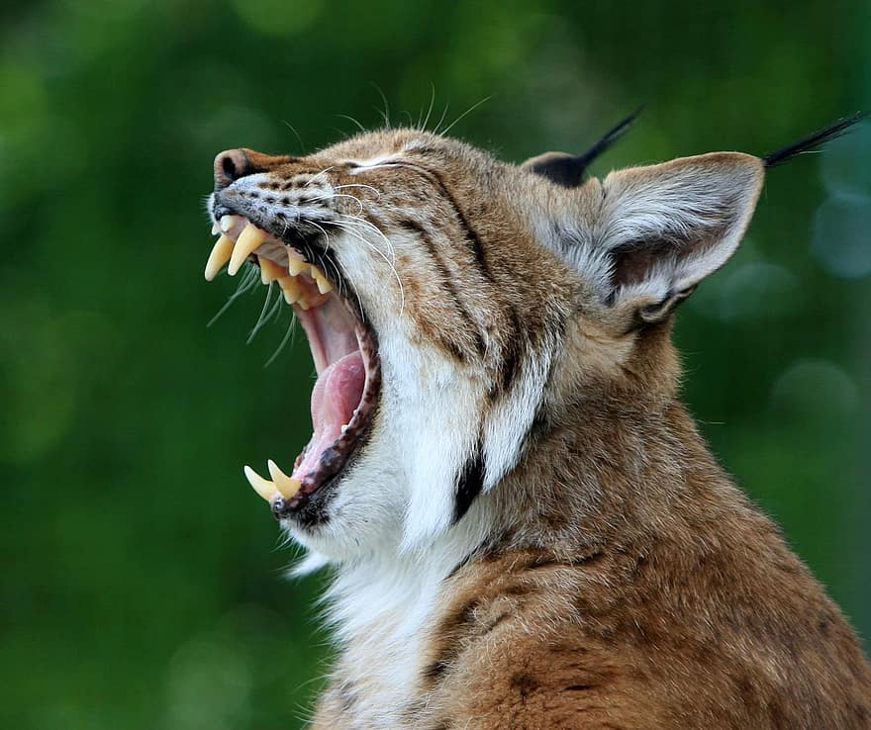
Carnivores
Animals that eat other animals arecarnivores.
Examples of carnivores are bobcats and hawks. These animals usually have very sharp teeth used for eating meat.

Slide 9
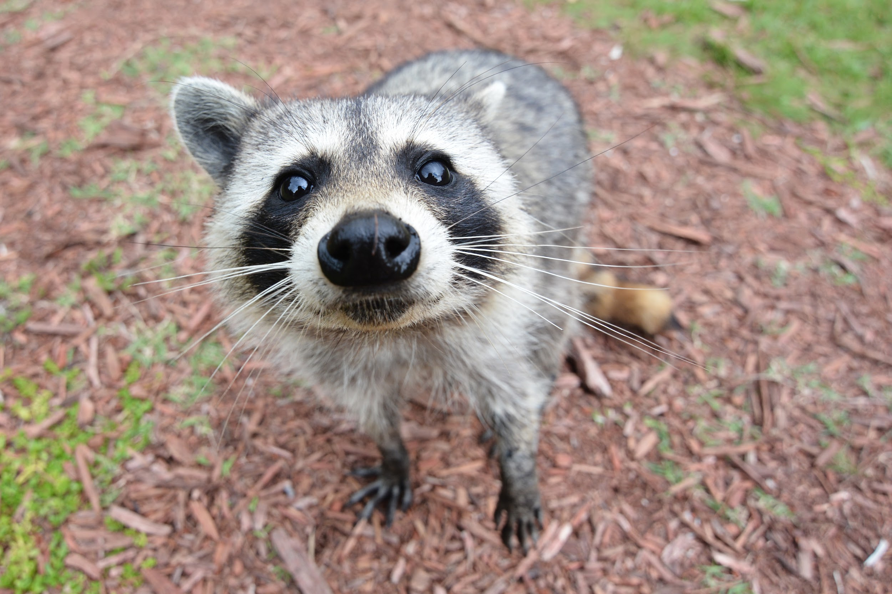
Omnivores
Animals that eat both plants and animals are called omnivores. WE are omnivores.
Other examples of omnivores are raccoons, mice, woodpeckers, and some crabs.

Slide 10
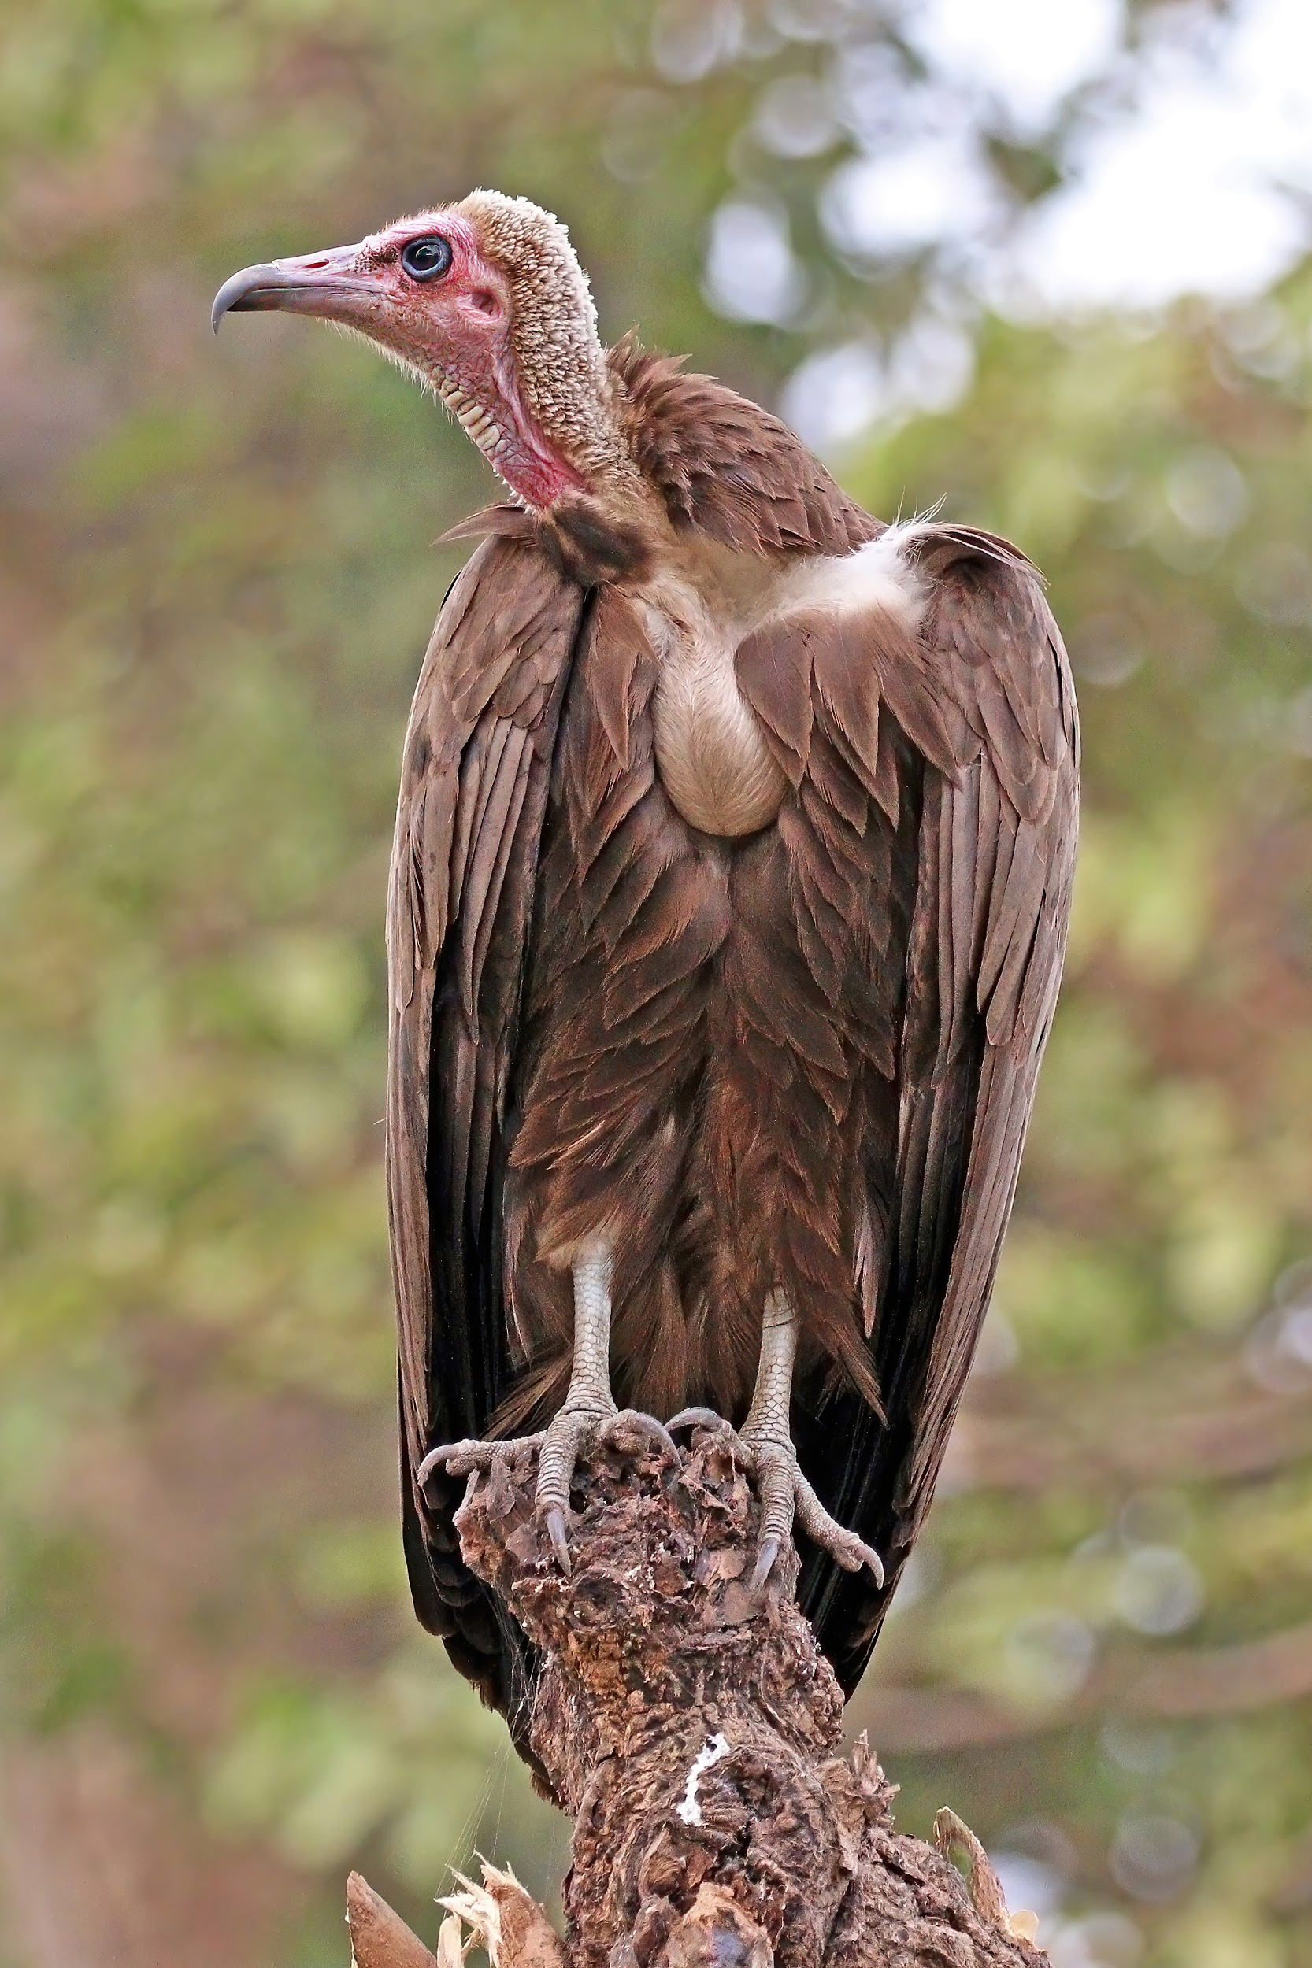
Decomposers
Lastly, there are decomposers in a food chain. Decomposers break down dead or decaying plan and animal matter.
Decomposers include fungi, bacteria, termites, and many worm species.
Scavengers are not included in the food chain because they eat leftover bodies after they have already started to rot. Common scavengers include vultures, raccoons, and some crabs.

Slide 11
Food Webs
A food web is a network of food chains that have some links in common. It is several food chains that are put together.
View the food web on page 146-147 of your textbook.
The arrows point to the predator, or the animal that eats the other animal.
Prey are animals that get eaten.

Slide 12
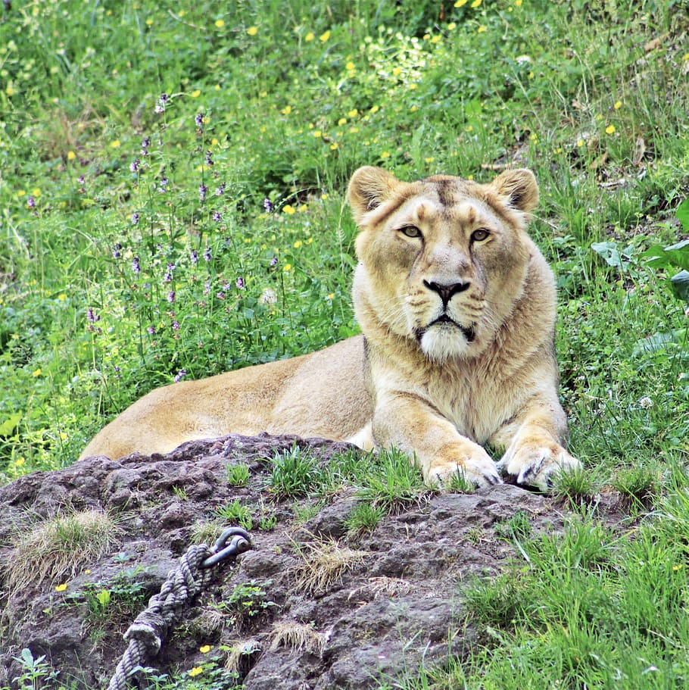
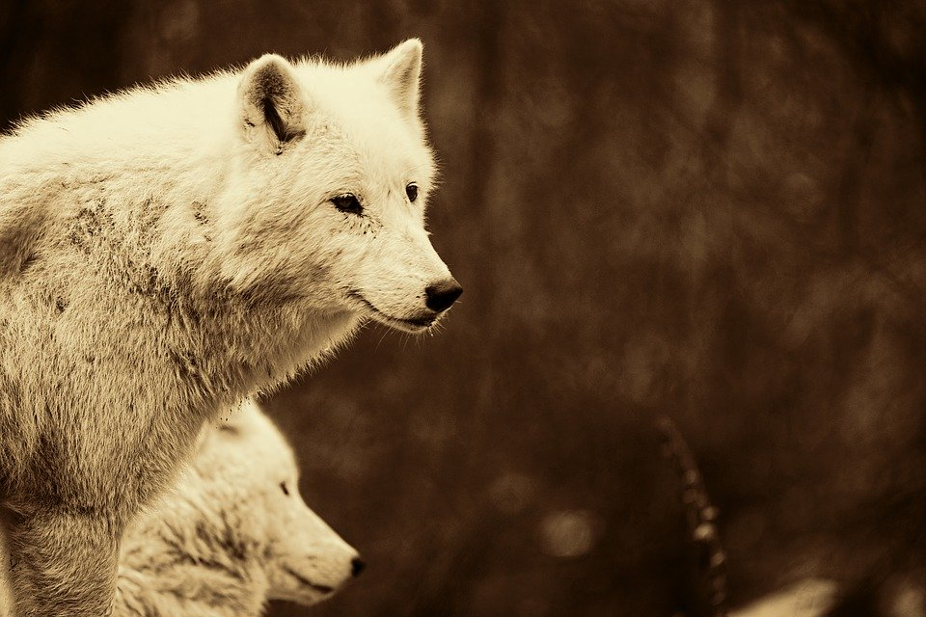
Predators are important to ecosystems because they limit the size of prey populations. When the number of prey animlas is smaller, producers and other resources in an ecosystem are less likely to run out.

Slide 13
Energy Pyramid
An energy pyramid is a diagram that shows the amount of energy available at each level of the ecosystem.
Energy pyramids show that it takes a huge number of organisms to support an ecosystem.
In any ecosystem the number of producers is greater than the number of herbivores. There are also more herbivores than there are carnivores. All of this is so in order to keep the ecosystem in balance.

Slide 14
Change in an ecosystem
Sometimes, change does happen though. When top carnivores are removed from the food chain, prey populations aren’t controlled. When there is more prey and less predators, the prey start to eat more of the producers.
For example: In a forest, if you remove the bobcat, there will be more mice, birds, and raccoons. If there are more mice, birds and raccoons, then they will eat more grass and berries and there will be less food for the animals.

Slide 15
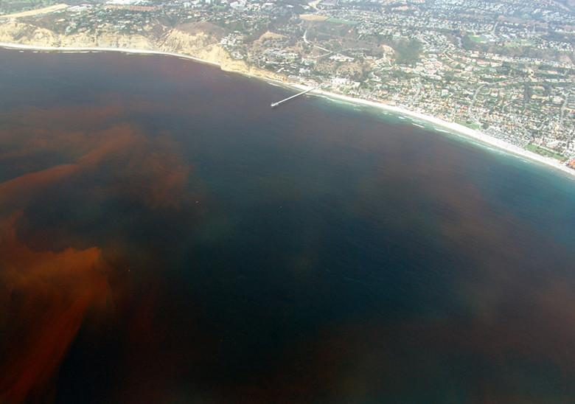
Changes in an ecosystem
Sometimes, a single population can grow out of control. For example, a red tide is a sudden explosive growth of single-celled algae in coastal areas. The algae is toxic. It then gets eaten by organisms in the water, like fish. This kills the fish and then reduces the energy available to predators that would usually eat the fish.

