Slide 1
2022-2023 Course Selection & Graduation Requirements

Slide 2
Sample PowerSchool Transcript

Slide 3
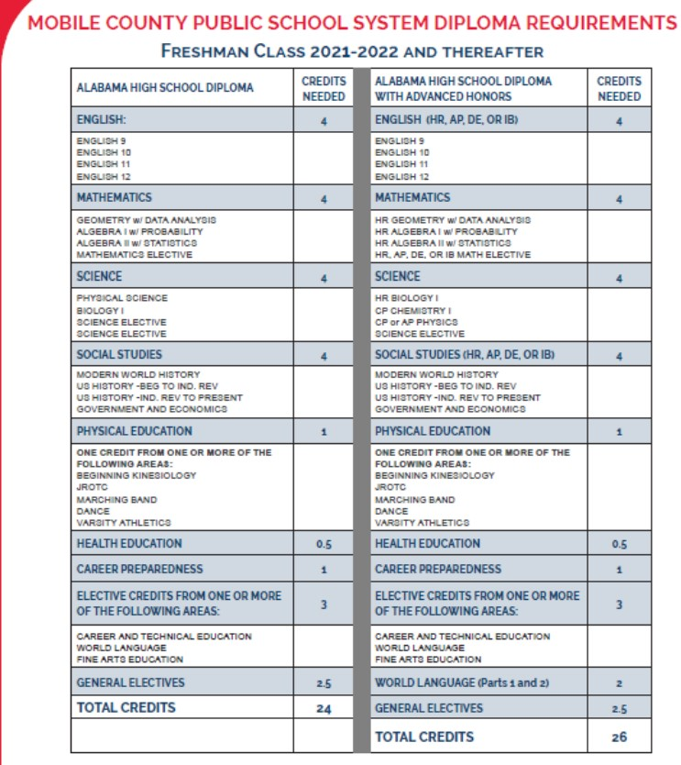

Slide 4
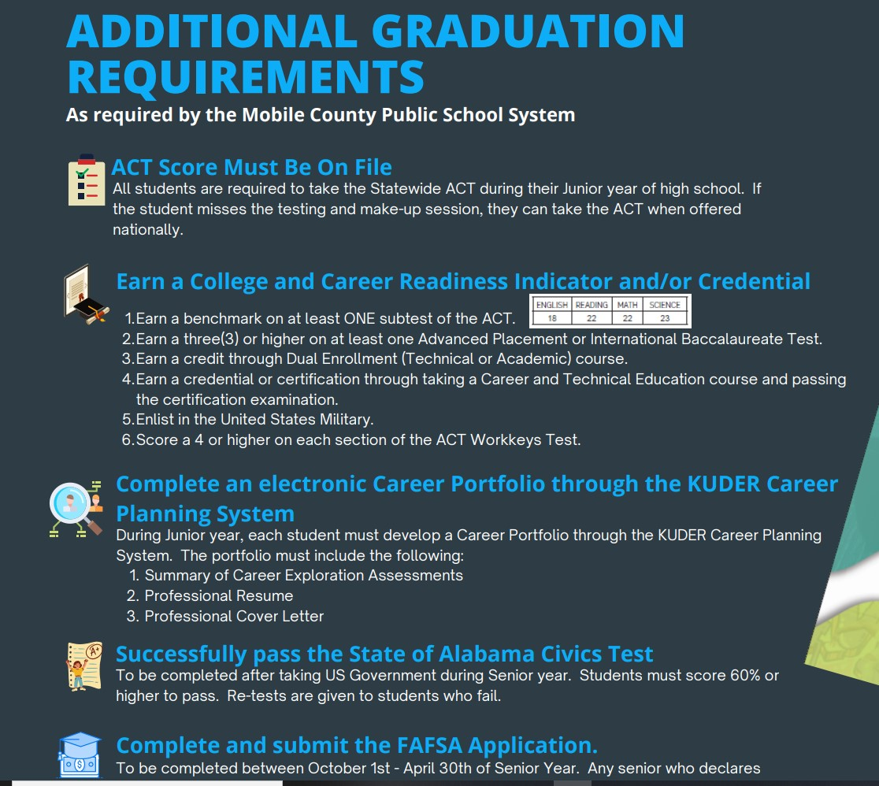

Slide 5
Faulkner Vocational School Programs https://www.youtube.com/watch?v=N1L-2FaJSJk

Slide 6
Complete grade appropriate 2022-2023 Course Selection Google Form on www.mhspanthers.com
Forms will be taken down on Thursday, May 5th! Please do not submit multiple Google forms. Do not chose your classes until you are certain. All questions should be directed to your grade level counselor.
9th Grade- Ms. James
10th Grade- Ms. Graham & Ms. Norris
11th Grade- Ms. Graham

