Slide 1
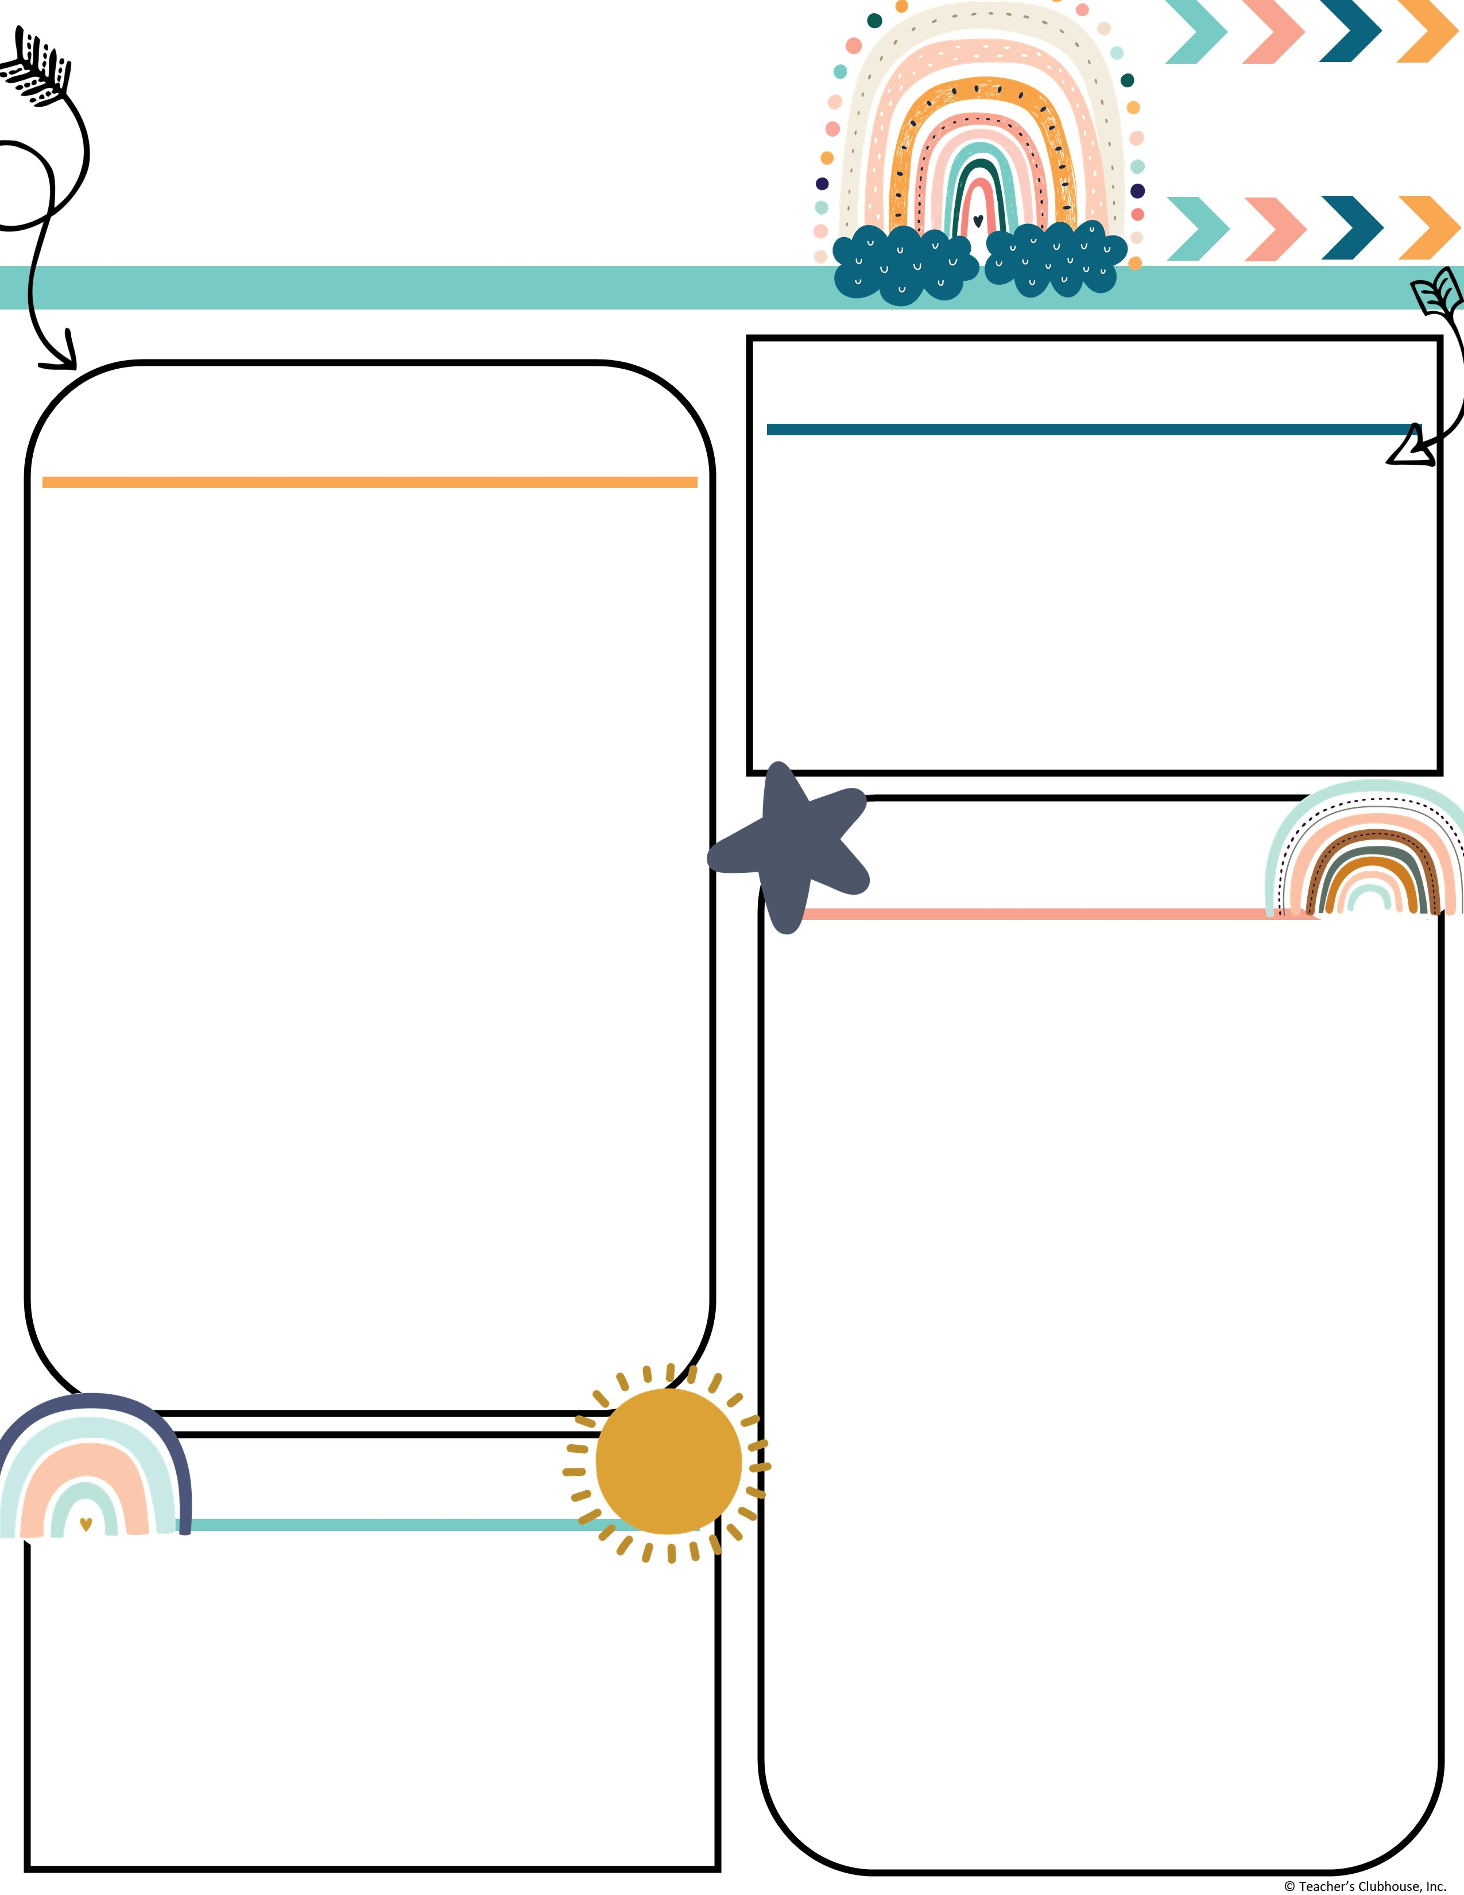
Every Student Empowered. Every student succeeds.
Second Grade, E122
334.285.0273
Remind App @6bc96eg
joan.johnston@elmoreco.com
Ms. Johnston’s
Newsletter
Week of November 11-15, 2024
Upcoming Events
A Peek at Our Week
November 11th ~ Veterans Day ~ No School
November 12th ~ Turkey Disguise Project Due
November 12th ~ Math Night @ 6pm
November 13th ~ Wonderful Wednesday Snack
November 13th ~ World Kindness Day (please wear your Kindness shirt)
November 14th ~ Progress Reports
November 19th ~ Friendsgiving Lunch @ 12:10, Tables
November 22nd ~ Money for Field Trip Due
November 25th - 29th ~ No School
December 5th ~ Field Trip
Reading:
Reading:
Benchmark
r controlled vowel → or, oar, ore
  EX: corn, torn, more, soar
Great link to decodable books! I encourage you to utilize this free resource:
https://portal.flyleafpublishing.com/learners-resources/
Word Study: before, oars, born, roar, fork, sports, horn, store, more, wore
Grammar:
Adjectives/Adverbs
Comprehension:
Ask questions about characters and events in a folktale
Differences in Points of View
Central Message
Math:
Two Digit Addition → Solving addition problems using different strategies (Number line, hundreds chart, break apart number, partial sums, mental math)
Writing/Language:
Writing complete sentences
Informative/Explanatory Essay
Journal/Diary Entries
Science/Social Studies:
3 branches of Government
Weekly Homework
Please check your child's folder for their homework that will be due on Friday
Tests this week
Phonics → er, ir, ur, and or, oar, ore (Wednesday)
3 Minute Timed Math Addition Facts (Tuesday & Friday)
Quarter 2 Sight Words:
Week 1: again, below, carry, does, eight, find, house, laugh, mother, school
Week 2: move, their, never, too, once, walk, round, where, small, year
Week 3: all, done, away, even, better, found, by, learn, change, only
Week 4: long, through, now, upon, our, was, some, when, them, work
Week 5: always, draw, any, four, blue, great, buy, how, city, live
Week 6: another, from, boy, hurt, could, out, every, over, far, these
Reminders
Turkey Disguise Project Due by Tuesday, November 12th
Wednesday, November 13th World Kindness Day. Please wear your kindness shirt.
Every Wednesday is Wonderful Wednesday Snack. All items are $2.
Every Friday is Hat day. You can wear a hat for $1.00.

