Slide 1
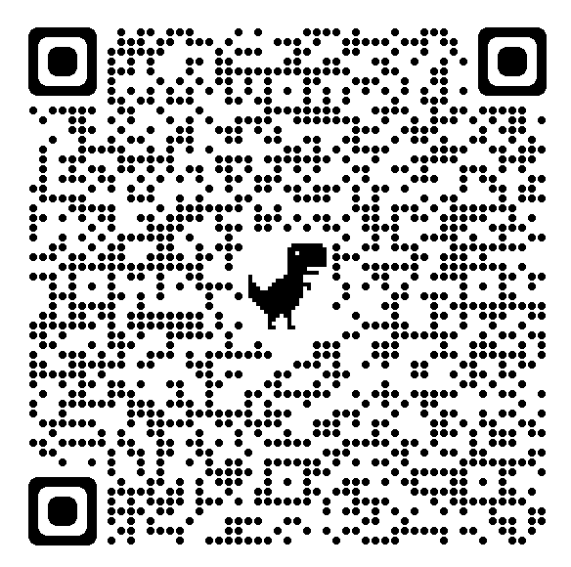
HPS
September Newsletter
Message From
The Coordinator
Awareness Highlights…
Childhood Cancer
Deaf Awareness
Student Sleep Health Week
Children’s Good Manners Month
Zzzzzz....Getting enough sleep is a crucial part of your child’s physical and cognitive growth. Please check out the following link to educate yourself on proper sleep habits for children!
How much sleep does your child get?
What’s Coming Up…
https://www.cdc.gov/chronicdisease/resources/infographic/children-sleep.htm
Please continue to get all medical actions plans to the school nurse.
Lion’s Club will complete vision screenings Friday, Sept. 22nd.
October is Bullying Prevention Month

