Slide 1
24-25 Edition
SAMPLE
5th Grade
Lesson 1

Slide 2



Safety
SAMPLE
What are you responsible for?
Are you starting to become more responsible as you get older, meaning you are doing more things for yourself and are more accountable for your behavior and choices?

Slide 3






Safety
MBF
5
Safety Rules
SAMPLE

Slide 4

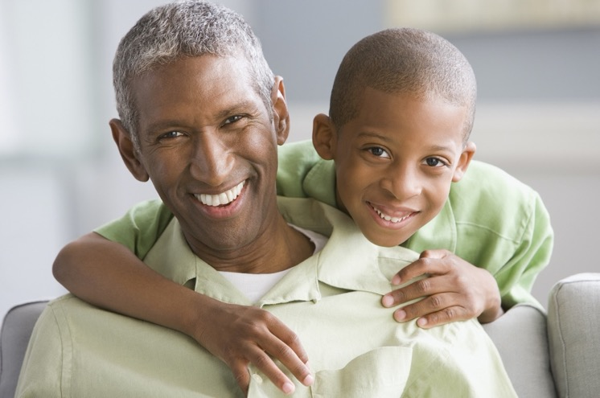

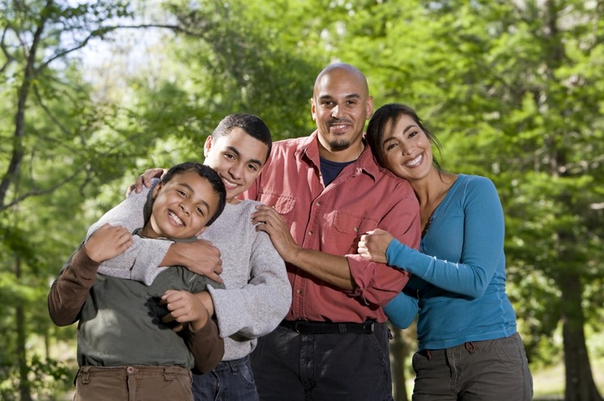



Safe Adults
SAMPLE
A Safe Adult is someone you can go to if you ever feel unsafe, if you’ve ever been hurt, or if you’re not sure if a situation is unsafe.

Slide 5

Safe Adults
SAMPLE
Who are your Safe Adults?

Slide 6





Who is a Stranger?
SAMPLE
?

Slide 7
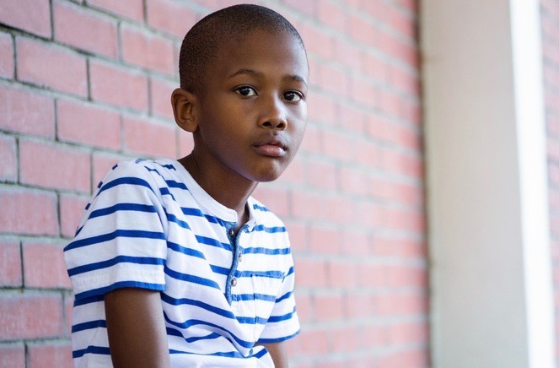


Neglect
A safe place to live
SAMPLE
Food and clothes
Someone to take care of you
Medical care
Neglect is when a child is not getting what they need to be healthy and safe.

Slide 8
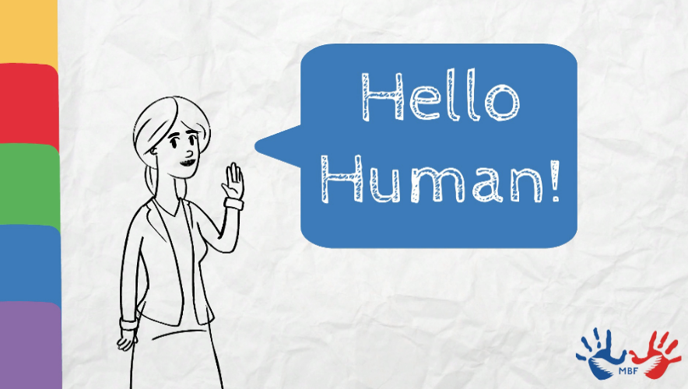
You are Perfect
By Monique Burr Foundation for Children
SAMPLE
What was the message of the video?

Slide 9



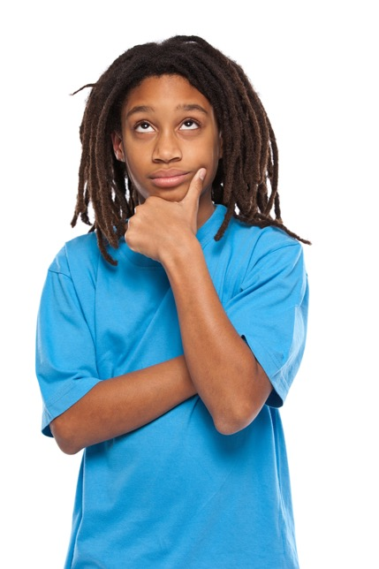
Safety Check
1
Strangers are most often the people likely to hurt children.
TRUE
SAMPLE
FALSE
2
An example of neglect would be when a child needs medical care and their parent/caregiver doesn’t take them to the doctor.
3
If someone seems unsafe to you, it is important to be polite and not hurt their feelings by running away or saying anything to them.
4
Emotional abuse leaves a mark on your body.
5
Physical abuse can be from an older child, as well as an adult.

Slide 10

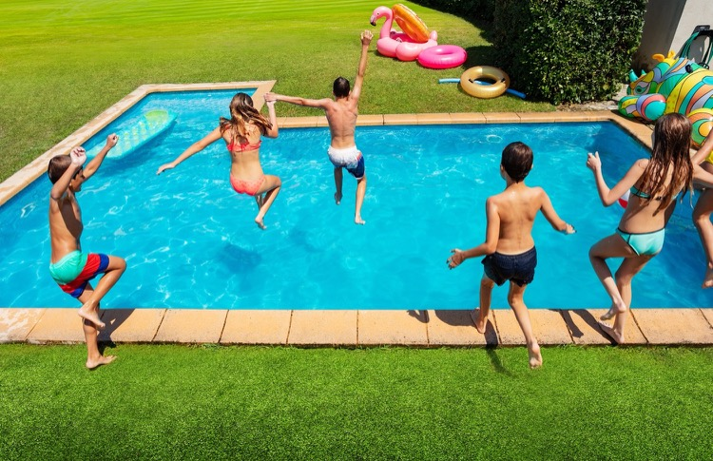
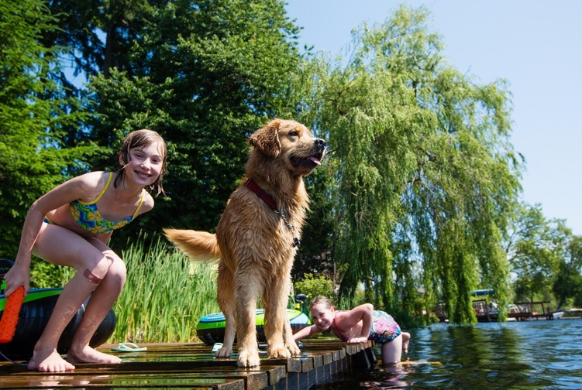
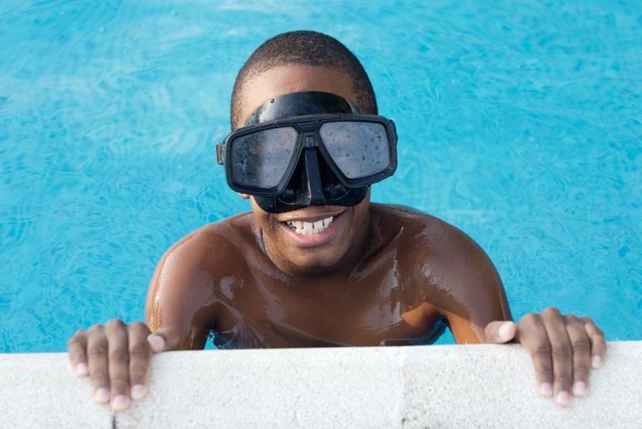
Private Body Parts
SAMPLE
The parts of your body covered by a bathing suit –
top and bottom, front and back.

Slide 11

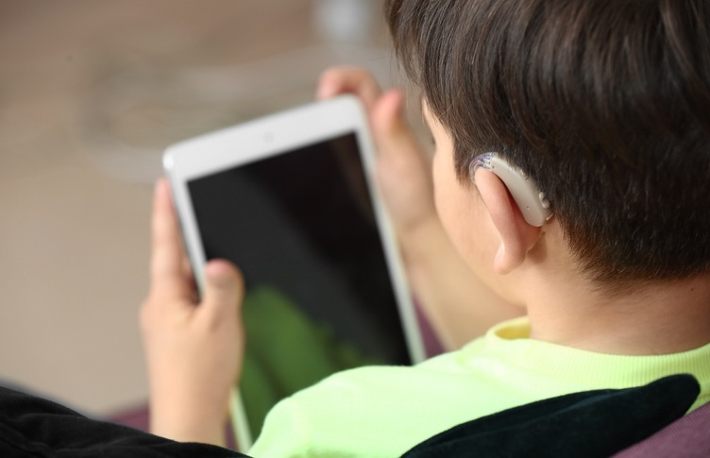


Inappropriate Images
SAMPLE
It is also sexual abuse when an adult or another child shows a child inappropriate pictures of people without their clothes on. Remember your Safety Rules if this happens to you or a friend.

Slide 12

Red Flags – Tricks
Examples of unsafe tricks:
SAMPLE
Offering you candy, gifts, or money to get you alone, or to help them do something unsafe.
Asking you to help them find something like a lost pet or child (when there really isn’t anyone lost).
Telling you there is an emergency and that you need to go with them (when there really isn’t an emergency).
Telling you a lie or asking you to tell a lie.
Calling something unsafe a game (like taking your clothes off).

Slide 13
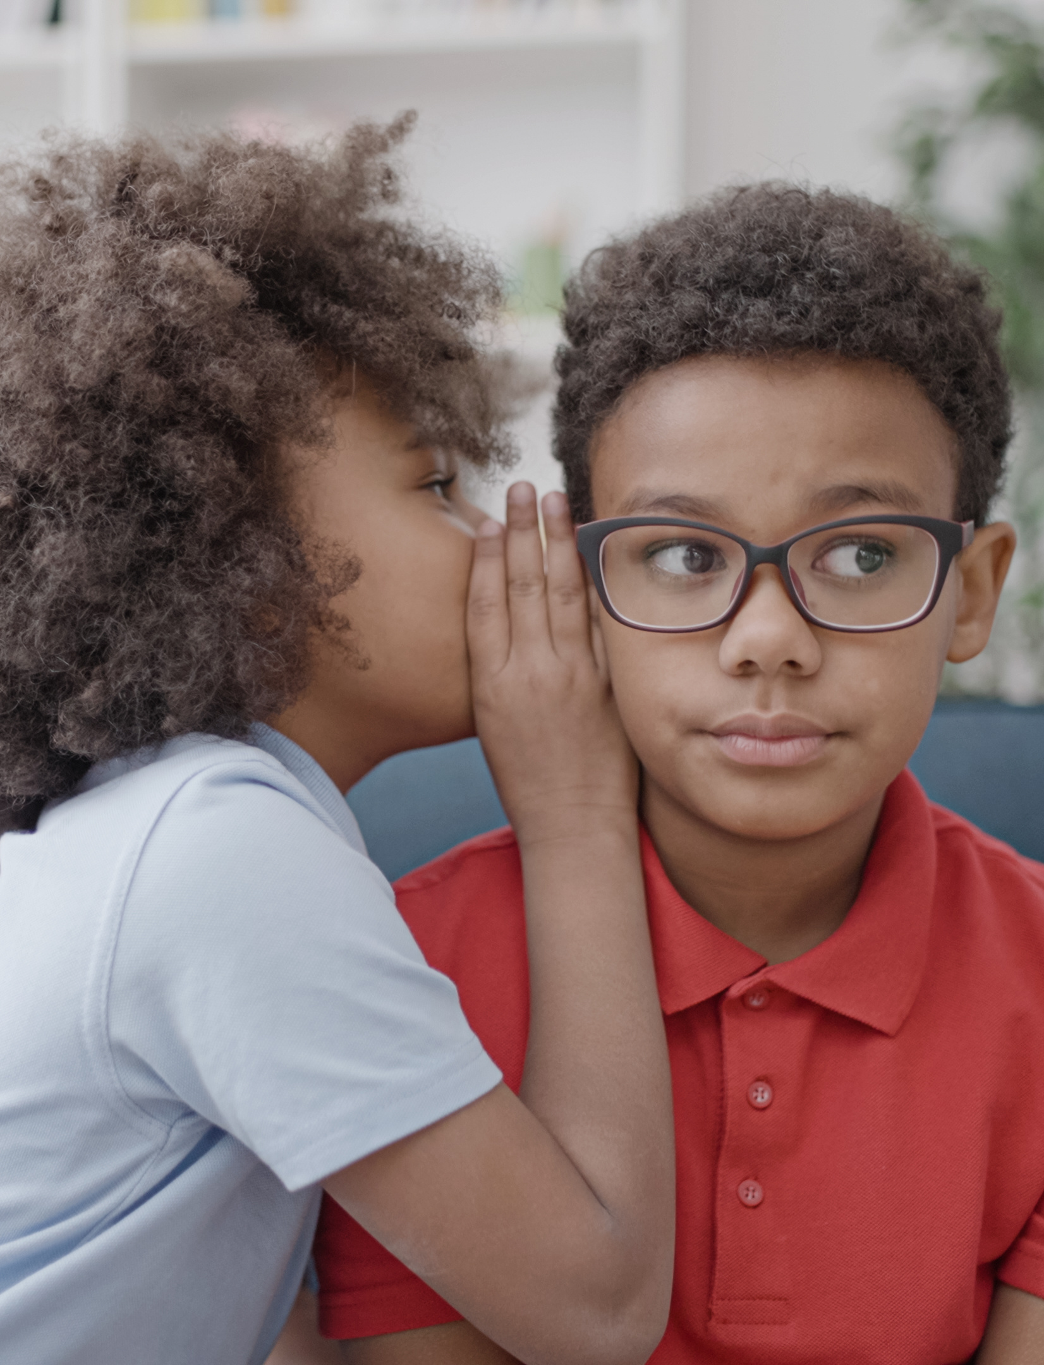
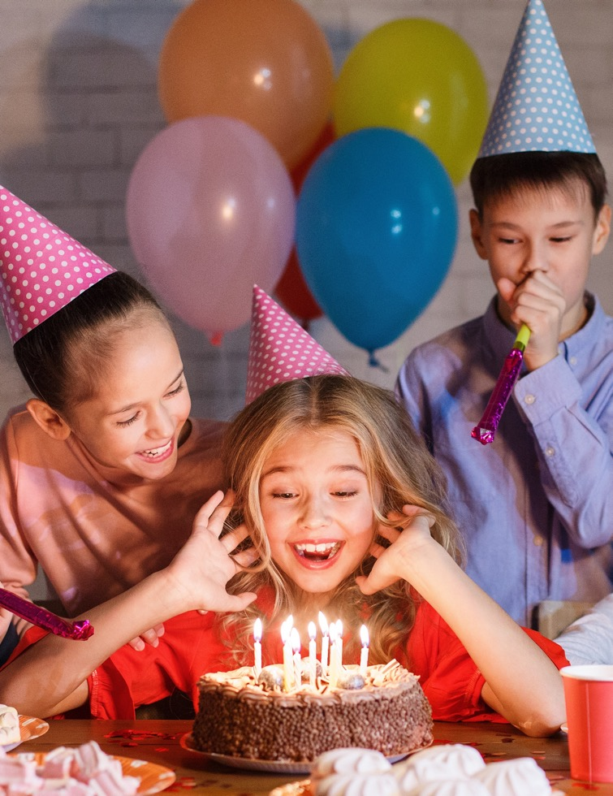




Red Flags – Safe vs. Unsafe Secrets
SAMPLE
There are some secrets that are safe and some that are unsafe.
Secrets
Surprises

Slide 14

Healthy Relationships
SAMPLE
What is a healthy relationship?

Slide 15

Let’s Play Fact or Fiction
SAMPLE
FACT
OR
FICTION?

Slide 16


Great job!
SAMPLE

