Slide 1
Welcome!!
OPEN HOUSE
2021-2022
4th Grade
Mrs. Quattlebaum and Mrs. Worthington

Slide 2
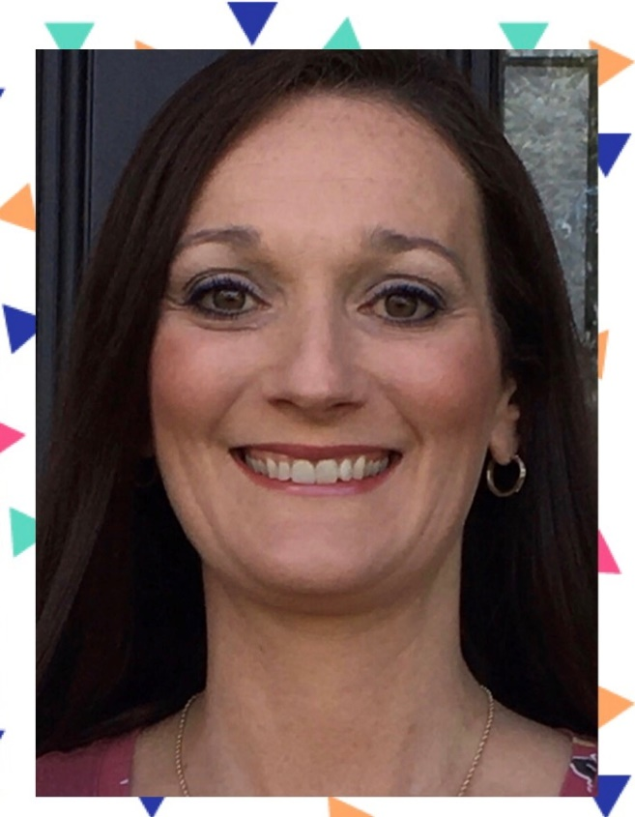
Meet Ms. Quattlebaum
Teaches English Language Arts.
Bachelors From WGU
Masters in Math and Reading from Walden University.
Teaching for 7 years now.

Slide 3
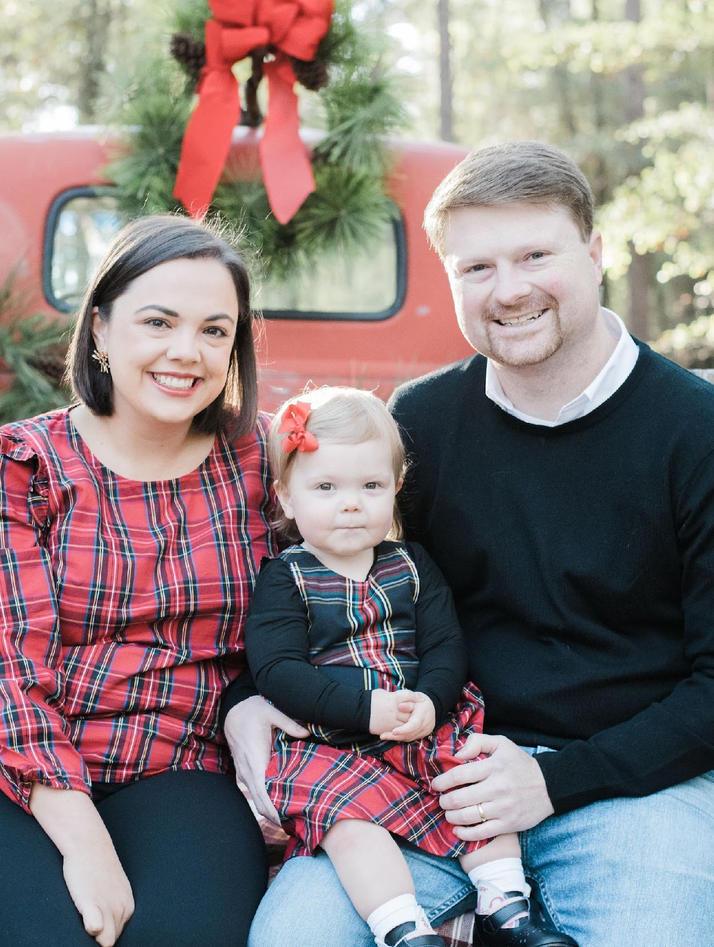
Meet Ms. Worthington
Teaches Math, Science, and Social Studies
Bachelors from Middle Georgia State University
Masters in Early Childhood Education from University of North Georgia
7th year teaching

Slide 4
Classroom Management
1. Be kind and respectful to each to each other.
2. Follow the directions from the teachers.
3. Be prepared with materials.
4. Take chances and risks.
5. Always give your BEST effort.
Mrs. Worthington and I believe in rewarding good choices with 4th grade bucks! At the end of every month, they can be cashed in for prizes.

Slide 5
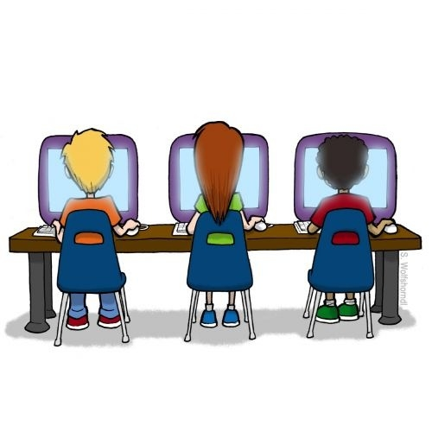
Technology
Google Classroom
ClassDojo
IXL
DiscoveryEd
Flocabulary
Iready
Xtramath
This Photo by Unknown Author is licensed under CC BY-SA-NC

Slide 6
Agendas
Students are not required, but highly encouraged to have to keep students on track. They can be purchased from the front office for $5.
Homework will be written in them as well as upcoming tests.
While we do announce tests on ClassDojo we want the students to begin practicing responsibility and to be able to tell you when tests are!

Slide 7
Homework
Homework will be assigned to the students every Monday and due each Friday.
Math: One math page with 4 problems to do each day. (A total of 16 problems.)
Reading: One reading passage with comprehension questions.
** This is subject to change throughout the year.

Slide 8
Non-negotiables
All work requires:
Name
When a student is absent they have 5 school days to complete any missing assignments per County policy. Any work given during their absence is available in the classroom absence folder the day they come back or is given to them by their teacher on Google Classroom.
Homework is due on the day communicated by the teacher by 9am.

Slide 9
Morning Arrival
As soon as students arrive, they will need to prepare for the day by gathering materials, using the restroom, and making their lunch choice. The board at the front of the classroom will have their morning work choices for that day.
We have started a “Soft Start” morning with our classes. Students have the opportunity to play a game, color, or work on any work they want to finish.

Slide 10
Specials
Our specials time is 9:55-10:45
We will rotate weekly between: Art, PE, Computer Lab, and Music.
If it is a P.E. week, they will need to make sure they wear tennis shoes or bring tennis shoes everyday!

Slide 11
Friday Binders
Every Friday your child’s graded papers will be sent home in the Friday Binder. Please make sure you take the time to look over your child’s work before you sign and return. Please leave all graded work in the binder until the end of the 9 weeks, then we will reorganize them in class.
Signed Friday Binders are due back on the following Monday so you child can earn a 4th grade buck.

Slide 12
AR
Lake Joy uses the Accelerated Reader program to encourage our student’s reading habits. They can earn prizes throughout the year for reading and testing over their books.
Every Monay your student will be able to check out a book from the school library. They know they must choose books they haven’t read/tested over before as well as books that are on their reading level to help improve their reading. Students will also be able to go to the library before school after checking in with their homeroom teacher!
In order to attend AR Fun day at the end of the year your student MUST earn 35 AR Points and have AT LEAST an 80% Average.

Slide 13
Tests
In most subjects the students can use the guided work and interactive notebooks that we create in class in order to study.
It is their responsibility to bring these notebooks home, although we will remind them every time we announce an upcoming test. It is vital that your students begin to develop their study habits now to help them be successful in 4th grade and beyond.
If they bring their notebooks home to study, they must also bring them back the next day as we will still be utilizing them in class.

Slide 14
PQRS
This is a comprehension strategy that 4th grade uses. This strategy will be implemented cross-curriculum.
P: Predict the genre
Q: Read the Questions. Circle question words.
Underline key words. R: Read the passage and highlight the key words S: Solve the questions. Underline where you find
your answer and write Q1, Q2, Q3 by it.

Slide 15
Important Math Information
It is extremely important that your student is fluent with their math facts (addition, subtraction, multiplication, and division). 4th grade math standards rely fact fluency. If your student is not fluent, please work 10-20 minutes daily on math facts. Students can practice on XtraMath, use flashcards ( I get mine from Dollar Tree or Amazon) or use other resources to practice. They will struggle this year in math if they are not fluent.
S

Slide 16
Afternoon Dismissal
Please make sure your student knows how they are getting home every day. Any changes from their normal routine must be communicated to the office. While we appreciate a message informing us of any changes, it is the front office that parents should notify first.

Slide 17
Communication
Please feel free to message us if you have any questions on ClassDojo. Alternatively, you can write in your student’s agenda or email us at:
Victoria.quattlebaum@hcbe.net
Megan.worthington@hcbe.net
We will respond to your email as soon as possible- if you do not get a response within 24 hours your email probably went to SPAM please write us a note to check our SPAM folder, and we will asap!

Slide 18
Handle With Care
If your family is experiencing a difficult time at home, we would like to provide additional supports at school. We understand you are not always able to share details and that's okay. If your child is coming to school after a difficult night, morning, or weekend, please email or DOJO us "Handle with Care." Nothing else will be said or asked. This is to let us know that your child may need extra time, patience or help during the day.

