Slide 1
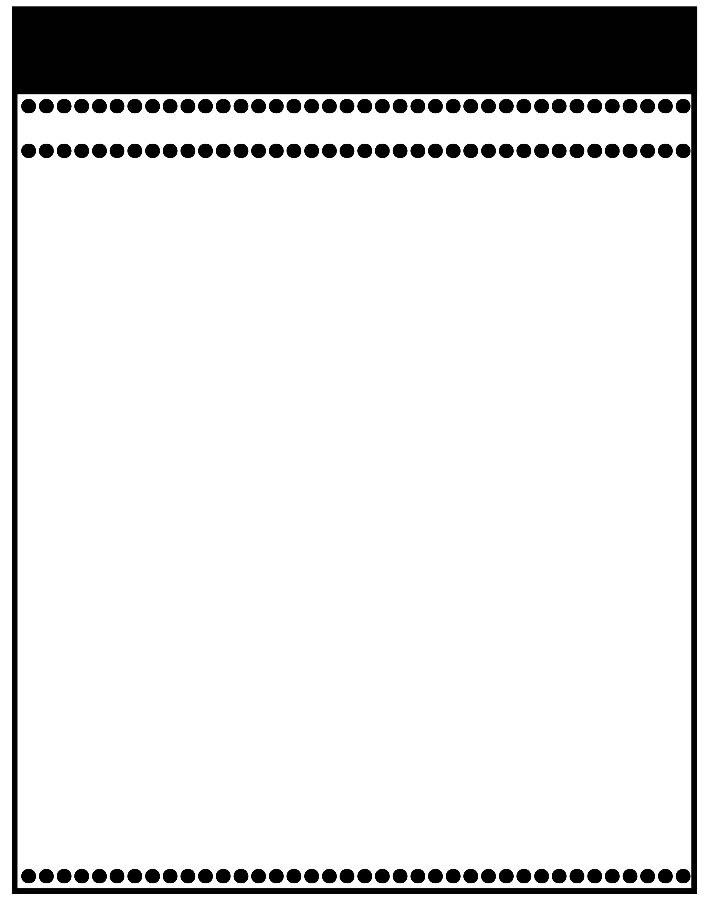
Branning’s Buzz
Dec. 12:Christmas Program at 8:30
Nov. 25-29: Thanksgiving Holidays
Week of: November 18-22, 2024
What’s Happening
This Week
Upcoming Events
This is Book Fair week in the Library. Money must be in a labeled envelope.
Tuesday Folders will be sent home Tuesday.
Nov. 18: Impact Aid forms due
Nov. 19: Hearing Screening
Nov. 22: PPS Spirit Day: Wear camo.
Please send in a dark gray short or long sleeve t-shirt for our Christmas Program by Dec. 2nd.
Nov. 25-29: Thanksgiving Holidays
Dec. 12: Christmas Program at 8:30
Christmas Holidays
Please review test papers & return them to school. Sign the page in the folder. Please don’t keep pages at home as I keep them on file for the entire year.
If you have questions or concerns, you may email me at Wendy.branning@acboe.net or message through Parent Square.
A Peek At What We Are Learning
Reading | Phonics: ink, ank, onk, unk. Qu Review v, ve, open & closed syllables
Writing | Imperative Sentences 11/18 Dictation
Math | Topic 4: Subtraction Facts to 20 11/21 Fact Families Minor Grade
Science | NA (We alternate weeks for SS/Science).
Social Studies | The First Thanksgiving
Spelling Words
No Spelling Test will be given until Unit 7.

