Slide 1








GETTING READY
FOR KINDERGARTEN

Slide 2

AGENDA
GKIDS (Kindergarten Report Card)
How to Help at Home
Moving From Pre-K to Kindergarten
End of Year Goals

Slide 3

WHAT IS GKIDS?
GKIDS stands for Georgia Kindergarten Inventory of Developing Skills.
It is a progression-based assessment that is aligned with the Georgia Standards of Excellence. GKIDS is considered the report card For Kindergarten.
What subjects are covered?
English Language Arts
Math
Approaches to Learning
Personal and Social Development

Slide 4




learning Progressions for gkids 2.0
LOOK INTO ELA
EXCEEDING STAGE
LEARNING PROGRESSION SHOWS WHERE THE STUDENT IS IN THE LEARNING CONTINUUM OF CONTENT AND REASONING DEVELOPMENT
DEMONSTRATING STAGE
Independently reads common sight words in early readers
level D
DEVELOPING STAGE
Independently reads common sight words in emergent readers level C
EMERGING STAGE
Independently reads common sight words in emergent readers levels B/C
BEGINNING STAGE
Independently reads common sight words in decodable books levels A/B
Identifying sight words

Slide 5
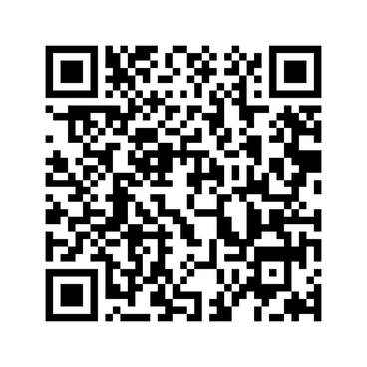





PARENT RESOURCES
UNDERSTANDING YOUR CHILD’S RESULTS
Additional information on the skills measured by each learning progression, as well as resources to help you support your child at home, can be found on the GKIDS 2.0 parent resource website

Slide 6
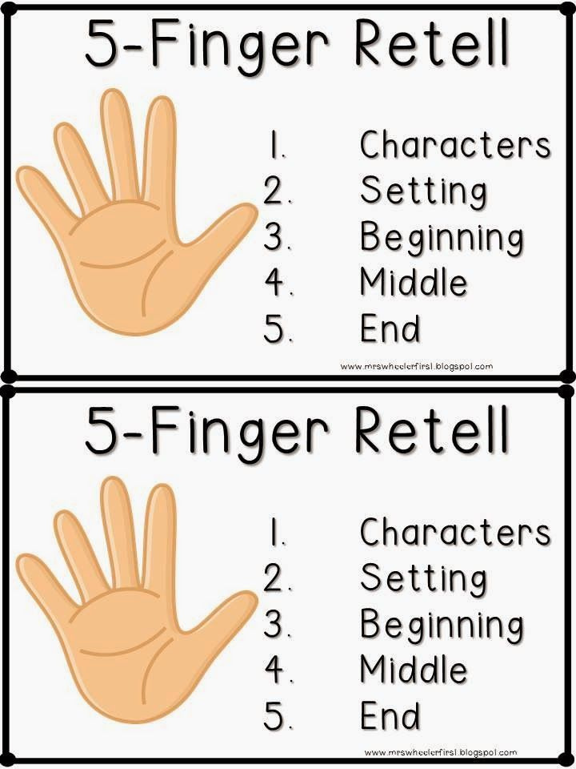

HOW TO HELP AT HOME?
Fine Motor Skills
Reading & Writing
Hold a pencil and crayon
Scissor cutting
Tearing paper
Recognizing their name and the letters in their name
Practice writing their name with first letter being uppercase
Drawing pictures
Environmental print awareness
Reading with your child and asking questions about the story
Math
Sorting items (socks, buttons, toys, etc.)
Counting out loud as high as they can go
Counting objects to 20
Looking for shapes

Slide 7
MOVING FROM PRE-K TO KINDERGARTEN
TO BE READY FOR KINDERGARTEN
I can write my First name
I can count to 20
I can listen to a story
I know my colors
I know my age and birthday
I can draw a picture
I can listen and follow multi-step directions
I can accept redirection

Slide 8
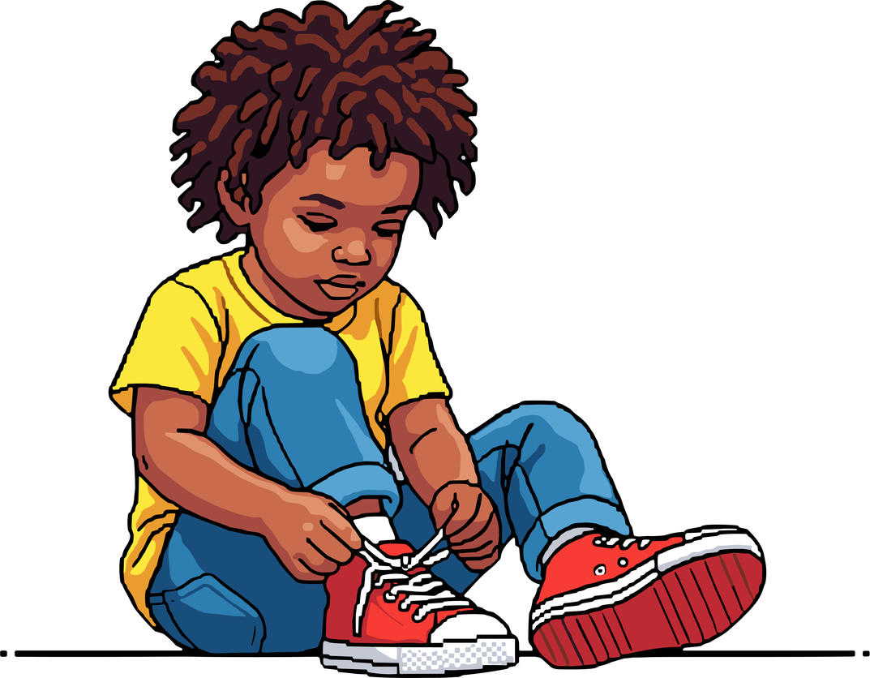

INDEPENDENCE IS KEY
I can go to the bathroom by myself
I can clean up after myself
I can open my own snack (bags, cartons, juice box, etc.)
I can put on my own jacket and shoes
I can keep up with my own stuff (pencils, crayons, jackets, etc.)
Side Note: Put your child's name on the inside tag of their Jacket

Slide 9
END OF THE YEAR REQUIREMENTS
WHAT STUDENTS SHOULD KNOW BY MAY
Reading
Math
Writing
Writes all letters
Writes sounds to CVC words (cat, dog, etc.)
Writes on a topic using a complete sentence and illustration
Consistent usage of spacing, punctuation, and capitalization.
Able to spell and write sight words
Letter Identification and Sounds
Sight Words (22+ words)
Reading decodable words (CVC)
Comprehension of text
Fluency of CVC words
Counting Forward to 100 by 5s and I0s
Counting backwards from 20 by l's
Counting a set of objects to 20
Writing numbers to 20
Comparing numbers
Fluently adding and subtracting within

Slide 10



THANK YOU FOR Joining US!
ANY QUESTIONS?

