Slide 1
Welcome to 5th Grade!
2024-2025
Mrs. Douglas & Mrs. Dunkerson

Slide 2
Meet the Teachers
From Mrs. Douglas: I am a wife to my amazing husband, Eric. We have two boys. My oldest is 16 (11th grade) and my youngest is 14 (9th grade). My oldest is at Prattville High School and plays on the Varsity baseball team. My youngest is also at Prattville High School and he plays football and baseball. This is my 22nd year teaching. I have taught 3rd for 15 years, 2nd grade for a year, 4 years in 4th grade, and this is my third year in 5th grade! I previously taught in Montgomery County Public Schools before transferring to Autauga County. I am excited for this school year and can't wait to see what all it brings!

Slide 3
Meet the Teachers
About Mrs. Dunkerson:
My name is Breannan Dunkerson and I am from Prattville. I am married to my husband Corey, and we have two boys, Collin and Cole. I graduated from Auburn University Montgomery, with a bachelor's degree in Early Childhood Education (birth-6th grade). I received my master's degree in Elementary Education from University of West Alabama. During my free time, I enjoy traveling, cooking new things, and spending time with my family and friends. I am so excited to meet your student and look forward to getting to know them this year.

Slide 4
Communication
-Throughout the year, we will keep you informed of things going on in the classroom and of your child's progress. Which includes:
- Parent Square- Is our primary means of communicating with you.
-Friday Folders- Graded assignments for the week. Please review the graded papers, sign any sheets that are 69% or below and return the folders on Mondays. These folders will go over every two weeks.
-Power School- Is also available (for FREE) for you to check your child's grades.
Notes:
Dear Parents,
The fourth grade teachers at Daniel Pratt Elementary would like to welcome you and your child to fourth grade. We are very excited to have your child in our classrooms. We are going to have a busy and productive school year. This year will be filled with many different activities designed to educate, motivate, and challenge your child.
Each year as your child gets older and changes grades, they experience changes in rules, routines, and responsibilities. We hope to make the transition to 4th grade as easy as possible by working together.
==== We are looking forward to sharing this school year with you and your child. We know we are going to have a great year!
Sincerely,
Mrs. Douglas & Mrs. LeFevre

Slide 5
Communication Cont’d./ Parent Square
We will be using Parent Square as a primary tool for communication. (e.g. events, behavior, reminders, etc.)
Please be sure to join our classes to receive updates

Slide 6
Communication Cont’d.
- Positive interactions between the teachers and parents strengthens the feeling of support all children need for success in school.
- Contact us if you have any questions or concerns.
-Our planning time is 9:25-10:05 if you need to contact us during the school day. You can also reach us by Parent Square or email.
*meredith.douglas@acboe.net and breannan.dunkerson@acboe.net

Slide 7
School Supplies
Planners will be provided- Students are
responsible for writing down all
important assignments and due dates
each week.
School supply lists are on the DPES
Website..

Slide 8
Teacher Wish List
Boys: Gallon size Ziploc bags
Girls: Sandwich size Ziploc bags
Hand sanitizer
Plug Ins- Air Wick (cinnamon or vanilla)
Kleenex Tissues
Board games for room
Band Aids
Swiffer Wet Jet and refills
Clorox Wipes

Slide 9
A Few Important Facts
Breakfast is from 7:10 A.M. - 7:55 A.M. in the lunchroom
Lunch at school at : 12:17P.M.
*Breakfast and lunch are FREE this year!!!!!!!

Slide 10
Lunch Information
Way to eat lunch with your student(s):
Family Lunch Days
Watch Parent Square for upcoming dates.

Slide 11
Students can purchase snacks before 8:10
Snack Shack is located next to the lunchroom, (all items priced from $0.25 to $1.25)

Slide 12
Water Bottles
Students should bring their own water bottles daily
They will be allowed to keep these with them at their desks
Students are responsible for their water bottle during transitional periods
Containers with screw on tops are encouraged

Slide 13
Classroom Information
Your child will be changing classes this year:
Reading and Language Arts - Mrs. Douglas.
Math, Science, and Alabama History- Mrs. Dunkerson
Your child will take all supplies with him/her to their 2nd block classroom.

Slide 14
Homework
Planners:
Overview
Student responsibility aspect
Homework Packets (Reading)- will be given out each Thursday.
They are due the following Thursday each week. Each day late
Is –10 Points. They are GRADED each week.

Slide 15
Forms
Please ensure the following forms are signed and returned by, Friday, August 9:
White Emergency Card
Photo/Video Form (Autauga Co Handbook)
Student Information Sheet
Starbase Permission Slip

Slide 16
Forms (Cont’d.)
Please fill out and leave the student information sheet that was provided today.
We must know how your child will be getting to and from school If transportation changes we must be notified! Please write a note or send a message in Parent Square to their afternoon teacher.

Slide 17
Classroom Locations
Mrs. Douglas and Mrs Dunkerson’s rooms are located on the purple hall.
Mrs. Douglas is the first room on the right, room 602
Mrs. Dunkerson is across the hall, room 601.
Look for our classroom hangers located above each door to help you find your way around DPES!

Slide 18
Important Reminders
Weekly Happenings:
Weekly information regarding what’s happening in the classroom will be available on our DPES staff webpage.
www.dpeseagles.com
Click School Staff
Find our names.
Study resources will be listed on our staff webpage too!
*Disclaimer: All posted plans are subject to change.
Notes:
Link to district school calendar: 2022-2023 SCHOOL CALENDAR.pdf

Slide 19
Important Reminders (Cont’d.)
Please Check the Following Things on the DPES Website:
For news and updates
Sign up for Notify Me (on the school website) for important school information. There is a call out each week with upcoming events.

Slide 20
Grading Policy
All subjects will be 60/40.
60% ~ Major Grades (tests, projects, writing projects,
presentations, etc.)
40% ~ Minor Grades (skills practice, fluency assessments, quizzes, DMR, homework, etc.)

Slide 21
Transportation Information
Car riders:
Carpool tags are mandatory (Pink sign in your folder)
Front parking lot closed until 8:00 A.M. daily
Front parking lot closed from 2:30 P.M. – 3:15 P.M. daily

Slide 22
Change in Transportation
Please send a note with your child
Your child will need to give the note to me upon arrival to school & should include:
Your name, his/her name, date and how he/she will be getting home that day
Only written changes of travel will be accepted

Slide 23
Quick Reminders Per Mr. Thornton
Day 1 : Walking child(ren) to class
8:00-8:30
Enter through Purple Hall doors
Per Student Handbook, please no fidget spinners, poppers, etc. in school
All deadlines for turning in funds are final! No money will be accepted in the office.
To receive the Sunday Call-Out messages, you must have the correct number in PowerSchool

Slide 24
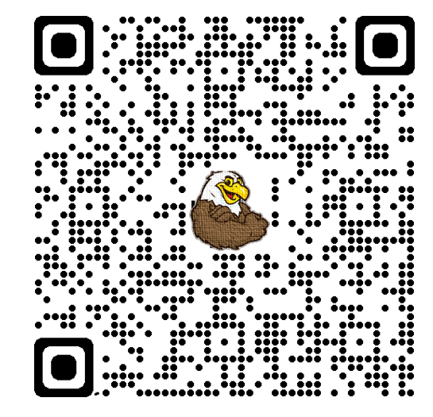
We would love to have you present about your career at our next Career Day! If you would like information please complete this form.
https://forms.gle/91H4nZ4DNmM7BQp39
This link is also available on the DPES website under the Counselor’s page !

Slide 25
The End!
We look forward to seeing you on the first day of school!

