Slide 1
ANNUAL TITLE I PARENT MEETING
August 28, 2024
Shirley Hills Elementary

Slide 2
What is a Title I School?
The purpose of Title I under ESSA is to “ensure that all children have a fair, equal, and significant opportunity to obtain a high-quality education and reach, at a minimum, proficiency on challenging state academic achievement standards and state academic assessments.”
A Title 1 School works to:
Identify students most in need of educational help Set goals for improvement
Measure student progress and develop programs that add to classroom instruction
Involve parents in all aspects of the program

Slide 3
Instructional Supplies
Technology
Professional Development Family Engagement Liaison
How Does Shirley Hills Spend Title I Funds?

Slide 4
Shirley Hills Elementary is a School- Wide Title I school, therefore ALL students benefit from Title I resources.
Title I School-wide Requirements for Shirley Hills Elementary

Slide 5
Shirley Hills Elementary School-Wide Program and School-Wide Goals
Goal #1: In order to strengthen student’s reading performance at Shirley Hills Elementary, the school will be committed to keeping a focus on the three big ideas of a PLC: Creating a collaborative culture, becoming results oriented and sustaining a focus on learning as evidenced by the employment of the protocols we have in place to increase the percentage of students reading on and above grade level as measured by MAP Lexile and GMAS by 5% this year over the cohort’s previous year’s scores.
Goal #2: Professional Learning Goal Statement: In order to strengthen the multi-tiered systems of support at Shirley Hills Elementary, the teacher will improve and consistently implement with fidelity the RTI (academics: literacy and mathematics) and PBIS (behavior) structures and procedures daily as evidenced by the employment of researched based interventions and strategies during the 2024-2025 academic school year.

Slide 6
What programs/supports are in place to help my child?
Flexible Learning Program
I-Ready
School Provided Computer
Educational Websites
Resource Teachers Parent Academic Events
PBIS
Professional Learning for Staff
Early Intervention Program Teachers (EIP)
After-School Tutoring
Parent Resource Center Parent Lending Library

Slide 7
Which Curriculum does our school use?
The Georgia Standards of Excellence provide a consistent framework to prepare students for success in college and/or the 21st century workplace.
The performance standards provide clear expectations for instruction, assessment, and student work.
The performance standards isolate and identify the skills needed to use the knowledge and skills to problem-solve, reason, communicate, and make connections with other information.
They also tell the teacher how to assess the extent to which the student knows the material or can manipulate and apply the information.
The performance standard incorporates the content standard, which simply tells the teacher what a student is expected to know (i.e., what concepts he or she is expected to master).

Slide 8
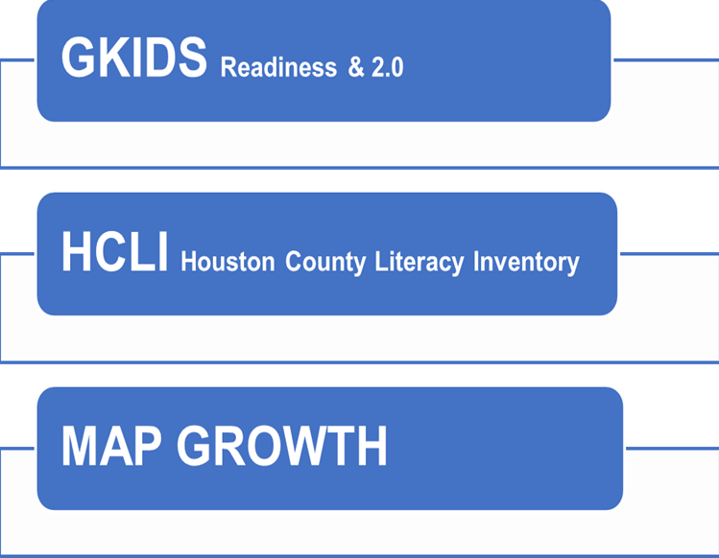
What tests will my child take?
Kindergarten ONLY & is on-going
GMAS
Georgia Milestones Assessment
Kindergarten – 5th Grades administered Fall, Winter, & Spring
3rd – 5th Grades ONLY administered in Spring
1st – 5th Grades administered Fall, Winter, & Spring

Slide 9
Family Engagement Requirements
The law requires a 1% set-aside of Title I Funds be allocated for a District Parent and Family Liaison
Parent and Family Liaison Salary
Parent Workshop Materials
Conferences
Programs that will improve student achievement and include ways to help parents help their children succeed (Building Capacity) Parent input in the development of a written Parent & Family Engagement Plan
Shared Decision-Making Opportunities Title I Handbook
Parent & Family Engagement Plan School-Parent Grade Level Compacts

Slide 10
Family
School Level Plan
The Engagement Plan describes how our school will
provide opportunities to improve family engagement
_{Engagement} that will support student learning at school and at home.
Plan
All students and their families are invited and
encouraged to fully participate in the opportunities
described in this plan. The school will provide
information and as many opportunities as possible
for the participation of all family members.
District Engagement Plan

Slide 11
What is a
School-Parent Compact?
The Compact explains what teachers, parents and students each will do in an effort to work together to make sure that our students reach grade level standards.
The Compact is discussed with families
during parent-teacher conferences throughout the school year.

Slide 12
Is my child’s teacher qualified?
What is Parent Right to Know?
All Shirley Hills Teachers are
are Highly Qualified.

Slide 13
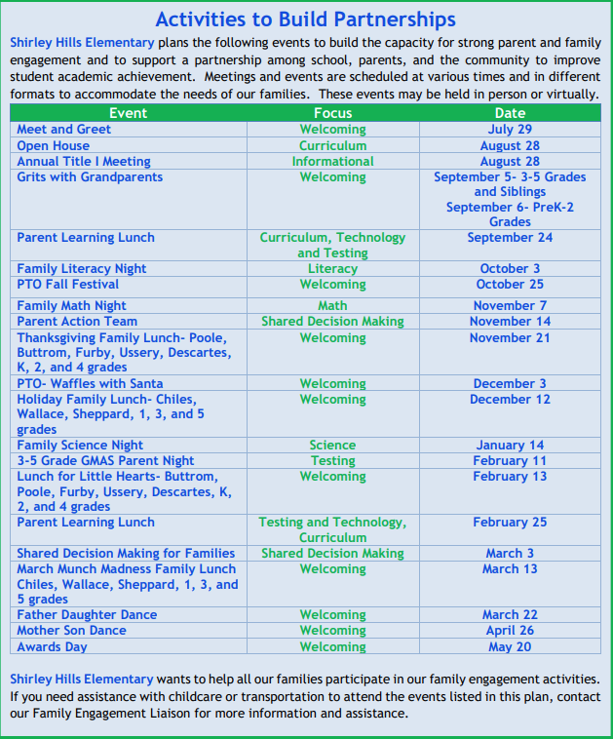
Parent & Family Engagement Opportunities

Slide 14
Staff Capacity for Family Engagement
The Staff of Shirley Hills Elementary are required to participate in four (4) professional development trainings designed to enhance and encourage Family Engagement.

Slide 15
Contact us with any questions you have, and we will address your concerns as quickly as possible!
Shes.hcbe.net
Mrs. Kristen Brooks, Principal
Mr. Matthew Dewitt, Asst. Principal for Discipline Mrs. Charlotte Dunlap, Asst. Principal for Instruction
(478) 929-7824
Heather Bowen, Family Engagement Coordinator
(478) 210.8075 or via email at heather.bowen@hcbe.net

Slide 16
Other Federal Programs
For more information about these programs contact:
Patricia Lane - McKenney-Vento Homeless Program Rosalin Rodriguez and Jessica Perez- ESOL
Araceli Ulmer- Migrant Education

Slide 17
Questions?????
Thank You!

