Slide 1
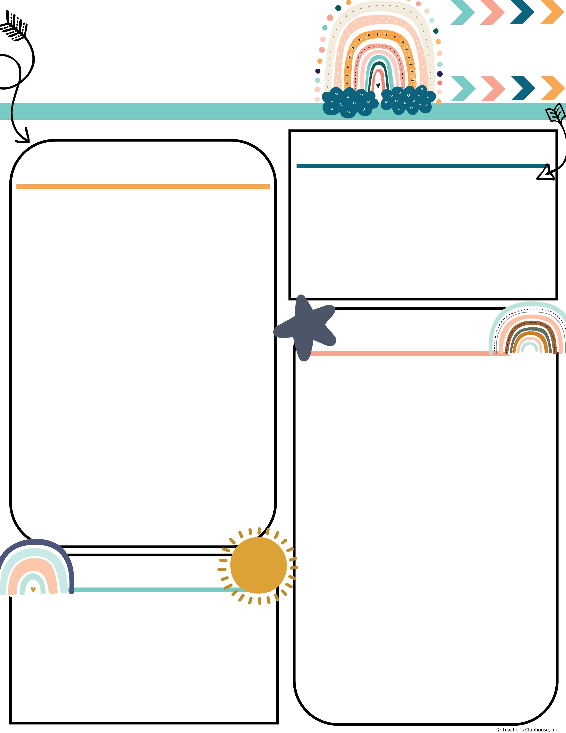
Every Student Empowered. Every student succeeds.
Second Grade, E122
334.285.0273
Remind App @6bc96eg
joan.johnston@elmoreco.com
Ms. Johnston’s
Newsletter
Week of October 14 - October 18, 2024
Upcoming Events
A Peek at Our Week
October 17th ~ Report cards go home and Thanksgiving lunch forms are due
October 21st ~ Be a champ reading logs are due
October 25th ~ Glow Run Fundraiser
October 28th ~ Happy Birthday Roderick!
October 28 ~ Red Ribbon Week
October 31st ~ Candy Grab! Send a bucket with your child.
Reading:
Reading:
Benchmark
Long u: u, ew, ue, u_e
Great link to decodable books! I encourage you to utilize this free resource:
https://portal.flyleafpublishing.com/learners-resources/
Word Study: cube, cue, cute, few, huge, January, menu, music, rescue, use
Grammar:
Verb Tenses ~ past, present, irregular
  EX: eat, ate, eaten; go, went, gone
Comprehension:
Main idea/ Details
Describe a connection between a series of events
Demonstrate understanding of different points of view
Math: Review
Use arrays to find totals
Writing/Language:
Writing complete sentences
Write an opinion essay on a book character
Science/Social Studies:
Code.org; American flag, and Statue of Liberty
Weekly Homework
Please check your child's folder for their homework that will be due on Friday
Tests this week
Math ~ Topic 2 Test on Arrays Friday
Quarter 2 Sight Words:
Week 1: again, below, carry, does, eight, find, house, laugh, mother, school
Please send in bags of candy for the candy grab!
Reminders
PTO Membership $10/Family
Class with most participation wins a party!
Attendance Matters! Be Present, Be Powerful!

