Slide 1
Alabama Literacy Act
For Families and Communities
Notes:
1
1
1
1

Slide 2
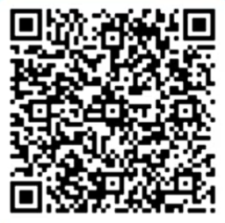
Overarching Outcomes
Participants will:​
Develop an initial understanding of the Alabama Literacy Act and its impact on classroom instruction and students’ growth/achievement.​
Set goals for at-home literacy support.
2024-2025 Sign-in link
https://forms.office.com/r/ZpxYTGr8qm
Notes:
4 min.
Handout 1- Microsoft link QR Code_ALA for Families Sign-in 2024-2025
Handout 1- Google link https://drive.google.com/drive/folders/1fCerLSFBFIMCVriDk4E-VwuCDXXqRRab?usp=sharing
Handout 2 (a school-created sign-in sheet)
Handout 3- Microsoft link Family and Community Involvement Communication Tool- ALA Family Communication Tool (Microsoft link)
Handout 3- Google link Family and Community Involvement Communication Tool- https://drive.google.com/drive/folders/12NRZ6Ytlqkri9Mrrg7_84DhDZMfLZPYG?usp=sharing
Handout 4- ALA FAQ for Families August 2024.pdf
Handout 4- https://drive.google.com/drive/folders/1BbllShQYnaE_Y-Q9QGXDh6UXp6snx7cd?usp=sharing
Handout 5- Microsoft link Family and Community Support Resources (Microsoft link)- Updates Family & Community Resource Support QR CODES
Handout 5- Google link Family and Community Support Resources (Google link)- https://drive.google.com/drive/folders/107L3NTM1wJrkNujIqwDFvoh42wkNqC-C?usp=sharing
Have participants sign in with the QR Code on the slide but also use (Handout 2: a school-created sign-in sheet) in case of technical difficulties.
2024-2025 Sign-in link
https://forms.office.com/r/ZpxYTGr8qm
Be sure to provide support with completing the sign-in. Families will be asked to identify their region. We want to be sure this information is accurate.
Have participants read the outcomes.
Say: I hope that today you leave with:
an initial understanding of the ALA,
ways to support your students’ growth and achievement,
And activities you can use at home to promote literacy.
If parents are unable to sign in due to internet issues, the LRS will need to submit the parent information to the QR code after the session.
2

Slide 3
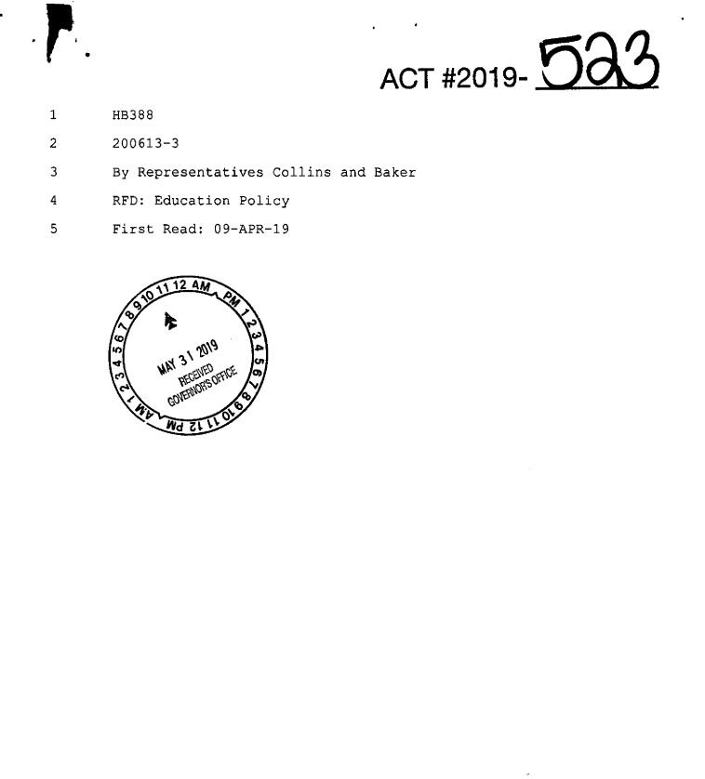
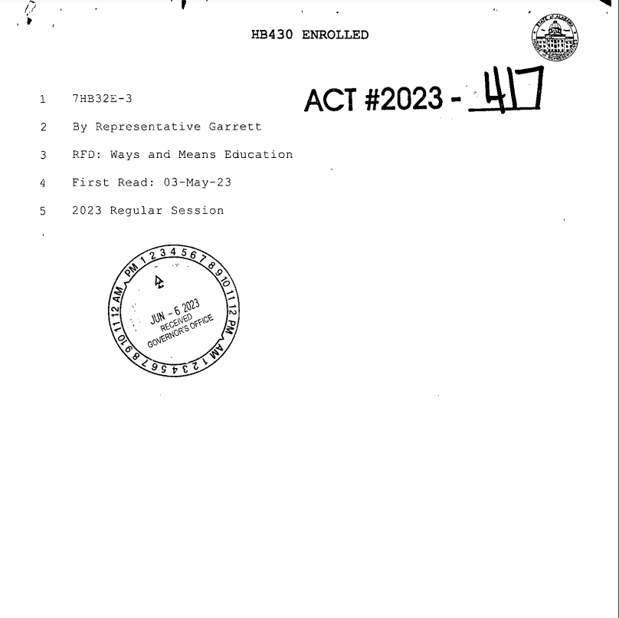
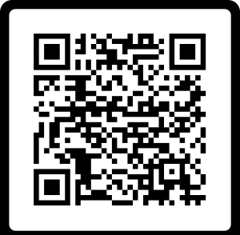
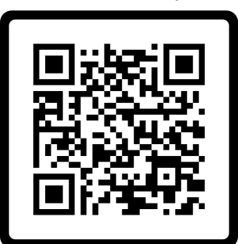
WHAT IS THE ALABAMA LITERACY ACT?
Purpose:
To implement steps to improve the reading proficiency of public-school kindergarten to third grade students and ensure that those students are able to read at or above grade level by the end of the third grade by monitoring the progression of each student from one grade to another, in part, by his or her proficiency in reading.
(Page 1, Lines 4-9)
Notes:
1 min.
Say: The purpose of the ALA is to ensure that all students are proficient readers by the end of 3rd grade.
This is a picture of the actual ALA. We want students reading at or above grade level by the time they exit 3rd grade. We do this by monitoring their progress in reading proficiency from grade level to grade level starting in kindergarten.
3

Slide 4
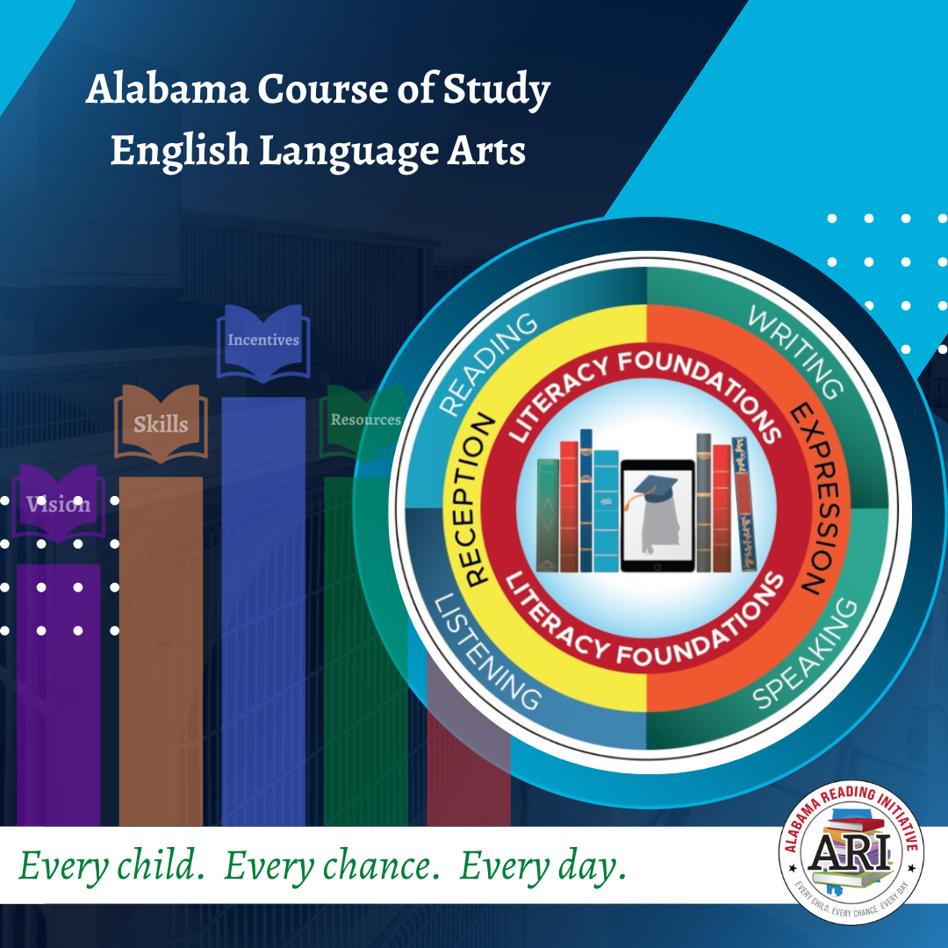
CURRICULUM & STANDARDS
2021 ELA COS supports essential learning to improve reading proficiency in accordance to the ALA.
Standards focus on foundational skills needed to support literacy development.
Development of the standards was guided by the science of reading.
Standards that define the minimum content of what learners should know and be able to accomplish at each grade level.
Notes:
1-2 min.
Read parent friendly bullets
Bullet 2 - Read the parent friendly definition of the Science of Reading:
The science of reading is a body of research from thousands of studies which have revealed how we learn to read, what goes wrong when students don't learn, and what kind of instruction is most likely to work the best for most students. (Moats, 2020 & Reading League).
4

Slide 5
Every child. Every chance. Every day.
Scientifically-based reading instruction and multisensory language instruction in the following areas:
Oral language development
Phonological awareness
Phonics
Fluency
Writing
Vocabulary
Comprehension
Notes:
1 min.
On this slide, we have information about the different parts of tier one instruction, which is the main reading instruction for all students.
You'll see the scientifically proven instructional components. These are the essential elements that are backed by research and help students learn effectively.
The tier one reading block includes both whole group instruction, where the entire class learns together, and small group instruction, where students receive personalized support based on their individual needs.
It's important to note that all students get opportunities to practice what they've learned through connected activities. This ensures that every student can apply and reinforce their reading skills.
Every child. Every chance. Every day.
5

Slide 6
INTERVENTION REQUIREMENTS
Additional instructional time spent on proven methods of reading instruction and intervention
Daily small group reading intervention that focuses on what the student needs
Frequent monitoring of the progress of the reading skills of each student throughout the school year and adjusting instruction according to student need
Notes:
5 min.
Handout 3 Family & Community Support QR Codes Family & Community Support Resources 2024.pdf
SAY:
One way we can meet these intervention requirements is through Tier 2 instruction. If, for example, you have students with multiple areas of deficiency, teachers will provide targeted instruction on a specific deficiency during Tier 2. This is a great way to bring in additional multisensory strategies. Reference your Parent Resource handout for activities that can be used at home as you practice foundational reading skills with your student at home.
FACILITATORS: Here are some examples that could be used to demonstrate multisensory instruction if ideas are needed.
Multisensory Strategies:
Letter Naming Fluency deficiency – work with alphabet arcs.
LWSF deficiency – if the need is accuracy: work with letter/sound correspondence (tactile experiences such as sand trays/fingerpaints/etc. child writes a letter as he/she says sound aloud) If the need is automaticity: work with RAN activities (letter names, sounds, objects, numbers – focus here is on strengthening the processing speed from print to speech) NOTE: Reading nonsense words is not a SKILL. It is an INDICATOR of student blending ability.
NWF deficiency – work with blending (blending boards, blending lines, analytic phonics (word families), etc.) Simply drilling nonsense words will not correct the foundational issue and is not a best practice for instruction.)
WRF deficiency – if accuracy: work with strategies for decoding non-phonetic patterns, such as heart word strategies, explicit phonics instruction, phoneme-grapheme mapping, etc. If fluency: practice with RAN activities using high frequency words)
ORF deficiency – if accuracy: explicit phonics instruction w/ additional multisensory elements. If fluency: explicit fluency instruction (phrasing, expression, prosody, etc.)
Vocab deficiency – Vocabulary preloading for the upcoming lesson, semantic mapping activities, LETRS vocabulary strategies
Comprehension deficiency – Explicit comprehension skill lesson, oral language building activities (read alouds / graphic organizers / writing activities)
Please note these are not the only activities that can be used, but they can help give you some ideas of ways to meet these specific deficiency areas.
6

Slide 7
Assessment
Screening and diagnostic information for monitoring student progress
Measure phonological awareness (hearing the sounds), the alphabetic principle (letter/sound knowledge), decoding (letter/word recognition), encoding (spelling), accuracy, vocabulary, and comprehension
Help to identify students who have a reading deficiency, including identifying students with characteristics of dyslexia
Notes:
2 minutes
Say: The ALA includes information specifically pertaining to assessing literacy. Students are screened, at a minimum, 3 times a year. (Beginning of the year, middle of the year, and end of the year). The screening data guides the instruction in the classroom.
Read bullets at the top.
Schools have selected an early literacy assessment that meets the requirements on this slide. Share with families the name of the assessment your school uses to screen students.
7

Slide 8
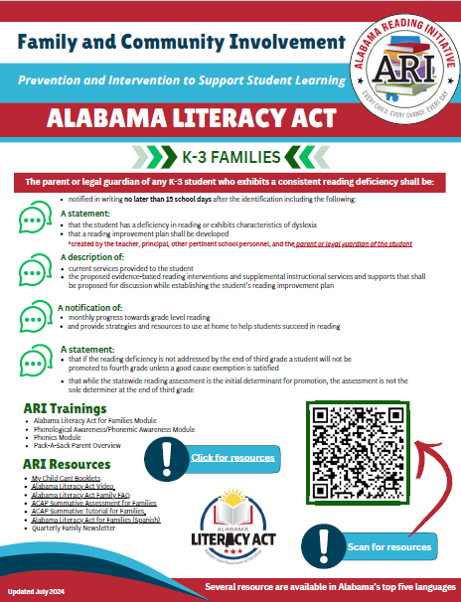
Student Reading
Improvement Plan (SRIP)
A guide for instruction for the student based on the specific deficiency in reading
Developed for the student by teachers and others in the school, along with parent input, within 30 days of the identification of deficit
Parents are notified monthly of progress
Intervention instruction is evidence-based reading intervention
The student will receive intense intervention until the student no longer has a deficiency in reading
Notes:
Discuss the process for developing Student Reading Improvement Plans using the five bullets. The ALA Family Communication Tool can be used as a guide for the school and families.
Handout 3- Microsoft Family and Community Involvement Communication Tool- ALA Family Communication Tool (Microsoft link)
Handout 3- Google Family and Community Involvement Communication Tool- https://drive.google.com/drive/folders/12NRZ6Ytlqkri9Mrrg7_84DhDZMfLZPYG?usp=sharing

Slide 9
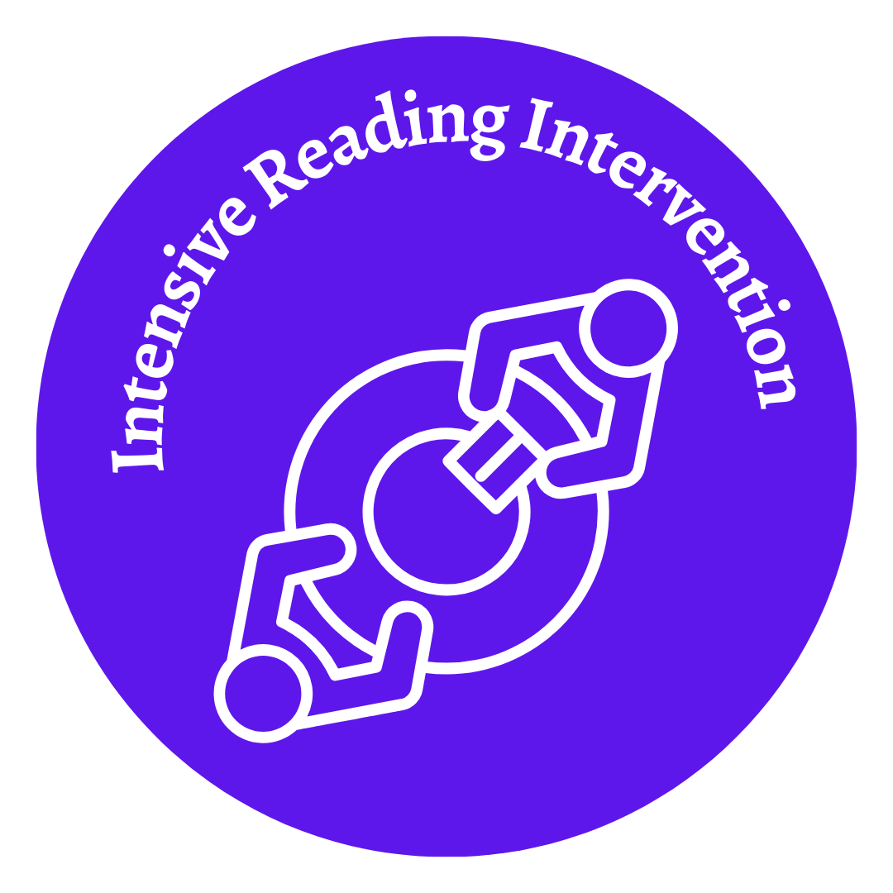
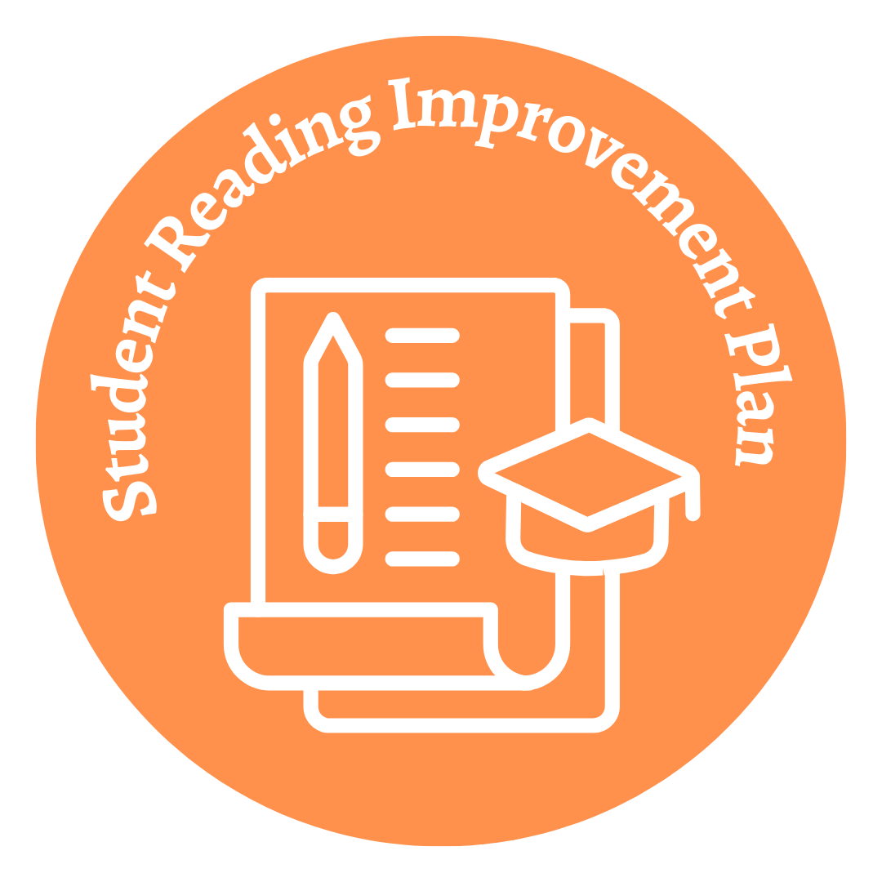
Layers of Support
Notes:
2 minutes
Say: These are the layers of support for a student with reading deficiencies according to the ALA - if multiple pieces of data support a consistent reading deficiency for a child, then the school notifies the parents/guardians of the identification and begins intervention supports in an effort to remedy the reading deficiency.
Fly-in each graphic representing the layers of support
As a reminder, the retention provision of the law went into effect during the 2023-2024 school year. The 2023-2024 3rd graders were the first students impacted by the promotion/retention requirement.
Every child. Every chance. Every day.
Facilitator Note: Before & After school tutoring varies at each school. Some schools offer tutoring before school and some schools offer tutoring after schools.
9

Slide 10
Summer Reading Camp
Alabama Summer Achievement Program is for all K-3 students in public elementary schools that are among the lowest performing five percent in reading
High quality summer reading camps at elementary schools that are not among the lowest five percent performing elementary schools
All K-3 students identified with a reading deficiency, or the characteristics of dyslexia
Notes:
2 min.
Say: In addition to in-school supports, schools are required to provide students who have an SRIP the opportunity to attend summer reading camp that includes 60 hours of scientifically-based reading instruction and intervention. Highly effective teachers will provide this instruction and use scientifically based instruction and interventions. Students progress will be measured before, during, and at the end of the summer reading camp.
10

Slide 11
Summer Reading Camp
A minimum of 60 hours of scientifically based reading instruction & intervention
May be held in conjunction with existing summer programs, designated as effective by the State Superintendent
High quality instruction with assessments administered at the beginning and end of the summer camp to measure progress
Notes:
2 min.
Say: In addition to in-school supports, schools are required to provide students who have an SRIP the opportunity to attend summer reading camp that includes 60 hours of scientifically-based reading instruction and intervention. Highly effective teachers will provide this instruction and use scientifically based instruction and interventions. Students progress will be measured before, during, and at the end of the summer reading camp.
11

Slide 12
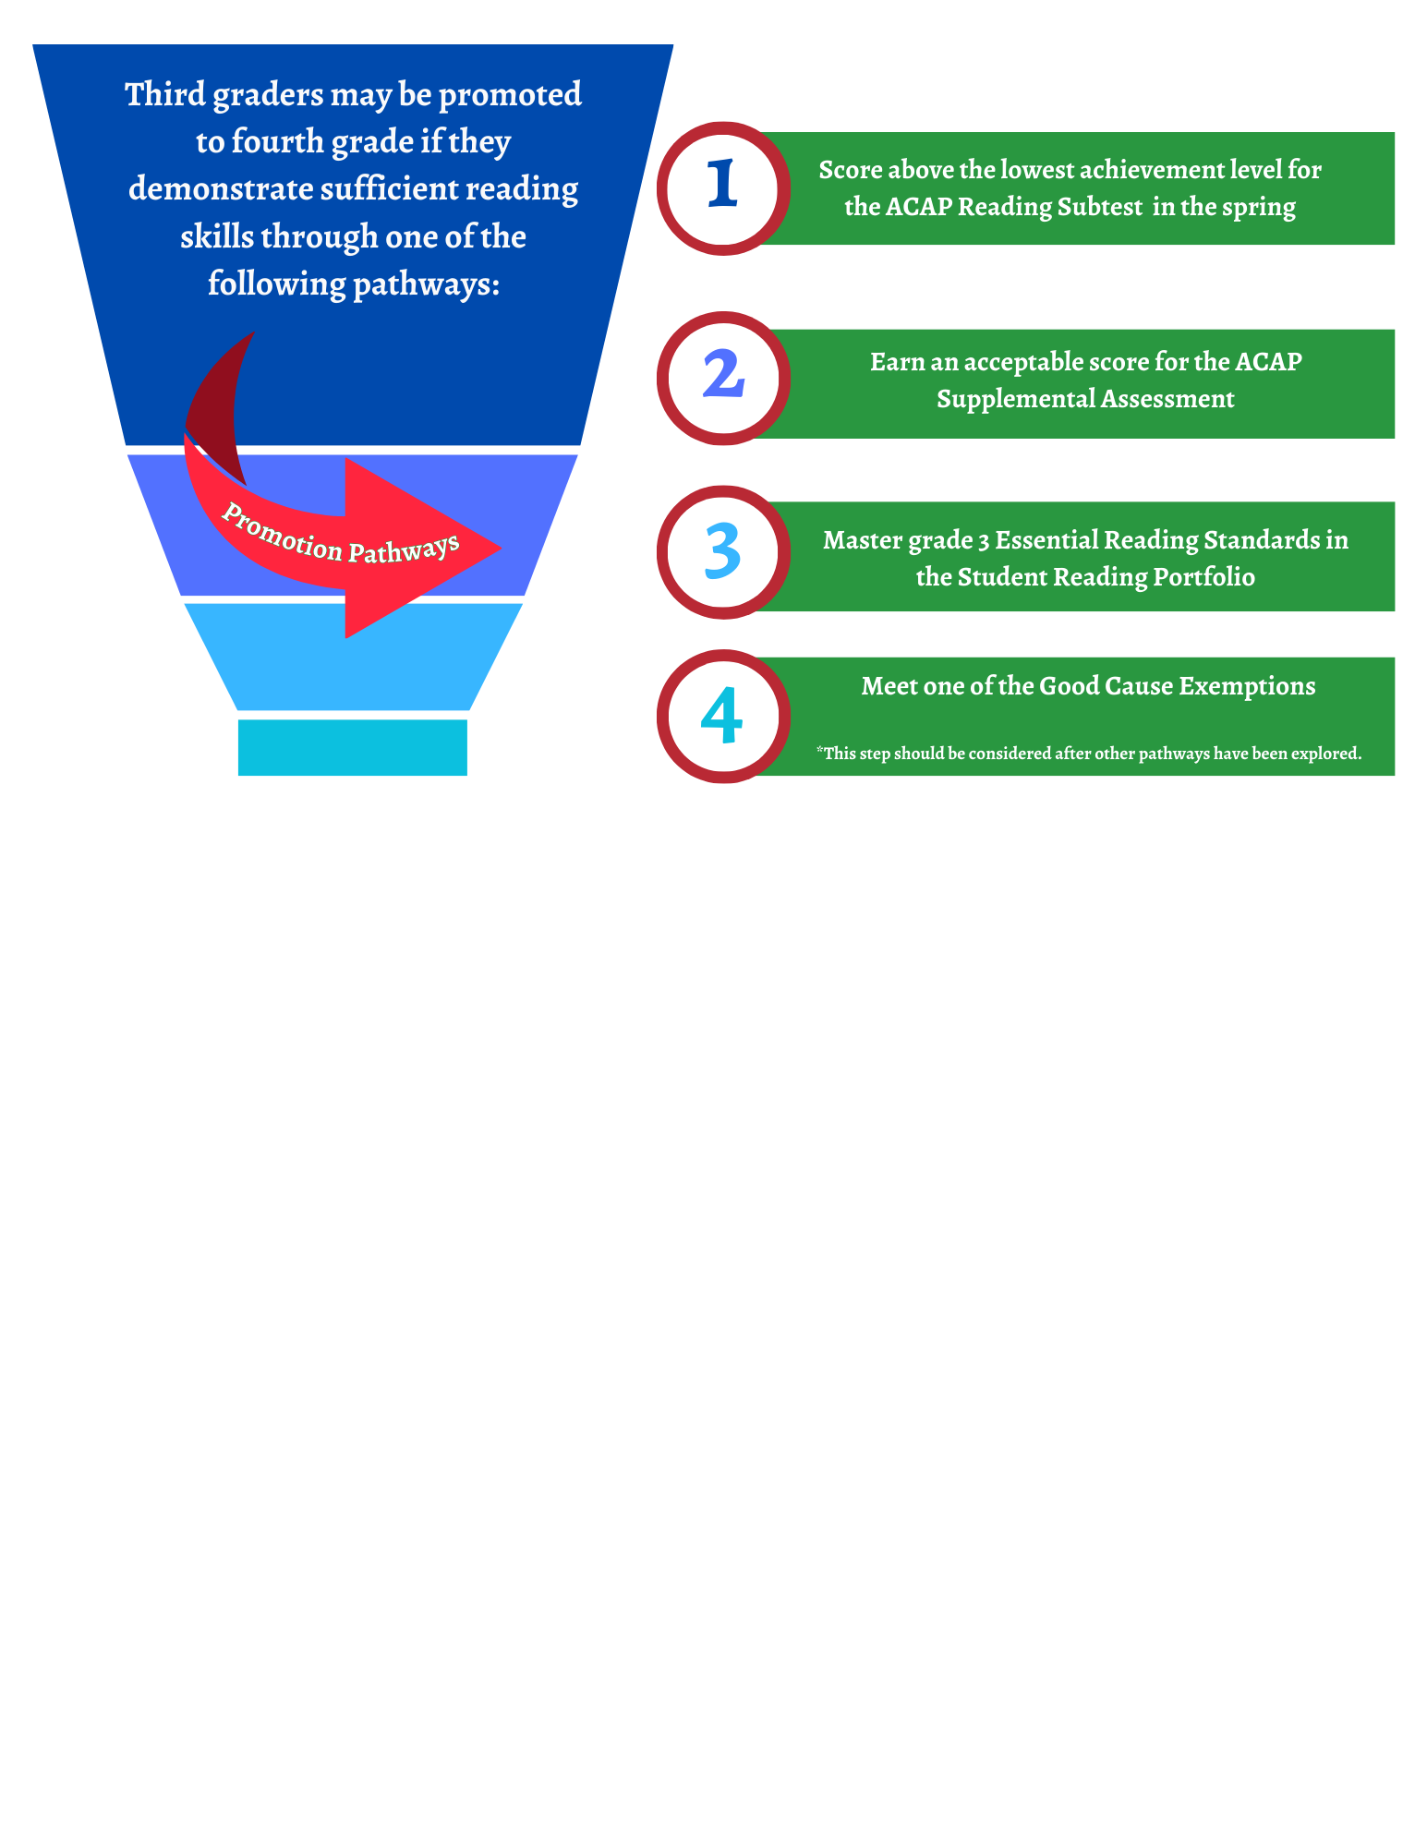
Promotion to Fourth Grade
Third graders can be promoted to fourth grade by…
Scoring above the lowest achievement level on a State Board approved assessment in reading. (ACAP)
Earning an acceptable score on an alternative (supplemental) reading assessment.
Demonstrating mastery of essential third grade state reading standards. Evidence pieces will be collected and stored in a Literacy Act Portfolio for each third grade student.
Notes:
2 min.
Say: Students will have several opportunities to demonstrate acquisition of 3rd grade standards. For students to be promoted from third grade to fourth, one of three criteria must be met. (facilitator reads slide and explains in parent-friendly terms.)
Here are the bullets in parent-friendly terms:
Students will take a state assessment called ACAP in the spring. Students who score above the lowest achievement level on this assessment in reading will be promoted to fourth grade.
Students who did not score above the lowest achievement level on the ACAP in the spring will be given the ACAP supplemental assessment at the end of summer reading camp. Students who earn an acceptable score on this assessment will be promoted to fourth grade.
Students who demonstrate mastery of third-grade essential reading standards through evidence collected in a reading portfolio, the Literacy Act Portfolio, will be promoted to fourth grade. The Literacy Act Portfolio evidence pieces are collected throughout the third-grade year.
Additional Information for facilitators only:
This information is located on page 21, line 17 – page 22 line 9.
“Scoring above the lowest achievement level” refers to meeting the cut score for reading sufficiency (not proficiency) on the ACAP, which is the “State Board approved assessment in reading.”
“Earning an acceptable score on an alternative reading assessment refers to the ACAP supplemental that is given at the end of summer reading camp.
12

Slide 13
Good Cause Exemption
Notes:
This is the last step in our funnel or path to promotion. Point out #3 because the language has slight changes. Make sure you address the word ‘and.’

Slide 14
Rising 4th Graders With Good Cause Exemptions
A student who is promoted to fourth grade with a good cause exemption shall continue to receive intensive reading intervention that includes specific reading strategies prescribed in the individual reading improvement plan of the student until the deficiency is improved.
Notes:
2 min.
Say: Students who are promoted to fourth grade through a good cause exemption will continue to receive targeted support in their area of reading deficiency.
Say: Examples of Continued Targeted Support:
Instruction with embedded research-based multisensory strategies
Multiple opportunities to practice identified skills
Daily targeted small group instruction
Intensive intervention based on the student needs
14

Slide 15
Reading Specialists
The local reading specialist is available to coach and mentor.
Model instructional strategies
Facilitate learning opportunities
Coach & mentor
Shares resources for community support
Monitor student progress
Analyze data
Every child. Every chance. Every day.
Notes:
2 min.
SAY: The local reading specialist at your school is available to coach and mentor teachers and student growth in your schools. They provide instructional tools and strategies to support teachers in their understanding of the science of reading and best instructional practices. The local reading specialist is not an intervention teacher however he/she coaches and mentors interventionists.
15

Slide 16
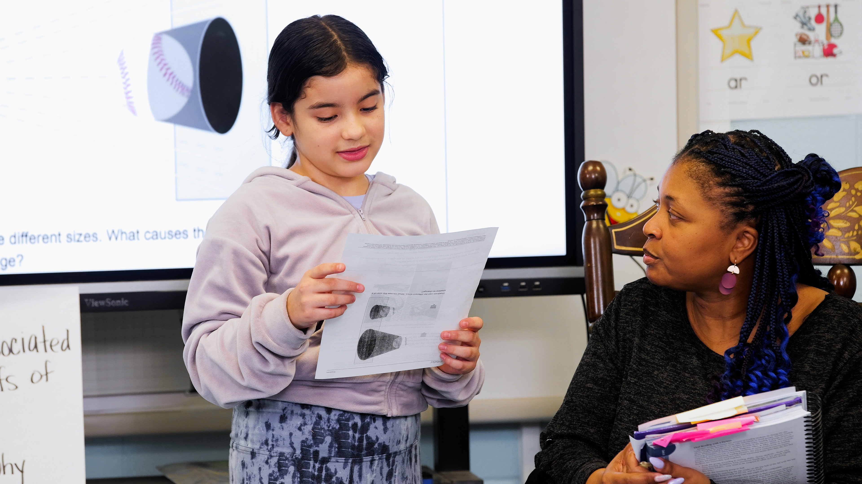
RETAINED THIRD GRADERS
How will schools help students who are retained in 3rd grade because the student does not meet the promotion requirement?
Students retained in 3rd grade will receive more intensive reading intervention services including:
Reading instruction provided by a highly effective teacher;
Dedicated time each day for intensive reading instruction;
Reading instruction that is grounded in the Science of Reading;
Frequent monitoring to help ensure students are progressing and on track to meet grade-level reading standards;
A Family Read-at-Home Plan
Notes:
2 min.
Say: Students retained in 3rd grade should receive more intensive reading intervention services, including the 5 bulleted areas you see on this slide.
Facilitator reads the information on the slide.
Say: The ALSDE has created resources for parents. We will share how to access these resources later in the session
16

Slide 17
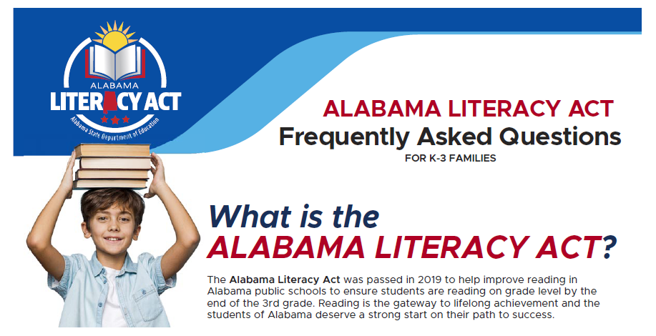
Frequently Asked Questions
Notes:
This is a resource to have accessible to families to help answer some of the questions they may have about the Alabama Literacy Act.
Handout 4- ALA FAQ for Families August 2024.pdf
Handout 4- https://drive.google.com/drive/folders/1BbllShQYnaE_Y-Q9QGXDh6UXp6snx7cd?usp=sharing

Slide 18
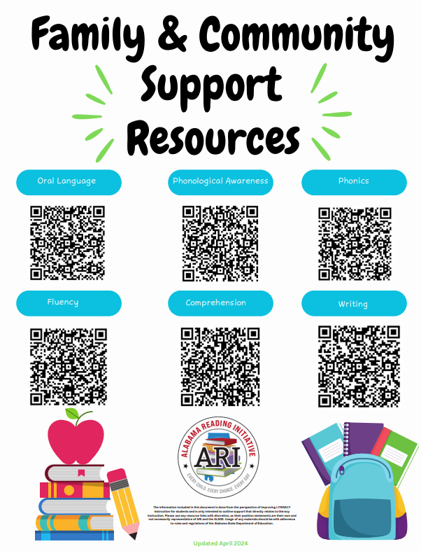
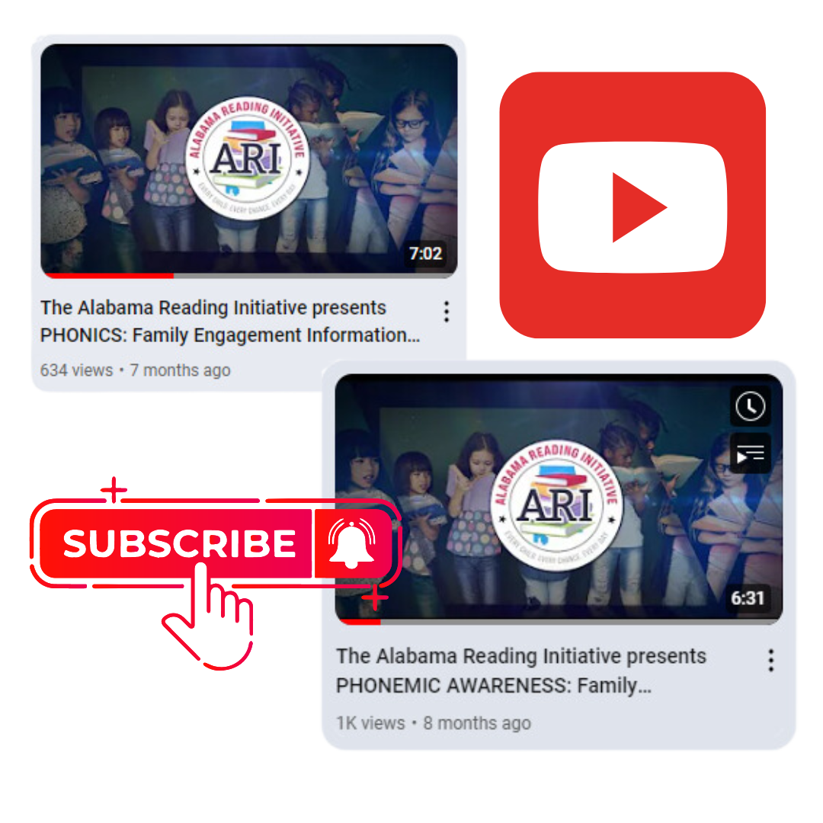
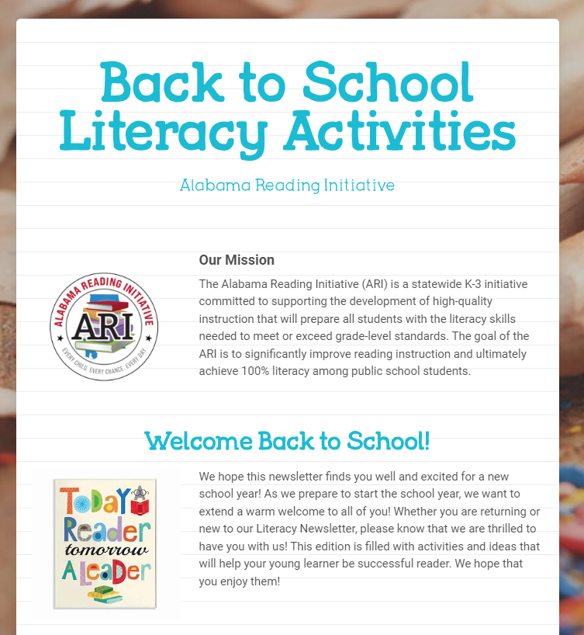
Parent
Resources
Notes:
Youtube Video Clips
Universal Literacy Screeners as a Tool for Families Video 2024- Universal Literacy Screeners as a Tool for Families Video 2024 (youtube.com)
ACAP Summative Assessment for Families January 2024- ACAP Summative Assessment for Families January 2024 (youtube.com)
The Alabama Reading Initiative presents Phonemic Awareness: Family Engagement Information and Ideas- The Alabama Reading Initiative presents PHONEMIC AWARENESS: Family Engagement Information and Ideas – YouTube
The Alabama Reading Initiative presents PHONICS: Family Engagement Information and Ideas- The Alabama Reading Initiative presents PHONICS: Family Engagement Information and Ideas – YouTube
Handout 5- Microsoft link Family and Community Support Resources (Microsoft link)- Updates Family & Community Resource Support QR CODES
Handout 5- Google link Family and Community Support Resources (Google link)- https://drive.google.com/drive/folders/107L3NTM1wJrkNujIqwDFvoh42wkNqC-C?usp=sharing

Slide 19
Literacy Act Review
Notes:
Let’s take a moment to review the components of the Alabama Literacy Act.
The Alabama Literacy Act (updated 8.15.23)- The Alabama Literacy Act (updated 8.15.23) (youtube.com)

Slide 20
Revisit Outcomes
Participants will:​
Develop an initial understanding of the Alabama Literacy Act and its impact on classroom instruction and students’ growth/achievement.​
Set goals for at-home literacy support.
2024-2025 Sign-in link
https://forms.office.com/r/ZpxYTGr8qm
Notes:
2024-2025 Sign-in link
https://forms.office.com/r/ZpxYTGr8qm

Slide 21
THE ALABAMA READING INITIATIVE IS YOUR PARTNER IN EDUCATION!

