Slide 1
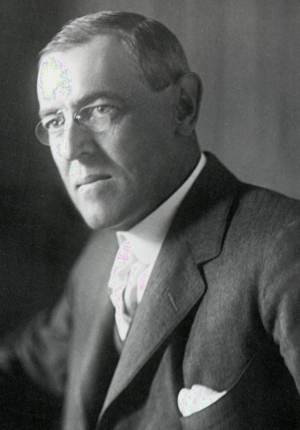
Wilson’s New Freedom
As America’s newly elected president, Wilson moved to enact his program, the “New Freedom”
He planned his attack on what he called the triple wall of privilege: trusts, tariffs, and high finance
Woodrow Wilson U.S. President 1912-1920

Slide 2
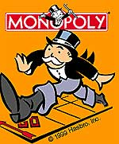
Clayton Anti-Trust Act
1914
strengthened the Sherman Anti-Trust Act
prevented companies from acquiring stock from another company if that created a monopoly
also supported workers unions

Slide 3
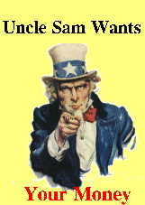
Federal Income Tax
Due to lower tariffs, lost revenue had to be made up
16th Amendment – created a graduated federal income tax

Slide 4
Federal Trade Commission
1914 - formed to serve as a “watchdog” agency to end unfair business practices
The FTC protects consumers from business fraud

Slide 5
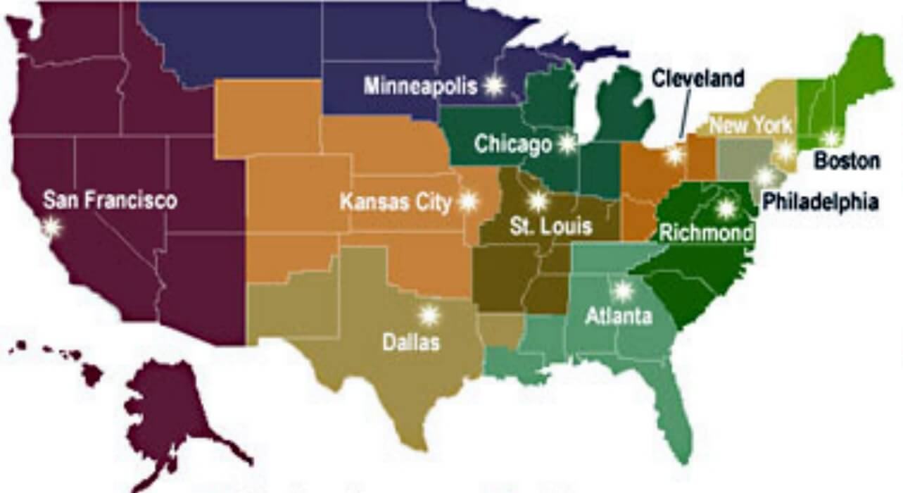
Federal Reserve System
1913
Made up of 12 reserve banks
Controls the amount of money in circulations
Controls interest rates
Often just called The Fed

Slide 6
Limits of Progressivism
The Progressive Movement failed to address the issue of civil rights for African- Americans.
However, there were a few individual leaders that did make a difference.
Voting rights, ending discrimination, and a federal anti-lynching law were the main goals.

Slide 7
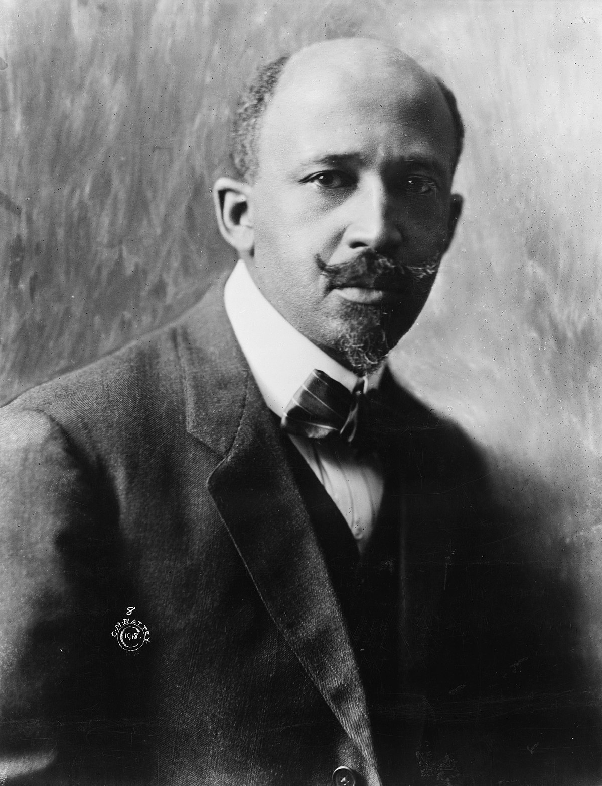
W.E.B Dubois
1st black man to receive a doctorate from Harvard
Wrote “The Soul of Black Folk” in 1903
called for immediate changes by having the most educated African Americans push for inclusion and equality
insisted that blacks should seek liberal arts degrees so that the black community would have well educated leaders
Founded the Niagara Movement in 1905
Helped start the National Association for the Advancement of Colored Peoples (NAACP) in 1909.

Slide 8
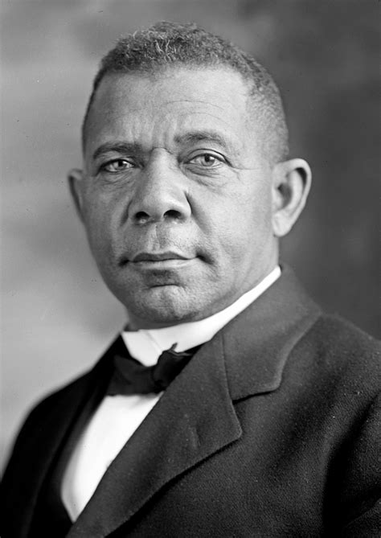
Booker T. Washington
reformer that suggested whites and blacks work together for social progress
thought that education and economic skills would lead to equality in the long term.
Tuskegee Normal and Industrial Institute (1881) – ran by Washington, aimed to help blacks earn teaching diplomas and useful skills in agricultural, domestic, and mechanical work
1st black man invited to a formal dinner at the White House

