Slide 1
Creating a Parent Portal Account (FOCUS)

Slide 2
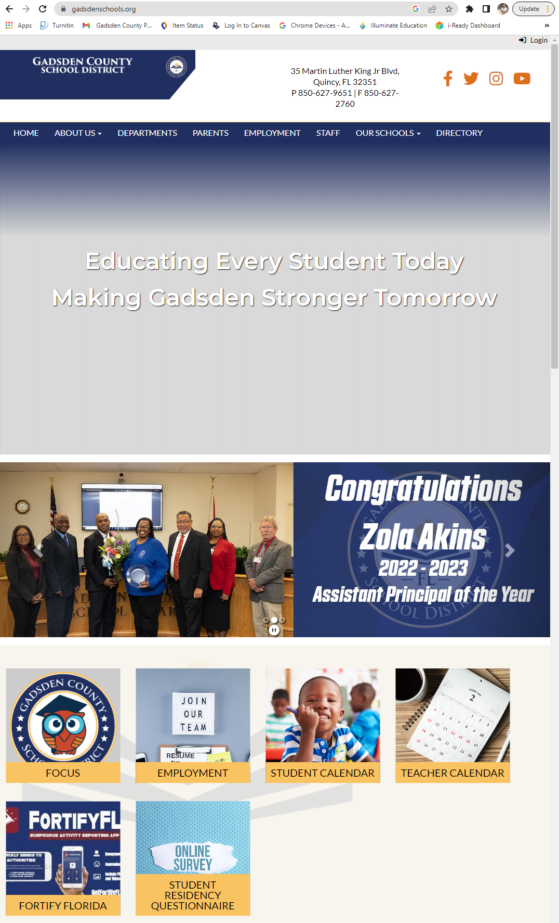
Step1: Navigate to Gadsdenschools.org
Scroll down until you see FOCUS icon and click it
This will bring you to the FOCUS home page

Slide 3
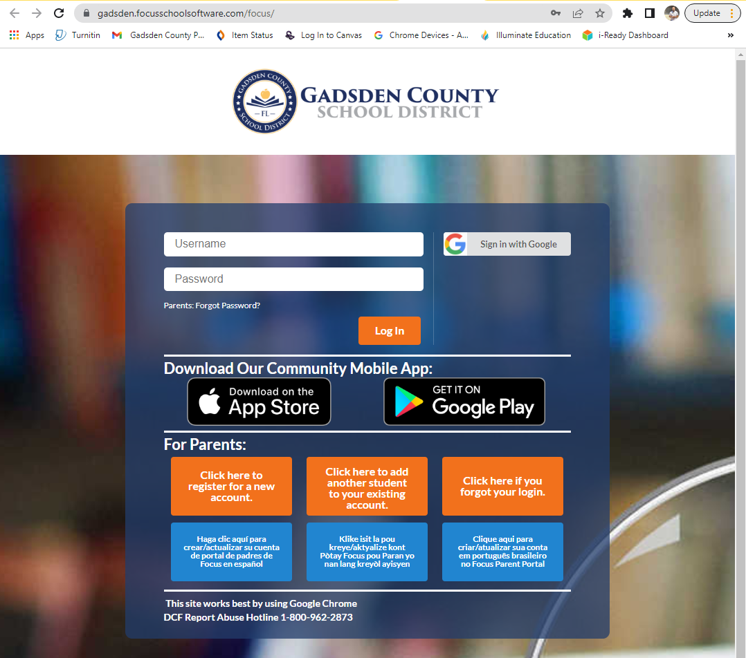
Step 2: Scroll to “For Parents:” Section
To create an account, click “click here to register for a new account”

Slide 4
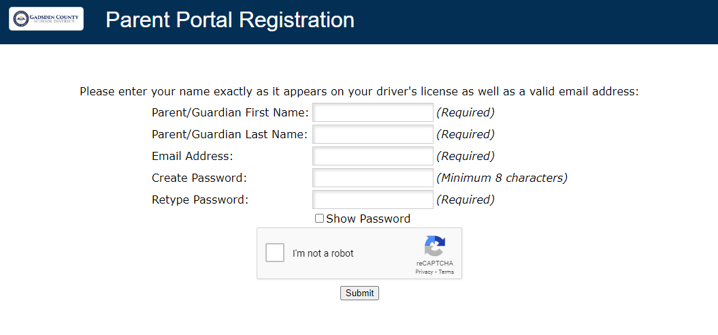
Step 3: Fill out information to create account

Slide 5
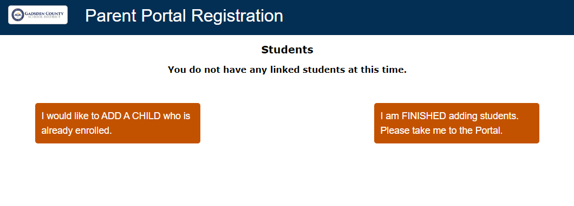
Step 4: Linking Students
Select “I would like to ADD A CHILD”

Slide 6
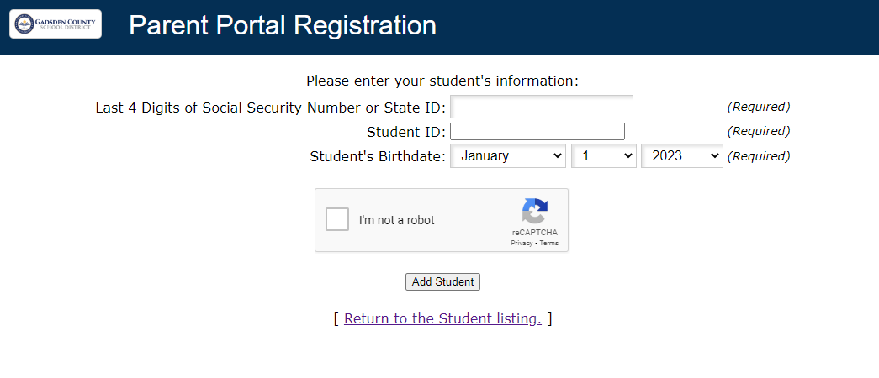
Step 5: Enter Student Info (*teacher given)

Slide 7
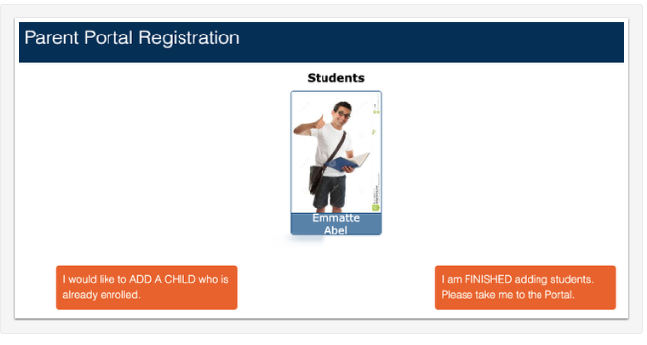
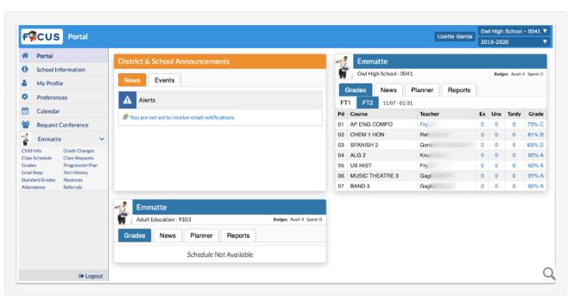
Step 6: To Student Portal
Once the student is added, you have to select “I am FINISHED” to view that students Focus Portal
**Select Add a Child if there are more**

Slide 8
For Questions…
See Classroom Teachers

Slide 10
How to access scores via Family Portal

Slide 11
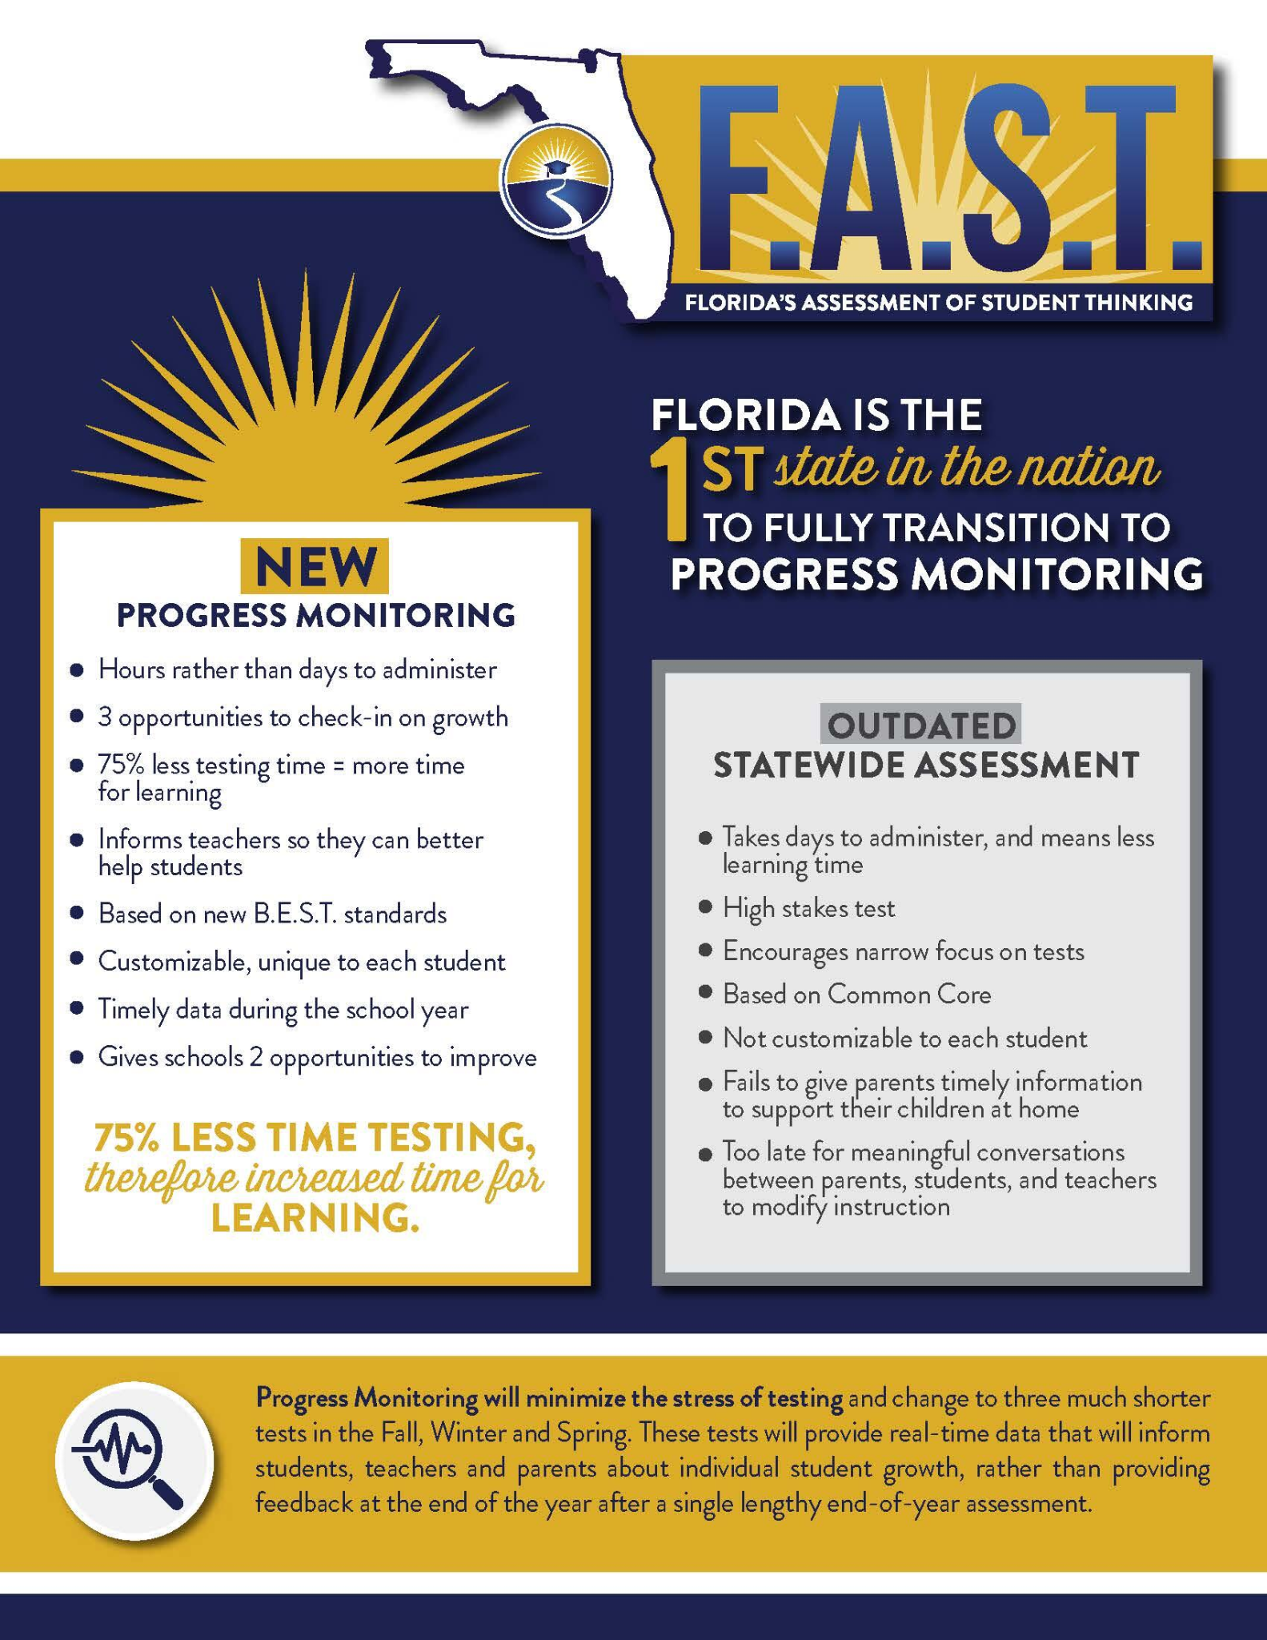

Slide 12
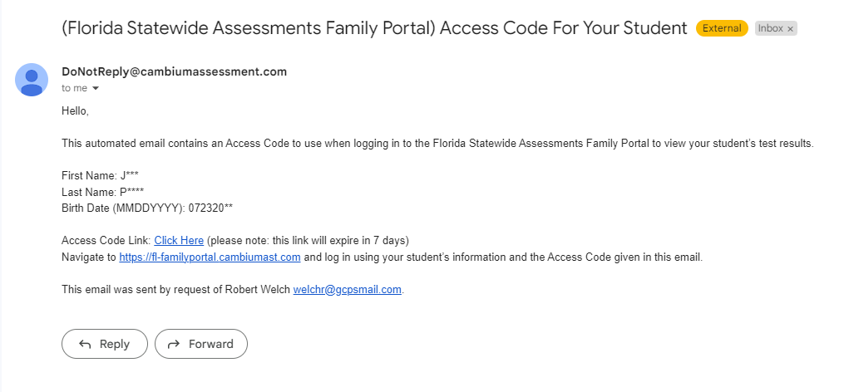
Step 1: Check Your Email
You should have received the following email that includes all the pertinent info needed for you and your scholar to login.

Slide 13
Step 2: Click Access Code Link
CLICK LINK TO GET CODE

Slide 14
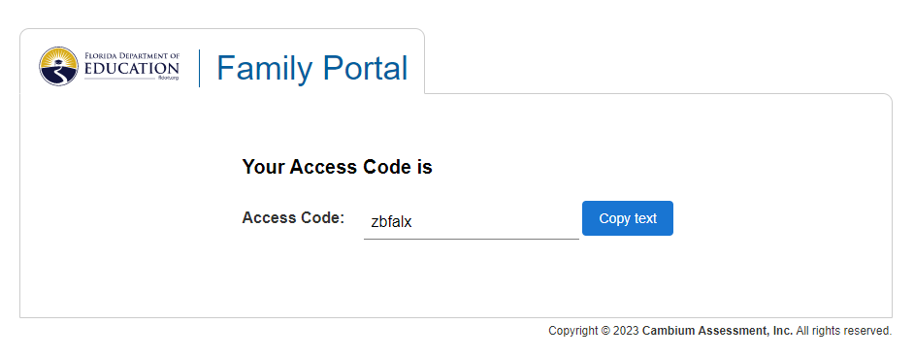
Step 3: Copy Access Code Link
Write the down the access code or click the [Copy Text] button to save the code. This will be needed for [Step 4].

Slide 15
Step 4: Go To Family Portal
Click Link to Access Family Portal

Slide 16
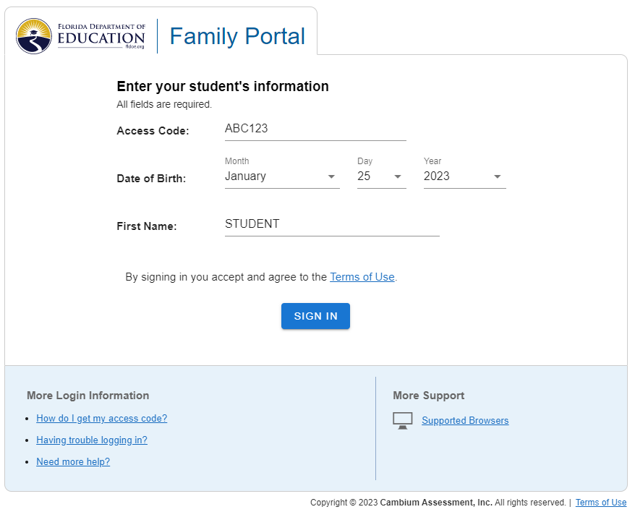
Step 6: Enter Information
Use the [ACCESS CODE] obtained in Step 2 to complete the all the required fields. Make sure the information input matches what is on the original email sent you and click [SIGN IN].
*[First Name & Access Code]
are NOT case sensitive*
CLICK

Slide 17
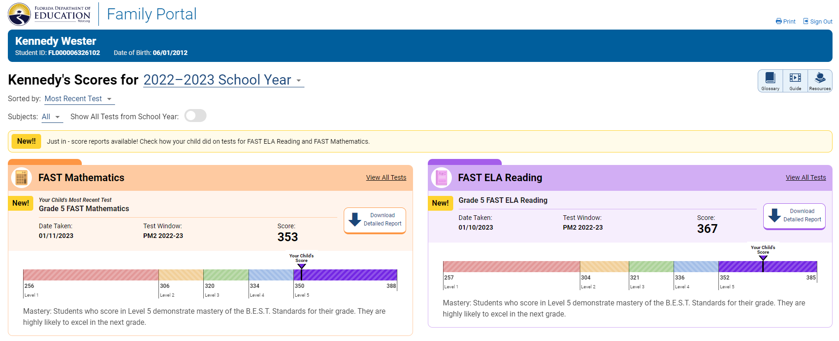
Step 7: Review Scoring Information

Slide 19
FUTURE TESTING DATES
[Progress Monitoring 3] testing dates are as follows:
FAST ELA - Tuesday, May 16th, 2023
FAST MATH - Thursday, May 18th, 2023

Slide 20
ANY QUESTIONS

