Slide 1
Welcome to Parent Night!
Mrs. Waddle’s Class

Slide 2
Our Classroom
A community of learners with rules and procedures to ensure everyone is safe, happy, and working toward showing growth throughout the year.
Students work independently, in cooperative groups, and with a partner to complete activities.
One on one with a teacher or peer tutoring for extra help or remediation.

Slide 3
Consequences
Green - no cards pulled-Good Behavior
Yellow – verbal warning
Orange - Walk 10 minutes at recess
Red - 4th Offense (Office Referral)
For severe behavior problems, the teacher has the right to bypass all the above and go straight to red

Slide 4
Daily Folders
Each day students are to bring their blue daily folder to school.
This is where their behavior calendar can also be found. You only have to sign the behavior calendar if it is not colored green. I also will leave a note or a Behavior Code, so that you can have some information on why the warning or consequence was given.
Please put any notes, money, etc. in the pencil bag that is at the front of the Daily Folder.
This is also where the weekly newsletter can be found.
I will try to send notes as much as I can in the Graded Folder, but some notes may be in the Daily Folder as well.

Slide 5
Homework
Homework will be assigned on Friday of each week and due completed the following Friday.
Homework will cover skills already taught and practiced in class. Please assist your child with directions, but allow him/her to complete the assignments independently. If your child is struggling with a specific skill, please feel free to send me a note, text message, or email.
Readworks.com will be where all reading homework is completed unless otherwise noted.

Slide 6
Testing Schedule
We do not have a set test schedule for weekly grades in 3rd grade. Please check website, homework, and newsletter for testing dates.
Assessments may be given at a later date than stated on newsletter, but never earlier than stated.
Additional Testing
Iready Testing- universal screener will be done a few times throughout the year.
Case 21 Testing- Also a screener that will be completed a few times a year.
MAAP Reading benchmark test– Taken in Spring.
Students must score proficient in order to pass.

Slide 7
Grading Scale
A = 90-100
B = 80-89
C = 70-79
D = 65-69
F = 64 and below
Please return all graded papers with
a score of 69 and below.

Slide 8
ELA
ELA Grade Breakdown
Assessments– 60% (Reading Comprehension/Writing Compositions)
Independent Assignments - 40% (Grammar Skill Checks, Spelling Average, Vocabulary Checks, Other Class Assignments )
Science and Social Studies will be recorded as
S (80-100), N (79-65), U (64 and below)

Slide 9
Math
Math Grades
Assessments - 60%
Independent Skills Practice - 40%
Fact Fluency Tests will begin after Labor Day and will be given once a week. These will be averaged as one test grade for the 9 week period. Facts should be drilled using flashcards or games on websites below.
Websites:
www.multiplication.com
www.arcademicskillbuilders.com
www.aplusmath.com

Slide 10
What ELA Looks Like
Monday- Review of previous week's skills
Tuesday: Introduce the story/reading skill for the week
Wednesday-Friday: Practice reading skills with the story
Student Work Time: Reading Workshop- Station work, guided reading groups, book clubs, read to self, and read to someone.
Students will also work on online reading websites

Slide 11
School Website
Email is available at Kristen.waddle@dcsms.org
Check my website for homework, weekly skills, study guides, extra practice websites, and important updates

Slide 12
Schoology
I will use Schoology throughout our regular classroom day. Here student may complete independent practices or discussions with other students. This will be the platfom that we use if virtual was ever needed. This would also be used for quarantine situations.

Slide 13
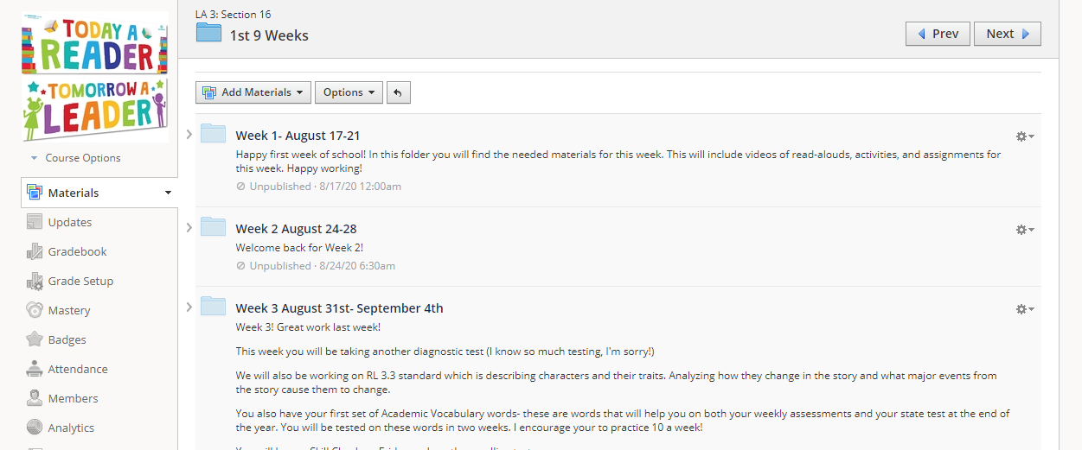

Slide 14
Money
Please send money or checks in the zippered pencil pouch at the front of their daily folder.
Be sure to include a current phone number on all checks.
Make separate checks for unrelated items. Example: Lunch and yearbook
Revopay- Option to pay with debit/credit card with a small fee

Slide 15
Graded Paper Folders
Sent home every Tuesday.
Please sign and return cover sheet that is in the inside pocket.
Return only the papers with a grade below a 69.
You are welcome to keep papers or make a copy to review with your child.
If you find an error in grading, please do not hesitate to send me a note

Slide 16
Parent Portal
Access your child’s grades by using Parent Portal. Parents may view progress reports, report cards, and attendance from any computer or phone that has internet accessibility.
If you have not signed up for Parent Portal, please complete the attached form and return it and a copy of your photo ID to school. This is to verify that you are the parent or guardian of the child in question. Log in information will be sent home with your child. Also, there is an app for the iPhone and Android devices.
Parents must create a single account for Parent Portal. If you have more than one child, you can create an account for all your children.
If a parent had a child/children in Desoto County Schools last year, that parent will need to use their original log in information to create a single account.
Parent Portal : www.desotopowerschool.com/public

Slide 17
Classroom Wishlist
Old magazines such as Highlights or National Geographic
Colored Cardstock
Colored Copy Paper
Multiplication Flashcards
Seasonal erasers, decorative pencils, or stickers
You may send in candy- we do not have any nut allergies

Slide 18
Contact Me!
Email: Kristen.waddle@dcsms.org
I try to respond as quickly as possible, it may take me up to 24 hours.
SchoolStatus: I use this for all calling and texting!

Slide 19
Class Websites
https://www.readworks.org/
https://www.Getepic.com
https://hernandohillselemdesotoms.schoolinsites.com/

