Slide 1
Unit 1
Measurements and Calculations

Slide 2
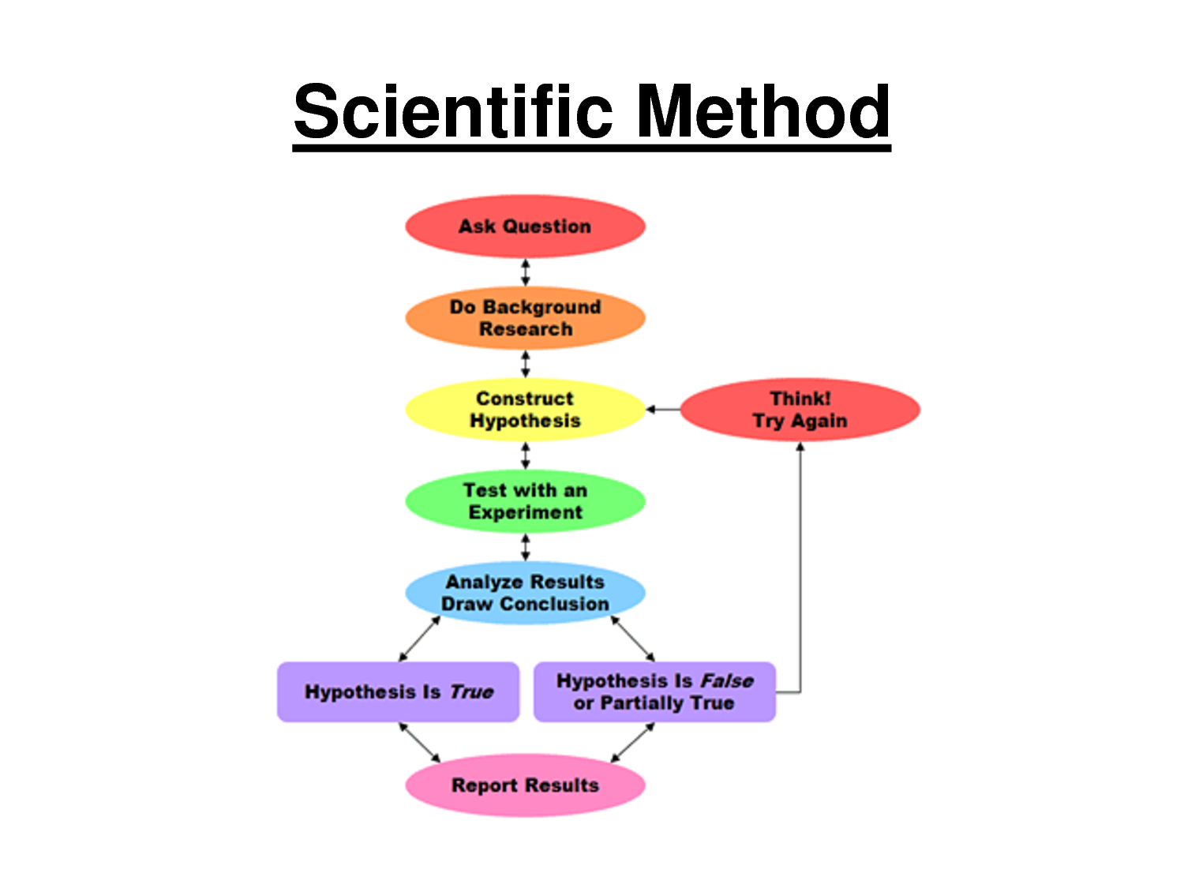

Slide 3
Scientific notation
Scientific notation is a way to write very large or very small numbers
Only one nonzero number can appear to the left of the decimal
If you move the decimal to the left, the exponent is positive
If you move the decimal to the right, the exponent is negative.
Negative exponents represent the inverse of a number.
Ex—10⁻³ = 1/1000 = 0.001

Slide 4
Scientific notation practice
Write the following numbers in scientific notation
560,000 ____________________
33,400 ____________________
0.0004120 ____________________
101.210 ____________________
0.301 ____________________
6,967,000 ____________________
32.1 ____________________
0.000000432 ____________________

Slide 5
Write the following numbers in scientific notation:
2,456,000,000
0.0000251
256.1
0.0217
Write the following numbers in scientific notation:
4.12 × 10³
5.23 × 10⁻⁷
9.01 × 10⁵

Slide 6
Multiplying and Dividing
When multiplying numbers in scientific notation, multiply the numbers and add the exponents.
(2.15 × 10¹⁵)(5.134× 10³⁴) = ___________________
(1.234 × 10⁻⁴)(5.134× 10²) = ___________________
Dividing—Divide numbers first, then subtract exponents
3.12 × 10⁹ / 4.355 × 10³ = ___________________
9.10 × 10⁻⁷ / 5.014 × 10² = ___________________

Slide 7
Addition and Subtraction
To add or subtract, move decimal places so that exponents are the same and then carry out the operation.
7.142 × 10⁵ + 4.12 × 10³ = ___________________
1.024 × 10⁻² – 3.12 × 10⁻³ = ___________________

Slide 8
SI measurement
A measurement must include a value and a unit.
Example: 54.3 grams (g)
Benefits:
Everything goes by 10’s.
Standard naming
Calculations and conversions are easier to perform.

Slide 9
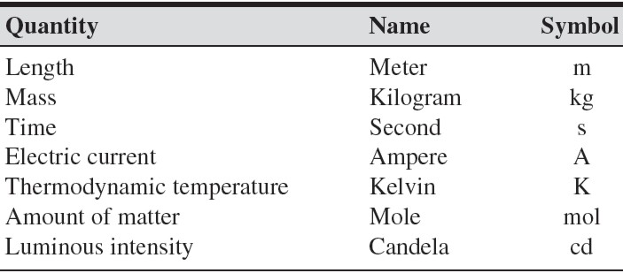
SI Base Units

Slide 10
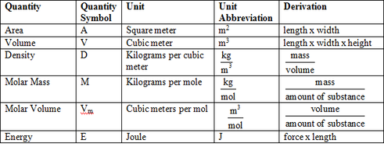
Derived SI Units

Slide 11
Prefixes
Prefixes are used to identify quantities that are much higher or much lower than the base units

Slide 12
Significant Figures (Sig Figs)
What are they?
The minimum number of digits required to report a value without loss of accuracy.
Why are they useful?
Tells us the accuracy of the data. Also gives insight into the instrumentation used to take the measurement.
For example: If a scientist reports the mass of a compound, which is more accurate?
100 g
100.3 g
100.3574 g?

Slide 13
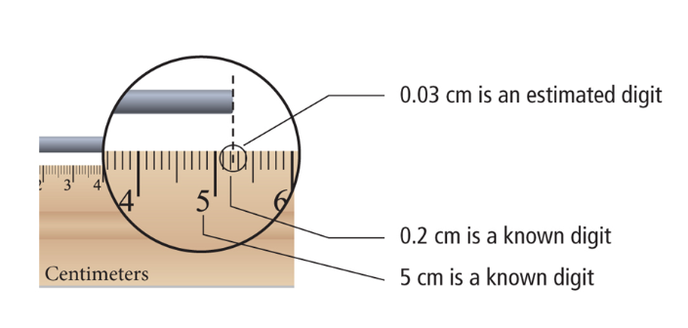
All known plus one estimated when reading measurements!

Slide 14
Significant Figures (Sig Figs)
Rule | Example
1.) Zeros appearing between non-zero digits are significant. | 40.7 has three sig figs. 56,007 has five sig figs.
2.) Zeros appearing in front of all nonzero digits are not significant. | 0.023154 has five sig figs. 0.00002 has one sig fig.
3.) Zeros at the end of a number and to the right of the decimal place are significant. | 85.00 has four sig figs
4.) Zeros used as placeholders are not significant. | 2000 has one sig fig 34,000 has two sig figs
5.) A decimal point placed after zeros indicates that they are significant. | 2000. has four sig figs 35,000. has five sig figs
Notes:
Do examples on the board and then hand out a worksheet.

Slide 15
Significant figures examples
How many significant figures are in each of the following measurements?
28.6 g _________
3440. cm _________
910 m _________
0.04604 L _________
0.0067000 kg _________
Suppose the value “seven thousand centimeters” is reported, how would you express the number to . . .
1 significant figures _______________
4 significant figures _______________
6 significant figures _______________

Slide 16
Significant figures cntd.
Addition and subtraction – the answer must have the same number of digits to the right of the decimal as the number having the fewest number of digits to the right of the decimal
Look to the right of the decimal
Fewest number of decimal places wins.
Multiplication and division – the answer must have the same number of digits as the number having the fewest number of digits
Look at the entire number
Least number of digits wins

Slide 17
Examples
Carry out the following calculations. Express each answer to the correct number of significant figures.
5.44 m – 2.6103 m =
2.4 mL x 15.82 mL =
2.099 g + 0.05681 g =
87.3 cm – 1.655 cm =
Calculate the area of a rectangle that measures 1.34 mm by 0.7488 mm.

Slide 18
Converting

Slide 19
Practice
Complete the following conversions:
10.5 g = ______________ pg
1.57 km = ______________ m
1.2 L = ______________ mL
78.3 μg = _______________ g

Slide 20
Volume (V)
Two ways to measure the volume of solids:
1.) Regularly-shaped
Measure length, width, and height then multiply.
2.) Irregularly-shaped
Must measure using displacement of water.
Units of measurement for volume: m³, cm³, mL
1 mL = 1 cm³

Slide 21
Volume problems
50 mL of water was added to a 100 mL beaker. A rock was added and the water level rose to 55.5 mL. What is the volume of the rock?
Calculate the volume of a dresser having a length of 1.2 m, a height of 1.98 m, and a depth of 0.60 m.

Slide 22
Density

Slide 23
Density problems
What is the density of a block of marble that occupies 310. cm³ and has a mass of 853 g?
Diamond has a density of 3.26 g/cm³. What is the mass of a diamond that has a volume of 0.351 cm³?
What is the volume of a sample of liquid mercury that has a mass of 76.2 g, given that the density of mercury is 13.6 g/mL?

Slide 24
Density problems cntd.
What is the density of an 84.7 g sample of an unknown substance if the sample occupies 49.6 cm³?
What volume would be occupied by 7.75 g of this same substance?

Slide 25
Temperature
Temperature – the quantity of the energy of motion of the particles that make it up
Three scales °C, °F, K (no degrees sign for Kelvin)
K = °C + 273.15
0 K = Absolute Zero

Slide 26
Dimensional Analysis
What is it?
A way to use units to solve mathematical problems involving measurements.
Quantity sought = quantity given × conversion factor
How many quarters are in 12 dollars?

Slide 27
Dimensional Analysis Problems
1.) How many centimeters are in 2.5 miles (1 mile = 1.61 km)?
2.) How many seconds are in 3.23 years?
3.) How many nickels are in 56.32 dollars?

Slide 28
Accuracy and Precision
Accuracy—how close a measurement is to the actual value.
Precision—how close together a group of measurements are.

Slide 30
Percentage Error

Slide 31
Representing data
Direct Relationship – as one value increases, the other value increases; dividing one value by the other gives a constant value
Indirect relationship or inverse relationship – as one value increases, the other value decreases; the product of these two values is constant

Slide 32
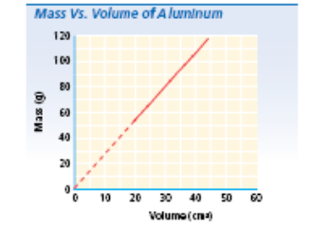
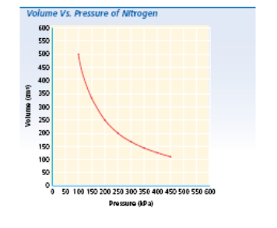
Direct Relationship
Indirect Relationship

