Slide 1
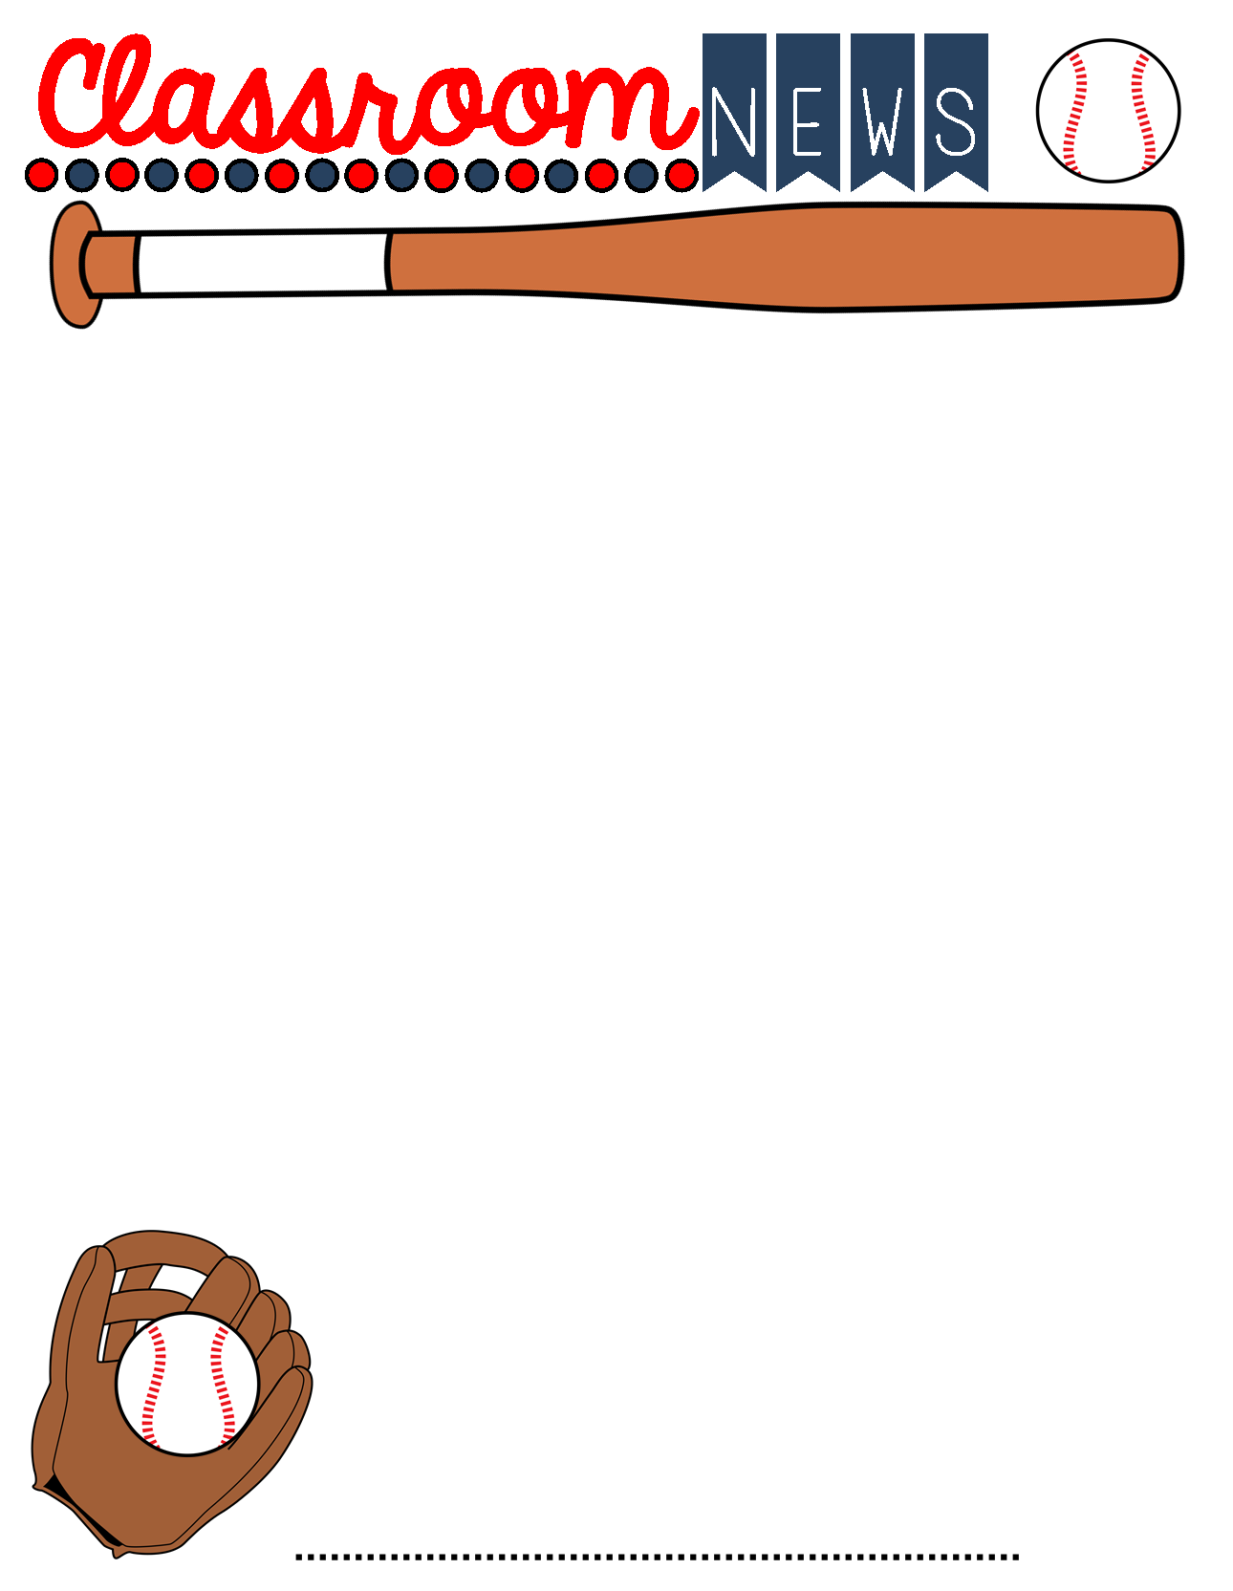
December 6th-10th 2021
Important Info
Calendar
Parents,
This week I will be out Wednesday, Thursday, and Friday. If you have dismissal changes, please contact the office. I will be available by cell or Remind if you need me.
If you have any questions or concerns, please contact me: pphillips@mcpss.com
Please be sure to send a note if your child is absent. After three days, it’s an unexcused absence.
Please Note:*Quiz = Minor grade *Test= Major grade
Clorox/Lysol wipes
Mini donuts- powdered or Glazed
Juice
Candy canes
*Thank you to Bradlee’s mom for
Sending glue sticks and tissue!!
Monday, December 6th -homework assigned and sent home
Wednesday, December 8th - ICE CREAM DAY ($1.00)
Friday, December 10th- SNO CONES $3
Friday, December 10th –Homework Due
December 1st-14th- Stuff the Bus Toy Drive (more information to come)
Friday, December 17th- Holiday Party
This week:
Library- Wednesday 10:15am
ART- Thursday 10:30am
Congratulations to our November Character Kid: Bradlee Critchfield
What We Are Learning this Week
Reading – Novel-Magic Tree House Test: Civil War on Sunday- Wednesday
Language Arts- Informative Writing
Math- Factors and Multiples Quiz Thursday
Fact Drill Tuesday (will include division and multiplication ) 6 minutes
Alabama History-Civil War Leaders – Test Thursday
Things to Know
Student Council will continue to collect toys this week!
Don’t forget to bring an unwrapped toy to school to help spread Christmas Joy to someone in need this holiday season. December 14th is the deadline.
Our compliment bucket is FULL! YAY! Our celebration will be the morning of our party on December 17th. We plan to make bell necklaces, have donuts and juice, and watch the Polar Express. If you would like to help send items, please let me know. THANK YOU!
Mrs. Phillips 4th Grade

