Slide 1
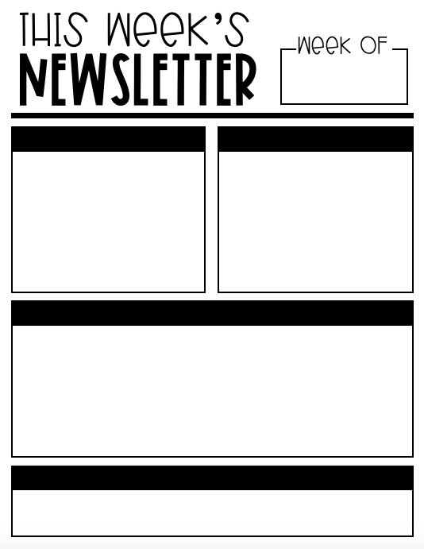
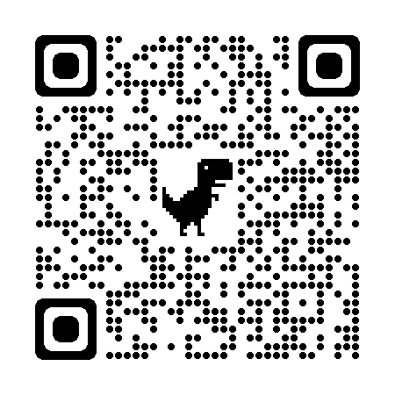
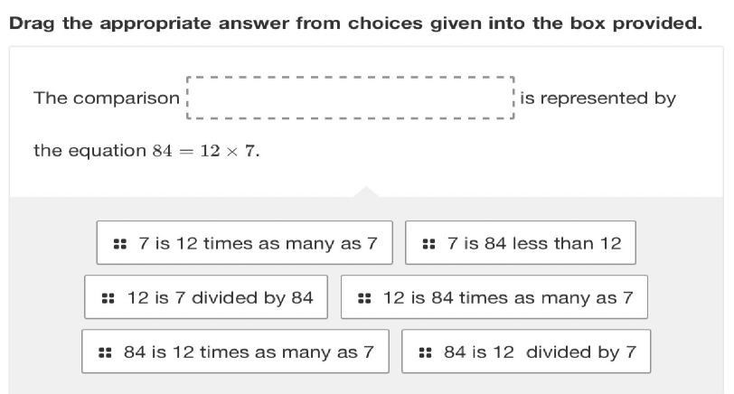
September 11-15
dTeacher Note
Important Dates
Order forms we sent home this week for field trip shirts. Shirts are $10 and money is due by September 15th. Teachers will accept cash and check payments, or you may use the code below to pay online using Revopay
September 12th- Progress Reports
September 15th- T-shirt orders are due
September 18-22- Homecoming Week
October 3rd- School Pictures (forms will be sent home closer to the time)
dMath
Skills:
OA 1
Interpret a multiplication equation as a comparison, e.g., interpret 35 = 5 × 7 as a statement that 35 is 5 times as many as 7 and 7 times as many as 5
OA 2
Multiply or divide to solve word problems involving multiplicative comparison, e.g., by using drawings and equations with a symbol for the unknown number to represent the problem, distinguishing multiplicative comparison from additive comparison
NBT 5
Multiply a whole number of up to four digits by a one-digit whole number, and multiply two two-digit numbers, using strategies based on place value and the properties of operations. Illustrate and explain the calculation by using equations, rectangular arrays, and/or area models.
Science
We will be studying plant and animal life cycles
Notes:
Master copy front

Slide 2
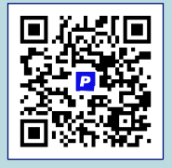
September 11-15
Classwork Help
Things to do at Home
Students can get free online support at home using an app called “Paper.”
Students can login using Clever to receive live help with reading or math.
Please make sure to study multiplication facts.
Read for 10-20 minutes every night.
dELA
Focus Standards:
RI 4.1
Refer to details and examples in a text when explaining what the text says explicitly and when drawing inferences from the text.
RI 4.2
Determine the main idea of a text and explain how it is supported by key details; summarize the text.
W 4.3
Write narratives to develop real or imagined experiences or events using effective technique, descriptive details, and clear event sequences.
Social Studies
In Social Studies we will be studying the Compass Rose and Mississippi Regions
Notes:
Master copy back

