Slide 1

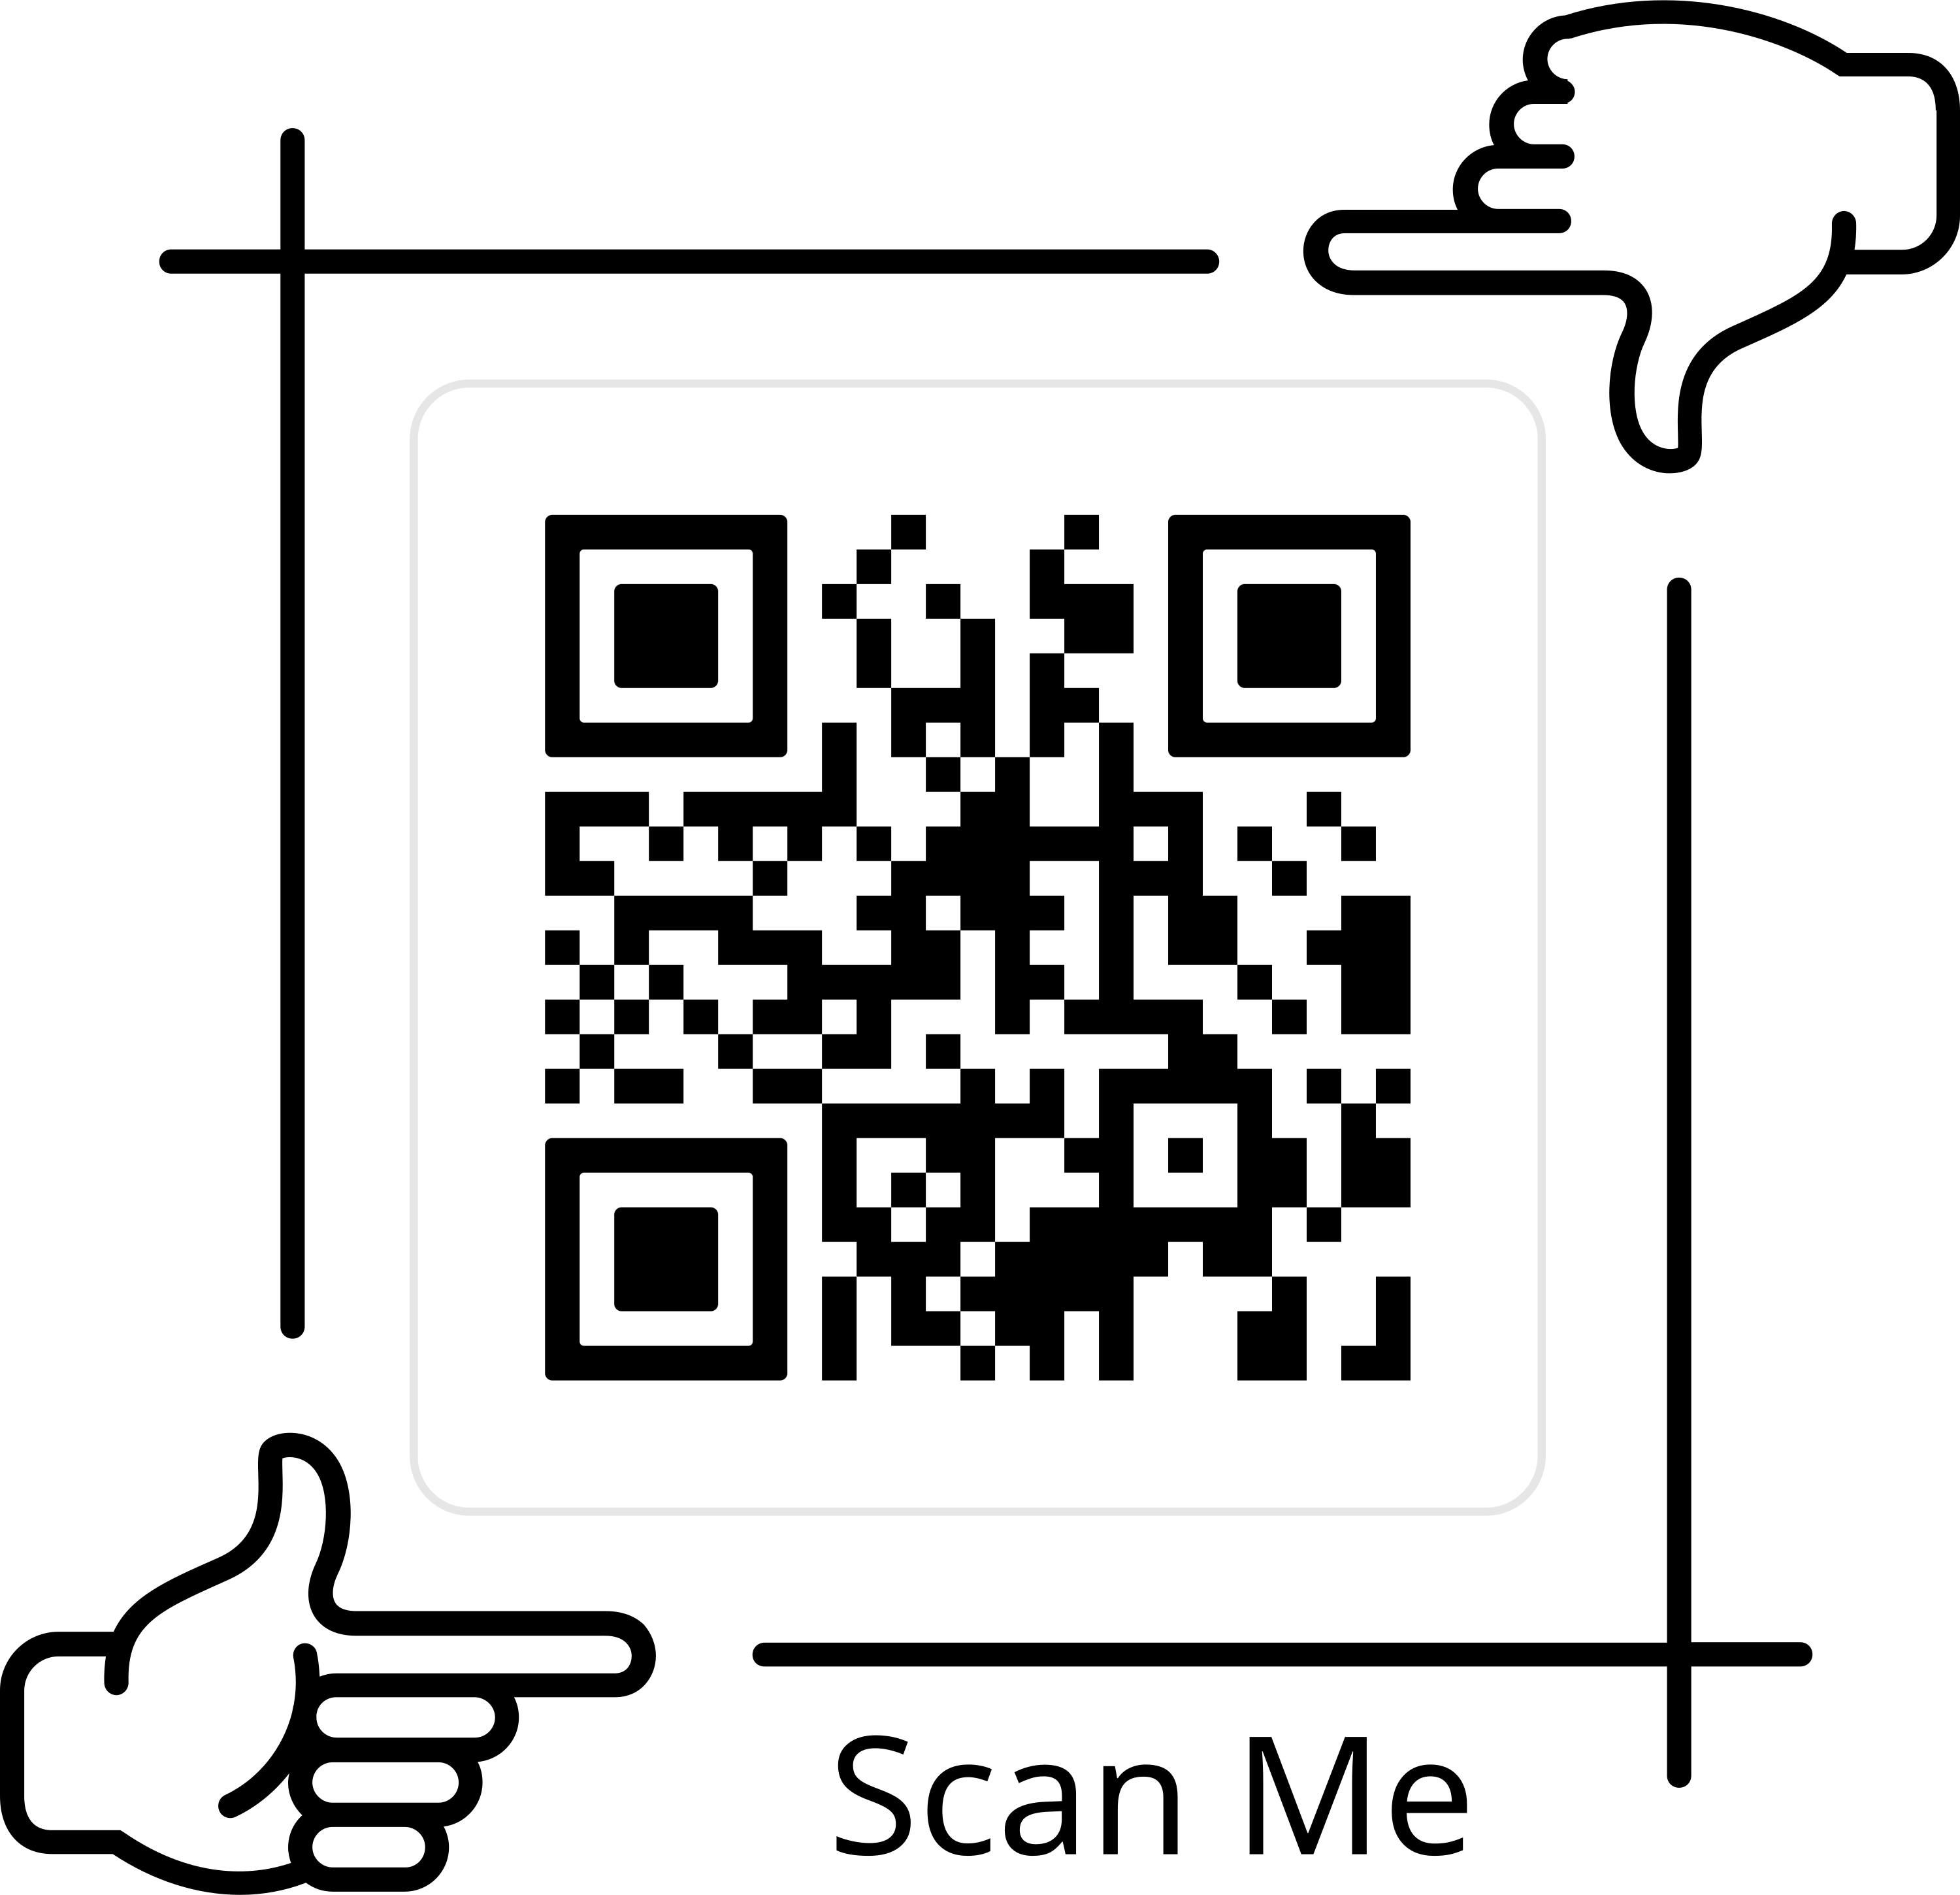

Mrs. Marks’ Wishlist
This is a QR code to my Amazon Wish List!
Check out our classroom wish list if you'd like to donate to our learning adventure! Here are other items we always need throughout the year.
• Starburst or Skittle Candy
• White cardstock
• Trash bags
• Treasure box items
• Band-Aids
Thank you for your generosity & support!
Mrs. Marks

Slide 2
Teacher
Wish List
(Grade Level) is fun and exciting.
We learn so much and work very hard. We are going to need a few supplies to make our year extra special.
Check out our classroom
wish list if you'd like to donate to our learning adventure!
...URL here...
Thank you for your generosity & support!
Your Name

Slide 3
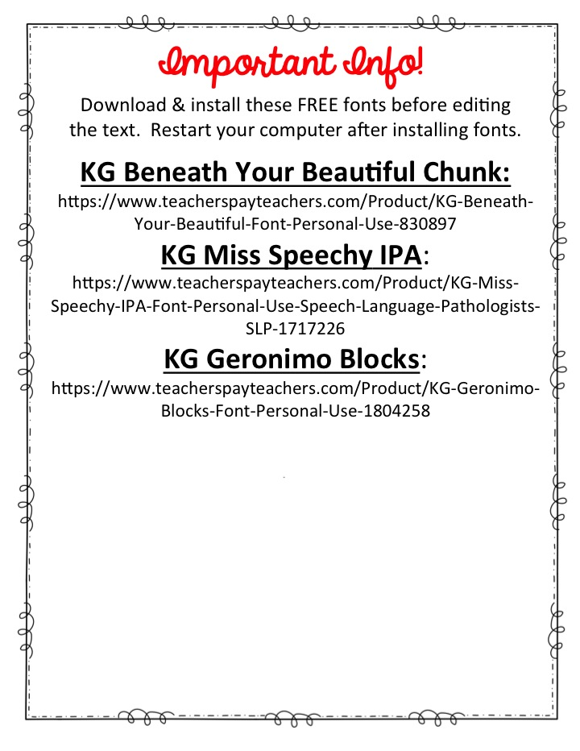

Slide 4


Slide 5


