Slide 1
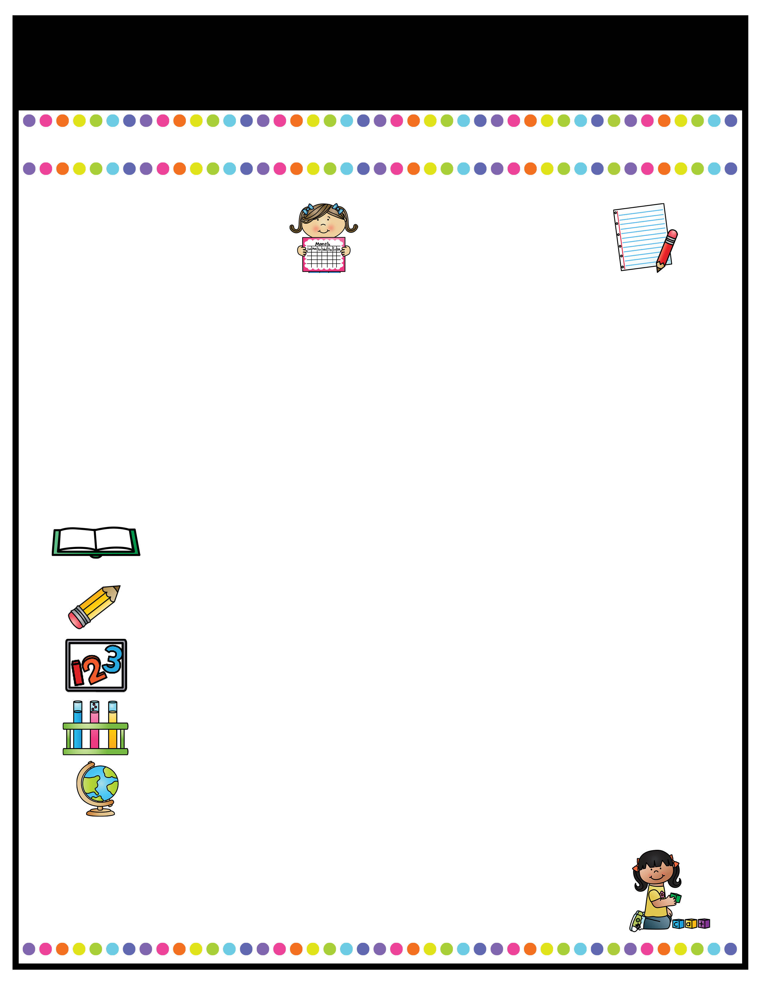
Our Classroom News
Week of: August 15 - 19th
What’s Happening
This Week
A Note From
Mrs. Cook
Math- Topic 1: Understanding Addition & subtraction
1-1: Add to
1-2: Put Together
1-3: Both Addends Unknown
1-4: Take From
1-5: Compare Situations
Science/Social Studies:
All about me, Leader In Me: Habits 1-5
Aug. 19- Sink-a-palooza money due​
Aug. 20- Sink-a-palooza 11-2:00 ​
Aug. 30- Curriculum Night​
A Peek At What We Are Learning
Language Arts: Kindergarten Review -Review of letter shape and sounds letters A-M -Developing new vocabulary- sport, sway, stew, doodle, glide, sails, cherish, lovely, drools, whines, annoys -Distinguish between Author/Illustrator -Make a class alphabet book -Introduce rules & expectations during “workshop time”
Check RED binders DAILY for notes, behavior problems, and classwork. Please sign up for my Remind if you have not done so already! This will be the main form of communication. Our "Classroom News" will come home every Monday with homework and should be completed and returned by Friday.

Slide 2

Our Classroom News
Week of:
What’s Happening
This Week
A Note From
Mrs. Jones
Type event here.
Type event here.
Type event here.
Type event here.
Type your teacher note here.
A Peek At What We Are Learning
Reading | Type your information here.
Writing | Type your information here.
Math | Type your information here.
Science | Type your information here.
Social Studies | Type your information here.
Spelling Words
Type your weekly spelling words here.

Slide 3
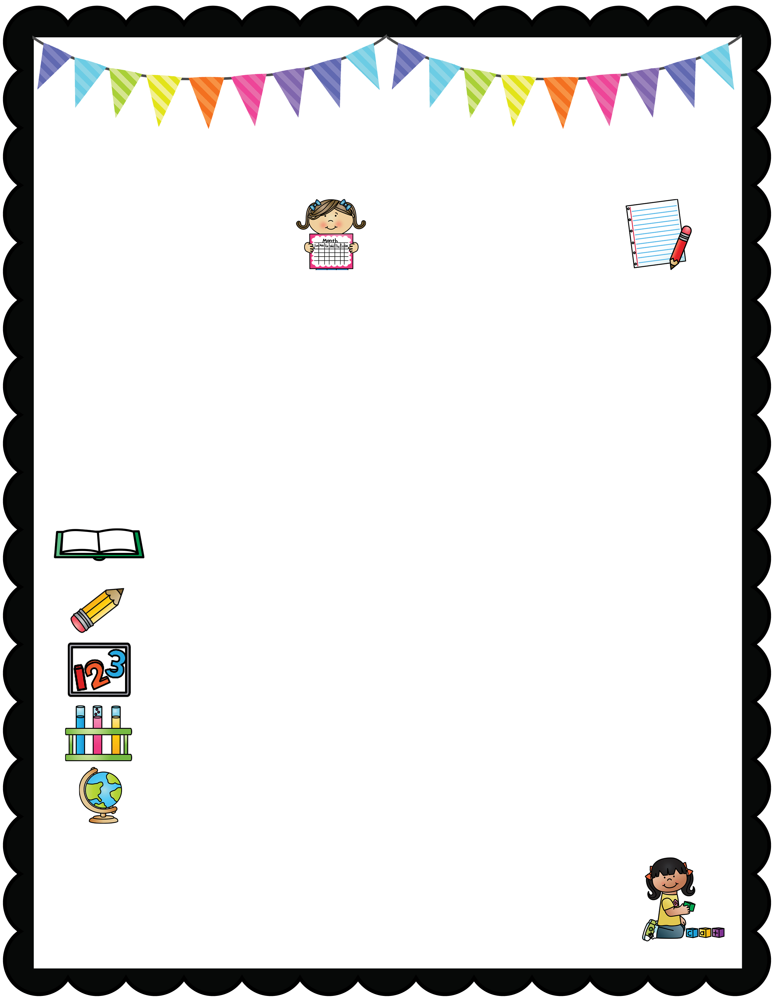
Our Classroom News
What’s Happening
This Week August 21 – 25th
A Note From
Mrs. Cook
*STAR Early Literacy Beginning of the Year testing will be administered this week.
*STAR Math Beginning of the Year testing will be administered this week.
*All week I will be testing each child on their ability to read Kindergarten sight words.
RED Tuesday Folders (Graded Papers) will come home on Tuesday, August 22nd Please review these papers, sign the papers, sign the yellow dated form, and return the folder and graded papers back to school on Wednesday.
SPIRIT DAY: Friday, August 25th: CrAzY SoCk DaY
“We are stepping into a new school year!”
A Peek At What We Are Learning
Reading | Letter and Sounds /d/ /n/ /i/ /h/, Beginning and Ending sounds, Rhyming words, Blending sounds to make words Sight Words: said as
Writing | Handwriting Upper and Lowercase Letters Ee Ff Gg Hh Ii Jj Kk Ll Mm Nn Oo Pp
Math | Topic 1 continues (Addition & Subtraction)
Language Arts | Common Nouns ( dog, girl, school, pencil) Proper Nouns ( Max, Susan, Prattville, Target)
Social Studies | All ABOUT ME and LEADER IN ME (7 Habits) Read Chrysanthemum: Respect/Understand Individual Uniqueness
Mark your calendars for Curriculum Night on Tuesday, August 29th 5:30 – 6:30pm
We will discuss grading and expectations in 1st grade and have a question/answer session. This night will be for parents.

Slide 4
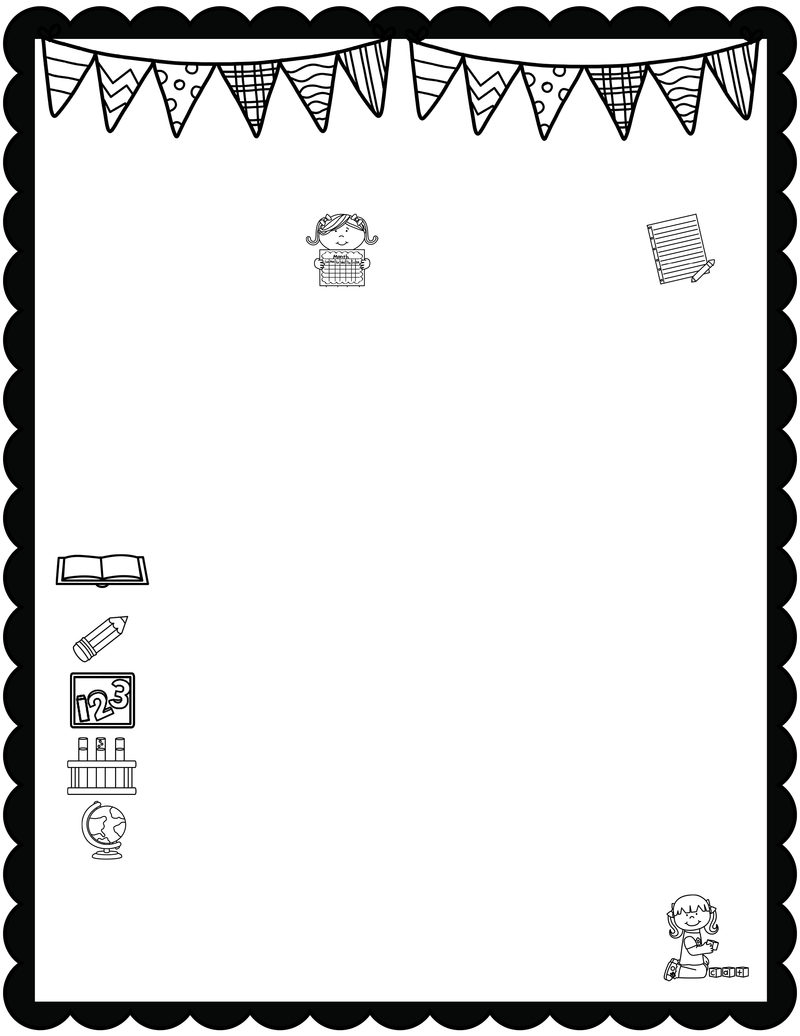
January News
What’s Happening
This Month
A Note From
Mrs. Jones
Type event here.
Type event here.
Type event here.
Type event here.
Type your teacher note here.
A Peek At What We Are Learning
Reading | Type your information here.
Writing | Type your information here.
Math | Type your information here.
Science | Type your information here.
Social Studies | Type your information here.
Spelling Words
Type your weekly spelling words here.

Slide 5

Our Classroom News
Week of:
What’s Happening
This Week
A Note From
Mrs. Jones
Type event here.
Type event here.
Type event here.
Type event here.
Type your teacher note here.
A Peek At What We Are Learning
Reading | Type your information here.
Writing | Type your information here.
Math | Type your information here.
Science | Type your information here.
Social Studies | Type your information here.
Spelling Words
Type your weekly spelling words here.

Slide 6

Our Classroom News
Week of:
What’s Happening
This Week
A Note From
Mrs. Jones
Type event here.
Type event here.
Type event here.
Type event here.
Type your teacher note here.
A Peek At What We Are Learning
Reading | Type your information here.
Writing | Type your information here.
Math | Type your information here.
Science | Type your information here.
Social Studies | Type your information here.
Spelling Words
Type your weekly spelling words here.

Slide 7

January News
What’s Happening
This Month
A Note From
Mrs. Jones
Type event here.
Type event here.
Type event here.
Type event here.
Type your teacher note here.
A Peek At What We Are Learning
Reading | Type your information here.
Writing | Type your information here.
Math | Type your information here.
Science | Type your information here.
Social Studies | Type your information here.
Spelling Words
Type your weekly spelling words here.

Slide 8

January News
What’s Happening
This Month
A Note From
Mrs. Jones
Type event here.
Type event here.
Type event here.
Type event here.
Type your teacher note here.
A Peek At What We Are Learning
Reading | Type your information here.
Writing | Type your information here.
Math | Type your information here.
Science | Type your information here.
Social Studies | Type your information here.
Spelling Words
Type your weekly spelling words here.

