Slide 1
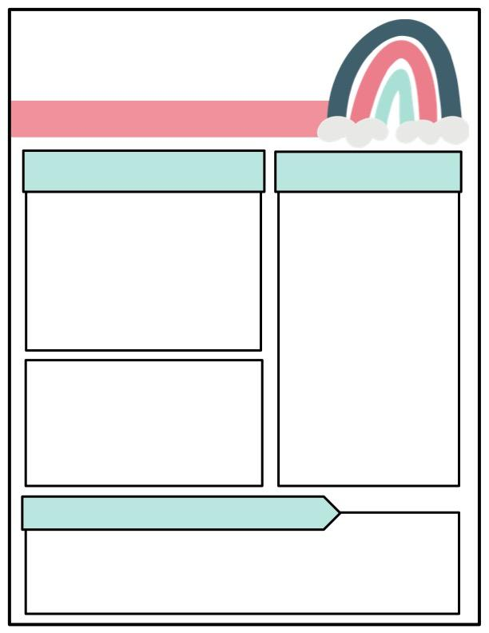
Class News
Mrs. Walters
October 14 – October 17
Special Dates
What We’re Learning
Story of the Week:
A River of Ice
Comprehension Skill:
- main idea and details
- cause and effect
Phonics Skill:
- long o spelled a and o_e
- long u spelled i and u_e
Spelling words:
1. menu 6. unit
2. nose 7. vote
3. most 8. fuse
4. cube 9. over
5. joke 10. mule
Grammar – Kinds of Sentences and Ending Marks
Math: Topic 4 Fluently Add Within
100
Friday, October 17th – Report Cards
Friday, October 17th – Fall Pictures
Assessments
Friday, October 17th - ELA Assessments
CONTACT INFORMATION:
stephanie.rowell@acboe.net
Parent Square– Ms. Rowell’s Class 2025-2026 Parent Square Hours 3:15 – 4:00 Please do not message me throughout the school day. Messages that need to get to me throughout the school day must go through the front office. Please only message me with the most urgent concerns. Thank you!

Slide 2
Vocabulary A River of Ice
1. glacier: a large mass of ice in very cold regions or on the tops of high mountains, formed by snow that does not melt
2. over: during the time of; throughout
3. time: the period during which all events, conditions, and actions happen or continue
4. press: to bear down on
5. crevasse: a deep crack or crevice, especially in a glacier
6. happens: to take place; occur
7. scratch: to cut or mark with something rough, sharp, or pointy
8. rub: to move against something else or against each other
9. valley: an area of low land between hills or mountains
10. fjords: a long, narrow inlet of the sea between high cliffs

