Slide 1
Chapter 5
The Periodic Law

Slide 2
History of the Periodic Table
Mendeleev—arranged the elements in order of increasing atomic mass
Created a table in which elements with similar properties were grouped together
In this way, properties of undiscovered elements could be predicted
Did not apply to some elements
Moseley—arranged atoms according to increasing atomic number
Gave us the periodic law—the physical and chemical properties of the elements are periodic functions of their atomic numbers
Produced a table in which elements with similar properties fell into the same column, or group.

Slide 3
S-Block Elements
Group 1—alkali metals
Soft enough to cut with a knife
Extremely reactive, found as compounds in nature, stored in oil in labs to prevent reacting with oxygen
Contains 1 valence electron
Group 2—alkaline earth metals
Harder than alkali metals
Although less abundant, still found as compounds in the Earth’s crust
Contains 2 valence electrons

Slide 4
P-Block Elements
6 Groups
Boron
Group 13
Always found combined with other elements in nature
Contains 3 valence electrons
Carbon
Group 14
Group varies in many properties because?
Contains 4 valence electrons
Allotropes – forms of an element in the same state of matter, but have different physical and chemical properties
Example: diamond and graphite are both made of carbon and are both solids, they differ in their properties because they have different structures – they are isotopes.

Slide 5
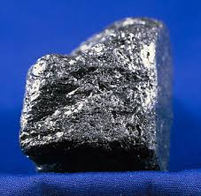
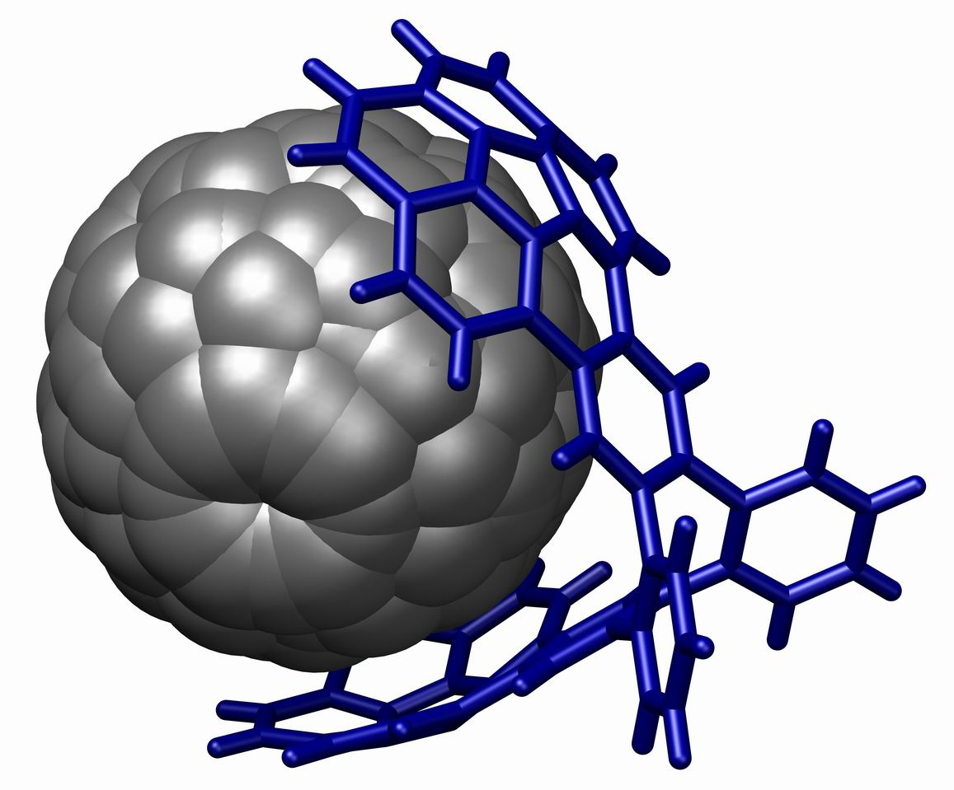
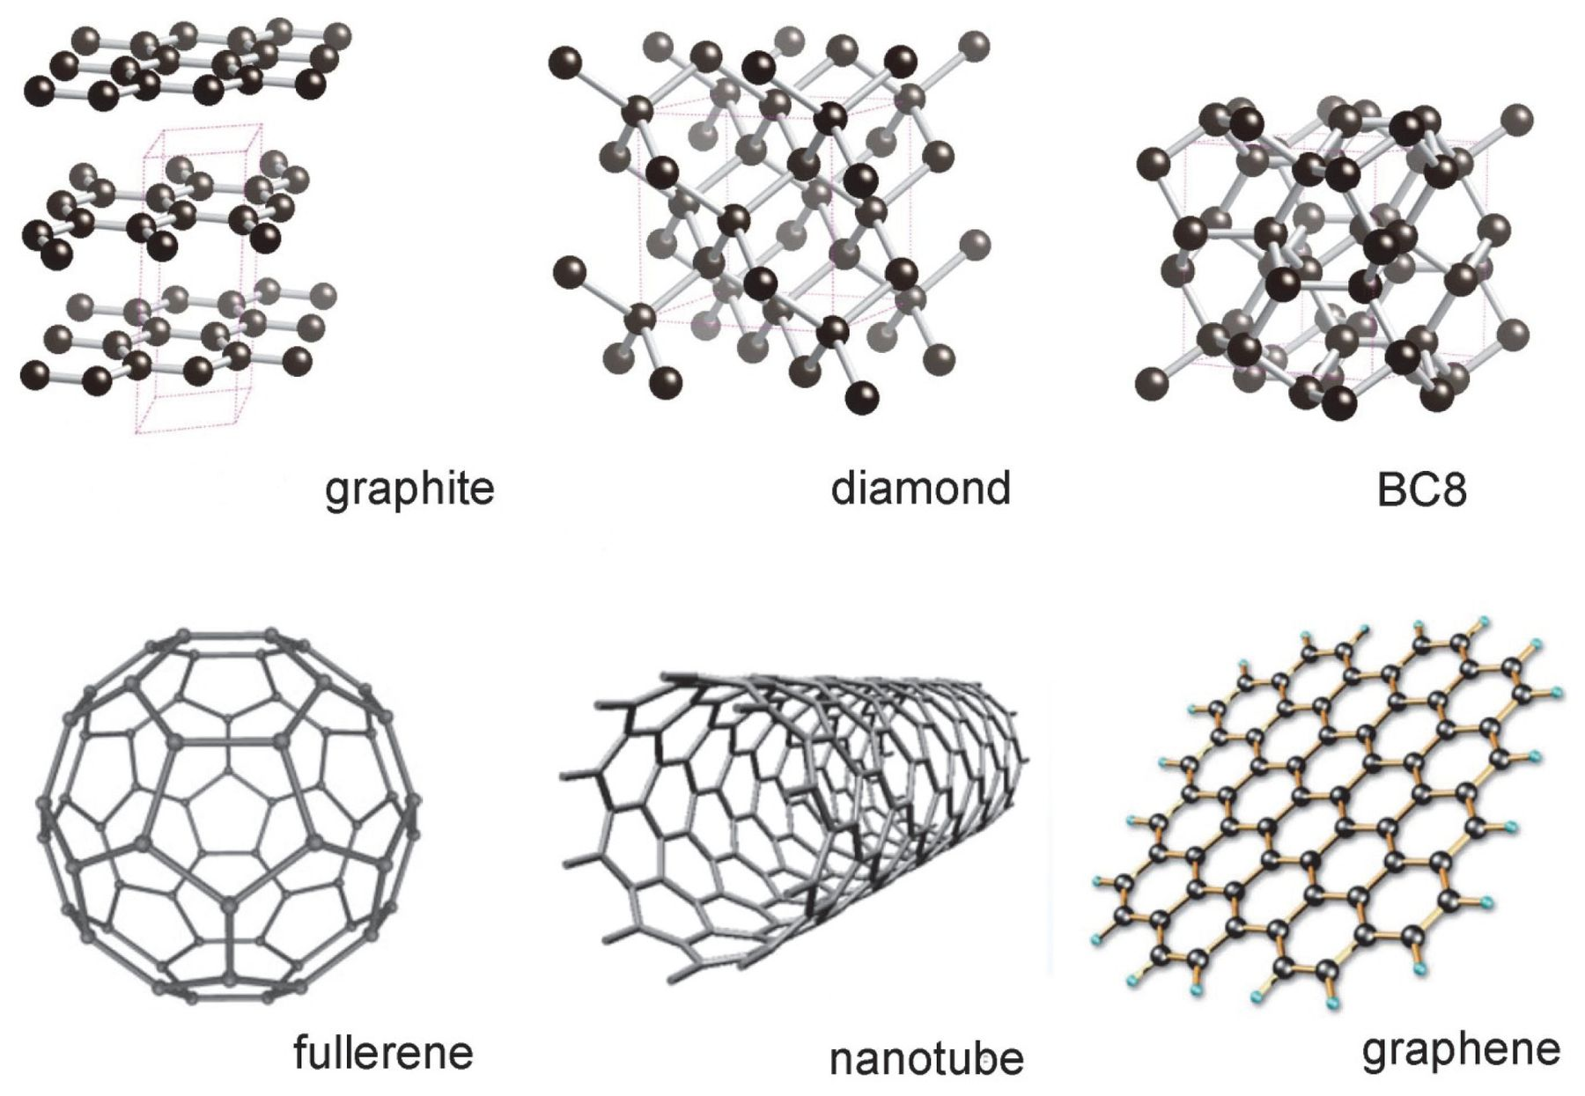
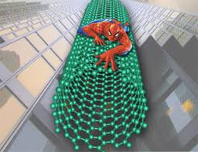
Allotropes of Carbon

Slide 6
P-Block Elements Continued
Halogens
Group 17
Form compounds with metals (salts)
A salt is a combination of a metal and a halogen
Reactive nonmetals that tend to gain 1 electron
Contains 7 valence electrons
Noble Gases
Group 18
Colorless
Unreactive
Contains 8 valence electrons – except helium which has 2

Slide 7
d-Block Elements
Known as Transition metals
Share properties such as conductivity, luster, malleability, atomic size, electronegativity, ionization energy, melting points, and boiling points
May have multiple oxidation states
Tend to lose electrons to become positively charged ions

Slide 8
f-Block Elements: Inner Transition Metals
Lanthanide series
Silvery metals
Similar reactivity with Group 2 elements
Actinide series
Radioactive elements
Only four exist in nature; the rest are synthetic elements that are created in particle accelerators

Slide 9
Atomic Radii
What is it?
One-half the distance between the nuclei of identical atoms that are bonded together
Periodic Trend
Gradual decrease in atomic radii from left to right
Caused by increasing positive charge of the nucleus
Group Trend
Gradual increase down a group
Caused by filling more energy levels as electrons are added to valence shells
Positive charge of the nucleus is overridden by sheer number of electrons

Slide 10
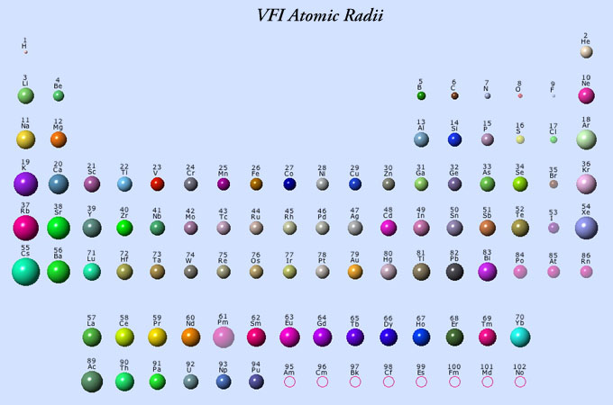

Slide 11
Ionization Energy
What is it?
The energy required to remove one electron from the outer shell of an atom
Ion—an atom or group of elements that bears a positive or negative charge
Periodic Trend
Caused by increasing positive charge of nucleus
Group Trend
Increase in distance from the nucleus = decrease in attraction between the nucleus and electrons

Slide 12
Removing electrons from positive ions
Second ionization energy—energy required to remove additional electrons from positive ions.
Requires much more energy than first ionization energy.

Slide 14
Electron Affinity
What is it??
The difference in energy when an electron is added to a neutral atom.
Most atoms release energy
Some require energy to gain an electron
Period Trend
Increases from left to right
Group Trend
Decreases from top to bottom

Slide 15
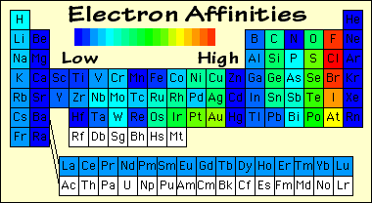

Slide 16
Electronegativity
What is it??
The ability of an atom in a compound to attract electrons from another atom in the compound.
Periodic Trend
Increases from left to right
Group Trend
Decreases from top to bottom
Fluorine is the most electronegative atom

Slide 17
Ionic Radii
What is it??
The radii of the most common ions of the elements.
Postive ions—cations
Negative ions—anions
Periodic Trend
Cation radii
Anion radii

