Slide 1
Welcome!!
OPEN HOUSE
2021-2022
4th Grade
Ms. Mayes and Mrs. Wetsel

Slide 2
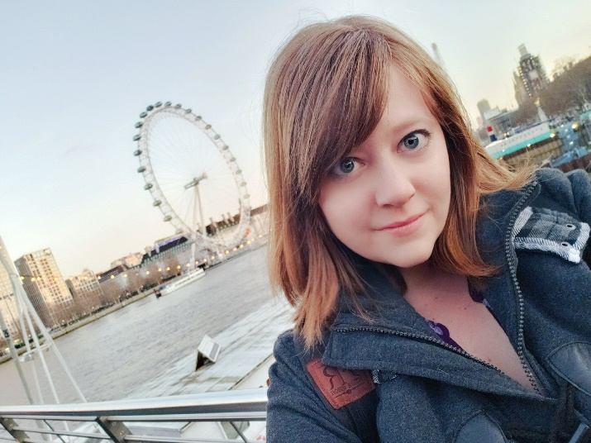
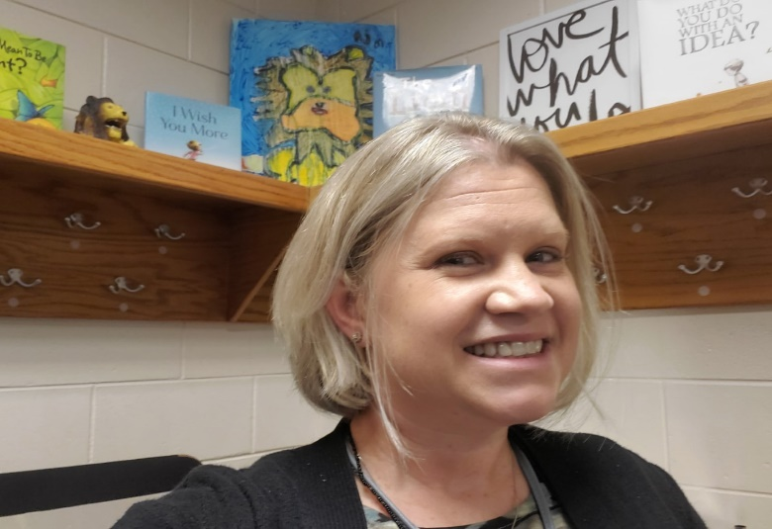
Meet Ms. Mayes and Mrs. Wetsel
Teaches English Language Arts.
GTE and Middle Grades Certified.
Masters in Instructional Technology.
Currently working on Specialist in Elementary Education.
Teaching for about 7 years now!
Teaches Math, Science, and Social Studies.
Certified in Early Childhood/Special Education and GTE.
Masters in Special Education.
Currently working on Specialist in Elementary Education.
Teaching for about 11 years now!

Slide 3
Classroom Management
1. Be respectful of others and maintain a positive learning environment.
2. Follow the directions of LJES staff.
3. Come prepared to work – both
material and mind.
4. Follow safe habits at all times.
5. Always give your BEST effort.

Slide 4
Covid-19 Classroom Information
Your students know that they are to remain at least an arm’s length away from each other. We call it their ‘zombie’ arms!
Barriers are utilized in the classroom to protect students that are not an arm’s length away.
Hand Sanitizer is available near the students for them to utilize as often as possible.
Masks are still optional at this time. Water bottles are still necessary as drinking fountains are unable to be utilized.
Students are also encouraged to wash their hands as often as possible. They can use our classroom sinks or the ones located at the student restrooms.

Slide 5
Covid-19 Classroom Information Continued
To limit the number of students in the cafeteria and at specials some changes have been made starting next week. Students will alternate between eating in the cafeteria and eating in the classroom every other day. We have also had the addition of a Computer Lab Specials to decrease the number of students in the Gym at one time.
If your student has to miss class due to being sick or having to quarantine all work can be found on their Google Classroom. Students are expected to keep up with their work if they are physically capable of it.
Students are still expected to keep up with their Book Club Reading at home if they received their book.
Students are also expected to still study for any upcoming tests. All notes and powerpoints for the tests are shared on Google Classroom.

Slide 6
Technology
IXL
DiscoveryEd
ClassDojo
Flocabulary
Quizlett
Iready
Google Classroom
Xtramath
Kahoot

Slide 7
Agendas
Students are required to have an agenda. They can be purchased from the front office for $5.
Homework will be written in them as well as upcoming tests. You can write any changes in dismissal or notes to us as well in the agendas.
While we do announce tests on ClassDojo we want the students to begin practicing responsibility and to be able to tell you when tests are!

Slide 8
Homework
Homework will be assigned to the students every week.
Math: Homework will always be assigned daily. It is due the next day. Students are supposed to write it in their agenda. Homework will also be posted on Dojo every Monday.
Reading: Students are to read every night for 20 minutes unless otherwise assigned. They can use this time to study for upcoming tests as well.

Slide 9
Non-negotiables
All work requires:
Name
Morning work and classwork are due on the day that it is assigned.
Unfinished morning work and classwork: Students will be given the
opportunity to complete unfinished work at either lunch or
recess. It is the student’s responsibility to submit their completed
work.
When a student is absent they have 5 school days to complete any missing assignments per County policy. Any work given during their absence is available in the classroom absence folder the day they come back or is given to them by their teacher on Google Classroom.
Homework is due on the day communicated by the teacher by 9am.

Slide 10
Morning Arrival
As soon as students arrive they will need to prepare for the day by gathering materials, using the restroom, and making their lunch choice. The board at the front of the classroom will have their morning work on it for that day.
If students do not make their lunch choice or have the necessary materials for class, they will lose some recess as a consequence. We ask that you support us in this endeavor as we prepare your children for 5th grade and beyond. Organizational skills are a necessary component of school success!

Slide 11
Specials
Our specials time is 9:00-9:50
We will rotate weekly between: Art, PE, Computer Lab, and Music.
If it is a P.E. week they will need to make sure they wear tennis shoes or bring tennis shoes everyday!

Slide 12
Friday Folders
Every Friday your child’s graded papers and school related information will be sent home. Please make sure you take the time to look over your child’s work before you sign and return. All work can be kept at home! The only thing needing to be returned is anything requiring parental signatures.
Folders are due back on the following Monday.

Slide 13
AR
Lake Joy uses the Accelerated Reader program to encourage our students reading habits. They can earn prizes throughout the year for reading and testing over their books.
Every Thursday your student will be able to check out a book from the school library. They know they must choose books they haven’t read/tested over before as well as books that are on their reading level to help improve their reading. Students will also be able to go to the library before school after checking in with their homeroom teacher!
In order to attend AR Fun day at the end of the year your student MUST earn 100 AR Points and have AT LEAST an 80% Average.

Slide 14
Tests
In most subjects the students can use the guided notes and interactive notebooks that we create in class in order to study.
It is their responsibility to bring these notebooks home, although we will remind them every time we announce an upcoming test. It is vital that your students begin to develop their study habits now to help them be successful in 4th grade and beyond.
If they bring their notebooks home to study, they must also bring them back the next day as we will still be utilizing them in class.

Slide 15
PQRS
This is a comprehension strategy that 4th grade uses. This strategy will be implemented cross-curriculum.
P: Predict the genre
Q: Read the Questions. Circle question words.
Underline key words. R: Read the passage and highlight the key words S: Solve the questions. Underline where you find
your answer and write Q1, Q2, Q3 by it.

Slide 16
Afternoon Dismissal
Please make sure your student knows how they are getting home every day. Any changes from their normal routine must be communicated to the office. While we appreciate a message informing us of any changes, it is the front office parents have to notify first. If you know about the change before hand feel free to write it in the agenda, and we will let the office know.

Slide 17
Communication
Please feel free to message us if you have any questions on ClassDojo. Alternatively you can write in your student’s agenda or email us at:
samantha.mayes@hcbe.net
laura.wetsel@hcbe.net
We will respond to your email as soon as possible- if you do not get a response within 24 hours your email probably went to SPAM please write us a note to check our SPAM folder, and we will asap!

