Slide 1
New Milford Early Childhood Council
Getting Ready to Read in Kindergarten ~
What Does It Look Like?
June 13, 2018 meeting

Slide 2
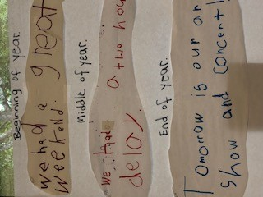
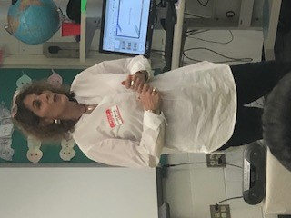
Getting Ready to Read in Kindergarten ~
What Does It Look Like?
Interactive Writing
The goal is to get the children’s thoughts on paper, discussing the topic and the process of writing direct and explicit instruction in hearing the sounds in words and teaching children how written text works. Interactive Writing also teaches children the connections between what we write and read and working on grammar, spelling, punctuation, letter formation, phonics, and voice. As children become more proficient writers, lessons can focus on style and writing for different purposes.
Connection to reading: Reading and rereading texts, searching, checking, and confirming while reading and writing.

Slide 3
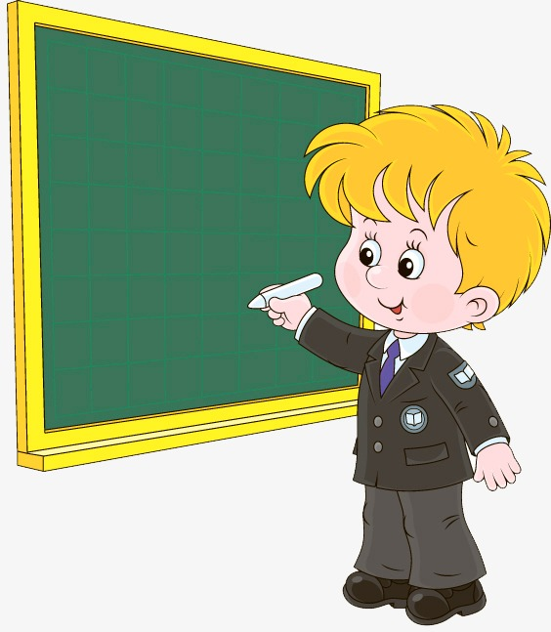
Interactive Writing
Procedure: 1. Negotiate a sentence. The teacher and students collaborate to write a meaningful text that can be read. 2. Count the words on fingers. As the teacher repeats the agreed upon sentence slowly, one finger is held up for each spoken word. 3. Recall the word to be written and stretch the word. The teacher articulates the word slowly using a technique known as stretching the word. As the word is stretched, or spoken slowly, the students listen for the individual phonemes that comprise the word. 4. Share the pen. A student volunteer uses the pen to write part of the word or the whole word on the chart paper. Conventional spelling is used. 5. Point and read. Once the word has been written on the chart, the teacher or a student can use the pointer to point to the word as it is read. 6. Recall the entire sentence to be written, then go back to step 3. The teacher and students repeat the sentence they have agreed to write to refresh their memory. The next word in the sentence becomes the new focus.

Slide 4
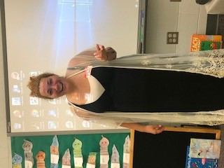
Getting Ready to Read in Kindergarten ~
What Does It Look Like?
Narrative Writing
Provided here is the link to Katie Carr (kindergarten teacher) presentation:
https://docs.google.com/presentation/d/1KlfDwIXU-egRUaYF50QqunEvx-ZBbIS-HzG_CEapZrU/edit?ts=5b265ebb#slide=id.p
Connection to reading: A child’s literacy development is dependent on this interconnection between reading and writing.

Slide 5
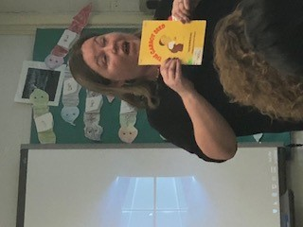
Getting Ready to Read in Kindergarten ~
What Does It Look Like?
Read-Aloud
Main Idea and details bags Materials: large plastic baggies, items that correlate to the story. Process: Teaching main idea and details is made fun with this approach! Create baggies filled with items such a toothbrush, toothpaste, a small mirror. Discuss with the children by looking through mystery bags of supporting details and determine the "main idea" of each bag. Read a story such as: Have You Ever Seen a Moose Brush His Teeth? Written by Jamie McClain discuss again and ask were their ideas about the main idea of the story right- and if so, why were they right?
Connection to reading: Parents can build their children’s vocabularies by talking to them, but reading to them is more effective. Reading aloud is the best way to help children develop word mastery and sentence structure understanding, which form the basis for learning how to read.

Slide 6
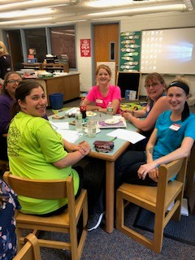
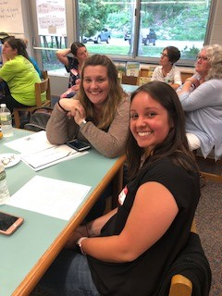
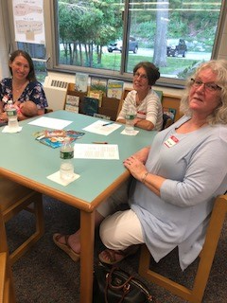
Thank you to all parents and teachers who attended!

Slide 7
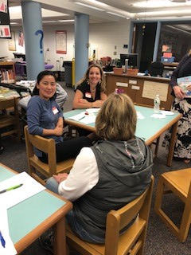
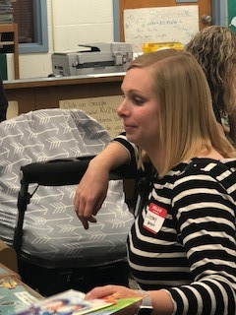
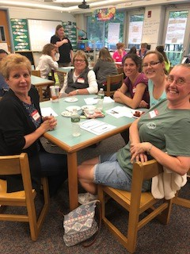
Thank you to all parents and teachers who attended!

Slide 8
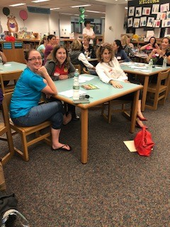
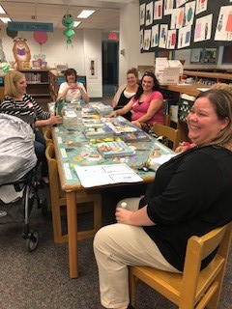
Thank you to all parents and teachers who attended!

Slide 9
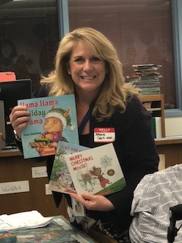
We appreciate that you took the time and energy to continue to make a positive difference in children’s literacy lives.
Books from grant money funded by the CT Community Foundation were provided to all who attended because we believe books need to be in the hands of children.

Slide 10
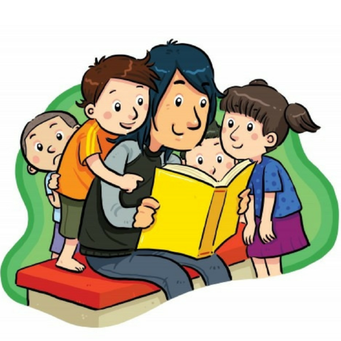
Read Aloud Tipps
Vary the length and subject of your readings, fiction and informational.
To encourage involvement, ask the child to turn pages for you when it is time.
Before you begin to read, always say the name of the book, the author, and illustrator—no matter how many times you have read the book.
The first time you read a book, discuss the illustration on the cover. “What do you think this is going to be about?”
As you read, keep listeners involved by asking, “What do you think is going to happen next?”
Jim Trelease

Slide 11
Fall in Love with Reading
From the National Association of Young Children NAEYC
There are many ways to enjoy reading with your child. Here are a few ways to make reading a fun part of your everyday life.
1. Develop family reading routines and rituals
Find a regular time of day when you can dedicate story time into your day. You can read in the morning, after school, or before bedtime! Making story time a cozy routine makes reading an essential and pleasant activity.
2. Read what interests your child
The nutrition facts on the milk box, newspapers, recipes, maps, and game instructions all make great reading material if your child is interested.
3. Try books that reflect your daily experiences
Making connections to topics you read about is a fun way to keep children engaged. For example, you can read You Can’t Take a Balloon into the Metropolitan Museum with your child before or after visiting an art museum. This opens up opportunities for conversations like discussing similarities and differences between the book and the museum visit.
Or read Dr. Seuss’s In a People House and then ask your child if they see any similar items, how they work, or even create a new book based on what’s inside your own home.
4. Let your child select books
When you visit the library, let your child select books. Try both fiction and informational books, and ask the librarian for recommendations based on your child’s interests.

Slide 12
Fall in Love with Reading Continued
5. Reread your child’s favorites
It’s common for young children to request the same book again and again. Re-reading familiar stories offers children a chance to absorb information over time and lets them master the whole story.
6. Encourage storytelling
Encourage your child to tell you a story from time to time or to retell a story after you’ve read it several times. Don’t feel the need to correct how she’s telling the story. Let her enjoy the experience of storytelling.
7. Have fun while reading
Try whatever style feels comfortable for you and your child. Some ways families have fun with stories include:
· Acting out the story while reading by using facial expressions, gestures, body movements, and voices to make the story come to life.
· Making the story relevant to your child’s life by adapting the story to include her name, a friend’s name, or your pet’s name. For example, surprise your child by saying “Olivia, Olivia, what do you see?” when you read Eric Carle’s Brown Bear, Brown Bear, What Do You See?
· Finding props to go along with favorite stories and offering them to your child to use in her play.
8. Change your setting!
It can be fun to read books in different places in and around your home. Try reading Eric Carle’s The Very Lonely Firefly in a dark room with a flashlight. I’ve read The Lamb and the Butterfly (written by Arnold Sundgaard, illustrated by Eric Carle) to a group of four-year-olds on the grass, and when they saw a butterfly fly by, they associated it with the one in the story! You can even ask your child where she wants to read a particular story.

Slide 13
Suggested titles for Read-Alouds NAYEC
9. Try one of these books that trigger children's interest in reading
Adam Lehrhaupt’s Warning: Do Not Open This Book! Is a great example of a book that draws children into the act of reading. Children wonder: “Why can’t I open this book?” and read on. Here are some others:
Don’t Push The Button by Bill Cotter
Go Away, Big Green Monster! by Ed Emberley
How To Hide a Lion by Helen Stephens I
If You Give a Mouse a Cookie by Laura Joffe Numeroff
Maisy’s Fairground by Lucy Cousins
My Granny’s Purse And My Mummy’s Bag by P. H. Hanson
Press Here by Herve Tullet
Tap to Play by Salina Yoon
The Foggy Foggy forest by Nick Sharratt
Where’s Wally? by Martin Handford

Slide 14
Resources:
Borski, Linda. Sharing the Pen: Interactive Writing With Young, http://www.carlscorner.us.com/Writing/Steps%20in%20an%20Interactive%20Writing%20Lesson.pdf
Diaz, Leslie. It’s in The Bag. https://www.education.com/lesson-plan/the-idea-is-in-the-bag/
National Association Education of Young Children, https://www.naeyc.org/our-work/families/fall-love-reading
Trelease, Tim. The Read Aloud Handbook, http://www.trelease-on-reading.com/

