Slide 1
INFORMATION TECNOLOGY
Security Awareness Training

Slide 2
NETWORK SECURITY
Cybersecurity
The Practice of protecting critical systems and sensitive information from digital attacks.

Slide 3
Cybersecurity
Starts with YOU!
You are the most important asset that we have in protecting our network
Credentials should not be shared.
Do not leave your workstation or laptop unlocked when you are not present.
Shutdown your device daily at the end of your day.

Slide 4
The Network, just like the circulatory system, touches all parts of the body; touches all parts of the school district

Slide 5
The Network
Any device or person that has been credentialed through HR and IT has access to the GCPS network.
Your level of access will not be the same for each staff.
“Need to Know” is the procedure used to establish access to network resources.

Slide 6
The Network cont.
Network resources can be data, bandwidth, voice, etc.
Accessing your computer and opening a program is using a network resource.
Checking your payroll on Skyward is a network resource.
These are just some examples of daily usage.

Slide 7
The Network cont.
We (IT) are tasked with protecting our resources and all information that flows in, out and stored here.
Bad Actors (Cyber Hackers) are always attempting to compromise networks and ours is no exception.

Slide 8
FACTS: Network Security
The Majority of network hacks (Compromise) comes through a conduit from inside the network. (Berkeley Information security office 2020)

Slide 9
FACTS: Network Security cont.
Ransomware is often spread through phishing emails that contain malicious attachments or from drive-by downloading.
Drive-by downloading occurs when a user unknowingly visits an infected website and then malware is downloaded and installed without the user's knowledge.

Slide 10
FACTS: Network Security cont.
External devices such as thumb drives are dangerous when not scanned prior to inserting them in your device, especially if used in other devices or outside of the network.
99% of our student computers will not allow a thumb drive to be used. It will not be recognized.
Students are highly encouraged to use their google drive in the district assigned emails if you want them to save items.

Slide 11
FACTS: Network Security cont.
The District has a training program to reinforce staff not to click on emails that are suspicious.
You will receive emails from our training program (KnowBe4) from time to time in an effort to test your consistency in following email security protocol.

Slide 12
FACTS: Network Security cont.
If you click on an email that has been sent by the program, you will be required to finish the assigned training.
We will be notified of your lapse in judgement, as well as, when you finish your training.
If you need to think about the email more than 15 seconds after reading it, then its probably not a good idea to click on it.

Slide 13
FACTS: Network Security cont.
We do not allow all staff to install software on their device(s).
We will install the necessary software needed to complete your assigned task.
All district devices have the same image, which means, the devices have the same basic software.

Slide 14
FACTS: Network Security cont.
We use Single Sign-On via CLEVER and other portals which decrease the need for installing external software.
But if a specific item is needed, employees can submit a ticket on our Technology HelpDesk.

Slide 15
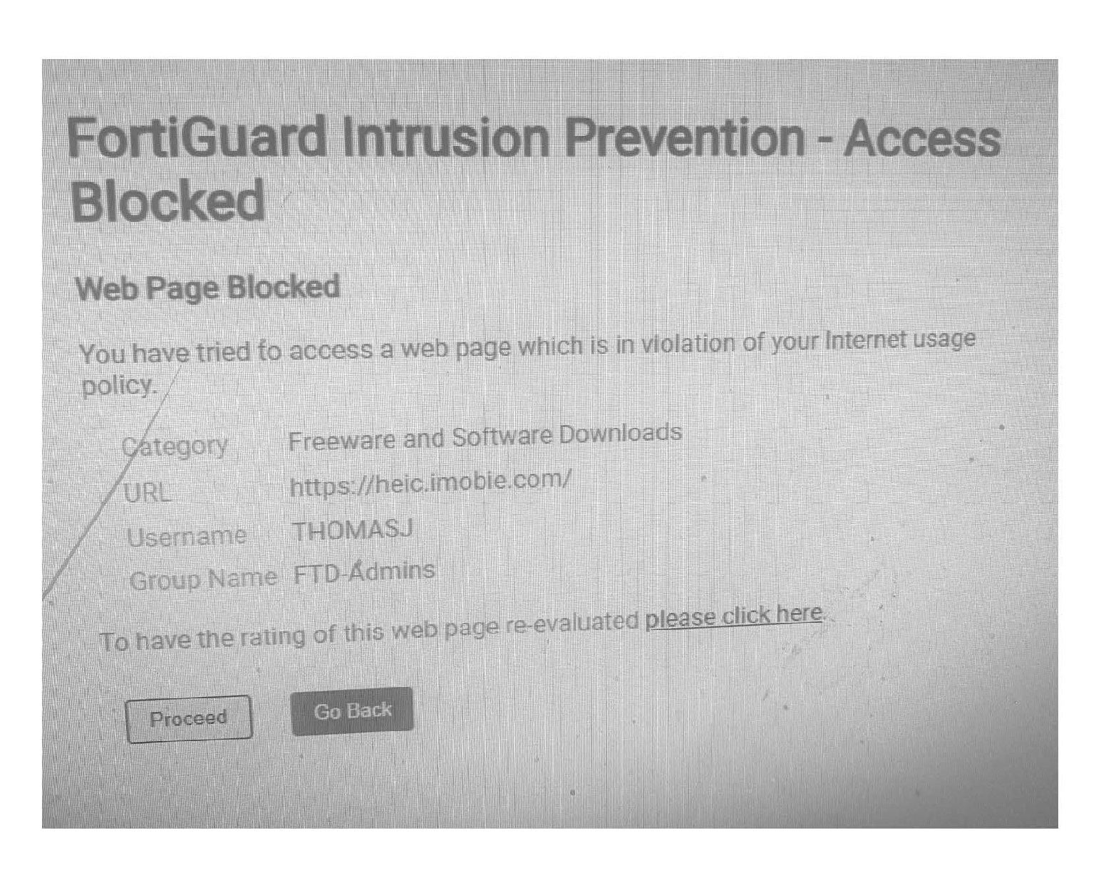
FACTS: Network Security cont.
Our firewall and end point protection system may at times block a website that is considered a risk to our network:

Slide 16
Wireless Network
If we block a site that is legitimate and it is needed for instruction, simply open a HelpDesk ticket.
We will vet the site for safety and integrity.

Slide 17
Wireless Network cont.
We have a district wide wireless network using the SSID-GCPS
All district wireless devices should have access to: GCPS-Secure
If you have a computer login and use a district device, you will have access to the GCPS-Secure wireless network.
Personal laptops are not guaranteed access to the GCPS-Secure network.

Slide 18
Wireless Network cont.
Your personal iPhone and/or android can access the secure wireless network once you authenticate on the network. Androids will require a tech person to assist due to the security realm.
The same level of security is applied to the wireless and you will be blocked if attempting to access sites considered questionable or dangerous.
We do not have a “GUEST” network.

Slide 19
Network Security
Periodically your device will ask you to reboot to complete an update.
If you can at that time click yes and allow the device to complete the update.
However if it cannot reboot at that time you can reboot at your convenience.
Keep in mind that this is part of our security so if you can reboot your device please do.

Slide 20
For more information contact the IT Department
EMAIL: technology@gcpsmail.com
or
PHONE: (850) 627-9651 x 1296

